Slide 1
Signfield
Software Project
N00212142 – Aaron McCormack
2023

Slide 2
Business Concept
Original
Revised
Multilanguage Website
Users have ability to post forums, comments, like and favourite words/signs
Advertisements for revenue
Social media links to extra communities
American Sign Language Focused
Users are not required to log-in
Search functionality for words
Focus on work bank over community
48 million people in the United States with hearing loss,
500k people use ASL as native language
Other resources are in desperate need of a redesign

Slide 3
Requirements
Functional
Interviews were conducted with 2 HOH members and 2 Hearing Members of the Deaf/HOH Community
Live search bar
CRUD for Words/Signs
Access to Deaf History/Culture
Authentication
Backend & Frontend Security
Interview Notes
Participants noted current resources are dated
Input from Deaf/HOH community is curtail
Up-to-date information is a must
Easy to use design
Non-Functional
Guest Access
Quick Navigation

Slide 4
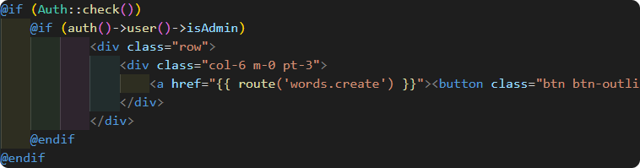
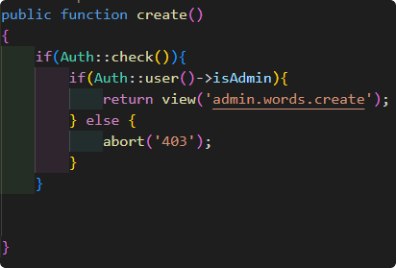
Authentication
Previously
Now
Required Admin & User versions of views and controllers
Required additional controller to be functional
Required linking table for single role making redundancy
Single controller required for authentication
Single view for each page
Authentication happening in view and controller
Less repeating code
Index View
WordController

Slide 5
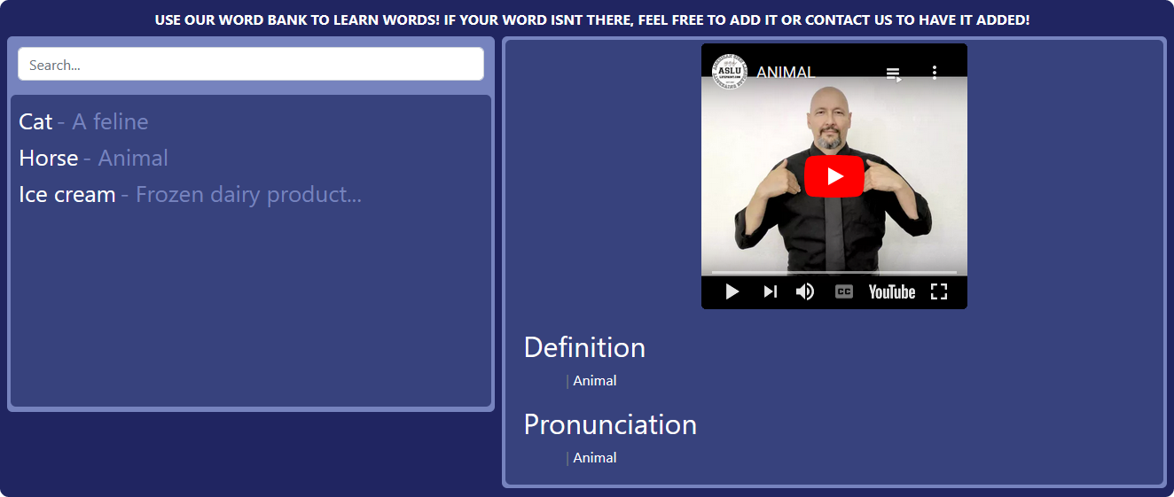
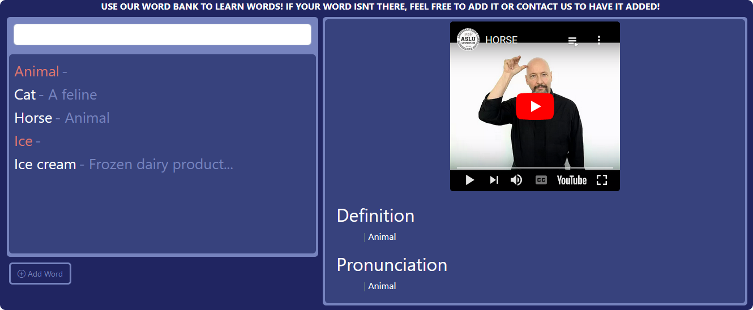
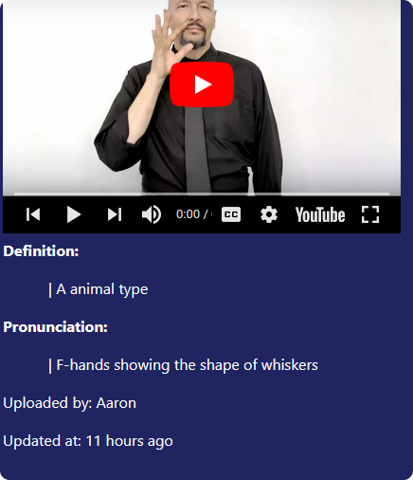
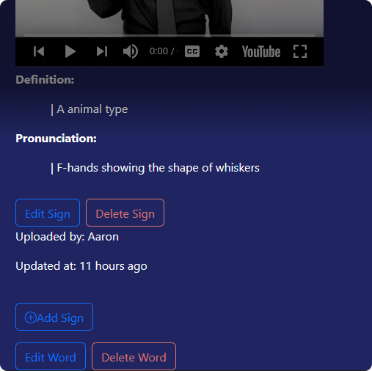
EXAMPLES IN PRACTICE
Guest
Admin
Index + Search
Index + Search
Show Page
Show Page

Slide 6
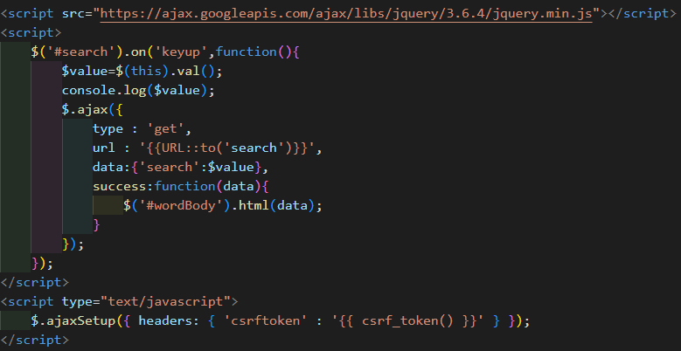
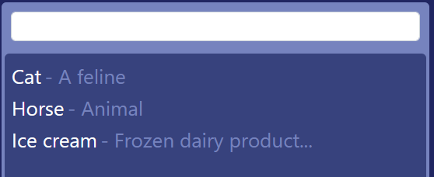
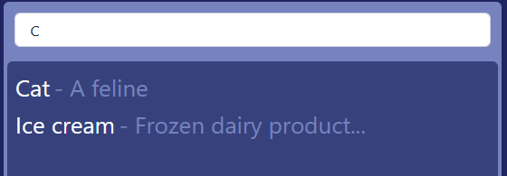
Search bar
jQuery
Lightweight JavaScript library
“Write less, do more”
HTML/DOM/CSS Manipulation
HTML Events
AJAX (Asynchronous JavaScript and XML)
Effects & Animations
AJAX loads data in the background and displays it on the webpage without reloading

Slide 7
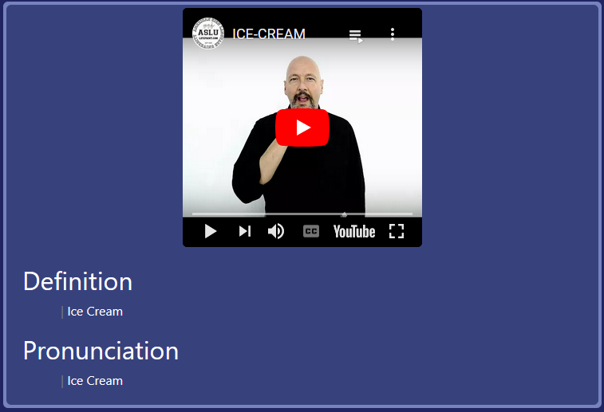
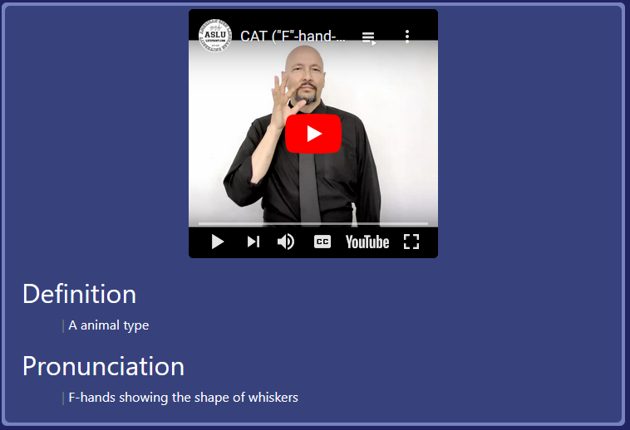
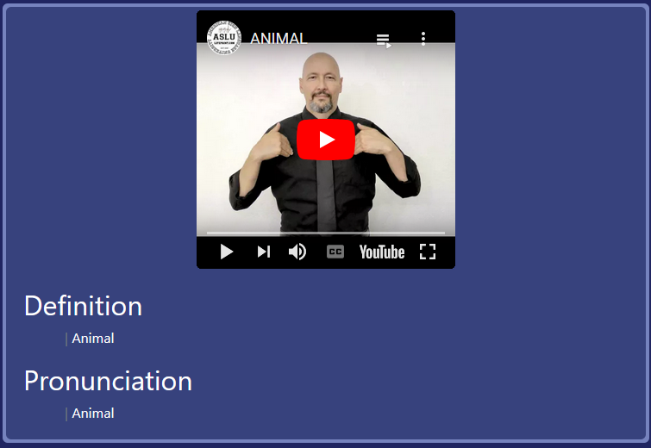
Random signs
Reload 1
Reload 2
Reload 3

Slide 8
IF MORE TIME
What I would like to learn
What I would expand upon
Further Knowledge of jQuery and AJAX
Use of JSON object to store data
More efficient practices for working with Laravel and breeze
Implement my original business plans
Create a more community based side of the application
Create system for favouriting/bookmarking
Levels of security for different members on administration team

Slide 9
reflection
What I learned
What I need to practice
Better practices when working with Laravel as a framework
Better database management
Improve on previous mistakes from previous projects
Realistic scope views from the beginning
Think creatively about frontend working with backend
Allocating my time to priority problems
Views on the overall project
Amazing Learning opportunity
Chance to truly learn a backend framework
Helped me become more confident with my code

Slide 10
Thank you

