Slide 1
Stat 605 Final Project Report
Yukun Fang, Mengkun Chen, Runze You, Mengqi Li
STAT 605 Group 10
November 2020
Group 10

Slide 2






Outline
1
Introduction
2
Pollution Data Description
3 Climate Data Description
4
Statistical Analysis
5
Difficulties
6 Conclusion
Group 10

Slide 3
Introduction
In Sofia, national capital of Bulgaria, air pollution norms were exceeded 70 times in the heating period from October 2017 to March 2018.
Sofia air quality data set describes daily five air-quality measurements-PM2.5, PM10, and climate statistics pressure, temperature and humidity from July 2017 to June 2019.
Group 10

Slide 4
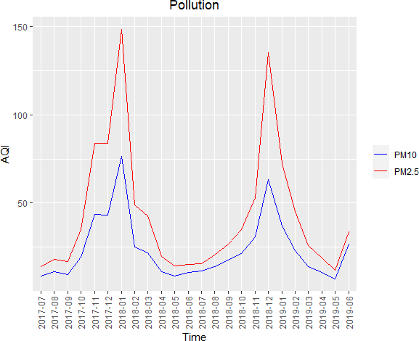
Pollution Data Description
A glance at the pollution data sets.
sensor id location latitude longitude
Timestamp PM2.5 PM10
1
2
2888
3641
1453 42.71
1837 42.69
23.28 2017-08-01T00:00:01 7.52
23.36 2017-08-01T00:00:02 10.70
6.48
6.10
Group 10

Slide 5
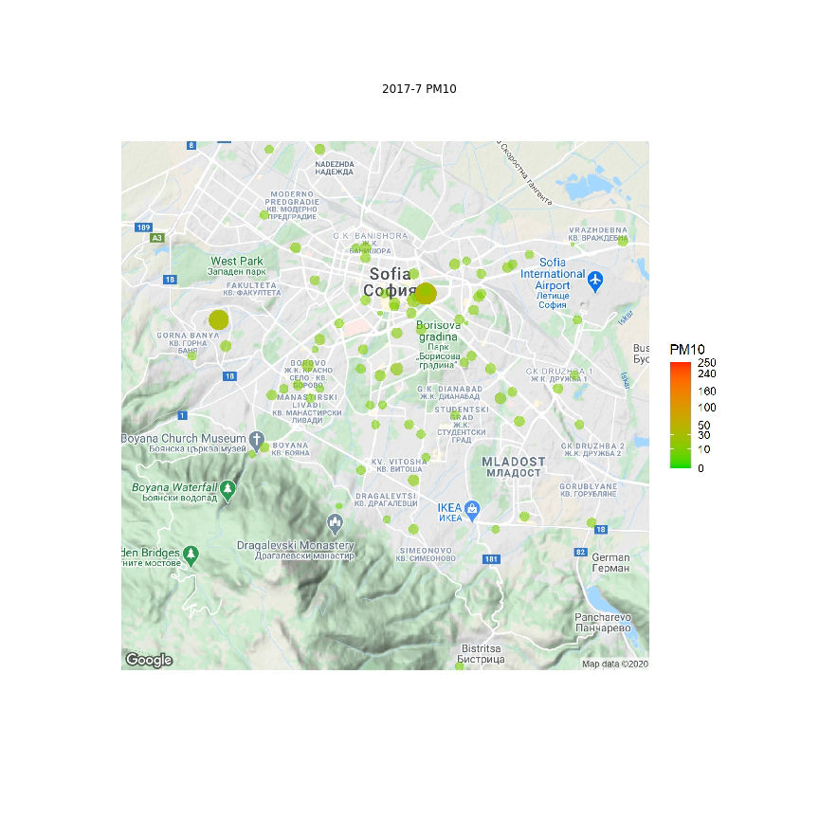

Pollution Data Description
Here are two videos of the change of PM10 and PM2.5.
Group 10

Slide 6
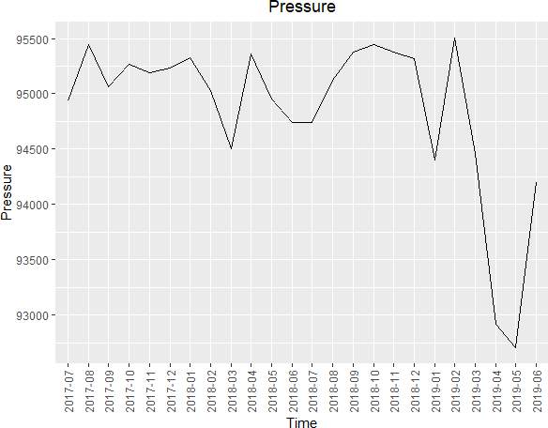
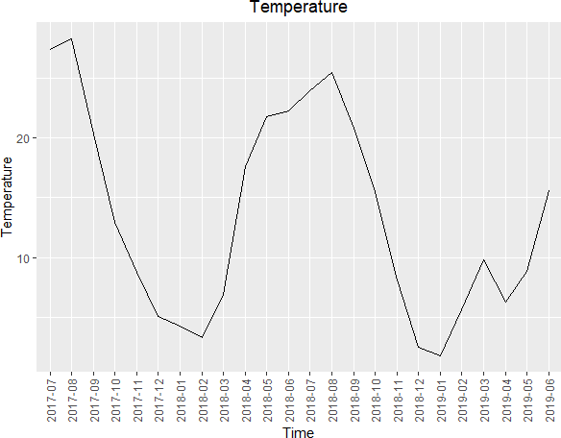
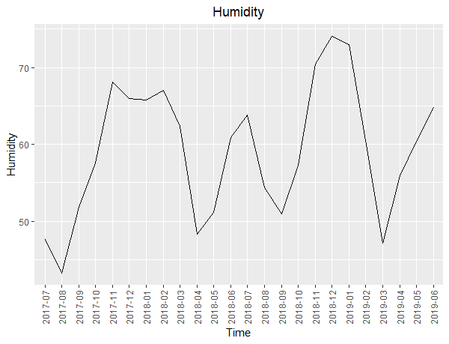
Climate Data Description
A glance at the pollution data sets.
sensor id location latitude longitude
timestamp pressure temperature humidity
1 | 2266 | 1140 42.74 | 23.27 2017-07-01T00:00:07 95270.27 | 23.46 | 62.48
2 | 2292 | 1154 42.66 | 23.27 2017-07-01T00:00:08 94355.83 | 23.06 | 59.46
Group 10

Slide 7
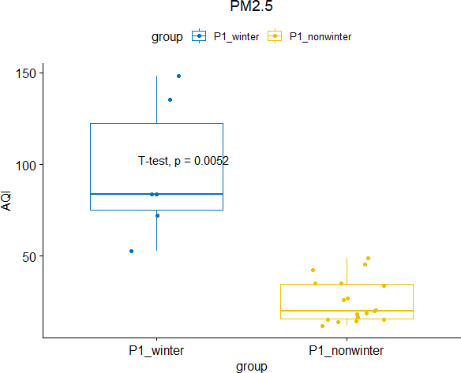
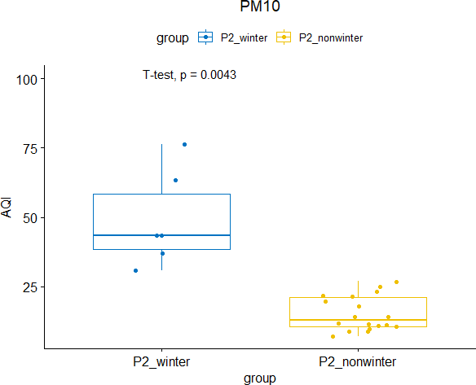
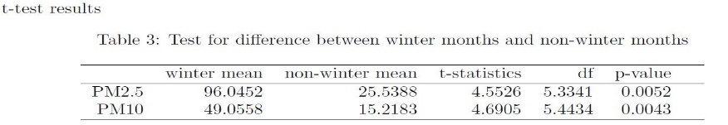
Statistical analysis
According to the plots above, we find that the pollution plot is a seasonal plot which contains two peaks in the winter month, which are November, December and January.. So, from following box plots and p-value from t-test, winter is a time which the pollution is so heavy.
Group 10

Slide 8
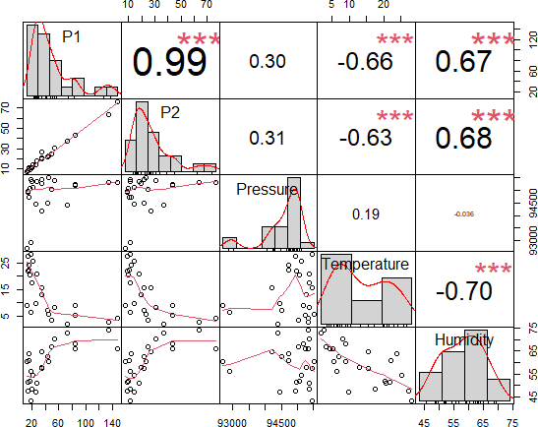
Statistical analysis
More precisely, the following correlation plot reveal clear relationships between PM2.5/PM10 and temperature/humidity.
Group 10

Slide 9
Difficulties
It is difficult for us to show daily data for two years. Actually we would make efforts to overcome that analyze every time in the data.
Drawing pictures and running code in CHTC are quite time consuming. Plus, the datasets contain many bad records like -30 Celsius temperature in June and it is tedious for us to identify.
Group 10

Slide 10
Conclusion
Air pollution is a serious problem in So a during winter.
Such correlation provides us a tool to predict air quality measurements and apply precautionary plans.
What we need to do in the future is to research the terrain of Soa to make it more reasonable.
Group 10

