Slide 1

Customer review insight ai
INFOSYS INTERNSHIP 6.0

Slide 2

Team members:-
ARYAN AMIT PARDESHI
VINUKOLLU HIMA JANANI
KANDADI SIDDARTHA
AKASAPU VENKATA SAI MANIKANTA GANGADHAR DHARSHAN
UNDER THE SUPERVISION OF:-
MUKILAN SELVARAJ

Slide 3
PROJECT OVERVIEW
In this digital age, customer reviews are a goldmine of feedback , yet their sheer volume often makes it impossible for business to extract actionable insights manually. Traditional sentiment analysis provides only an overall positive or negative score, failing to pinpoint what specific aspects of a product or service customers love or dislike (e.g., "The battery life is great, but the camera is disappointing").
The Customer Review Insight AI project aims to solve this by developing an advanced Natural Language Processing NLP) system that performs aspect-based sentiment analysis on customer reviews, identifying specific features or attributes and their associated sentiment

Slide 4
Key Outcomes & Benefits
Granular Sentiment Insights
Accurately identify sentiment (positive, negative, neutral) towards specific aspects of products or services.
Actionable Business Intelligence
Provide clear, data-driven insights to help businesses understand customer pain points and strengths
Automated Review Analysis
Significantly reduce manual effort required to process large volumes of customer feedback Trend Identification
Trend Identification
Track sentiment shifts for specific aspects over time, revealing evolving customer preferences
Scalable & Flexible
Designed to analyze reviews across various industries and product types
Interactive Visualization
User-friendly dashboards to present complex sentiment data in digestible format

Slide 5
Implementation timeline
Milestone 1
Weeks 1-2
Milestone 2
Weeks 3-4
Milestone 3
Weeks 5-6
Milestone 4
Weeks 7-8
Develop secure user authentication with JWT, login, and profile management. Enable review data upload via Flask/Streamlit supporting CSV and text inputs
Implement a text preprocessing pipeline with NLTK, spaCy, and Hugging Face models. Enhance the UI to display review sentiments, supporting multiple formats
Implement aspect-based sentiment analysis using rule-based extraction, spaCy parsing, and optional NER models. Analyze aspect sentiments with Hugging Face, VADER, and Pandas, displaying detailed results in the web app.
Create interactive dashboards with Streamlit, Dash, or Plotly to show sentiment trends over time. Develop an admin interface for managing aspect categories.

Slide 6
Core Modules & Features
User Authentication and Profile Management
User registration and login with JWT security
Profile management for datasets and analysis reports
Review Ingestion & Preprocessing
Interface for uploading review datasets CSV, text files)
Automated text cleaning, tokenization, and normalization
NLP Analysis Module Core
Aspect Extraction: Identify key aspects/features mentioned in reviews
Overall Sentiment Analysis: General sentiment score for entire review
Data Aggregation & Insight Generation
Aggregate sentiment scores per aspect across multiple reviews
Identify top positive/negative aspects
Visualization & Reporting
Interactive dashboards with aspect-level sentiment distribution
Filter capabilities by aspect, product, or time
Generate summary reports of key findings
Admin Dashboard
Management of review categories/industries
System usage and performance monitoring
Analysis quality and model performance review

Slide 7
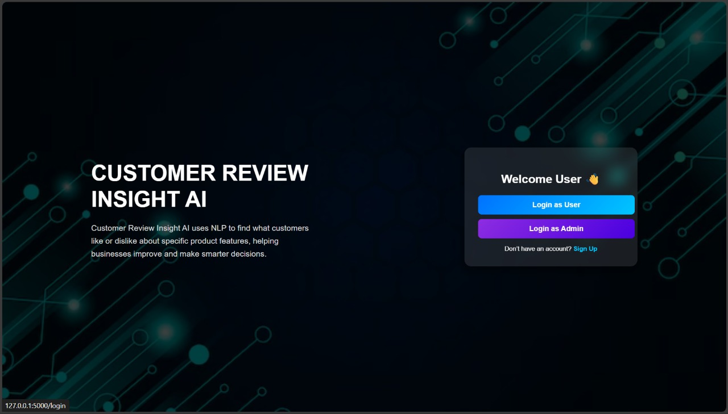
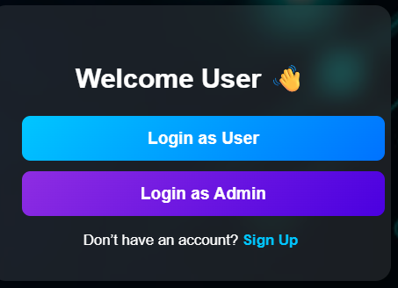
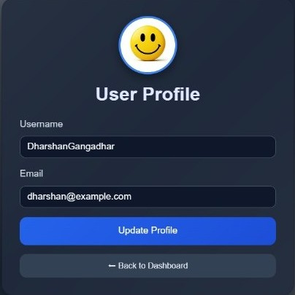
HOME PAGE
The user can select to login or register
USER PROFILE PAGE
The user can create a new user id

Slide 8
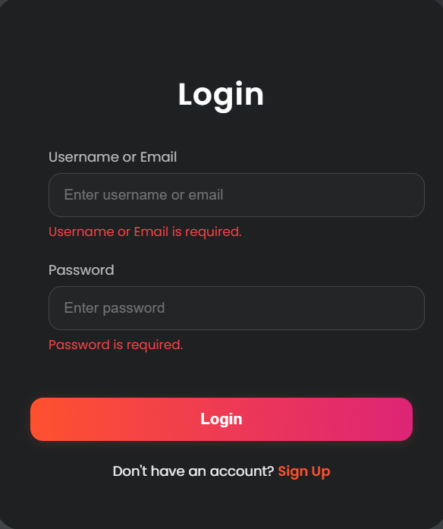
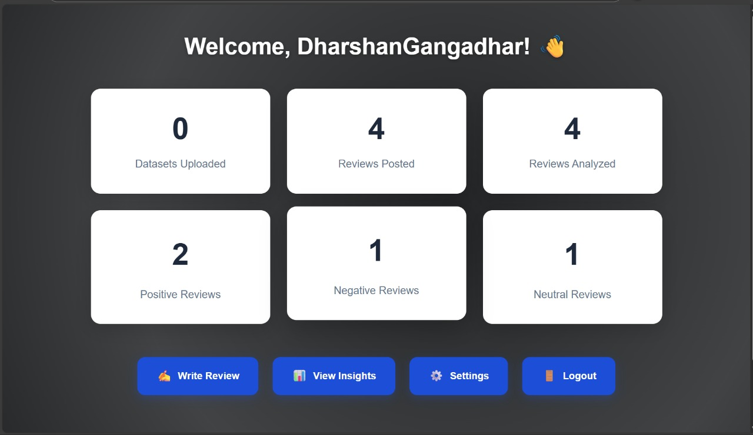
LOGIN PAGE
The user can login to his account
DASHBOARD
The Statistics of the user is present in this page

Slide 9
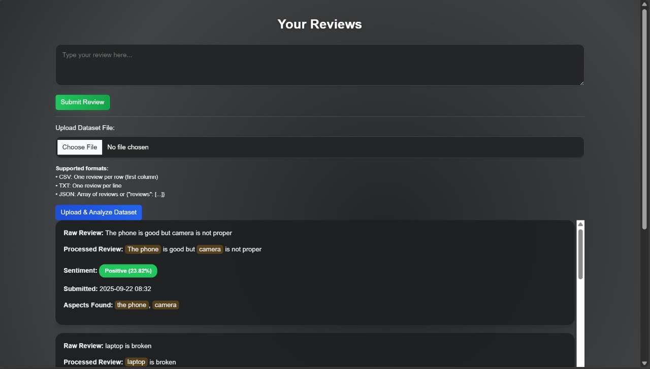
REVIEW PAGE
User can write the reviews here

Slide 10
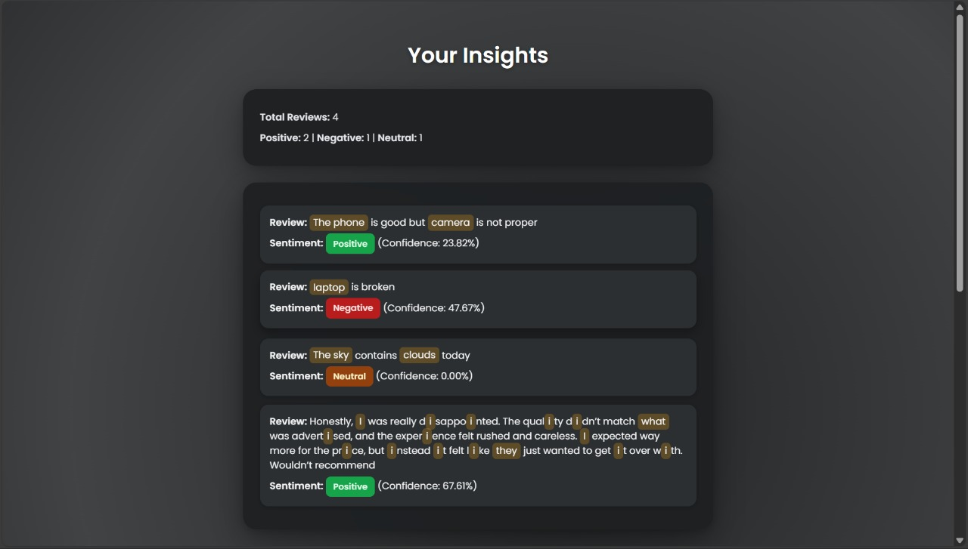
User insight page

Slide 11
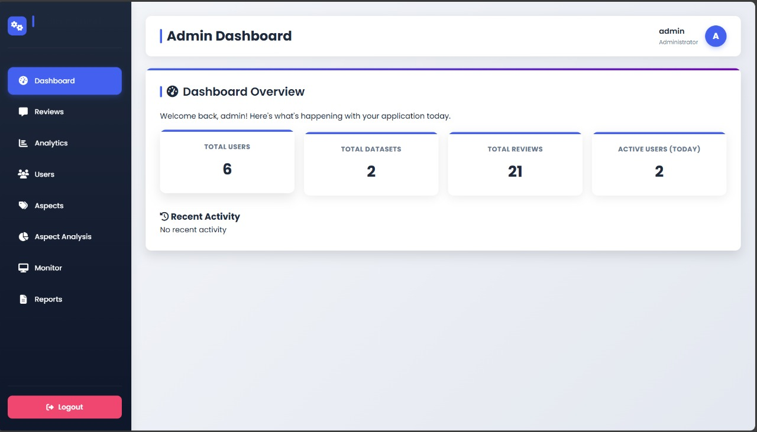
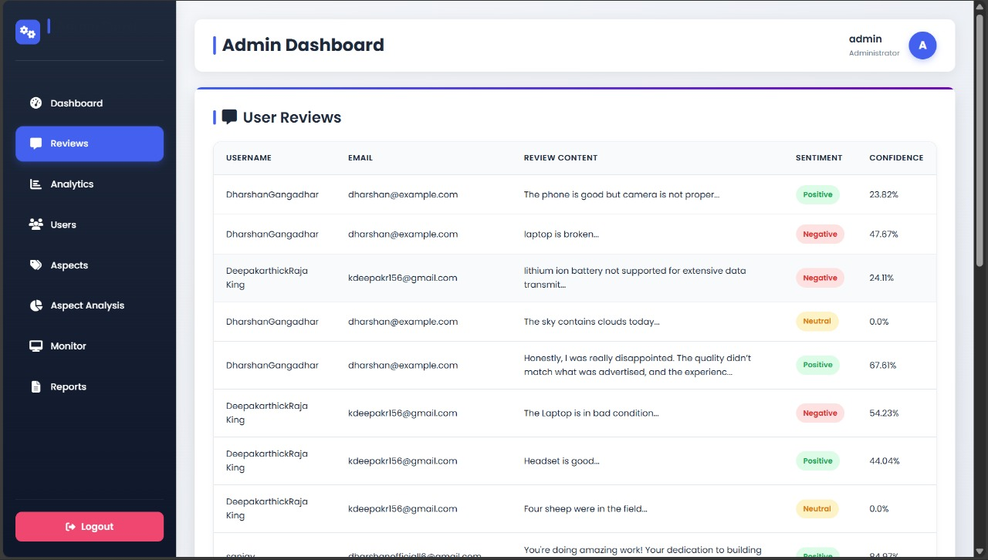
ADMIN DASHBOARD
All the stats are available of the users are available here
All the reviews of the users are available here

Slide 12
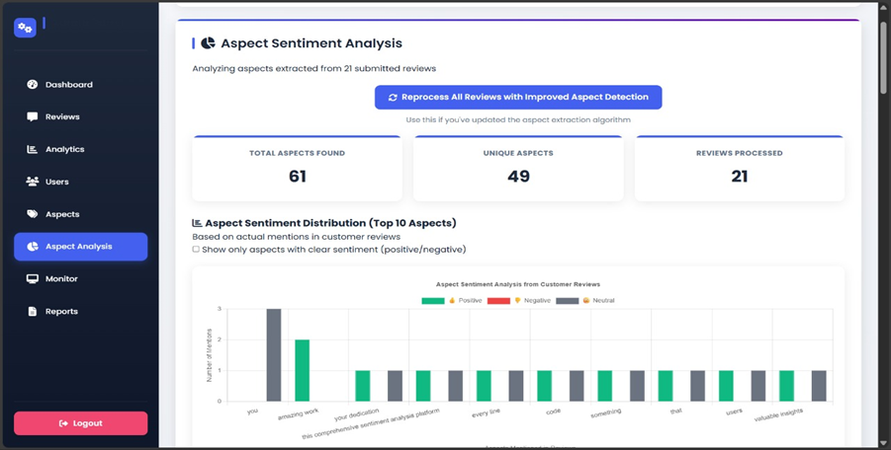
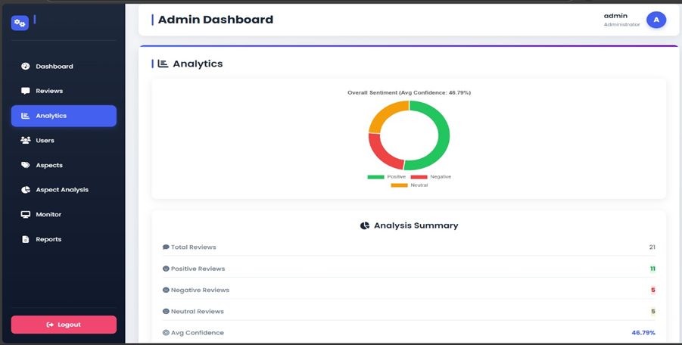
All the analysis of the sentimental aspects is done in this page
All the analytics available in this page

Slide 13
Technical Architecture
Technology Stack
Backend: Flask/Python
NLP Libraries: NLTK, spaCy, Hugging Face Transformers
Data Processing: Pandas
Visualization: Streamlit, Dash, Plotly
Database: SQLAlchemy
Security: Werkzeug.Security
Deployment: Docker, Cloud Platforms

Slide 14
Business Impact & Applications
Target Industries
Consumer Electronics
Hospitality & Tourism
E-commerce & Retail
Entertainment & Media
Healthcare Services
Financial Services

Slide 15
Use Cases
Product Development: Identify features customers love or dislike
Service Improvement: Understand service quality pain points
Marketing Strategy: Focus campaigns on positive aspects
Quality Assurance: Monitor product/service quality trends
Competitive Analysis: Compare sentiment across different offerings

Slide 16
Conclusion
The Customer Review Insight AI project represents a comprehensive solution for businesses seeking to extract actionable insights from customer feedback. By combining advanced NLP techniques with user-friendly interfaces and powerful visualization tools, this system transforms the way organizations understand and respond to customer sentiment.

Slide 17

THANK-YOU

