Slide 1
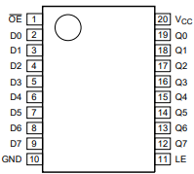
Note the orientation of the 74HTC573
mounting.Refer to the following figure.
27c512_Socket
74HTC573
Top
Silkscreen
PIN1
87c510 to
27c512 Adapter

