Slide 1

Investment & Profit Correlation
Source <https://entrackr.com/2019/11/government-to-exempt-startups-from-regulatory-filings-for-10-years/>
Lindsey Bang

Slide 2
Introduction and Problem
According to Yahoo(1), about 543,000 new businesses are started each month. Also, small businesses in the U.S. employ 57 million people (StartBlox(2), 2018). There are many startups in the U.S., and they are big part of the U.S. business overall. Over 99% of U.S. employers are small business owners (Cision(3), 2016). These facts lead to the question how startups are growing in the U.S. market.
In order to understand, what variables will lead success of startups, I would like to know how much R&D, administration and marketing expenses other startups the startups have invested and profits they have generated. Within the dataset I found, I will be able to learn about 50 startups’ R&D, administration and marketing expenses as well as their profits by states.
<Reference>
https://smallbusiness.yahoo.com/advisor/16-surprising-small-business-statistics-infographic-190434232.html
https://startblox.com/blog/8-small-business-statistics-2018/
https://www.prnewswire.com/news-releases/small-business-owners-us-is-facing-a-retirement-crisis-300215234.html

Slide 3
Contents
Objectives - Metrics and assumptions
Methodology and scope
Approach and process
Models
Findings
Performance evaluation
Impact of your findings.
Recommendations

Slide 4
Objectives
Include the following elements:
Hypothesis/assumptions:
High investments = High profits
High marketing and R&D expenses will lead startups to their success.
Goals and success metrics:
To find the variables which lead the success of start-ups
Risks or limitations:
Data-set limitation: other variables which are not includes in the datasets, such as variable expenses, business types, start date, and etc. could be the important predictors to predict the target variable.
50 startups are not enough data to draw any conclusion regarding the correlation between expenses (Marketing, R&D and Admiration) and profits.
Identify at least one relevant internal dataset and confirm that you have (or can get) the right access permissions.

Slide 5
Methodology and scope
Models
Linear regression
Lasso regression
Ridge regression
Random Forest Regressor
Neural Networks
K-Folds
Dependent variables
Independent variable
Market
US
Type
Expenses and Profits
Source
Kaggle
https://www.kaggle.com/farhanmd29/50-startups/version/1

Slide 6
Understanding Data - Overview
Startups (50 samples)
Continuous variables: R&D Spend, Administration Spend, Marketing Spend and Profit
Categorical variables: State
Independent variables: R&D Spend, Administration Spend, Marketing Spend, State
Dependent variable: Profit

Slide 7
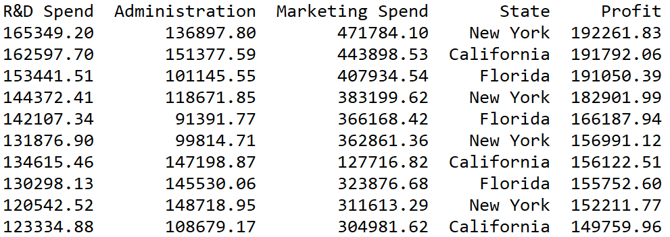
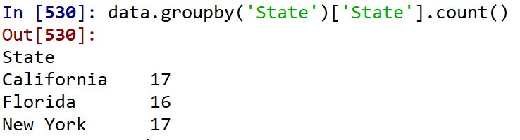
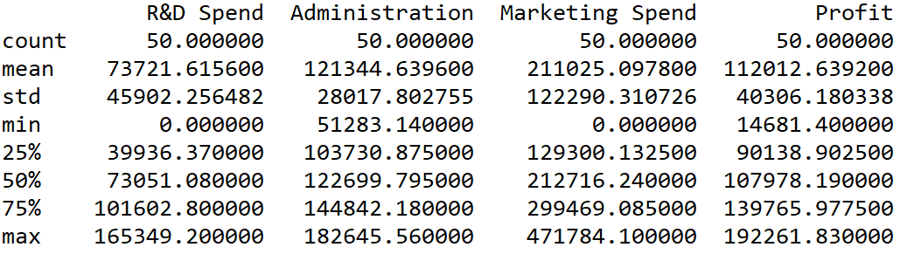
Understanding Data (cont’d)
Small Dataset
No outstanding outliers
Three different states
Dataset is fairly selected from each state (.34/.32/.34)

Slide 8
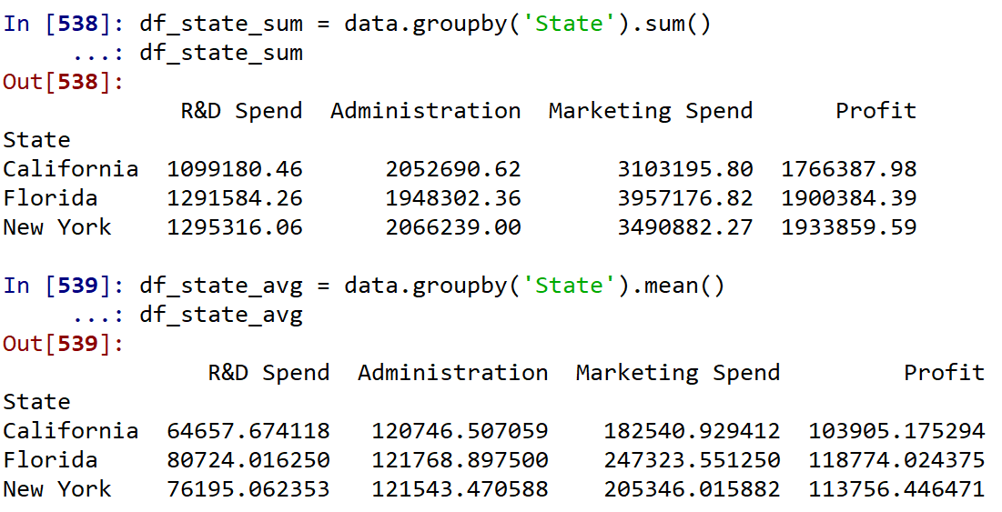
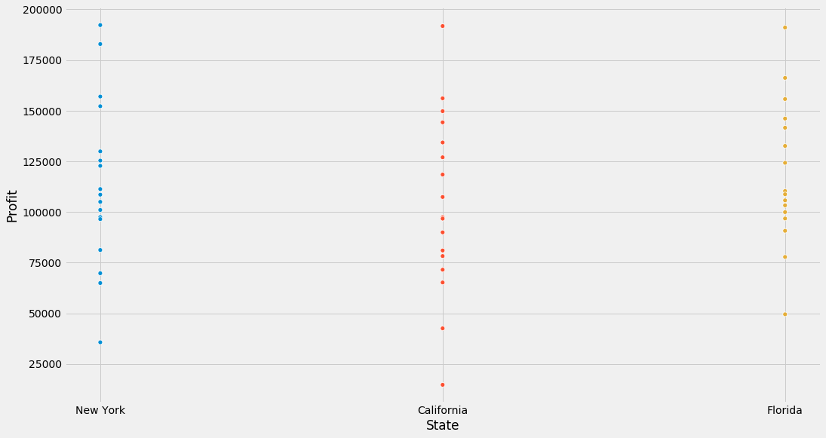
Understanding Data (cont’d)
Within this dataset, no correlation was found between states and profits, so state will be dropped from the modeling process.

Slide 9
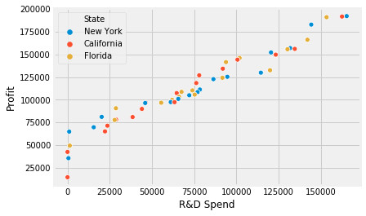
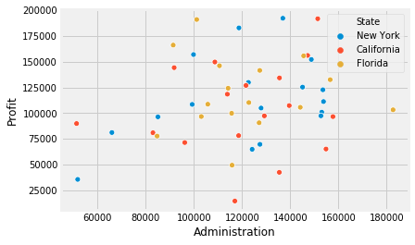
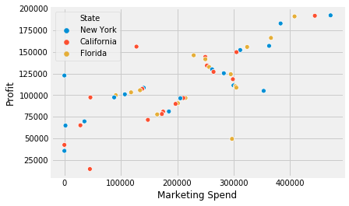
Understanding Data (cont’d)
Within this dataset, very week correlation was found between administration expense and profits, so administration will be dropped from the modeling process.

Slide 10
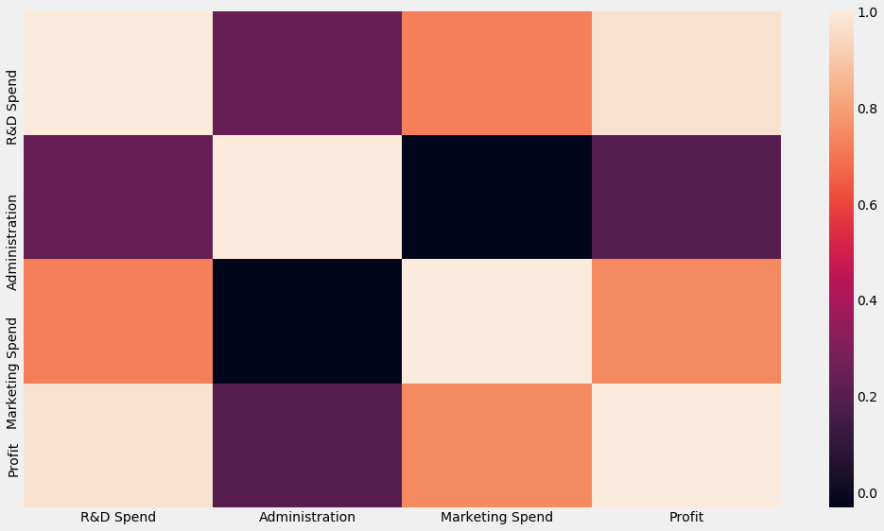
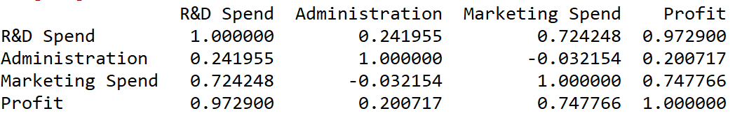
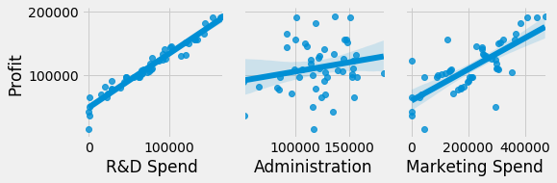
Understanding Data (cont’d)
Strong positive correlation between R&D Spend and Profit
Strong positive correlation between Marketing and Profit
Week positive correlation between Administration and Profit

Slide 11
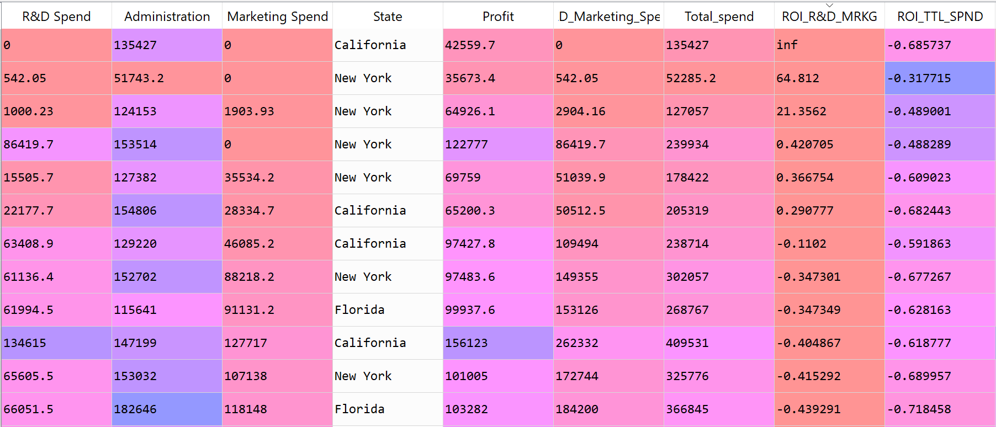
ROI
All the startups’ ROIs were under $0.
Net profits were under $0

Slide 12

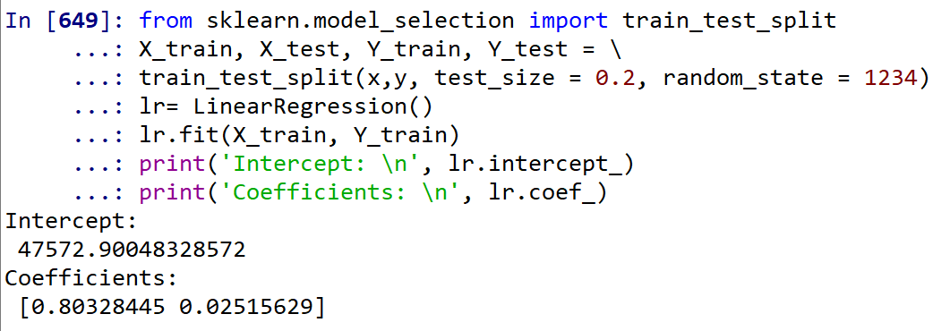
Linear Regression
What is Linear Regression
In statistics, linear regression is a linear approach to modeling the relationship between a scalar response and one or more explanatory variables. .
<http://ci.columbia.edu/ci/premba_test/c0331/s7/s7_6.html>
Multiple Linear Regression (two independent variables)

Slide 13
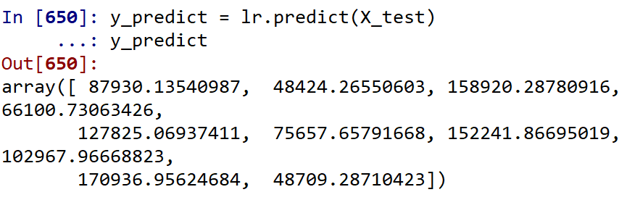
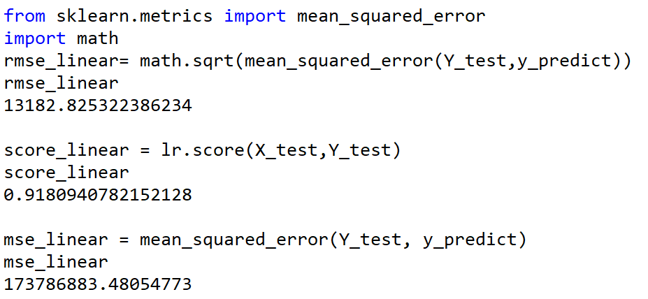
Multiple Linear Regression
R-squared value is close to 1
smaller differences between the observed data and the fitted values

Slide 14
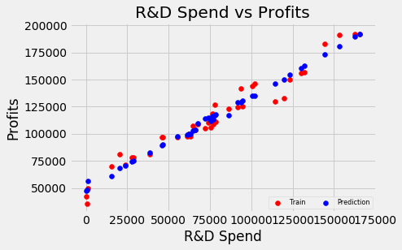
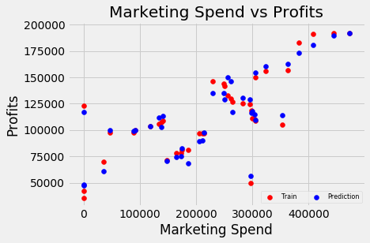
Train vs. Prediction

Slide 15
Lasso Regression
In statistics and machine learning, lasso is a regression analysis method that performs both variable selection and regularization in order to enhance the prediction accuracy
<https://www.coursera.org/lecture/machine-learning-data-analysis/what-is-lasso-regression-0KIy7>
Lasso regression shrinks coefficients all the way to zero, thus removing them from the model.
When alpha is 0 , Lasso regression produces the same coefficients as a linear regression. When alpha is very large, all coefficients are zero
<https://git.generalassemb.ly/tiffmkell/DAT-course-materials-students-12-9/blob/master/lessons/data-science-modeling/linear_regression_tiff.ipynb>

Slide 16
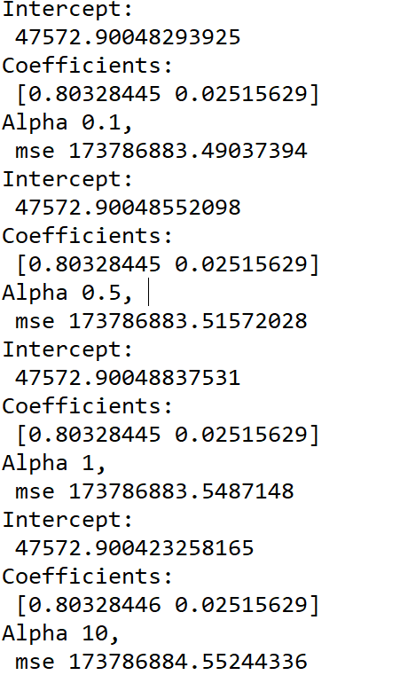
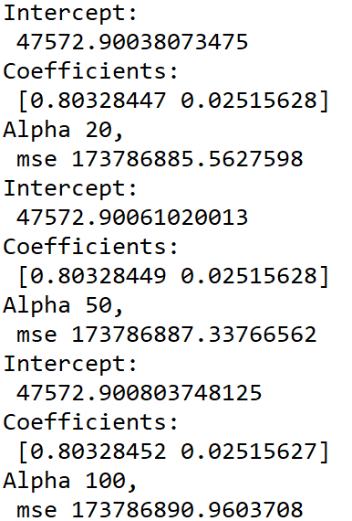
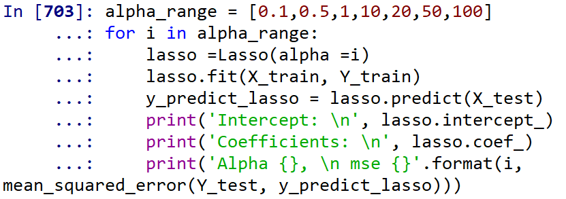
Lasso Regression (cont’d)
MSE does not change much between 0.1 and 1.
MSE gets a slightly higher when alpha => 10.
The Best Alpha Value = 0.1
Lasso regression shrinks coefficients all the way to zero, thus removing them from the model.

Slide 17
Lasso Regression (cont’d)
Predictions via Lasso regression and linear regression models came out very close to each other (coefficient, Interception, RMSE, R-squared, and MSE).

Slide 18
Ridge Regression
Ridge regression is a way to create a parsimonious model when the number of predictor variables in a set exceeds the number of observations, or when a data set has multicollinearity (correlations between predictor variables).
<https://www.statisticshowto.datasciencecentral.com/ridge-regression/>
Ridge regression shrinks coefficients toward zero, but they rarely reach zero.
<https://git.generalassemb.ly/tiffmkell/DAT-course-materials-students-12-9/blob/master/lessons/data-science-modeling/linear_regression_tiff.ipynb>

Slide 19
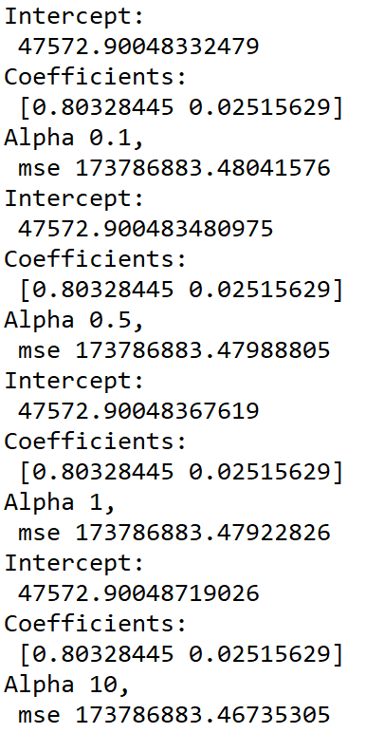
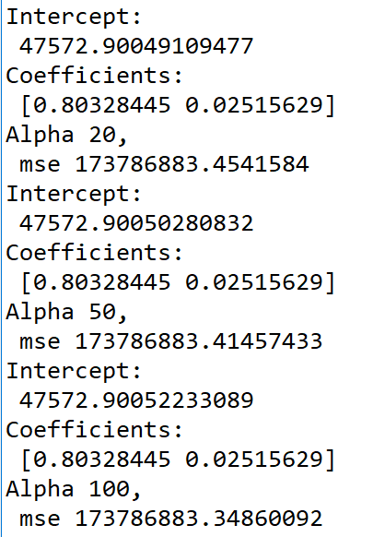
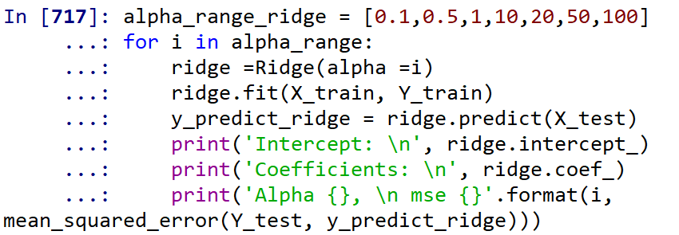
Ridge Regression (cont’d)
Ridge prediction does slightly change (under 1).
The best alpha value = 0.1
Very similar to Linear and Lasso regressions.

Slide 20
Ridge Regression (cont’d)
Predictions via Ridge Regression, Lasso regression and linear regression models came out very close to each other (coefficient, Interception, RMSE, R-squared, and MSE).

Slide 21
Random Forest Regression
Random Forest is an ensemble machine learning technique capable of performing both regression and classification tasks using multiple decision trees and a statistical technique called bagging. Bagging along with boosting are two of the most popular ensemble techniques which aim to tackle high variance and high bias.
The fundamental idea behind a random forest is to combine the predictions made by many decision trees into a single model. Individually, predictions made by decision trees may not be accurate but combined together, the predictions will be closer to the true value on average.
<https://gdcoder.com/random-forest-regressor-explained-in-depth/>

Slide 22
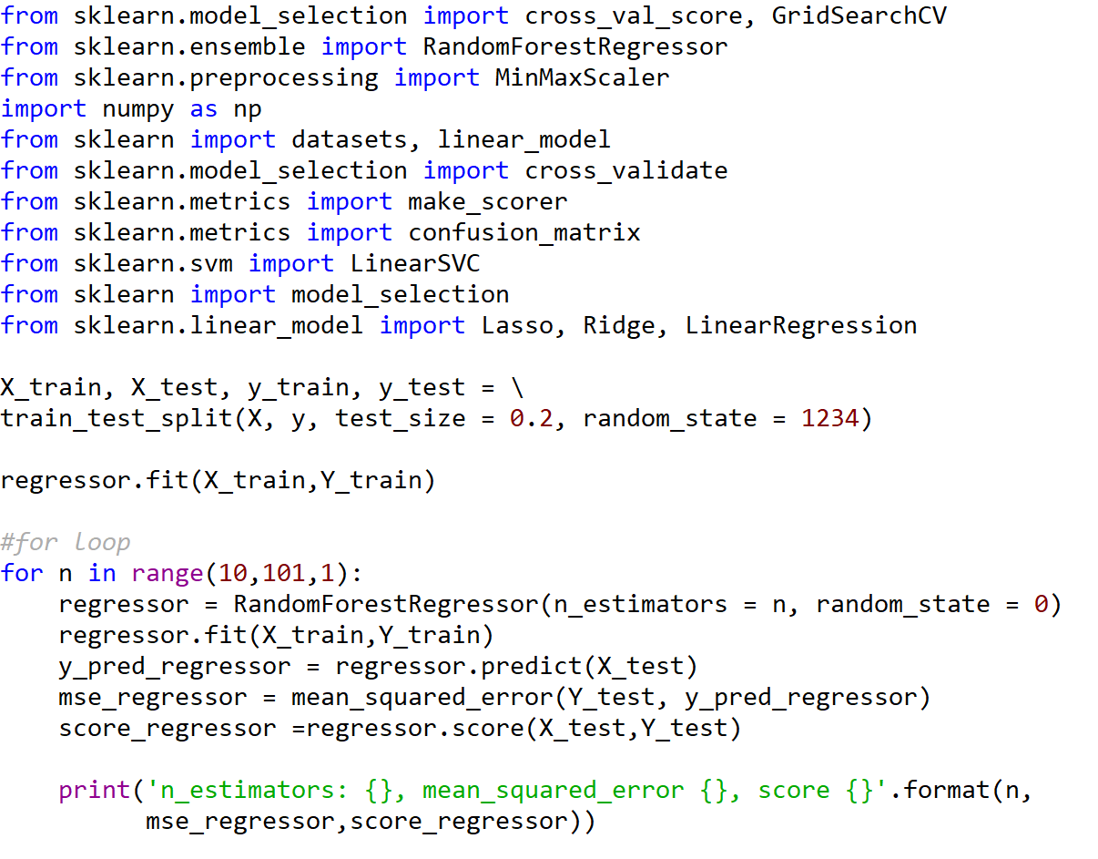
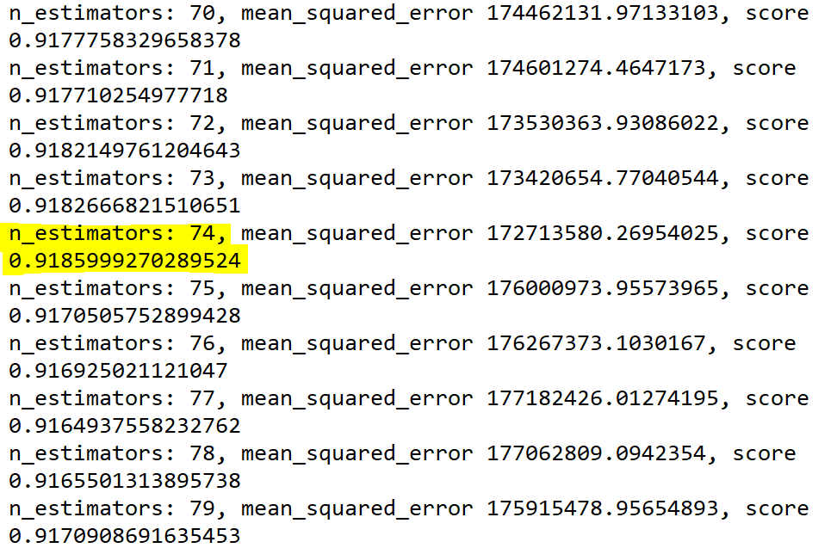
Random Forest Regression (cont’d)
Find the best n_estimator for Random forest regression
n_estimator: 70, mean_squared_error: 172713589.27
The best n_estimator value = 74

Slide 23
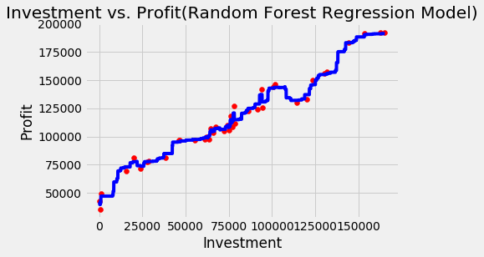
Visualizing Random Forest Regression
R&D Investment

Slide 24
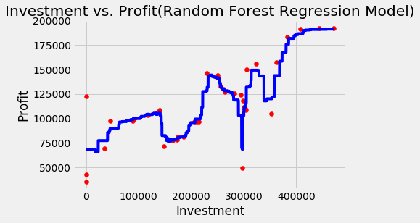
Visualizing Random Forest Regression
Marketing Investment

Slide 25
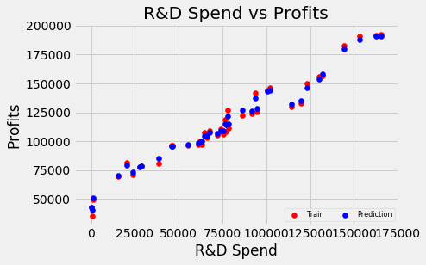
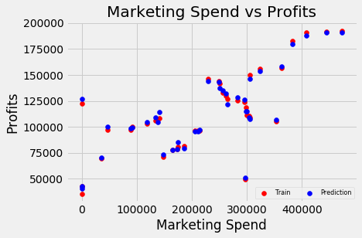
Random Forest Regression (cont’d)
Prediction via Random forest regression model fits to Y_test plots better than other three prediction models.

Slide 26
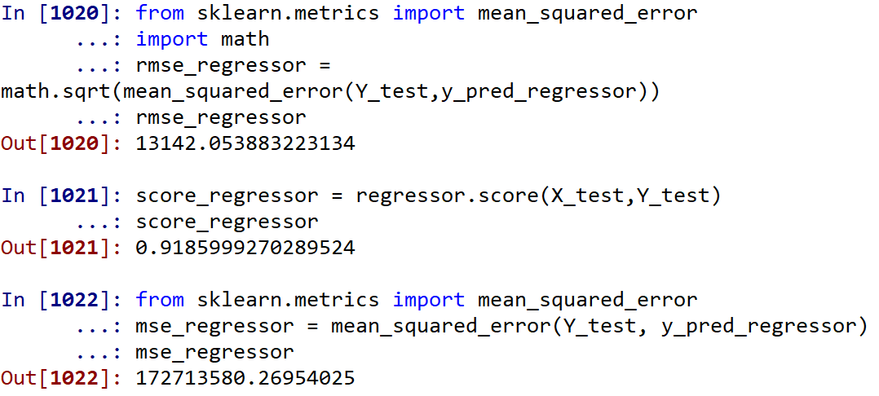
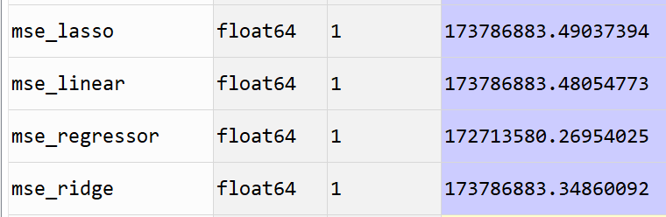
Random Forest Regression (cont’d)
Random Forest regression model is the better model than Ridge, Lasso and Linear regressions with this dataset.

Slide 27
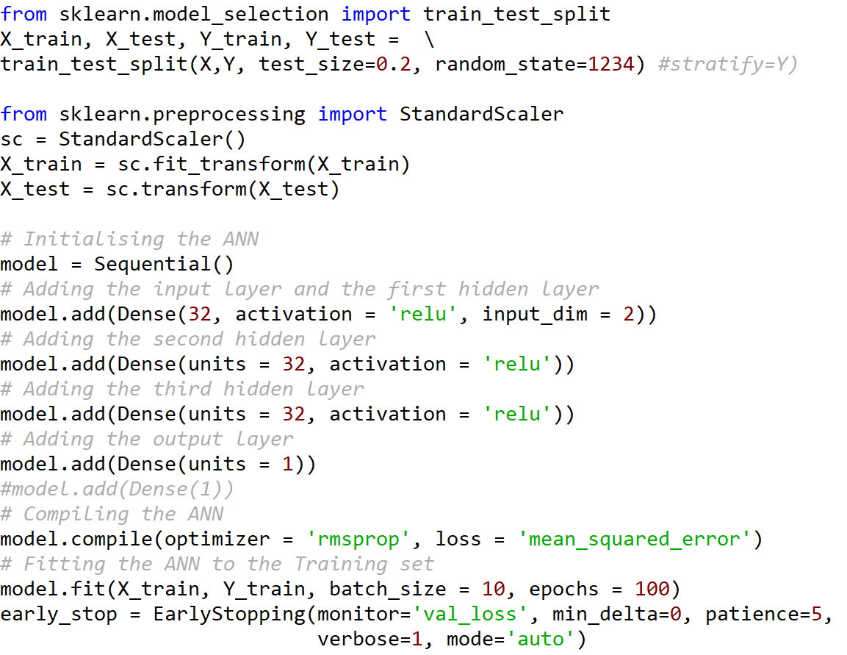
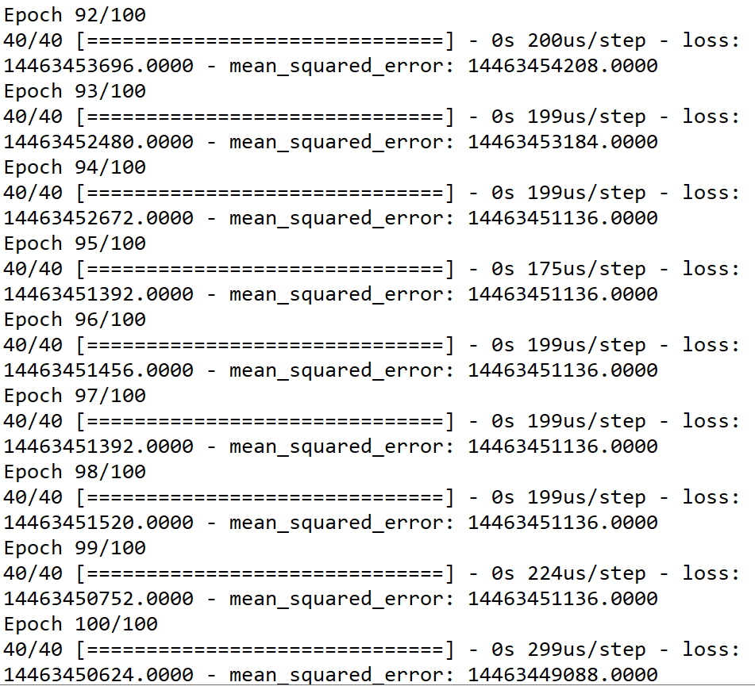
Neural Networks

Slide 28
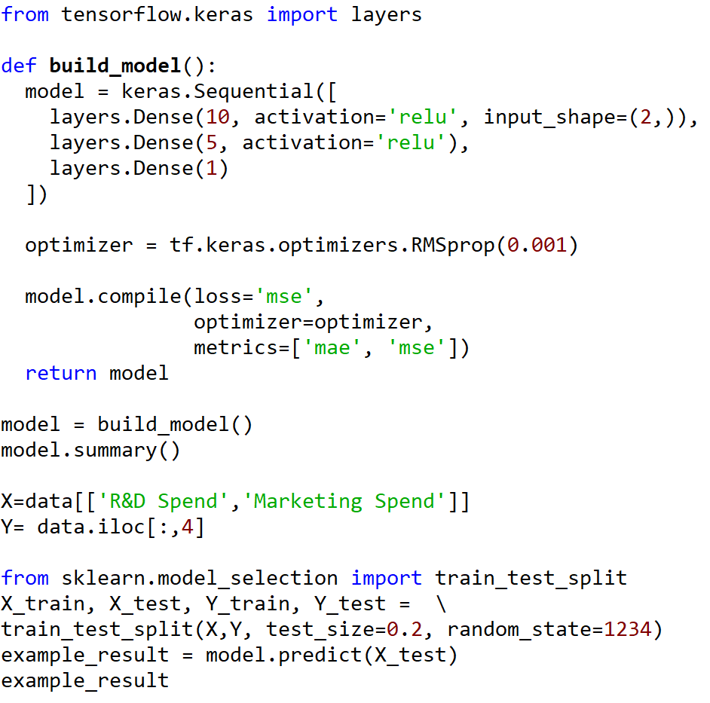
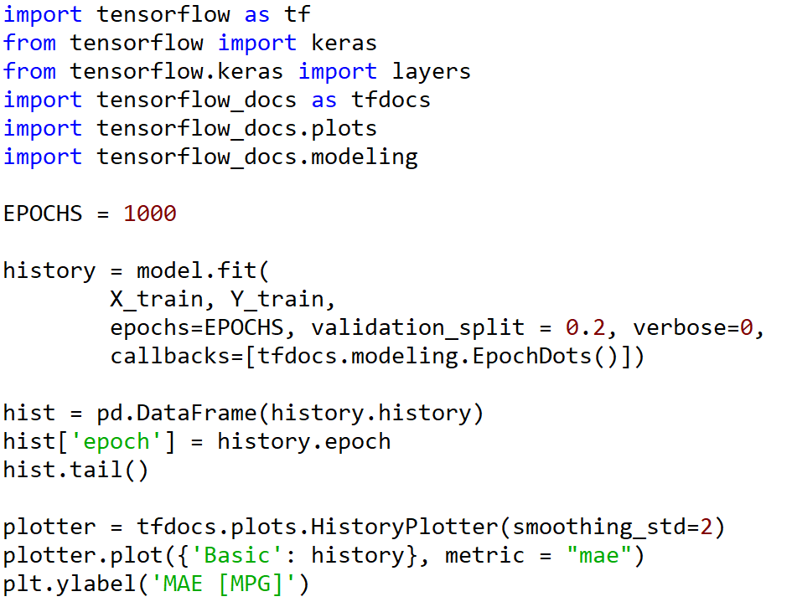
Neural Networks (cont’d)
Due to size of the dataset, the neural networks are the not right model to apply.
MSE is too high compared to other regression models.

Slide 29
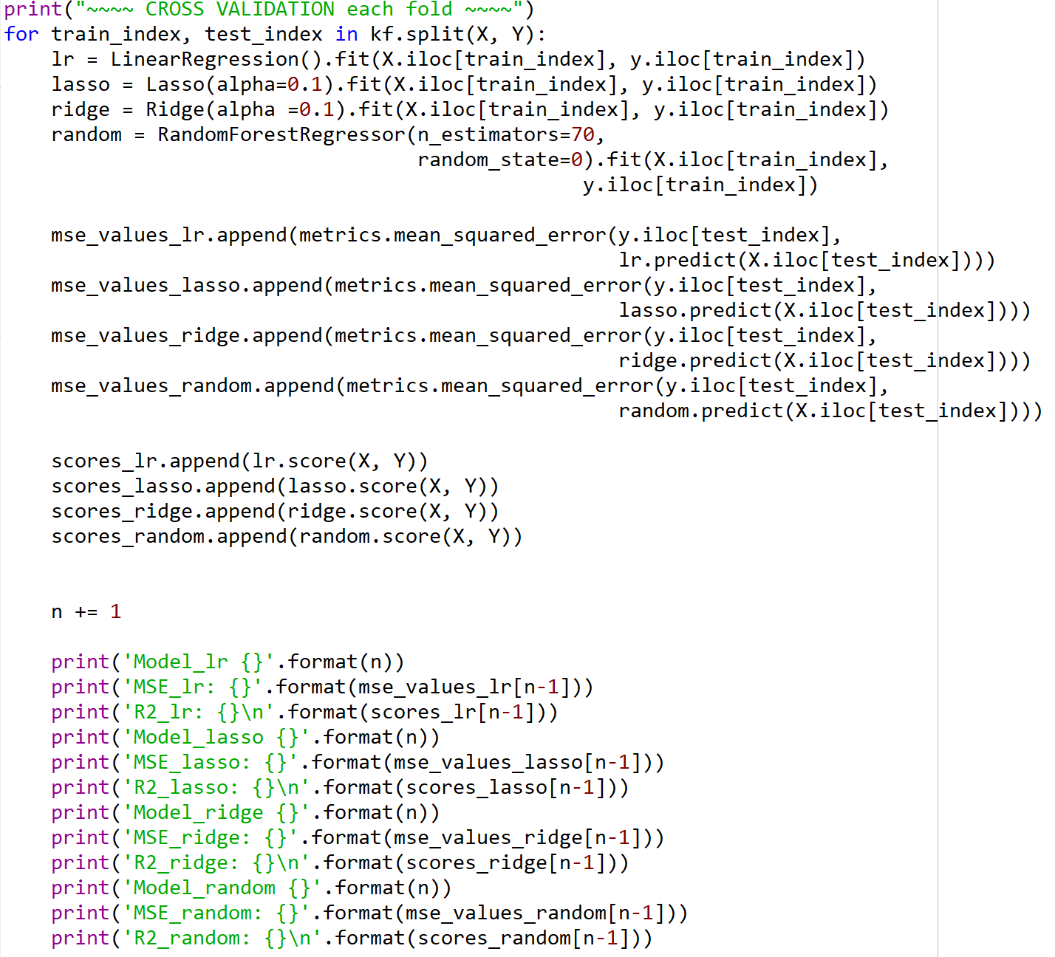
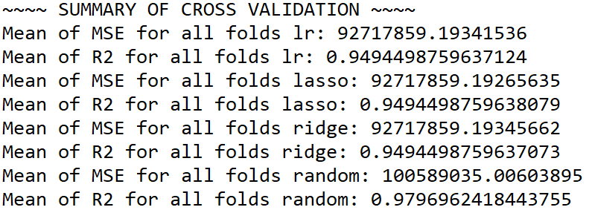
Performance evaluation (K-Fold)
Validating which prediction model is the best fit with the given dataset
Random Forest Regression is the best prediction model with this dataset.
R² = 1 indicates that the regression predictions perfectly fit the data.

Slide 30
Findings
Random Forest Regression was the best prediction model.
Assumptions → Findings
High investment on R&D is highly correlated to high profits
High investment on Marketing is highly correlated to high profits
Hight investment on Administration is slightly correlated to high profits.
Locations do not correlated to high profits or investment.
Due to size of the dataset, there was no significant difference in R² from different regression models (Multiple linear, Lasso, Ridge and Random forest regressions).

Slide 31

To increase the quality of modeling
Gathering 1-2 years of monthly expense and profit data from the same startups or more startups is a very important key to find a better prediction model and validate the assumptions. Also, the below models can be added with a bigger dataset.
Time series regression
Neural Networks
Classification (with business type information)

Slide 32
ANY QUESTIONS?

