Slide 1
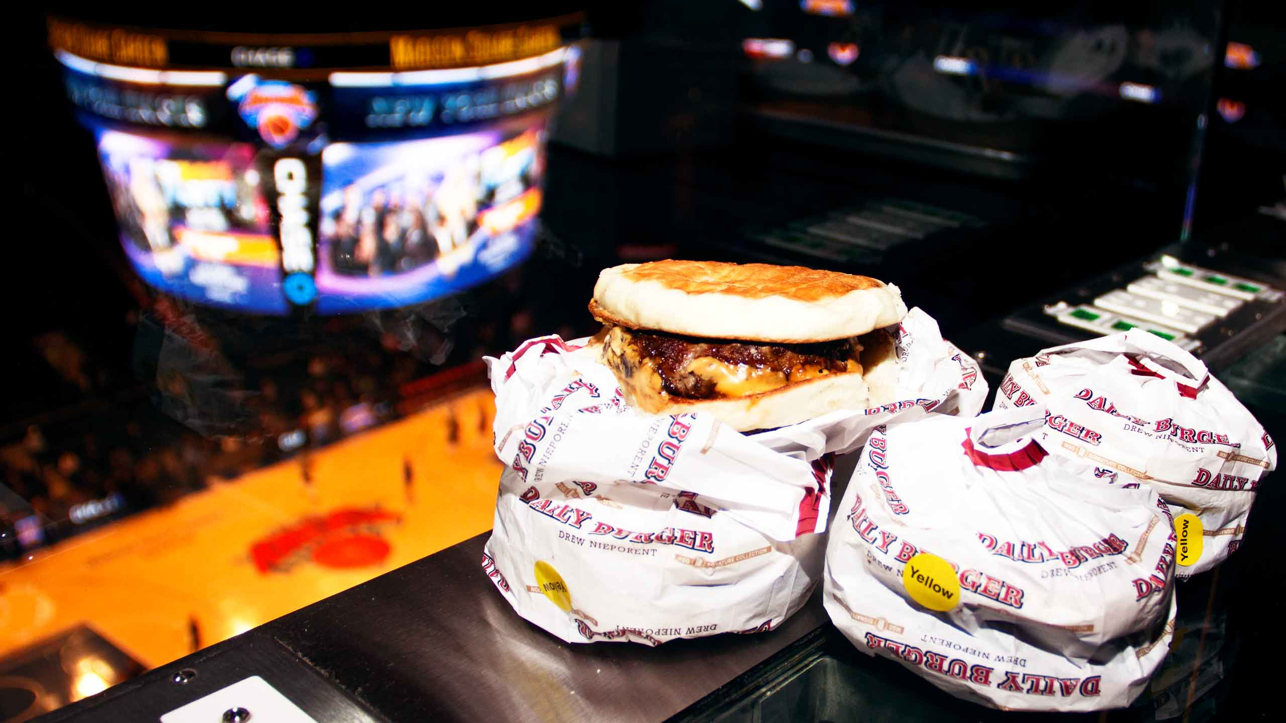
Recommendation System for Madison Square Garden
Machine Learning recommendation technology to personalize venue food item orders with MSG’s mobile application

Slide 2
The Goal
We’ll be covering in details the step-by-step process in constructing a recommendation system with Python and machine learning module Turicreate. These steps include:
Transforming and normalizing data
Training models
Evaluating model performance
Selecting the optimal model

Slide 3
Product Overview
With the MSG mobile application, customers at the venue can place orders before they even have to walk into the venue.
There is an opportunity for the app to show recommendations: When a customer first taps on the “order” page, we may recommend top 10 items to be added to their basket, e.g. burgers, French fries, chicken fingers, beer, etc.

Slide 4
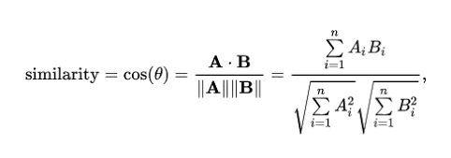
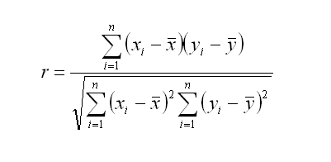
The idea is to calculate how similar a product is to another product. There are a number of ways of calculating this. We use cosine or pearson similarity measure, respectively.
Cosine: Pearson:

