Slide 1
SeeFish
By Fish* ptr;

Slide 2


Slide 3

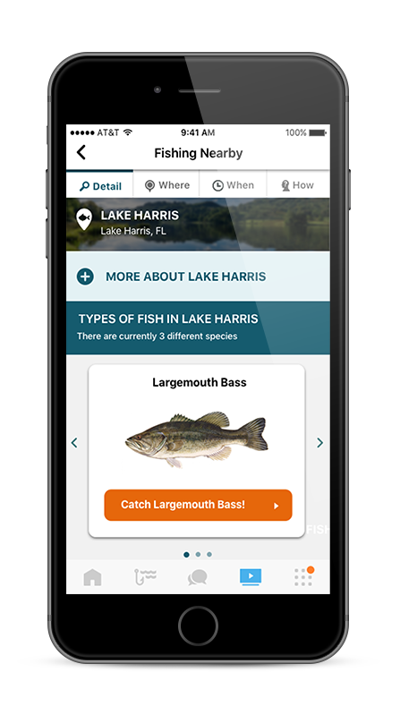
ReelSonar Netfish

