Slide 1

How Does a Bike-Share Navigate Speedy Success?

Slide 2
About Company
offers bike-sharing across City with over ten thousand bikes at thousand stations. They rely on flexible pricing with single-ride, day passes, and annual memberships.
Problem: While attracting customers, we want to increase annual members who are more profitable.
Solution: Convert existing casual riders to members. Casual riders already know and use, making them prime targets.
Goal: Design marketing strategies targeting casual rider conversion.
Action: Analyze historical data to understand differences between casual riders and members, motivations for membership, and digital media's impact.

Slide 3
Produce a report with the deliverables
1. A clear statement of the business task
2. A description of all data sources used
3. Documentation of any cleaning or manipulation of data
4. A summary of my analysis
5. Supporting visualizations and key findings
6. My top three recommendations based on analysis

Slide 4
ASK
business task :
To find out how casual riders and annual members use bikes differently. From these insights, would help team to design a new marketing strategy to convert casual riders into annual members.

Slide 5
Prepare
All data sources used :
The data is public data that can use to explore how different customer types are using bikes.
Data are disorganized, but only needs to be cleaned, all the file are readable. It’s ROCCC.

Slide 6
Process
Documentation of any cleaning or manipulation of data :
Using python in Jupyter notebook helps notify and adjusting in short period of time, by running code in a line with short time, and gives out result after running saving lots of time, therefore I can check the data every now and then, and it can document every steps I take.

Slide 7
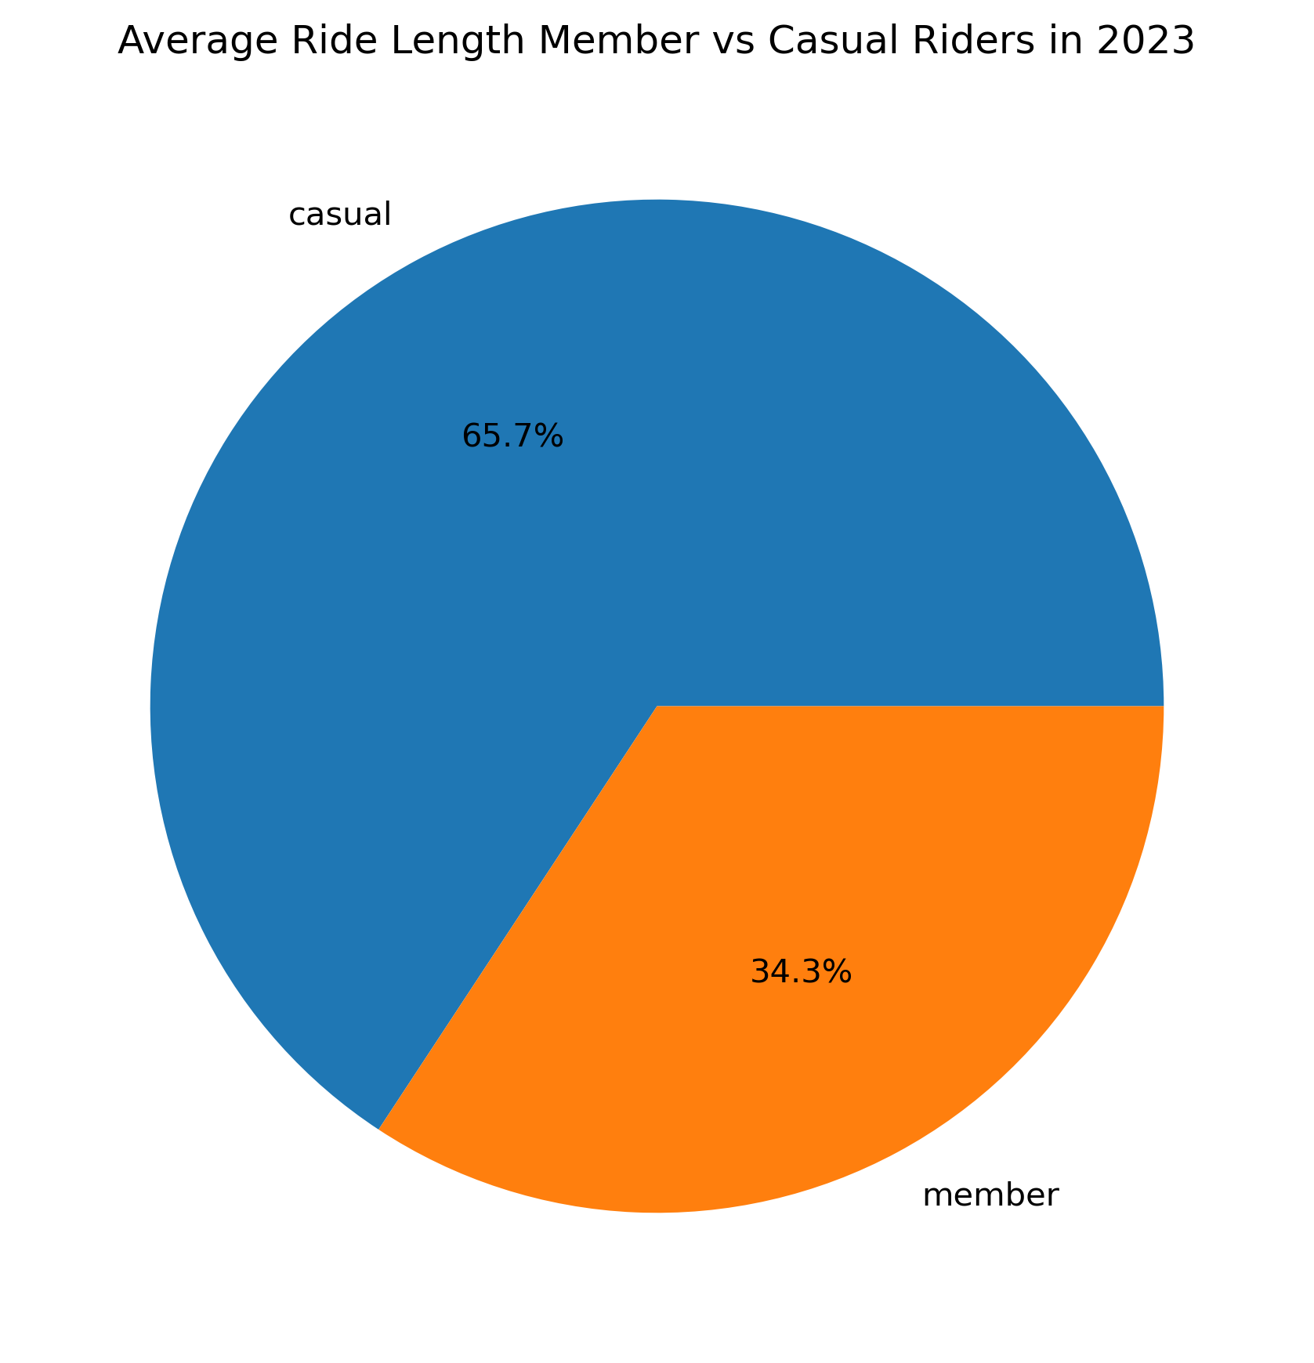
Analyze
The average trip duration for the casual rider is less than that of average trip durations of the members.
During summer months number of rides at its highest level for both casual and member riders.

Slide 8
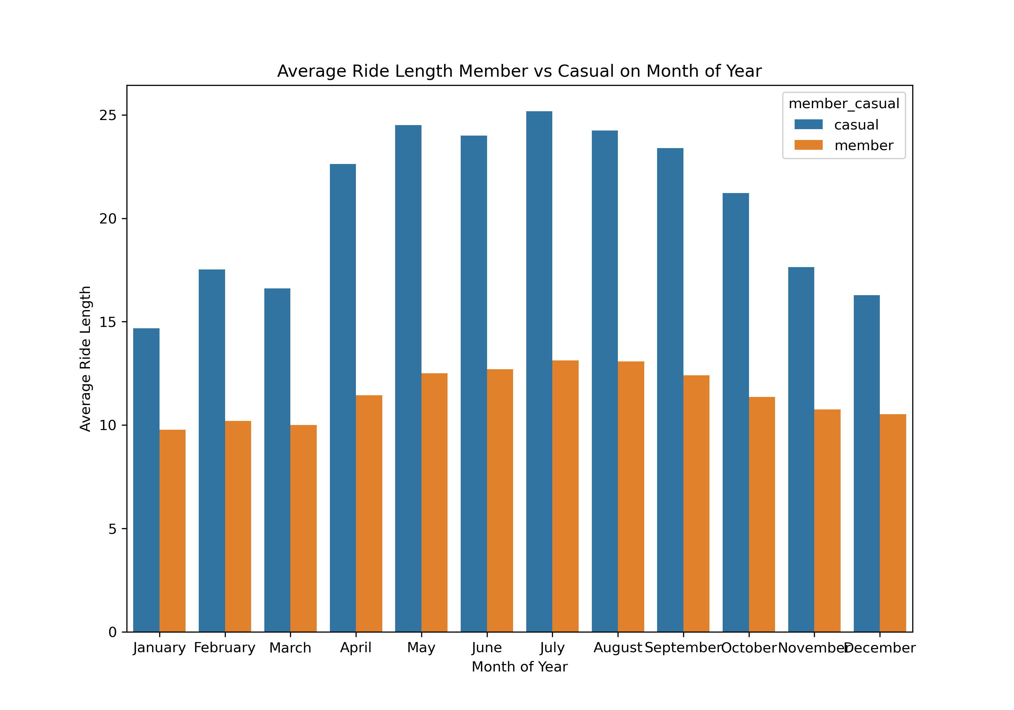
Analyze
The average trip duration for the casual rider is less than that of average trip durations of the members.
During summer months number of rides at its highest level for both casual and member riders.

Slide 9
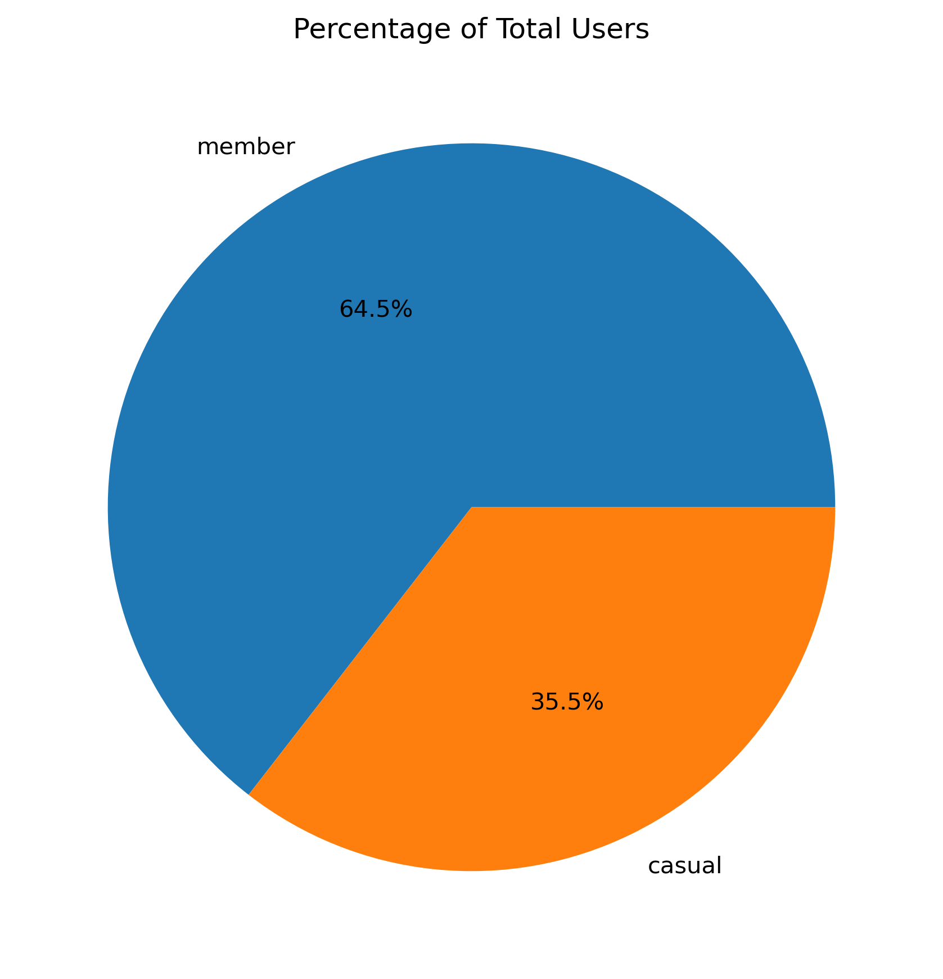
Analyze
Most of the riders are member users.
Classic bikes are the most popular kind.
Only casual users use docked bikes, membership users prefer classic bikes, While the number of e-bikes used by members is almost double the number used by casual visitors.

Slide 10
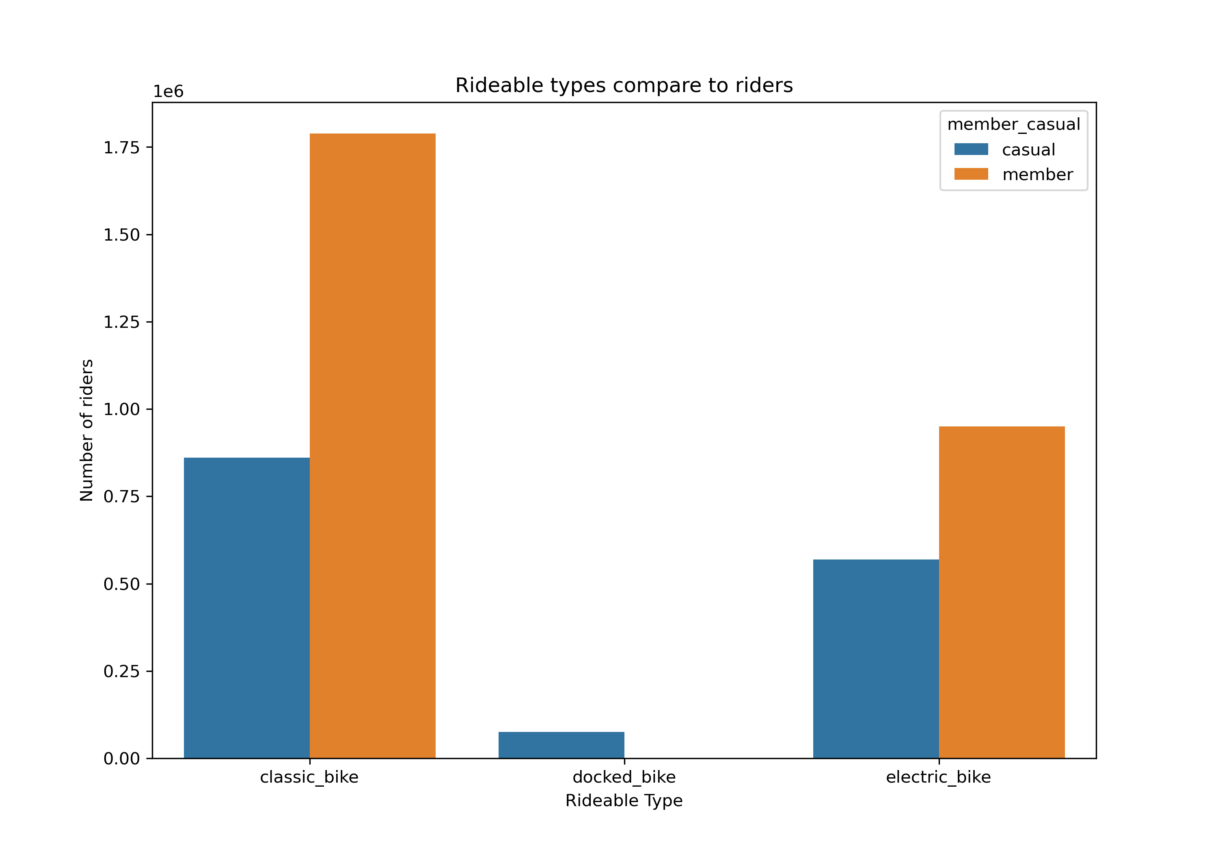
Analyze
Most of the riders are member users.
Classic bikes are the most popular kind.
Only casual users use docked bikes, membership users prefer classic bikes, While the number of e-bikes used by members is almost double the number used by casual visitors.

Slide 11
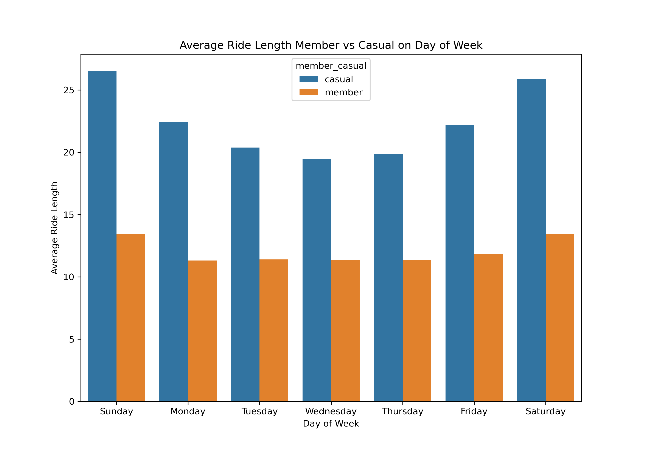
Analyze
There is a seasonal trend in ridership by both casual and member riders. Can see that the rise in no of rides during summer (July to September)
Member ridership surpasses casual ridership
In weekends casual riders' ride length is maximum when compared to Weekdays. Members' ride length tend to be almost same in all weekdays
The average ride length by casual riders is less than half of the members in the same year (2023).

Slide 12
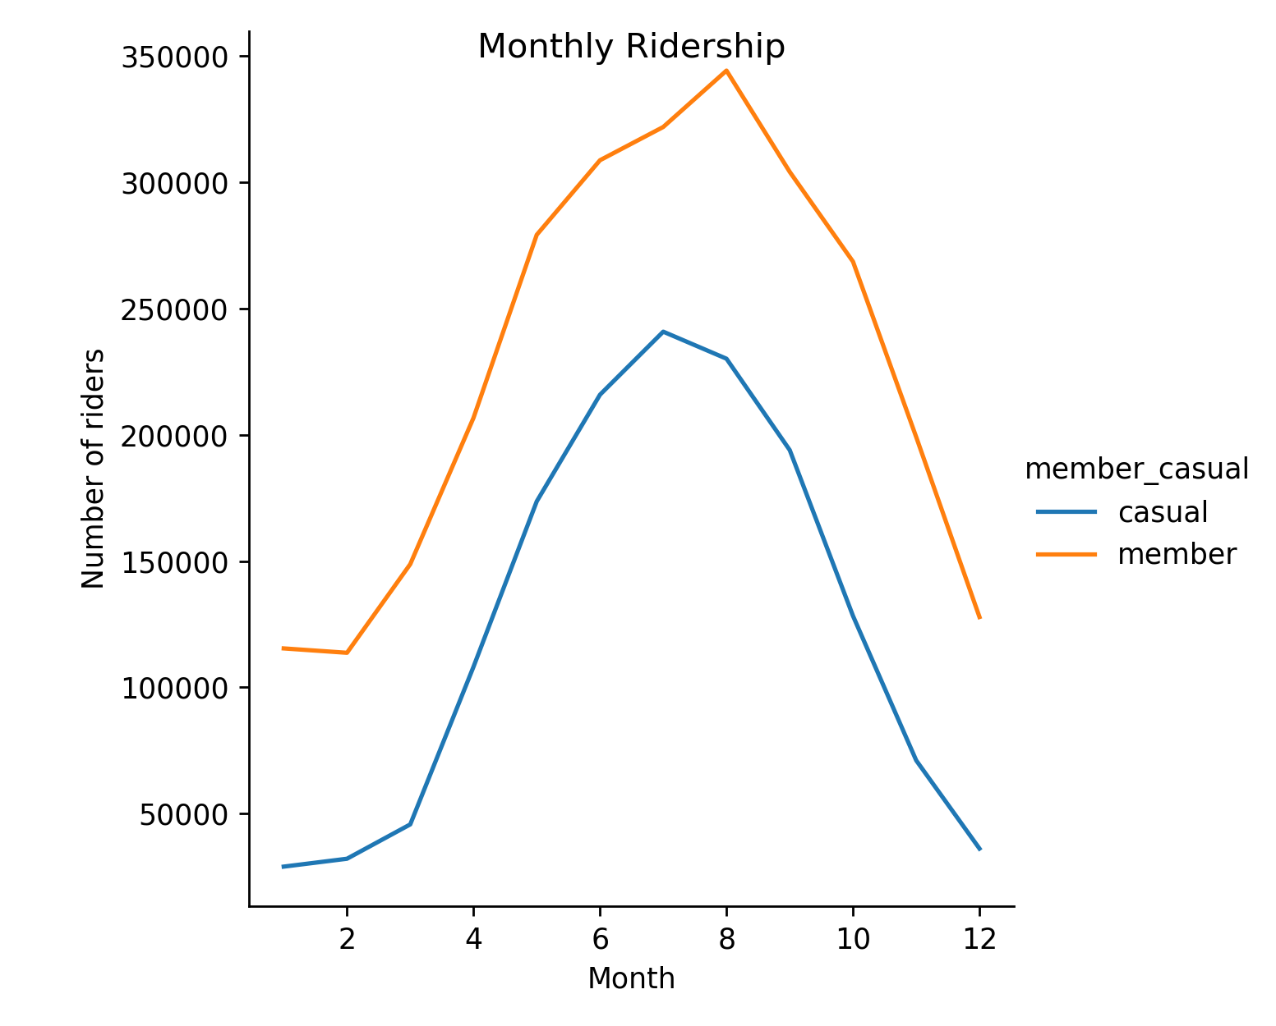
Analyze
There is a seasonal trend in ridership by both casual and member riders. Can see that the rise in no of rides during summer (July to September)
Member ridership surpasses casual ridership
In weekends casual riders' ride length is maximum when compared to Weekdays. Members' ride length tend to be almost same in all weekdays
The average ride length by casual riders is less than half of the members in the same year (2023).

Slide 13
Share
How annual members and casual riders use Company’s bikes differently?
Trip Frequency and Duration:
Casual riders: Take fewer rides overall but their individual rides tend to be longer, especially on weekends, suggesting they use bikes for leisure or personal activities.
Annual members: Make more frequent trips, potentially indicating usage for commuting or errands. Their average trip duration is shorter, though they also use bikes for longer rides on weekends.
Bike Type Preference:
Casual riders: Primarily use classic bikes, possibly for their affordability and familiarity. They are the only group using docked bikes, suggesting shorter point-to-point trips.
Annual members: Prefer classic bikes but also use electric bikes nearly as much. This might indicate a mix of commuting and leisure purposes, with electric bikes chosen for efficiency or fun on some occasions.
Seasonality: Both groups ride most frequently during summer months, aligning with leisure activities and potentially warmer weather encouraging cycling.

Slide 14
Act
Top three recommendations
For casual riders:
Highlight the convenience and affordability of classic bikes for leisure activities.
Offer weekend promotions or discounts to encourage more frequent usage.
Consider promoting docked bikes in specific areas popular for sightseeing or recreation.
For converting casual riders to annual members:
Emphasize the cost savings of an annual membership compared to frequent casual rides.
Showcase the versatility of classic and electric bikes for commuting, errands, and leisure.
Target marketing campaigns during the summer months when cycling is most popular.

Slide 15
hanks for listening
elcome to ask questions
If the answer to this question is incomplete, please let me know.

