Slide 1

How Does a Bike-Share Navigate Speedy Success?

Slide 2
Scenario
About the Company
Offers a bike-sharing service across the city, featuring over ten thousand bikes at a thousand stations. We provide flexible pricing options, including single-ride day passes and annual memberships.
Problem Statement
Goal is to increase the number of annual members, as they are more profitable.
Proposed Solution
Strategy is to convert existing casual riders into annual members. Casual riders are already familiar with our service, making them prime targets for membership.

Slide 3
Produce a report with the deliverables
1. A clear statement of the business task
2. A description of all data sources used
3. Documentation of any cleaning or manipulation of data
4. A summary of my analysis
5. Supporting visualizations and key findings
6. My top three recommendations based on analysis

Slide 4
ASK
Business task
To find out how casual riders and annual members use bikes differently. From these insights, would help team to design a new marketing strategy to convert casual riders into annual members.

Slide 5
Prepare
Data Sources
Publicly available data from open database.
Data requires cleaning but is readable and conforms to ROCCC standards.

Slide 6
Process
Data Cleaning
Used Python in Jupyter Notebook for efficient data cleaning and manipulation.
Documented each step to ensure reproducibility and transparency.

Slide 7
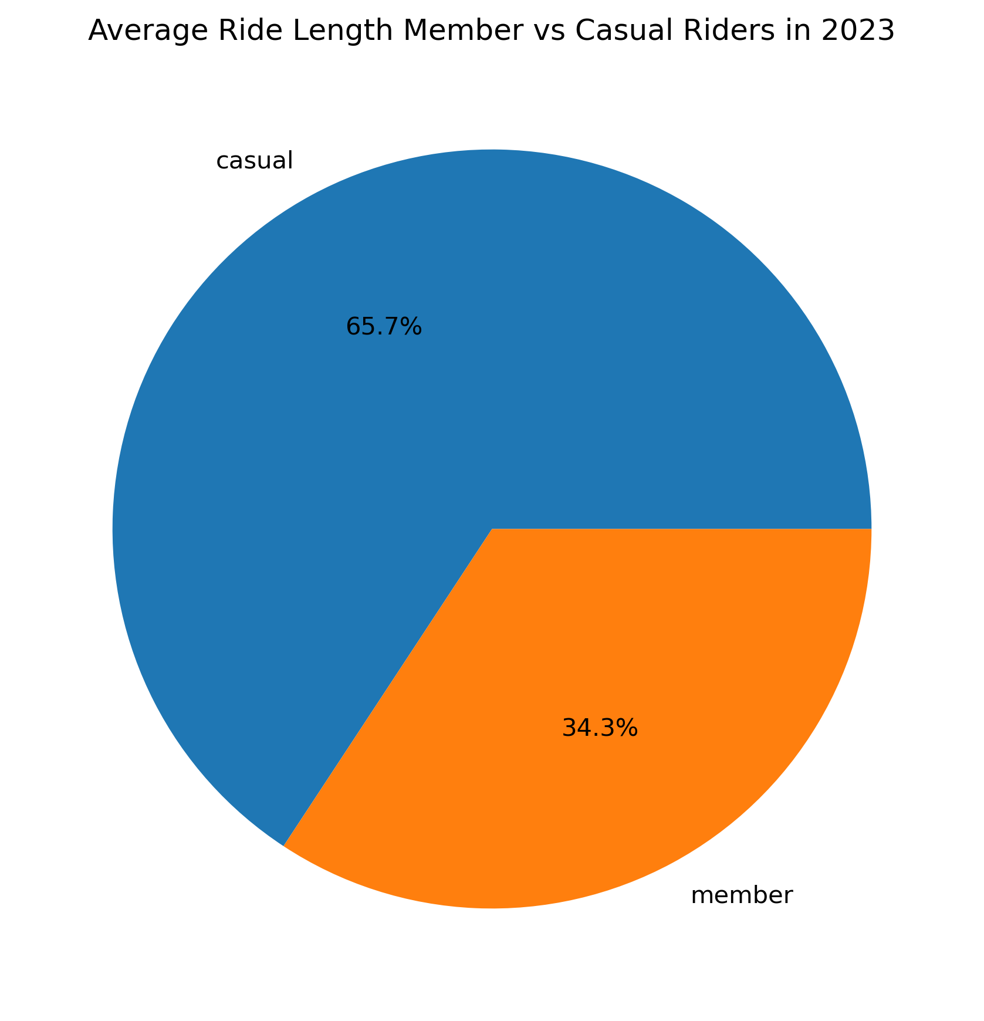
Analyze
The average trip duration for the casual rider is less than that of average trip durations of the members.

Slide 8
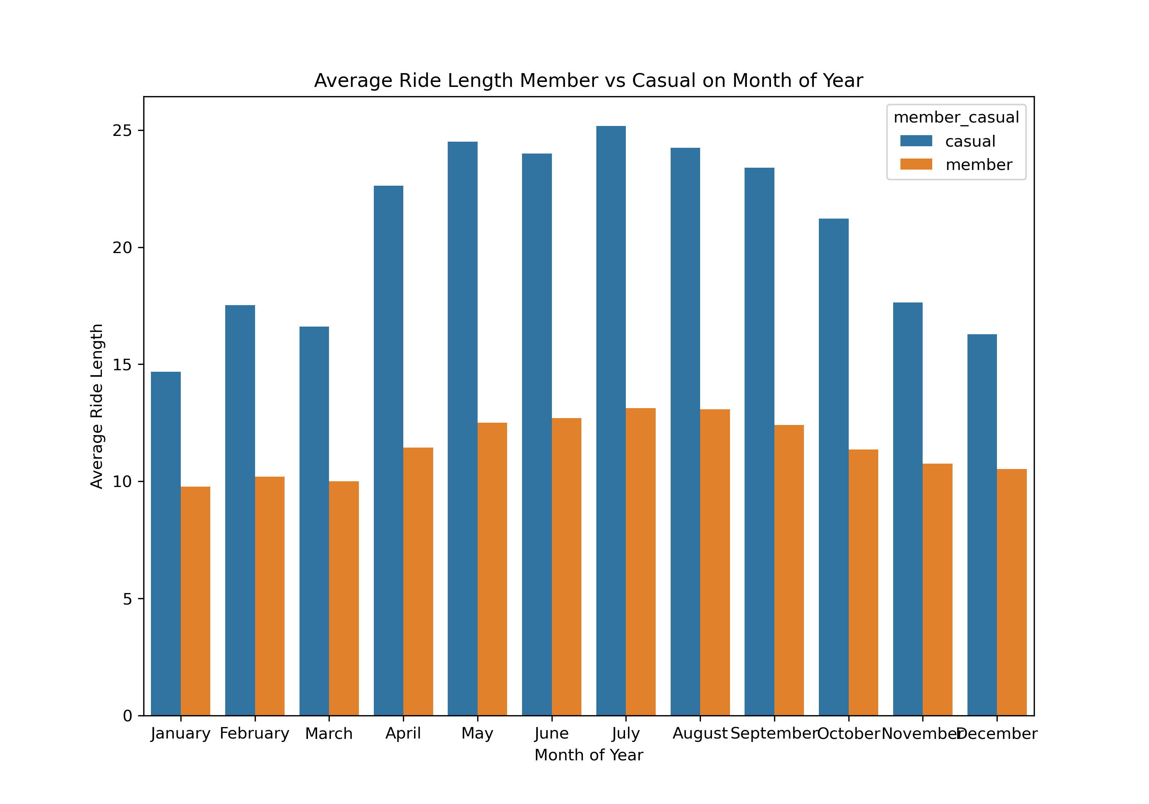
Analyze
During summer months number of rides at its highest level for both casual and member riders.

Slide 9
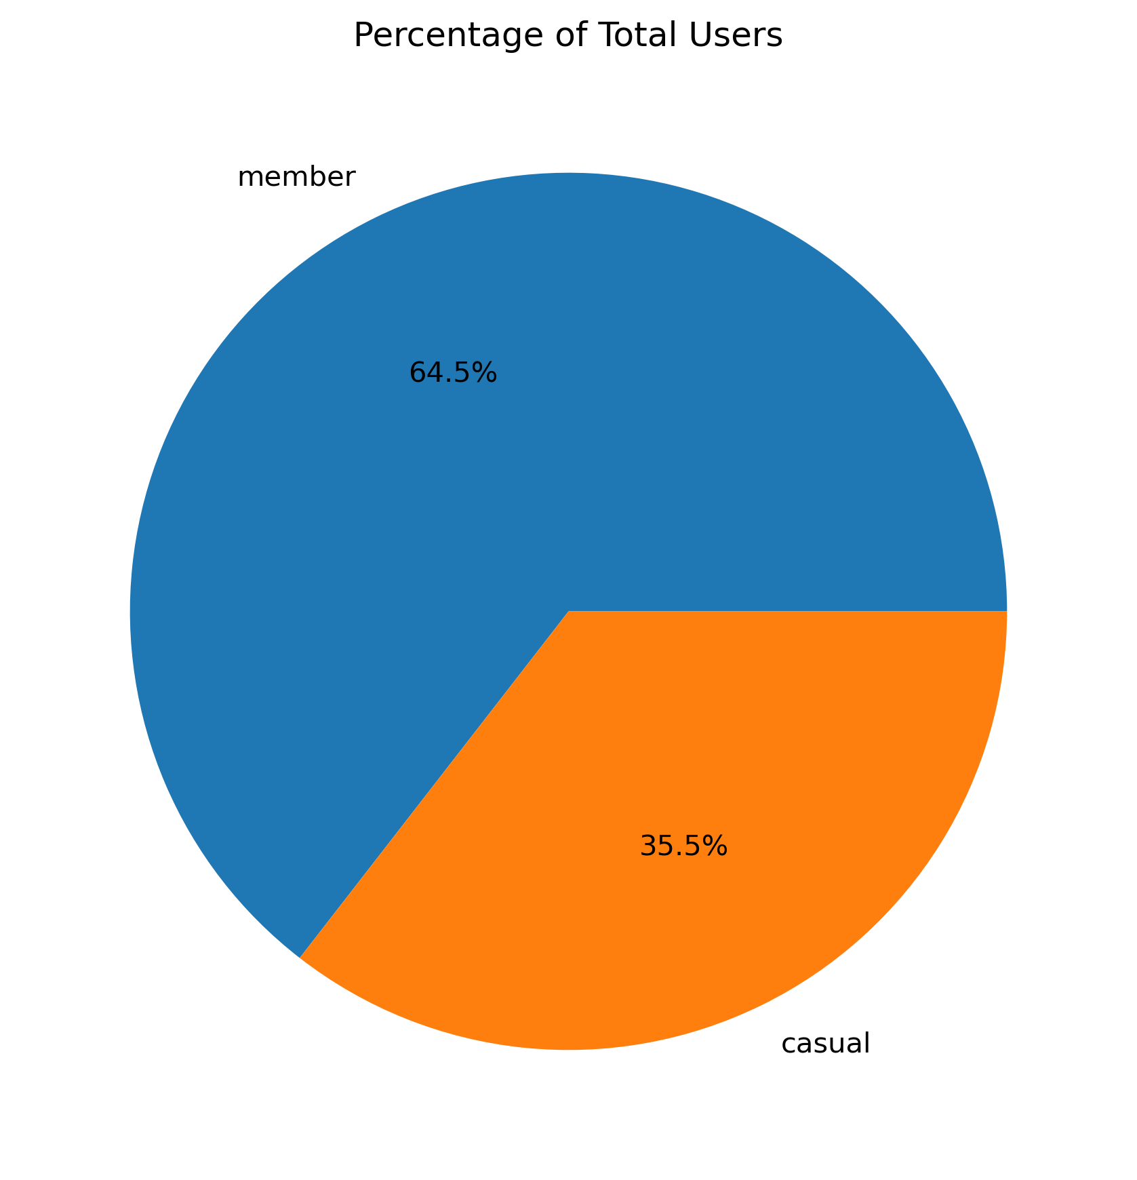
Analyze
Most of the riders are member users.

Slide 10
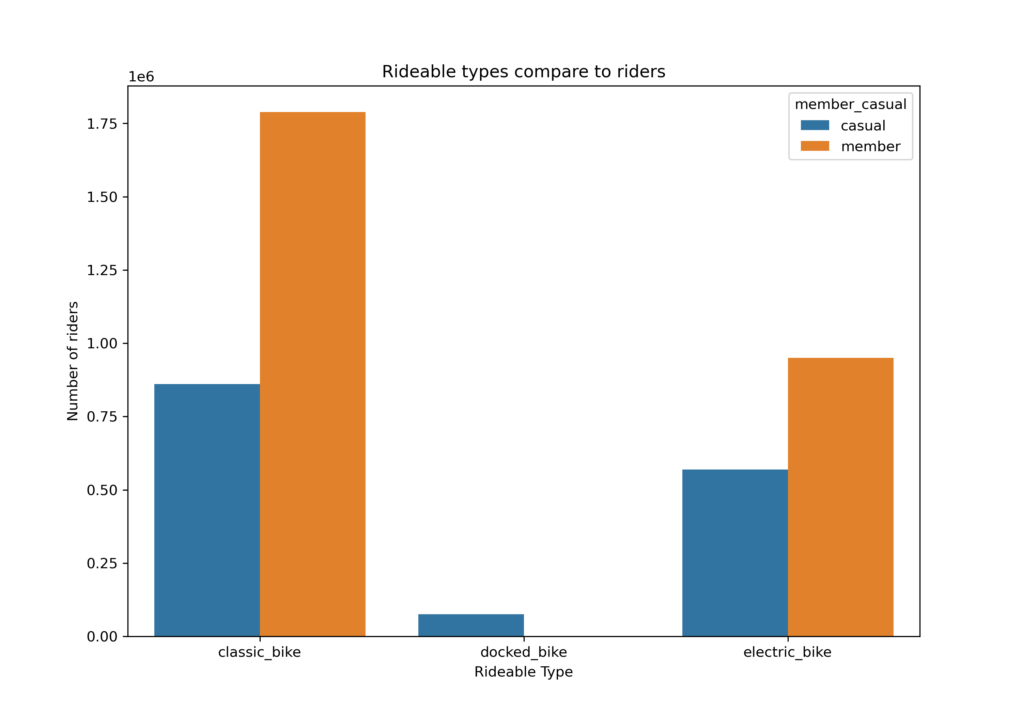
Analyze
Classic bikes are the most popular kind.
Only casual users use docked bikes, membership users prefer classic bikes, While the number of e-bikes used by members is almost double the number used by casual visitors.

Slide 11
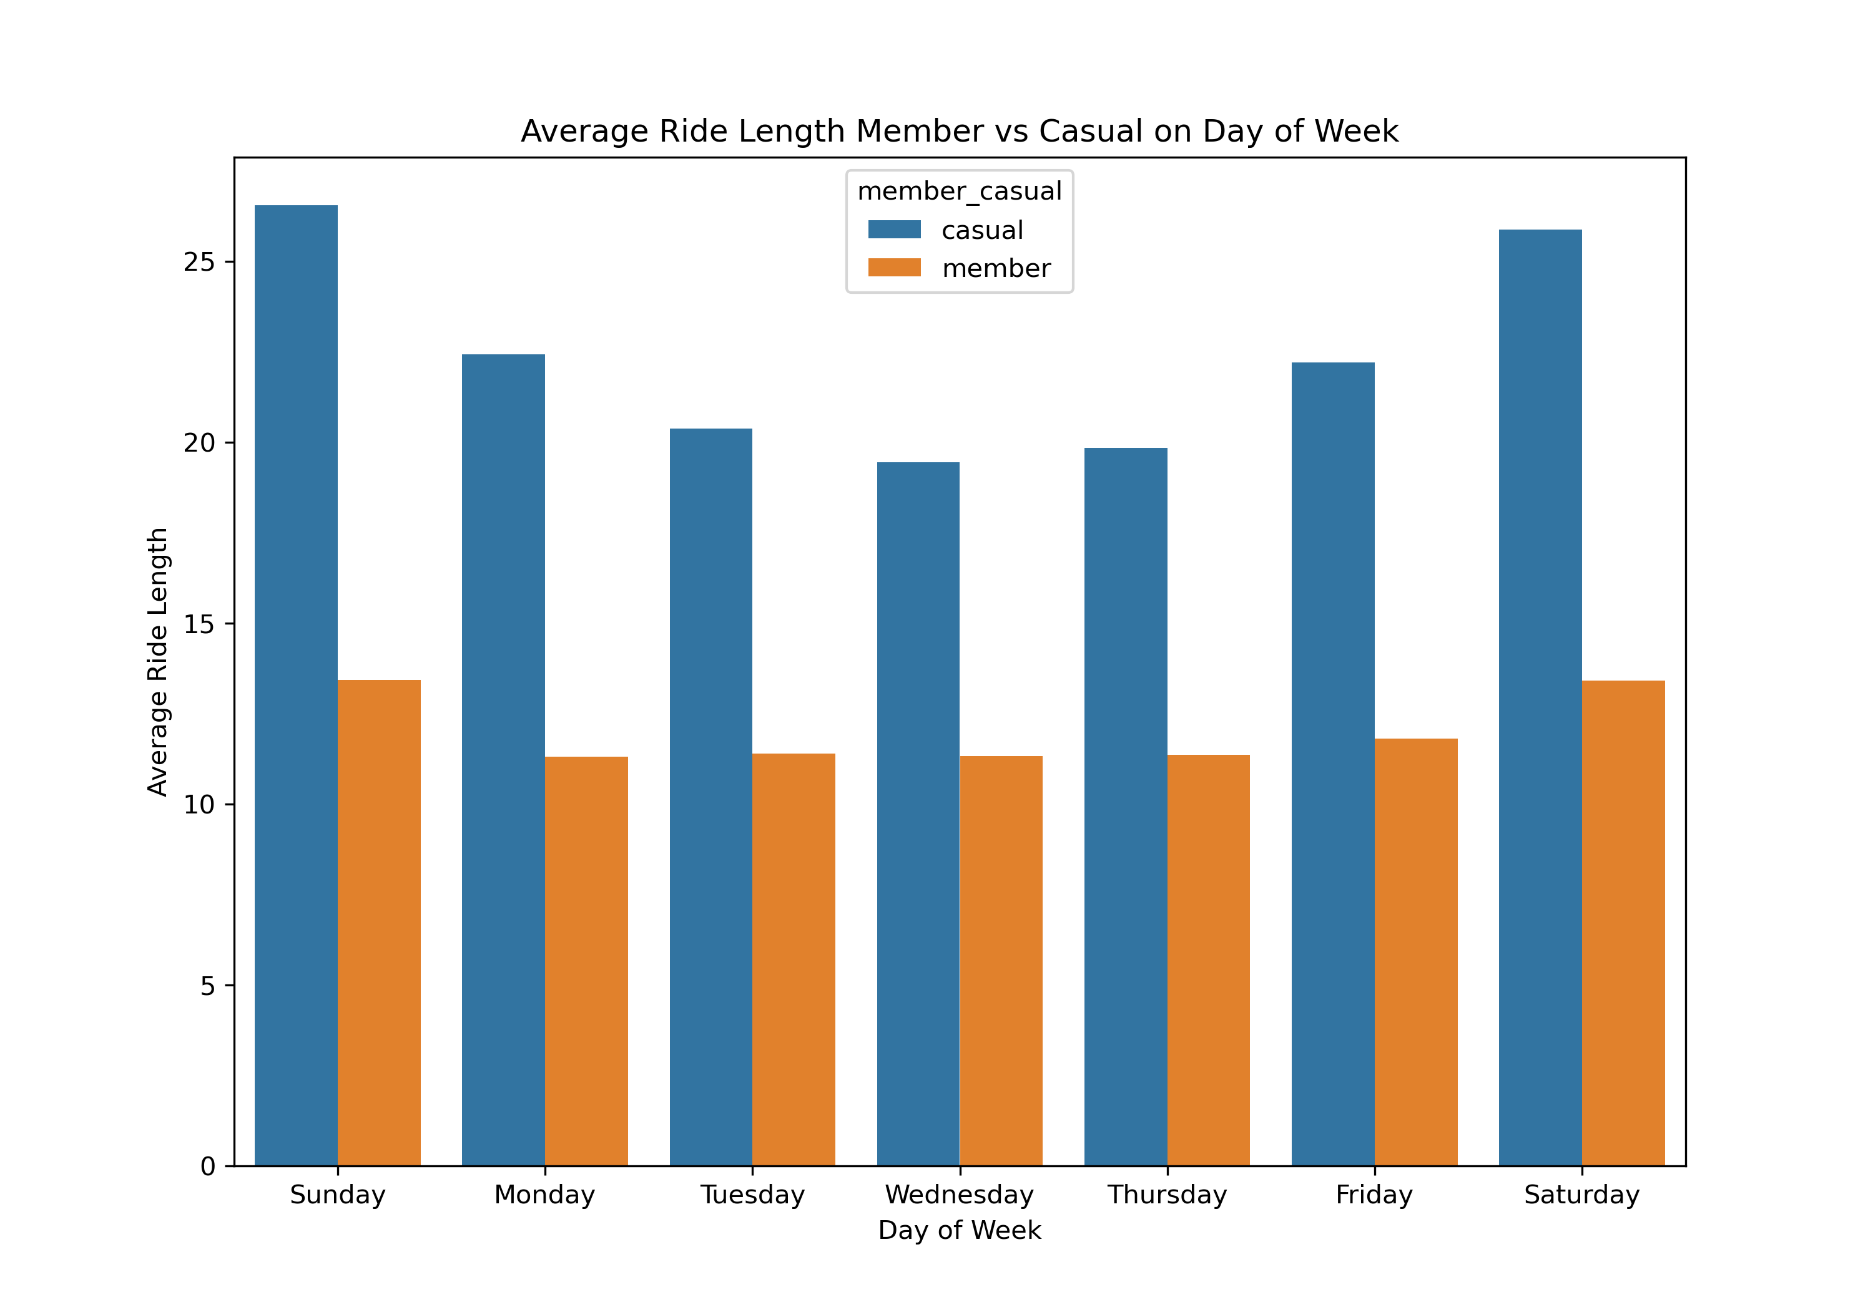
Analyze
Ride Duration: On weekends, casual riders have longer ride durations compared to weekdays, suggesting they use bikes for leisure activities. Conversely, members have relatively consistent ride lengths throughout the week, likely indicating usage for commuting.

Slide 12
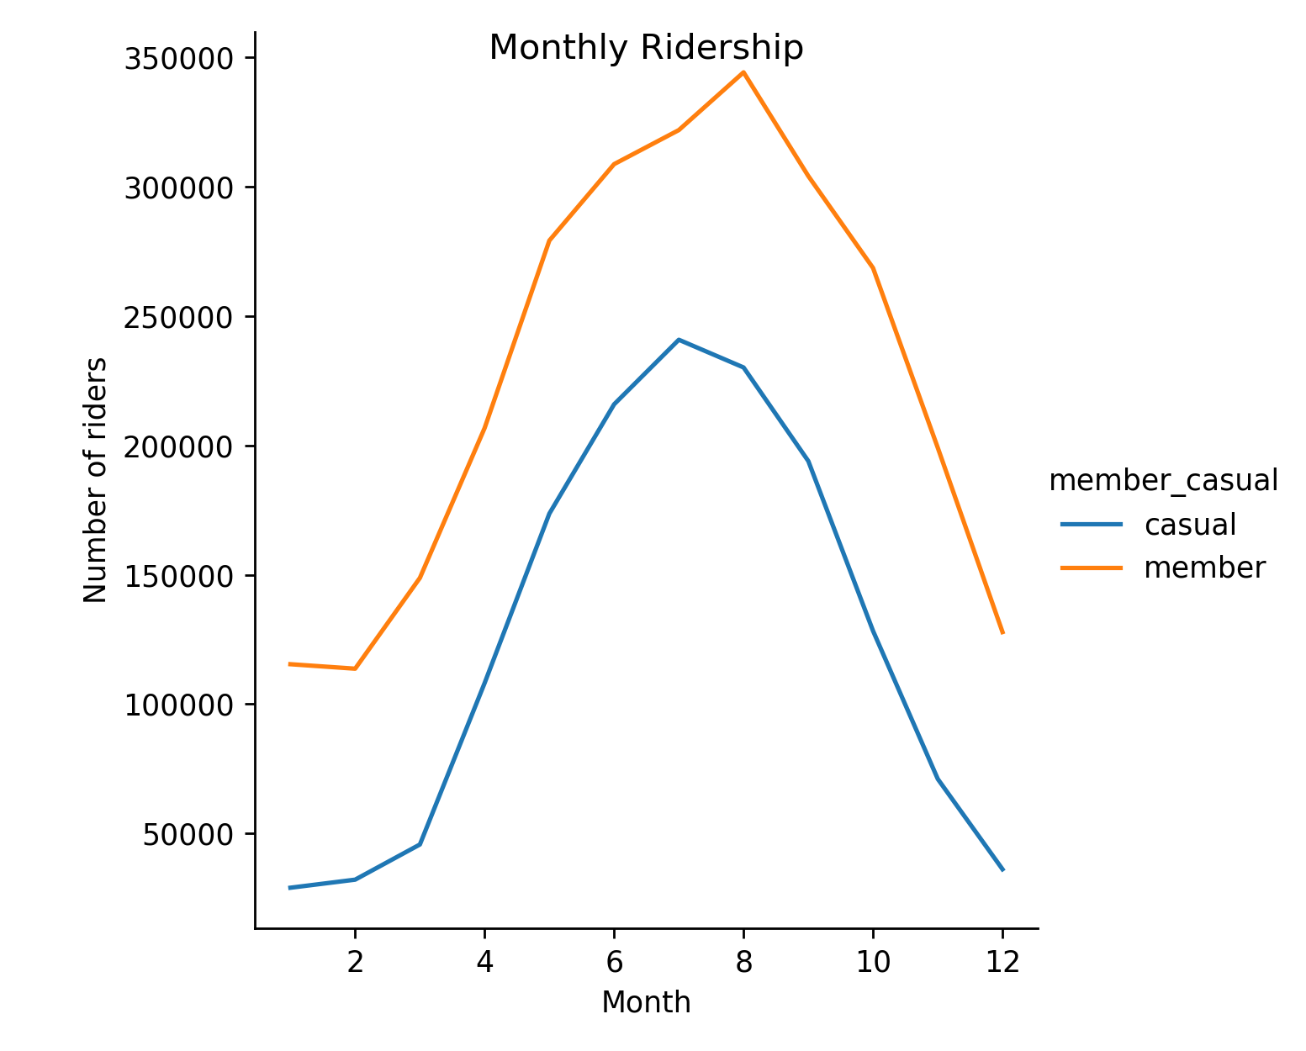
Analyze
Distinct seasonal trends in ridership for both casual and member riders. There is a noticeable increase in the number of rides during the summer months (July to September).
Member Ridership: Members consistently surpass casual riders in terms of the number of rides.
Annual Comparison: In 2023, the average ride length for casual riders was less than half that of members.

Slide 13
Share
Usage Differences:
1. Trip Frequency and Duration:
- Casual Riders: Fewer but longer rides, especially on weekends, indicating leisure use.
- Annual Members: More frequent, shorter rides, indicating commuting or errands, with longer rides on weekends.
2. Bike Type Preference:
- Casual Riders: Prefer classic bikes, use docked bikes for short trips.
- Annual Members: Prefer both classic and electric bikes, indicating a mix of commuting and leisure use.
3. Seasonality: Both groups ride most frequently during summer months.

Slide 14
Act
Recommendations
1. For Casual Riders:
- Promote the convenience and affordability of classic bikes for leisure.
- Offer weekend promotions or discounts.
- Target docked bike usage in popular sightseeing or recreational areas.
2. For Converting Casual Riders to Annual Members:
- Highlight cost savings of annual membership over frequent casual rides.
- Showcase the versatility of classic and electric bikes for various uses.
- Focus marketing efforts during the peak summer months.

Slide 15
Understanding Usage Patterns
- Trip duration
- Seasonal trends
- Bike preferences
- Weekly trends
Targeted Strategies
- Promotions and discounts
- Highlighting cost savings
- Seasonal marketing campaigns
Increased Annual Memberships
- Higher profitability
- Enhanced customer engagement
- Sustainable growth for the company

Slide 16
Data Source
[Amazon](https://divvy-tripdata.s3.amazonaws.com/index.html)

