Slide 1
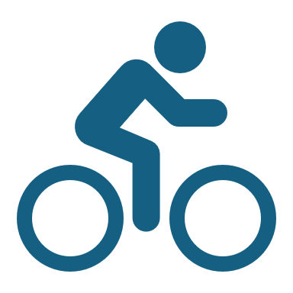
How can a wellness technology company play it smart

Slide 2
How can a wellness technology company play it smart
Introduction:
follow the steps of the data analysis process: ask, prepare, process, analyze, share, and act.
Scenario:
Data analyst working at leading manufacturer of health-focused products for women, tasked with analyzing smart device data to unearth growth opportunities.
Company's co-founder and Chief Creative Officer, leveraging smart device fitness data can drive this growth.
Examining consumer usage patterns and deriving insights to shape the company's marketing strategy.

Slide 3
Characters and teams
Characters:
- Ur : Co-founder and Chief Creative Officer of Bx.
- Mur: Co-founder and mathematician, a key member of the Bx executive team.
- Bx marketing analytics team: A group of data analysts responsible for collecting, analyzing, and reporting data to guide Bx’s marketing strategy.
Products:
- Bx app: Provides users with health data on activity, sleep, stress, menstrual cycle, and mindfulness habits. It connects to Bx's smart wellness products.
- Leaf: Bx’s classic wellness tracker worn as a bracelet, necklace, or clip, tracks activity, sleep, and stress.
- Time: A wellness watch combining a classic timepiece with smart technology to track activity, sleep, and stress. It connects to the Bx app.
- Spring: A water bottle that tracks daily water intake using smart technology, connects to the Bx app to monitor hydration levels.
- Bx membership: A subscription-based program providing users with personalized guidance on nutrition, activity, sleep, health and beauty, and mindfulness, tailored to their lifestyle and goals.

Slide 4
About Company
Bx, founded by Ur and Mur, is a prominent high-tech company specializing in health-focused smart products. Leveraging Ur artistic background, Bx crafts beautifully designed technology aimed at informing and inspiring women worldwide. Through data collection on activity, sleep, stress, and reproductive health, Bx empowers women with insights into their health and habits. Since its establishment in 2XXX, Bx has experienced rapid growth, establishing itself as a tech-driven wellness leader for women.
By 2XXX, Bx expanded globally, launching various products and making them available through numerous online retailers and its own e-commerce platform. The company employs a diverse marketing strategy, investing in traditional media like radio, billboards, print, and television, while focusing extensively on digital marketing channels. Bx maintains an active presence on platforms like Google Search, Facebook, Instagram, and Twitter, complemented by video ads on YouTube and display ads on the Network.

Slide 5
Produce a report with the deliverables
1. A clear statement of the business task
2. A description of all data sources used
3. Documentation of any cleaning or manipulation of data
4. A summary of my analysis
5. Supporting visualizations and key findings
6. My top three recommendations based on analysis

Slide 6
ASK
Questions:
Identify the business task
Answer:
1. What are some trends in smart device usage?
2. How could these trends apply to Bellabeat customers?
3. How could these trends help influence Bellabeat marketing strategy?

Slide 7
Prepare
Questions:
A description of all data sources used
Answer:
The primary data source utilized for analysis is the FitBit Fitness Tracker Data, which is available under the CC0: Public Domain license and made accessible through Mobius. This dataset encompasses personal fitness tracker information from thirty Fitbit users who provided consent for the submission of their data.
Fit into the guideline of ROCCC

Slide 8
Process
Questions:
Documentation of any cleaning or manipulation of data
ROCCC analysis
Reliability: LOW — dataset was collected from 30 individuals whose gender is unknown.
Originality: LOW — third-party data collected using Amazon Mechanical Turk.
Comprehensive: MEDIUM — dataset contains multiple fields on daily activity intensity, calories used, daily steps taken, daily sleep time, and weight record.
Current: MEDIUM — data is 5 years old but the habit of how people live does not change over a few years
Cited: HIGH — data collector and the source is well documented

Slide 9
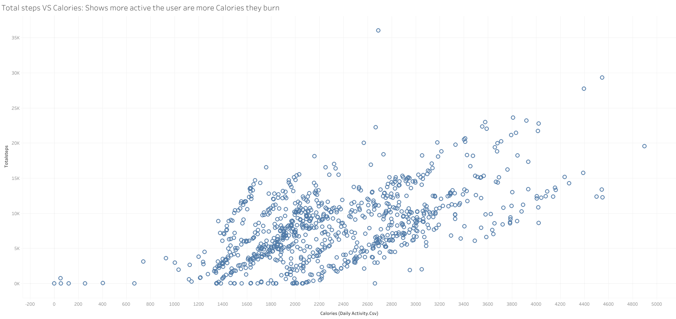
Analyze
A summary of my analysis
Correlation between the number of steps and the calories burned by the users. We can see on the graph below a positive correlation: the more active the user is, the more significant the number of burned calories is.

Slide 10
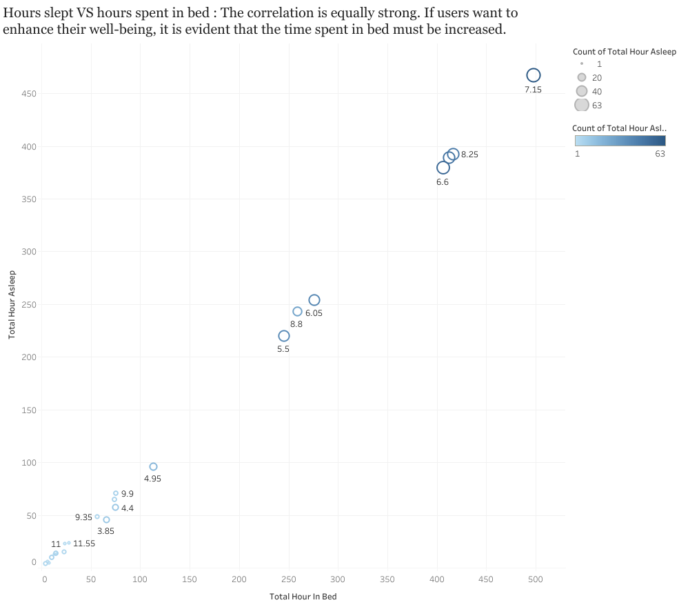
Analyze
A summary of my analysis
Correlation between the number of hours slept and the number of hours spent in bed. The data points are very close, and the correlation is equally strong. If users want to enhance their well-being, it is evident that the time spent in bed must be increased.

Slide 11
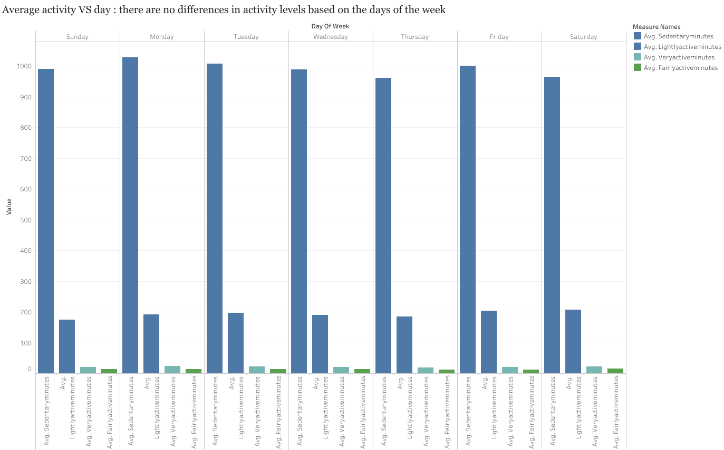
Analyze
A summary of my analysis
While the average sedentary activity clearly dominates, it appears that there are no differences in activity levels based on the days of the week, regardless of the type of activity.

Slide 12
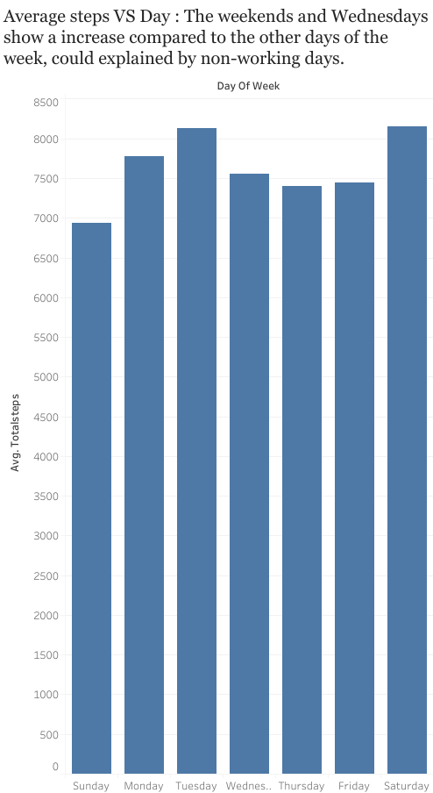
Analyze
A summary of my analysis
Average number of steps per week among users. The graph below seems to confirm the initial impression. However, the weekends and Wednesdays show a slight increase compared to the other days of the week, which could be explained by non-working days.

Slide 13
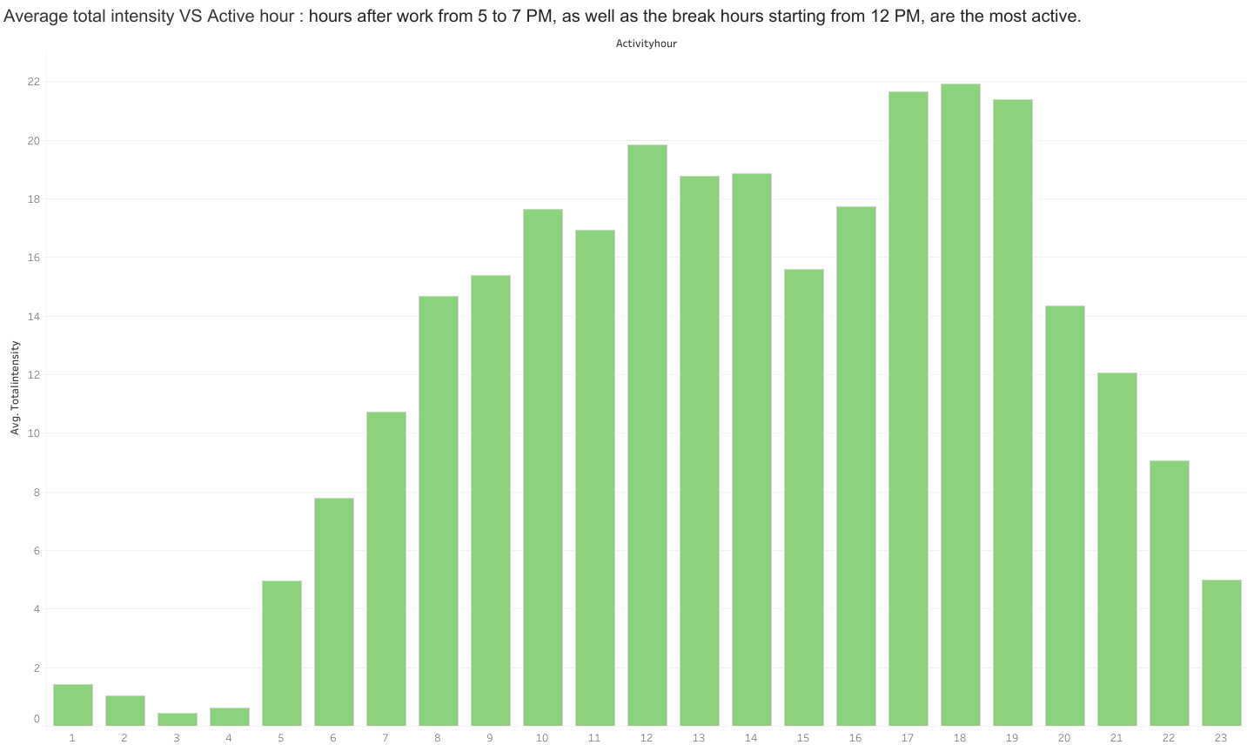
Act
A summary of my analysis
Most active hours are after work from 5 to 7 PM, as well as the break hours starting from 12 PM.

Slide 14
Share
Questions:
1. What are some trends in smart device usage?
2. How could these trends apply to Bellabeat customers?
3. How could these trends help influence Bellabeat marketing strategy?
Answer:
1. Trends in Smart Device Usage:
- Identify and explore correlations between device usage and other variables like age, gender, location, and lifestyle.
2. Application to Bellabeat Customers:
- Consider how the usage trends may influence customer preferences, needs, and expectations regarding health-focused products and services.
3. Influence on Marketing Strategy:
- Implement data-driven decision-making processes to continuously monitor and optimize marketing initiatives based on evolving smart device usage trends.

Slide 15
Act
My top recommendations based on analysis
Set reminders during peak activity hours to engage users in physical exercise if calorie goals are unmet.
Record average wake-up times to recommend optimal bedtimes for better rest.
Create varied activity programs to suit different schedules and preferences.
Gamify usage to incentivize goal achievement and promote engagement.
Use data-driven insights to continuously optimize marketing initiatives.

Slide 16
Thanks for listening
If there’s any question, please let me know
If I can’t answer in short period of time, please leave a hint so I can understand how to connect individually.

