Slide 1

Enhancing Cybersecurity Through Analyst Expertise with Incribo's Synthetic Cyber Dataset

Slide 2
Scenario
About the Company
Incribo offers cutting-edge synthetic data generation tailored for cybersecurity needs.
Problem Statement
Addressing the need for precise and actionable insights to enhance cybersecurity posture.

Slide 3
Produce a report with the deliverables
1. A clear statement of the business task
2. A description of all data sources used
3. Documentation of any cleaning or manipulation of data
4. A summary of my analysis
5. Supporting visualizations and key findings
6. My top three recommendations based on analysis

Slide 4
ASK
Task
Explicitly state the importance of Incribo's synthetic cyber dataset in identifying and mitigating cybersecurity threats, demonstrating the analyst's expertise in data interpretation and strategy formulation.

Slide 5
Prepare
Data Sources
Data requires rigorous cleaning and adheres to ROCCC (Relevant, Original, Comprehensive, Consistent, and Correct) standards, ensuring high-quality input for analysis.
Data Cleaning
Utilized Python in Jupyter Notebook for efficient data cleaning and manipulation. Documented each step meticulously to ensure reproducibility and transparency, showcasing the analyst’s technical proficiency.

Slide 6
Process
Detection and Response Planning:
Analyze traffic volume trends to identify potential threats
Targeted Mitigation:
Focus on potential attackers and prioritize threat response efforts.
Trend Analysis:
Predict potential escalation points and anomalous authentication patterns to enhance patching and mitigation strategies.

Slide 7
Analyze

Slide 8
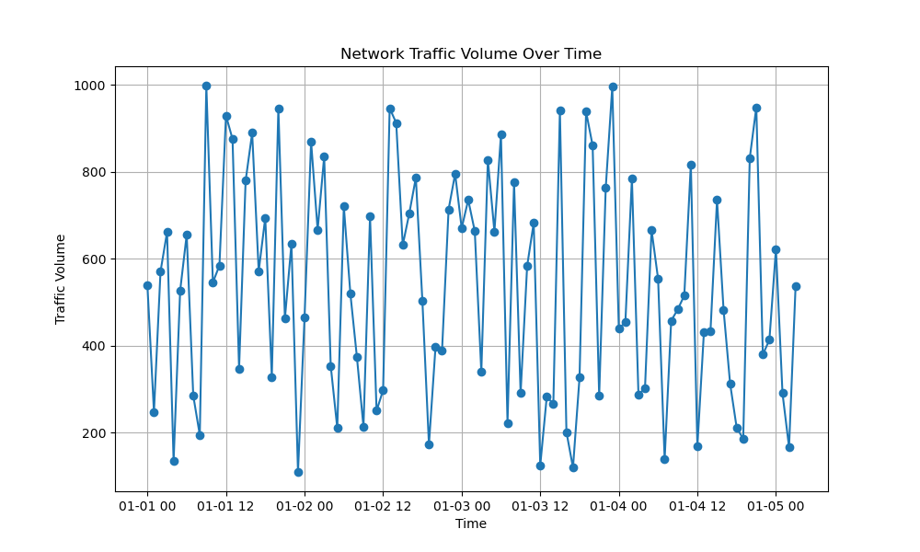
Detection and response planning based on traffic volume trend

Slide 9
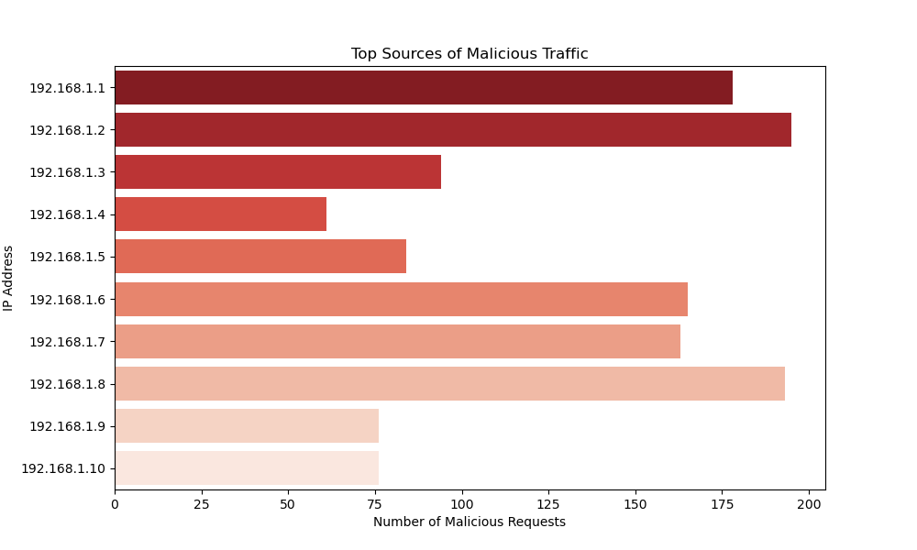
Potential attackers and facilitates targeted mitigation strategies.

Slide 10
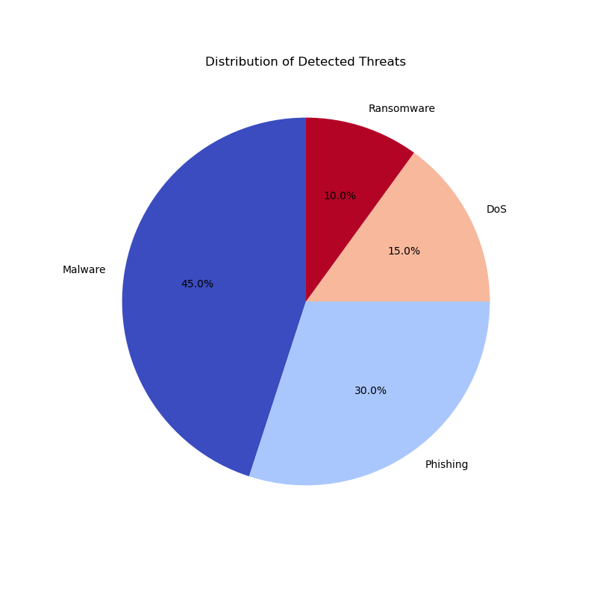
Prioritizes threat response efforts

Slide 11
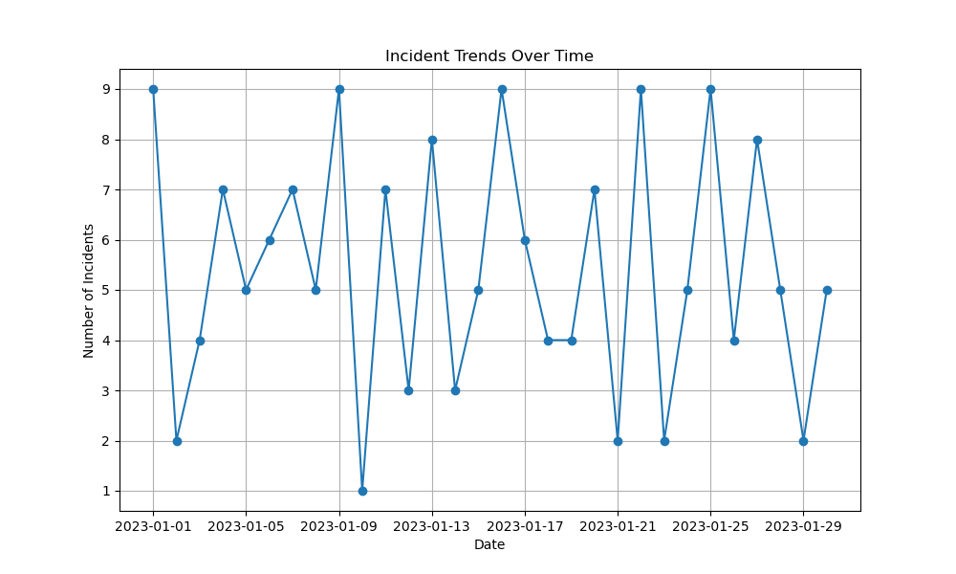
Trend analysis and prediction of potential escalation points

Slide 12
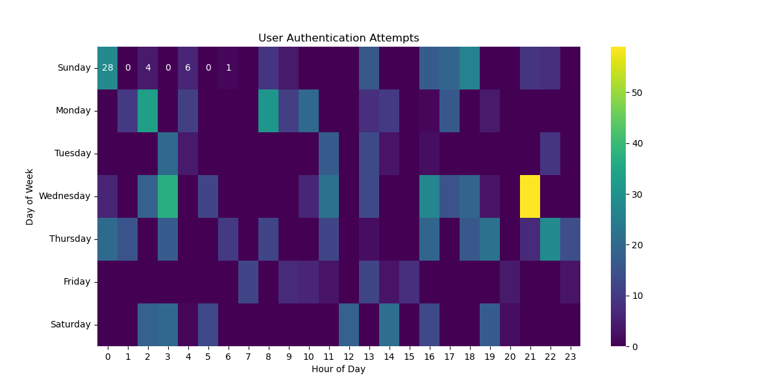
Anomalous authentication patterns

Slide 13
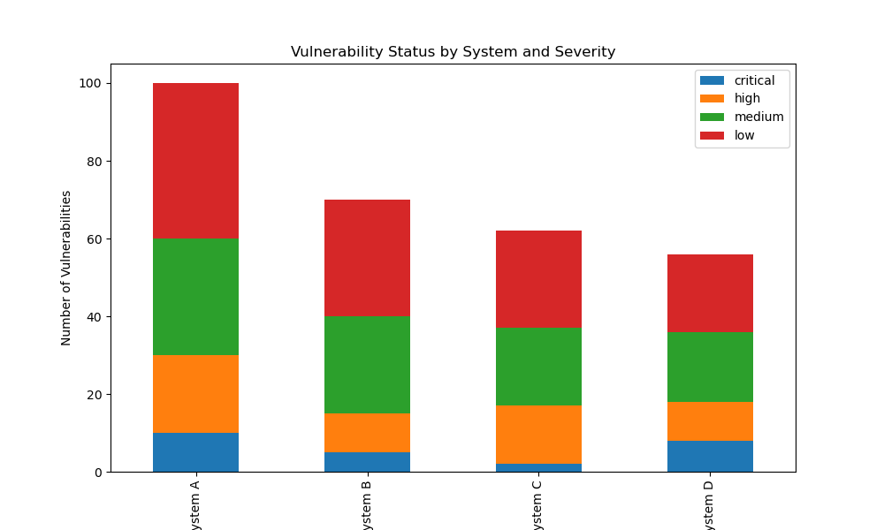
Prioritization of patching and mitigation efforts

Slide 14
Share
DDoS Attack Detection:
Recognize patterns of high traffic volume and specific packet characteristics indicative of DDoS attacks.
Response: Activate DDoS mitigation tools, alert IT security teams.
Credential Stuffing:
Identify patterns of multiple login attempts from different IP addresses within short time frames.
Response: Implement multi-factor authentication (MFA), lock accounts after several failed attempts.
Insider Threats:
Detect unusual access patterns to sensitive data by internal employees.
Response: Conduct thorough investigations, enforce least privilege access controls.

Slide 15
Act
Recommendations
- Regular Monitoring:
Continuously monitor and update visualizations to capture real-time changes in network behavior and threat landscape.
- Collaborative Analysis:
Foster collaboration between analysts and stakeholders to interpret visual insights and implement effective security measures.
- Adaptive Strategies:
Develop adaptive strategies based on evolving threat trends and insights derived from visualizations.

Slide 16
Understanding Patterns
- Identifying potential threats
Targeted Strategies
- Develop targeted strategies
Outcome Improvement
- enhances incident response

Slide 17
Data Source
[Incribo](https://github.com/incribo-inc)

