Slide 1

Enhance network security by analyzing Inribo synthetic network data sets

Slide 2
Scenario
About the Company
Incribo offers cutting-edge synthetic data generation tailored for cybersecurity needs.
Problem Statement
Addressing the need for precise and actionable insights to enhance cybersecurity posture.

Slide 3
Produce a report with the deliverables
1. A clear statement of the business task
2. A description of all data sources used
3. Documentation of any cleaning or manipulation of data
4. A summary of my analysis
5. Supporting visualizations and key findings
6. My top three recommendations based on analysis

Slide 4
ASK
Task
Explicitly state the importance of Incribo's synthetic cyber dataset in identifying and mitigating cybersecurity threats, demonstrating the analyst's expertise in data interpretation and strategy formulation.

Slide 5
Prepare
Data Sources
Data requires rigorous cleaning and adheres to ROCCC (Relevant, Original, Comprehensive, Consistent, and Correct) standards, ensuring high-quality input for analysis.
Data Cleaning
Utilized Python in Jupyter Notebook for efficient data cleaning and manipulation. Documented each step meticulously to ensure reproducibility and transparency, showcasing the analyst’s technical proficiency.

Slide 6
Process
Detection and Response Planning:
Analyze traffic volume trends to identify potential threats
Targeted Mitigation:
Focus on potential attackers and prioritize threat response efforts.
Trend Analysis:
Predict potential escalation points and anomalous authentication patterns to enhance patching and mitigation strategies.

Slide 7
Analyze

Slide 8
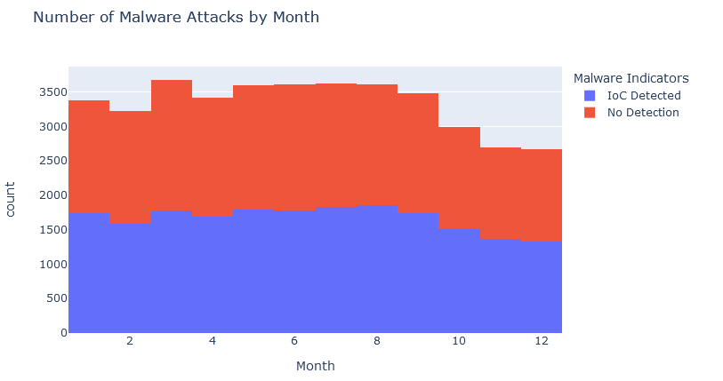
evaluate security control effectiveness

Slide 9
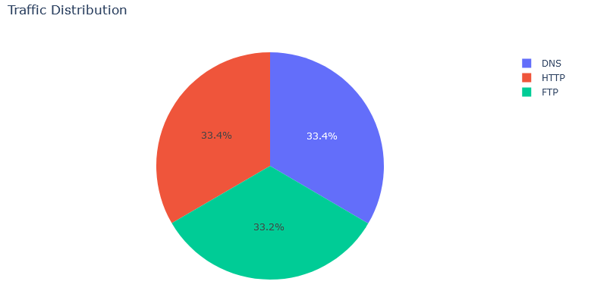
monitoring changes in the future

Slide 10
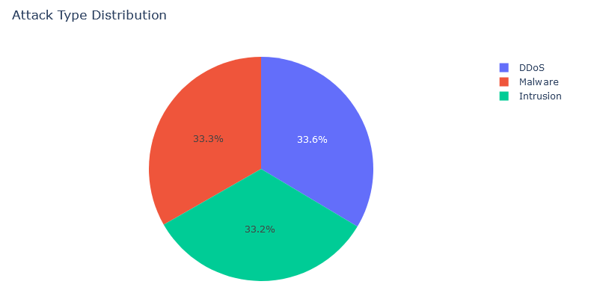
Guides incident response, mitigation

Slide 11
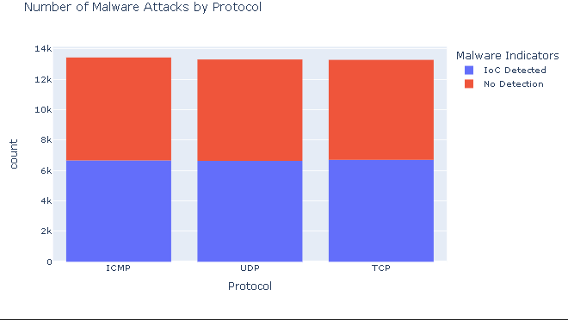
incident response and mitigation planning

Slide 12
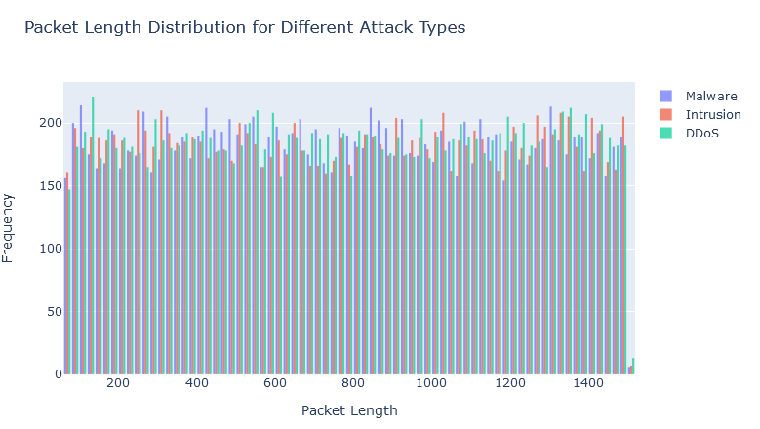
anomaly detection

Slide 13
Share
DDoS Attack Detection:
Activate DDoS mitigation tools, alert IT security teams.
Credential Stuffing:
Implement multi-factor authentication (MFA), lock accounts after several failed attempts.
Insider Threats:
Conduct thorough investigations, enforce least privilege access controls.

Slide 14
Act
Recommendations
- Regular Monitoring:
Continuously monitor and update visualizations to capture real-time changes in network behavior and threat landscape.
- Collaborative Analysis:
Foster collaboration between analysts and stakeholders to interpret visual insights and implement effective security measures.
- Adaptive Strategies:
Develop adaptive strategies based on evolving threat trends and insights derived from visualizations.

Slide 15
Threat Detection
- Identifying potential threats
Targeted Strategies
- Develop targeted strategies
enhances incident response
- enhances incident response

Slide 16
Data Source
[Incribo](https://github.com/incribo-inc)

