Slide 1

Enhance network security by analyzing Inribo synthetic network data sets
30 / 何祐昇

Slide 2
Scenario
About the Company
Incribo offers cutting-edge synthetic data generation tailored for cybersecurity needs.
Problem Statement
Addressing the need for precise and actionable insights to enhance cybersecurity posture.

Slide 3
Self introduction
Data analyst | Security Data Analyst
Capable in data analytics. Familiar with SQL, Python, and Tableau for transforming data into simple graphs. Developing skills in cybersecurity analysis to ensure data integrity and protection against basic threats for informed decision-making.
Skills
Python
SQL
Excel
Power BI
Google Analytics
Splunk
Splunk Phantom
Wireshark
Tenable Nessus
Autopsy

Slide 4
Self introduction
Education
Cisco Certified Support Technician (CCST) Cybersecurity
Pearson VUE Information Technology Specialist
Google Advanced Data Analytics Professional Certificate
Google Cybersecurity Professional Certificate
IBM Data Analytics with Excel and R Professional Certificate
Google Analytics Certi􀀁cation

Slide 5
Produce a report with the deliverables
1. A clear statement of the business task
2. A description of all data sources used
3. Documentation of any cleaning or manipulation of data
4. A summary of my analysis
5. Supporting visualizations and key findings
6. My top three recommendations based on analysis

Slide 6
ASK
Task
Explicitly state the importance of Incribo's synthetic cyber dataset in identifying and mitigating cybersecurity threats, demonstrating the analyst's expertise in data interpretation and strategy formulation.

Slide 7
Prepare
Data Sources
Data requires rigorous cleaning and adheres to ROCCC (Relevant, Original, Comprehensive, Consistent, and Correct) standards, ensuring high-quality input for analysis.
Data Cleaning
Utilized Python in Jupyter Notebook for efficient data cleaning and manipulation. Documented each step meticulously to ensure reproducibility and transparency, showcasing the analyst’s technical proficiency.

Slide 8
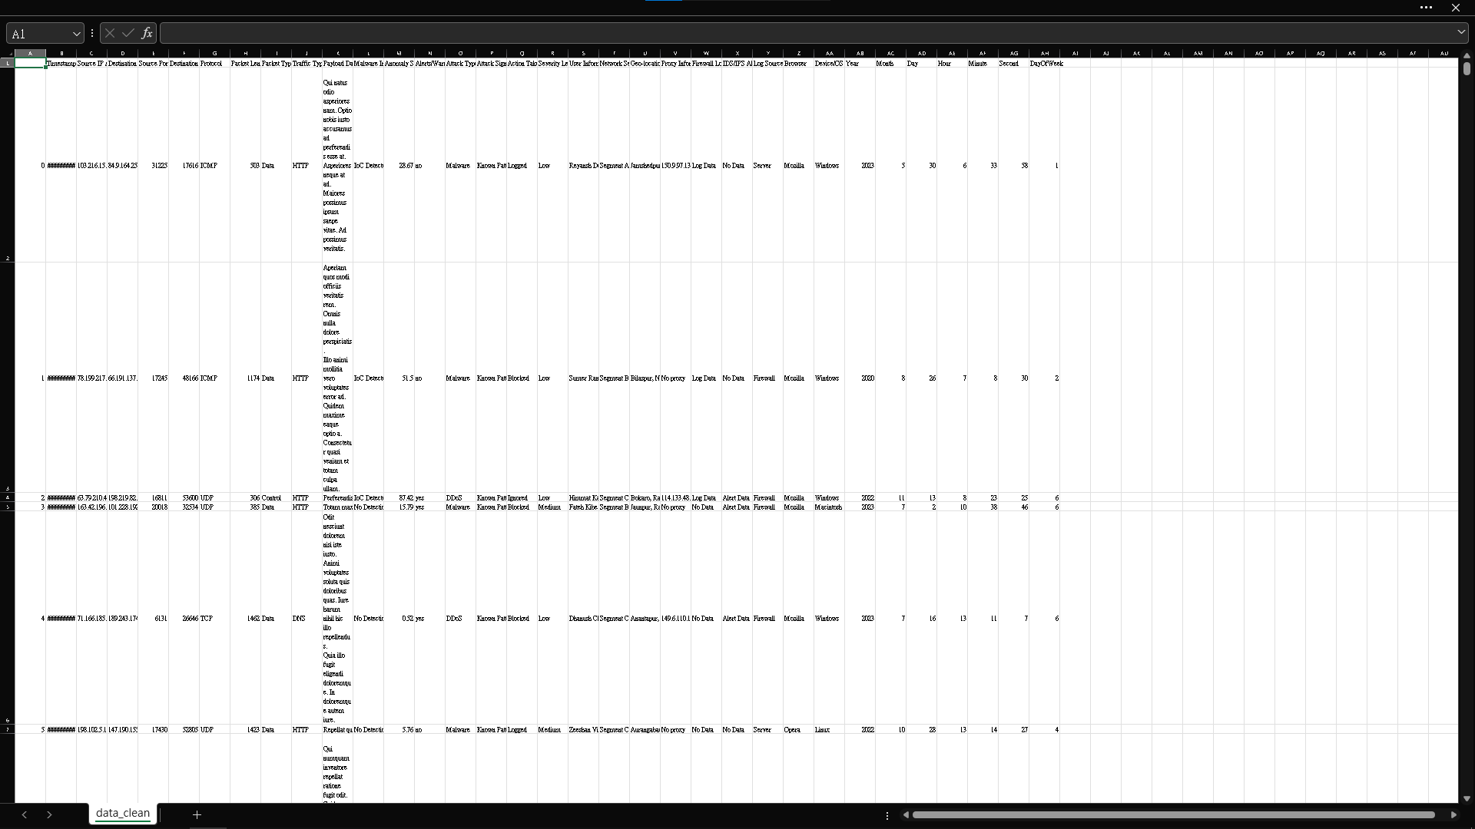
準備
數據源： 數據需要嚴格清理，並遵守 ROCCC（相關、原始、全面、一致和正確）標準，確保高品質的分析輸入。
數據清理： 在 Jupyter Notebook 中使用 Python 進行高效的數據清理和操作。一絲不苟地記錄每個步驟，以確保可重複性和透明度，展示分析師的技術熟練程度。

Slide 9
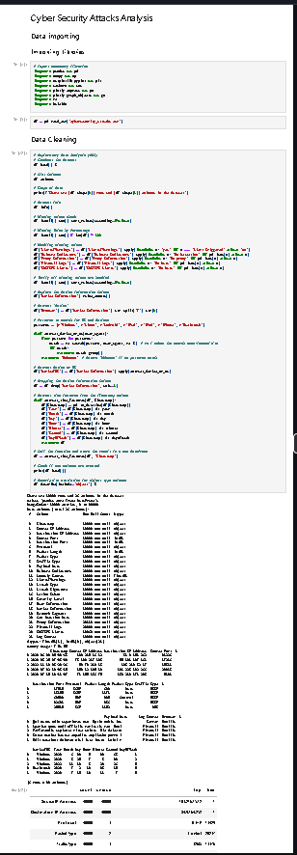
Process
Detection and Response Planning:
Analyze traffic volume trends to identify potential threats
Targeted Mitigation:
Focus on potential attackers and prioritize threat response efforts.
Trend Analysis:
Predict potential escalation points and anomalous authentication patterns to enhance patching and mitigation strategies.

Slide 10
Analyze

Slide 11
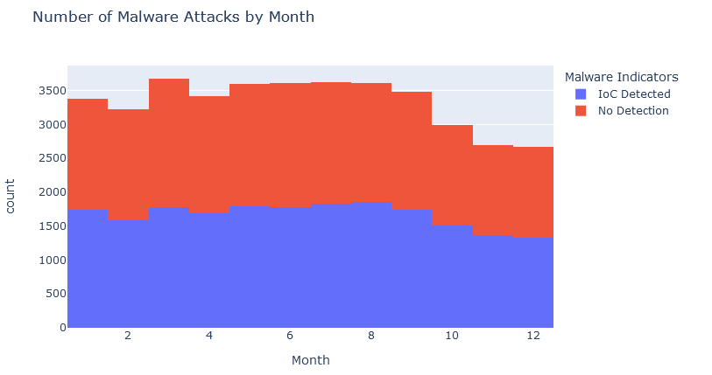
evaluate security control effectiveness

Slide 12
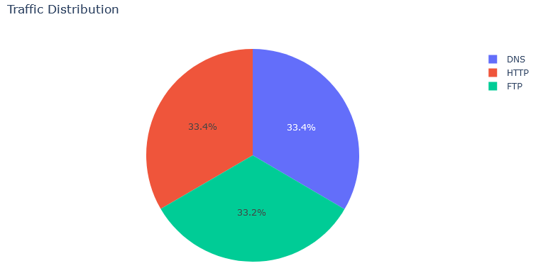
monitoring changes in the future

Slide 13
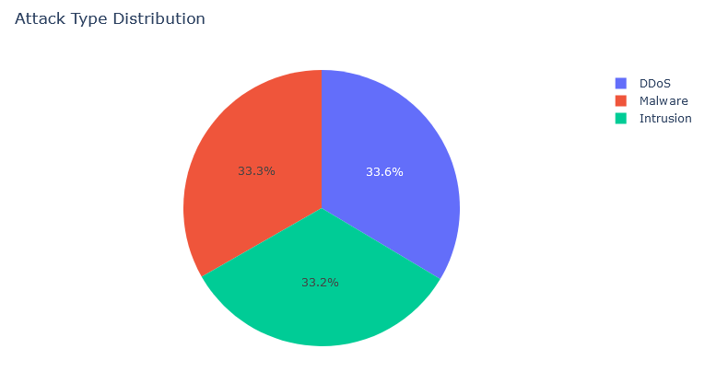
Guides incident response, mitigation

Slide 14
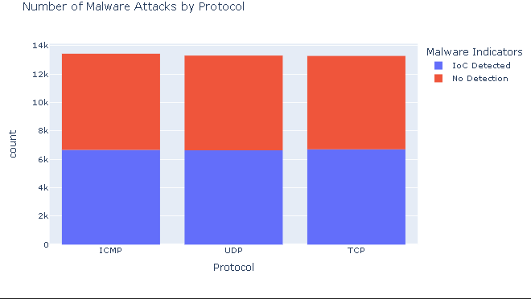
incident response and mitigation planning

Slide 15
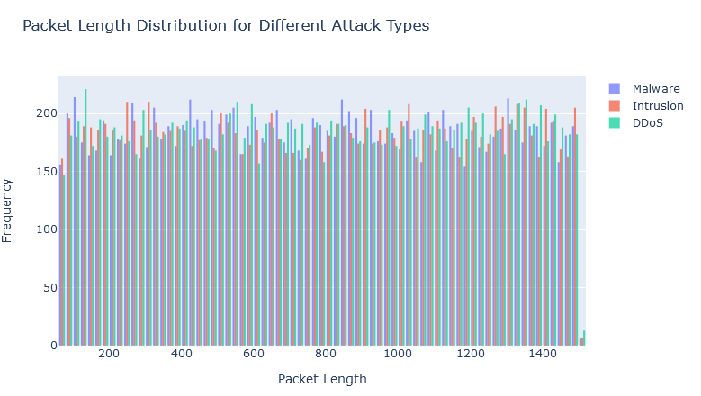
anomaly detection

Slide 16
Share
DDoS Attack
Credential Stuffing
Insider Threats

Slide 17
Act
Recommendations
- Regular Monitoring
- Collaborative Analysis
- Adaptive Strategies

Slide 18
Threat Detection
- Identifying potential threats
Targeted Strategies
- Develop targeted strategies
Improve
- enhances incident response

Slide 19
Thoughts on class
AI, data analysis, and synthetic network data are crucial for modern cybersecurity.
AI-powered threat detection, automated incident response, and proactive vulnerability assessment are essential.
Hands-on experience, real-world case studies, and expert insights enhance learning.

Slide 20
Data Source
[Incribo](https://github.com/incribo-inc)
[ROCCC](https://csrc.nist.gov/glossary/term/grc)

