Slide 1
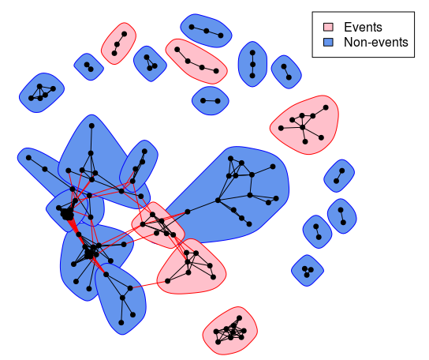
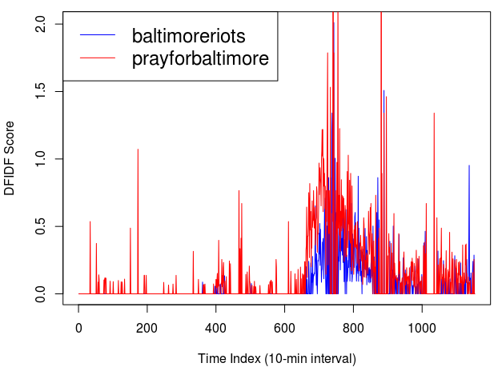
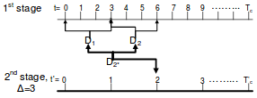
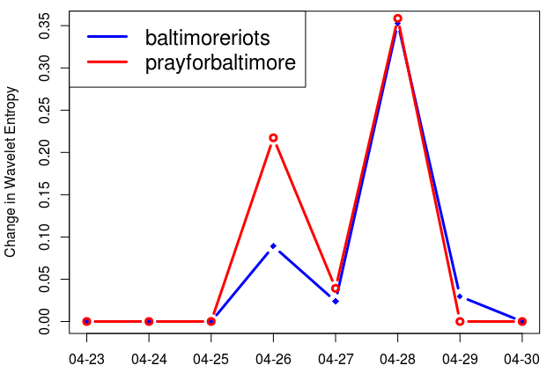
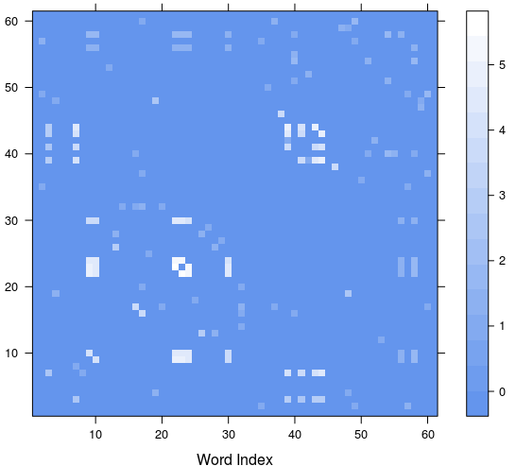
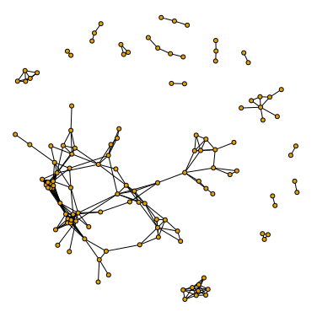
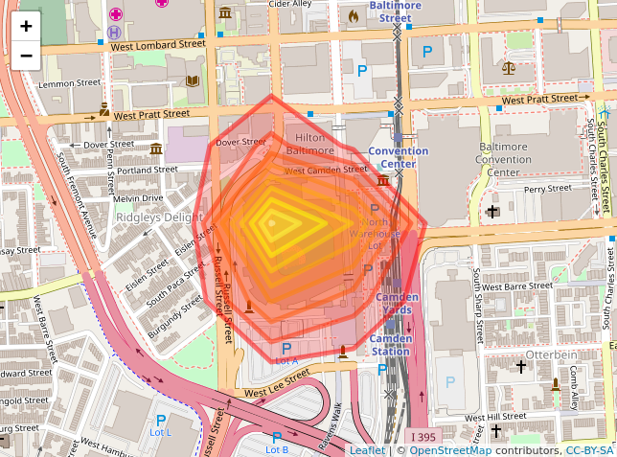
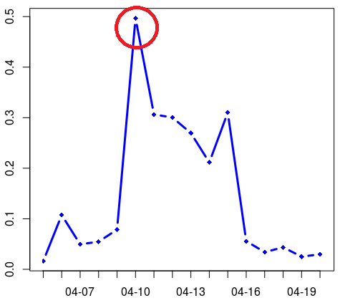
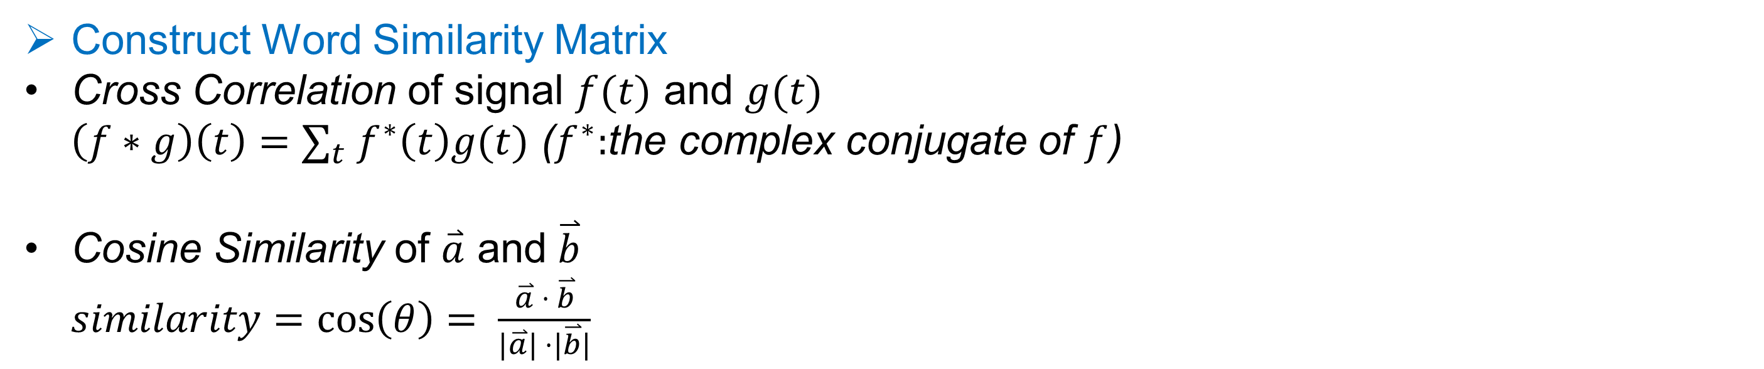
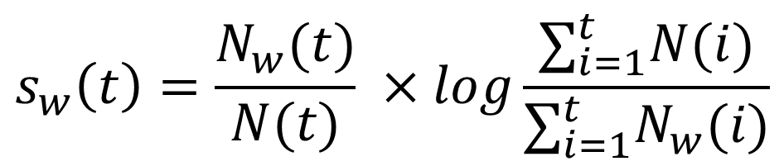


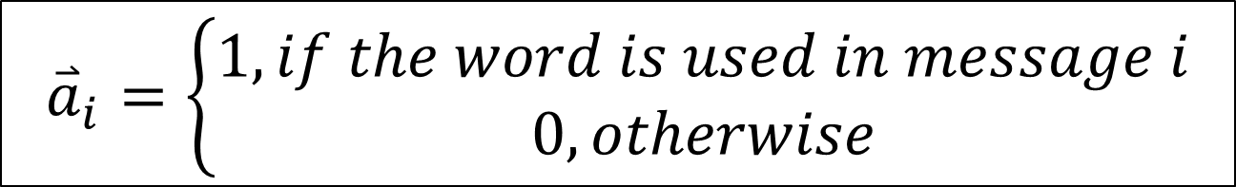

Yuanjing Cai
Text Analytics Co-op Student
Ottawa, ON, K1K 2E1, Canada
Event Detection on Social Network
2018 Summer Student Symposium
INTRODUCTION
Twitter as a Source of Information
Social networks like Twitter and Instagram contain large and diverse amount of information ranging from daily-life stories to the latest local and worldwide news and events. Many real-world examples have shown the effectiveness of the information reported by social networks during natural disasters, outbreak of diseases, and social events.
Challenge
Text streams on social media contain large amount of meaningless daily chatter. The major challenge is to separate mundane information from significant real-word events.
GOAL
Use automated processes to detect events from a generic time and geo-location referenced text stream on social media (e.g. Twitter, Instagram), without any prior knowledge about the dataset.
RELATED WORK
In a number of recent works, researchers use topic modelling (e.g. LDA) combined with time series analysis (e.g. CPD, MMPP, STD, clustering of time series) to detect events in text streams. Each message is assigned a topic, and for each topic we construct a time series by counting the number of messages assigned that topic in a time interval. Then various time series analysis techniques are applied to detect bursty or abnormal patterns.
DATASETS
Summary
e.g.
PREPROCESSING
Remove non-English characters, punctuations, emojis, numbers
Remove all URLs, mentions of users (@username)
Remove stop words, acronyms, and rare words that appear less than 5 times everyday
Convert all words to lowercase
METHOD[1]
Overview
Details
Newman’s Modularity-based Graph Partitioning
Word Signals
Non-trivial Word Signals
Burst Similarity of Word Signals
Filter by Auto Correlation
Cross Correlation
Cross Correlation of Word Signals
Word Co-occurrence Cosine Similarity
Word Similarity Matrix
Events
Non-events
Graph Partitioning
Word Clusters
Wavelet Analysis
DF-IDF Score
Individual Words
Cosine Similarity
Signal Construction
RESULTS
$$Precision= \frac{Number of true events}{Number of detected events}=67\%$$
Stage 1 Signal – Time-dependent DF-IDF score (how important a word is in (t-1, t))
$$s_{w}\left(t\right)=\frac{N_{w}(t)}{N(t)} ×log\frac{∑_{i=1}^{t}N(i)}{∑_{i=1}^{t}N_{w}(i)}$$
Stage 2 Signal – Change in wavelet entropy (how significant the change of the word's DF-IDF score is from t'-1 to t')
Word | Event | Significance
freddiegray, baltimoreriots, justice, police | 2015 Baltimore Protests | 0.0275
orioles, baseball, game, camdenyards | Baseball game | 0.0125
today, mother’s, happy, day | Mother’s Day | 0.0063
marylanddeathfest, suffocation, demilich | 2015 Maryland Death Festival | 0.0031
night, Friday, tgif | - | 0.0030
dmvnetwork, glam, ilovebaltimore | - | 0.0008
$$s_{w}^{′}\left(t\right)=\left\{\begin{aligned}\frac{H_{t∗}−H_{t^{′}−1}}{H_{t^{′}−1}}, if{ H}_{t∗}>H_{t^{′}−1} \\ 0, otherwise\end{aligned}\right.$$
Construct Word Similarity Matrix
Cross Correlation of signal $f(t)$ and $g(t)$
$\left(f∗g\right)\left(t\right)=∑_{t} f^{∗}\left(t\right)g(t)$ ($f^{∗}:$the complex conjugate of $f$)
Cosine Similarity of $\overset{⃑}{a}$ and $\overset{⃑}{b}$
$similarity=\cos\left(θ\right)= \frac{\overset{⃑}{a} ⋅ \overset{⃑}{b}}{|\overset{⃑}{a}| ⋅|\overset{⃑}{b}|}$
The higher burst similarity of word signals, the higher cross correlation.
$${\overset{⃑}{a}}_{i}=\left\{\begin{aligned}1, if the word is used in message i \\ 0, otherwise\end{aligned}\right.$$
Baseball Game Example
Toronto Blue Jays vs. Baltimore Orioles
Time: April 10, 2015
Location: Oriole Park at Camden Yards, Baltimore, MD, USA
Location | Time Span | # of Messages
Baltimore, MD, USA | 2015-04-01 – 2015-05-30 | 358,458
Message Content | Created Time | Longitude | Latitude
#morning #sunrise on the way to #work | 2015-04-01 05:32:34 | -76.62511 | 39.28523
I'm so tired but can't sleep 😳😳😳 | 2015-04-01 00:37:07 | -76.64791 | 39.28288
Weighted Graph Representation
Each word as a vertex
Two vertices are connected by an edge if similarity score > 0
Weight of an edge is the similarity score (element in $M$)
References
[1]Jianshu Weng, Yuxia Yao, Erwin Leonardi, and Bu-Sung Lee. “Event Detection in Twitter”. ICWSM-11
Figure 1. Similarity Matrix M

