Slide 1
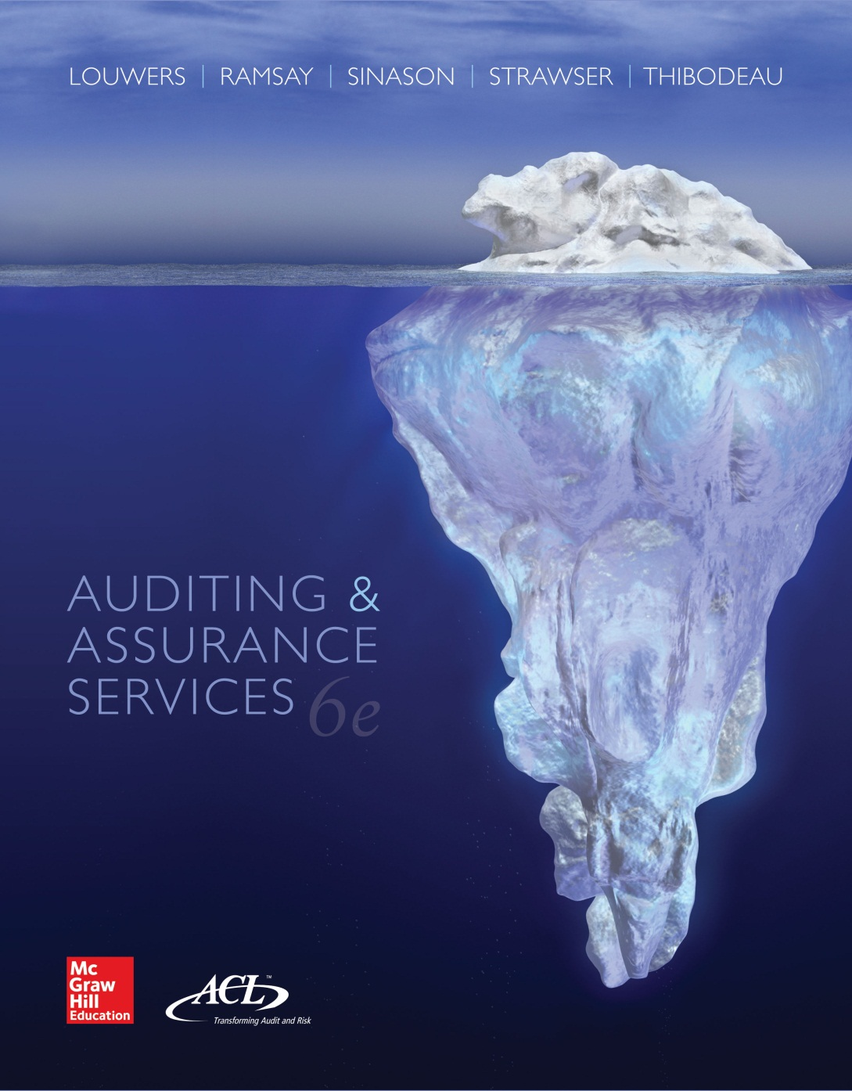
Auditing & Assurance Services, 6e

Slide 2
Chapter 8
Acquisition and Expenditure Cycle
“Show those numbers to the damn auditors and I'll throw you out the $%*@@ window.”----(Buddy Yates, director of WorldCom, Inc. general accounting, to an employee asking for an explanation of a large accounting discrepancy).
8-<number>

Slide 3
Inherent Risks
Unrecorded liabilities
Non-cancelable purchase agreements
Capitalizing expenses
See Exhibit 8.2 for assertion risks
8-<number>

Slide 4
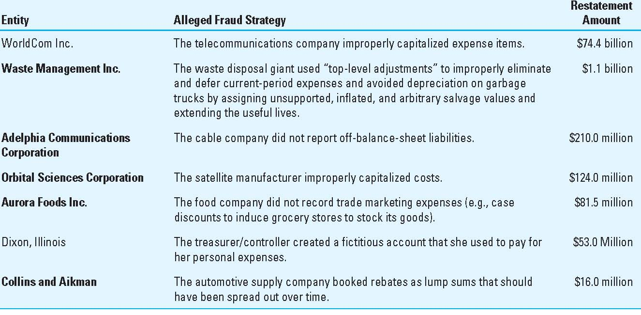
Exhibit 8.1
Cost and Expense Capers
8-<number>

Slide 5
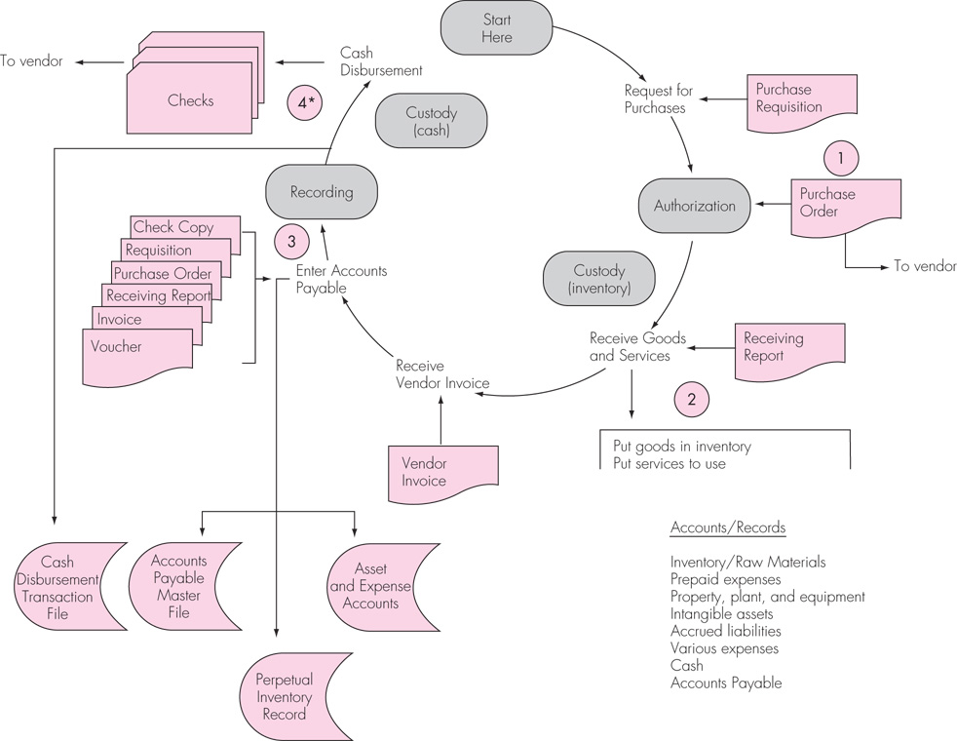
Exhibit 8.3
Acquisition and Expenditure Cycle
8-<number>

Slide 6
Acquisition and Expenditure Cycle: Typical Activities
Purchase Goods and Services
  Department requesting purchase of item(s) prepares a PURCHASE REQUISITION
  Bidding may be required on high dollar purchases
  Purchasing prepares a PURCHASE ORDER approved by the appropriate person (usually dependent on dollar amount of PO)
  May be done electronically by EDI
Receiving the Goods or Services
  After vendor approval, goods are received by company and evidenced by preparing a RECEIVING REPORT
Recording the Asset or Expense and Related Liability
  Vendor bills company for goods using a VENDOR'S INVOICE
Paying the invoice through the cash disbursement process
8-<number>

Slide 7
Control Procedures
Information processing controls
  Compare PO number on BOL with company PO
  Compare quantities against receiving report and purchase order
  Compare prices against quoted price or catalog listing
  Recompute vendor's invoices
  Determine when to pay invoice
  Properly prepare voucher
8-<number>

Slide 8
Control Procedures (Con’t)
Separation of duties
  AUTHORIZATION of the purchase is done by the purchasing department.
  CUSTODY of the inventory item(s) is held by the receiving department and, ultimately, the requesting department.
  Transactions are RECORDED by general accounting (control account) and accounts payable department (subsidiary accounts).
  RECONCILE liabilities to customer statements and general ledger account.
  Bids are received by someone independent of the purchasing decision.
8-<number>

Slide 9
Control Procedures (Con’t)
Physical controls
  Prepare a receiving report upon initial receipt of inventory
  Count and verify inventory quantities upon delivery to the inventory warehouse
  Restrict access to inventories by keeping them in a secured location
Performance reviews
  Compare purchases data to data from previous years or expected purchases data
  Review bids to ensure that documentation exists regarding the selection of the vendor
8-<number>

Slide 10
Audit Evidence in Management Reports and Data Files
Open purchase orders
Unmatched receiving reports
Unmatched vendor invoices
Accounts (vouchers) payable trial balance
Purchases journal
Fixed asset reports
8-<number>

Slide 11
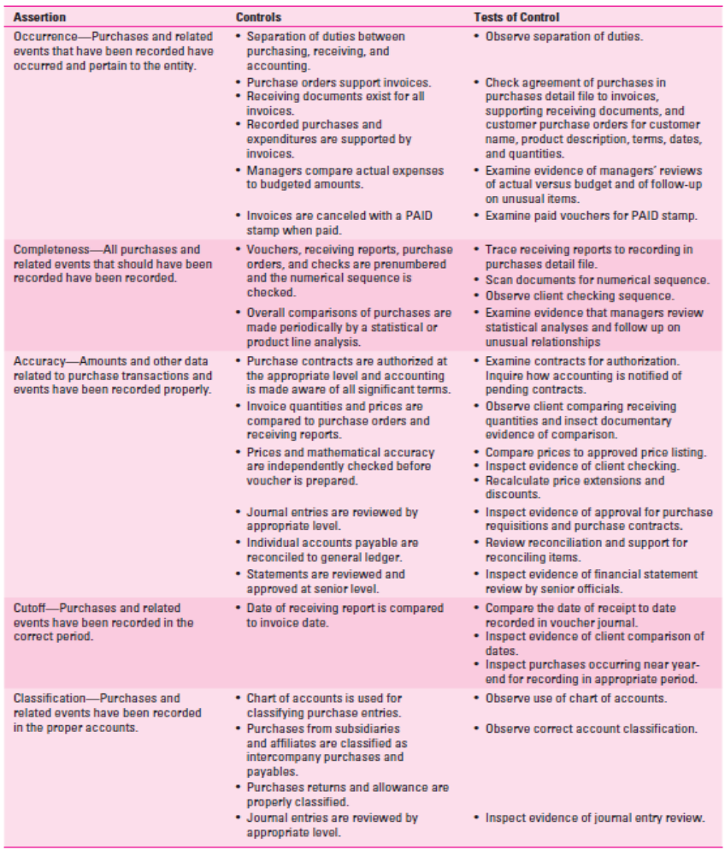
Exhibit 8.4
Assertions about Classes of Transactions and Events for the Period: Acquisition and Expenditure Cycle
8-<number>
8-<number>

Slide 12
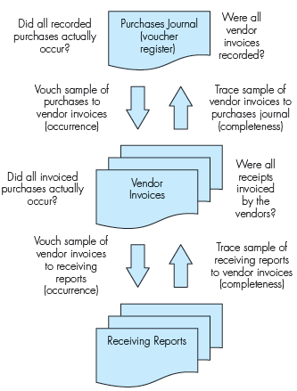
Exhibit 8.5
Direction of Tests
8-<number>

Slide 13
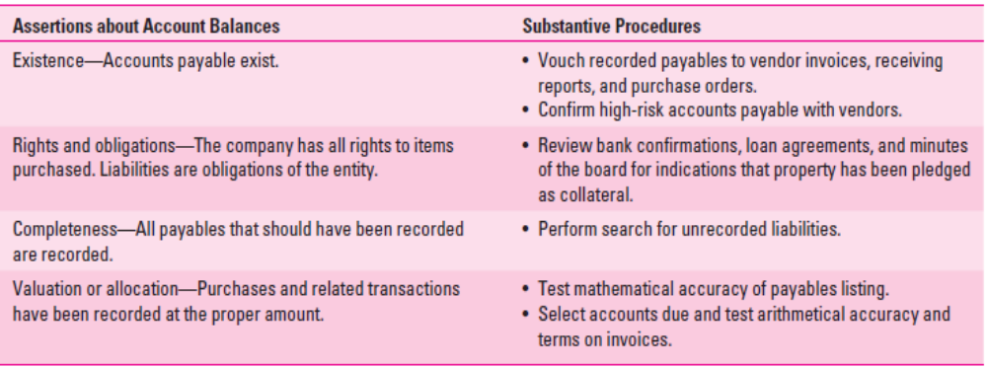
Substantive Procedures
Exhibit 8.6 Assertions about account balances at the period end and substantive procedures: Acquisition and Expenditure Cycle
8-<number>

Slide 14
The Completeness Assertion
Search for Unrecorded Liabilities
  Inquire about procedures for identifying and recording liabilities
  Scan open purchase order file
  Examine UNMATCHED VENDOR STATEMENTS or INVOICES
  Examine UNMATCHED RECEIVING REPORTS occurring near year-end
  TRACE unpaid VOUCHERS in A/P ledger to receiving reports
  Confirm A/P with NORMAL SUPPLIERS (even those with zero balances)
  Review CASH DISBURSEMENTS occurring after year-end
8-<number>

Slide 15
Purchase Cutoffs
Verify CUT-OFFs for purchases
  Examine Receiving Reports and Vendor Sales Invoices occurring around year-end to ensure inventory received is included in the appropriate period.
8-<number>

Slide 16
Other Accounts in Cycle
Prepaid Expenses
Accrued Liabilities
Expenses
Inventory
Property Plant and Equipment
8-<number>

Slide 17
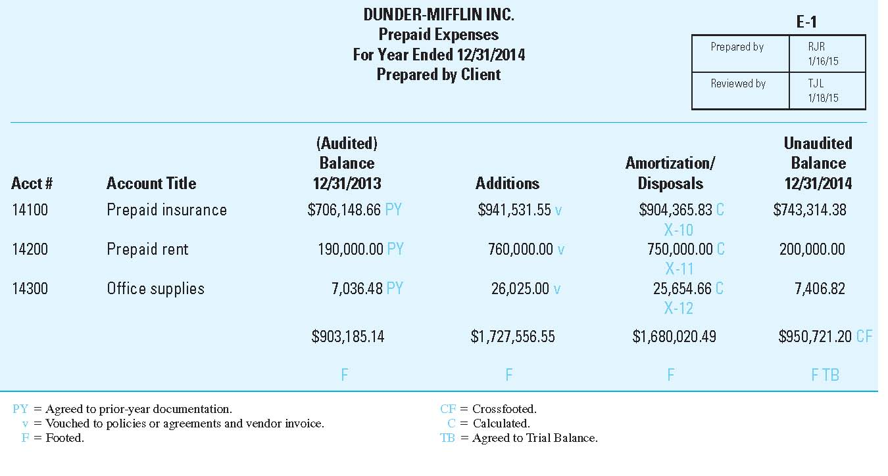
Account Analysis for Prepaid Expenses
Exhibit 8.7
8-<number>

Slide 18
Accrued Liabilities
Major differences between ACCRUED Liabilities and ACCOUNTS PAYABLE
  Examples include INTEREST, PROPERTY TAXES, WAGES, and INCOME TAXES PAYABLE
  These payables are not normally INVOICED or EVIDENCED by the RECEIPT OF GOODS
These differences may make it more difficult to detect UNRECORDED ACCRUALS
8-<number>

Slide 19
Auditing Accrued Liabilities and Prepaid Expenses
Agree balances to PRIOR YEAR WORKPAPERS
Verify PAYMENTS
Examine UNDERLYING AGREEMENTS
RECALCULATE amounts
  Agree EXPENSE ACCOUNTS to trial balance
Search for UNRECORDED ACCRUALS
  Review CASH DISBURSEMENTS at year-end
  Look for expected accruals at other stages of the audit (BONDS, NOTES, employees paid on 15th, etc.)
ANALYTICAL PROCEDURES
8-<number>

Slide 20
Income Taxes Payable
Extremely complex area
  Client may operate in multiple tax jurisdictions
Usually requires tax specialist
Vouch payments
Examine correspondence with government agencies
Follow standard for auditing estimates
8-<number>

Slide 21
AUDITING PROPERTY, PLANT, AND EQUIPMENT
GENERAL APPROACH
  Small number of transactions
    Relatively high dollar transactions
  Authorization of Transactions (Board of Directors or approved capital budget) takes on added importance.
  Less concern for ACCESS to ASSETS
  More concerned with UNRECORDED DISPOSALS
8-<number>

Slide 22
AUDITING PROPERTY, PLANT, AND EQUIPMENT
Agree balances to prior year documentation
PURCHASES OF PP&E
  VOUCH to INVOICE or COST RECORDS
  Inspect TITLE
  VOUCH to BOARD MINUTES
EXPENDITURES SUBSEQUENT TO ACQUISITION
  VOUCH to INVOICE and WORK DESCRIPTIONS
  Consider propriety of classification (EXPENSE or CAPITALIZE)
8-<number>

Slide 23
AUDITING PROPERTY, PLANT, AND EQUIPMENT
DISPOSAL OF PP&E
  VOUCH from PP&E to BOD MINUTES
  Vouch to cash receipts journal and validated deposit slip
  Recalculate gain/loss
  TRACE from BOD MINUTES to PP&E for disposals (COMPLETENESS)
Look for unrecorded disposals
  Agree balances to PRIOR YEAR WORKPAPERS
  Examine insurance policies, property tax records, etc.
  PHYSICALLY INSPECT or CONFIRM fixed assets
    Both existing and newly-acquired items
    Confirm assets LEASED to others under capital leases
8-<number>

Slide 24
AUDITING PROPERTY, PLANT, AND EQUIPMENT
DEPRECIATION EXPENSE
  Recalculate using USEFUL LIFE, SALVAGE VALUE, COST, and METHOD
  Evaluate REASONABLENESS of USEFUL LIFE, SALVAGE VALUE, etc.
  Is depreciation consistent with COMPANY POLICY (half year conventions)?
LEASE AGREEMENTS
  Verify proper treatment (Capitalized or Operating)
  Ensure disclosure in footnotes is appropriate
8-<number>

Slide 25
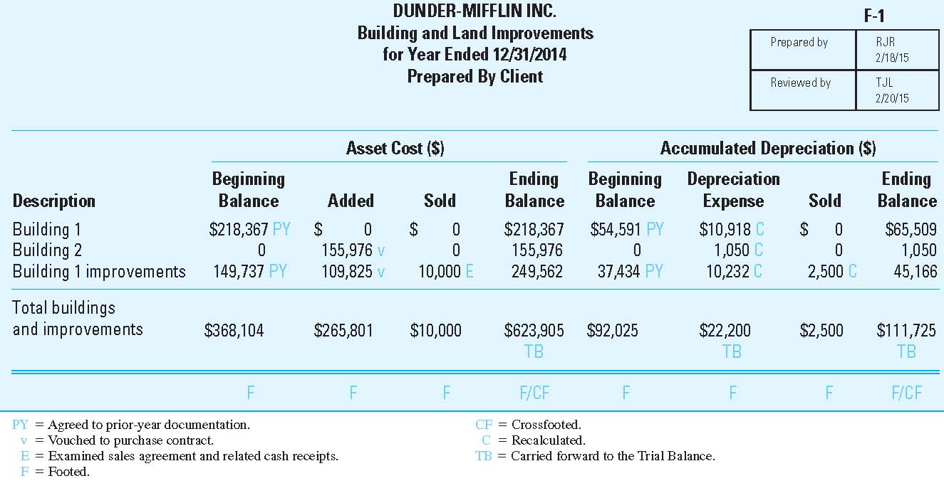
Exhibit 8.8
Sample PP&E and Depreciation Documentation
8-<number>

Slide 26
Auditing Cost and Expense Accounts
Analytical procedures (e.g. sales commissions)
Agree to related balance sheet account (e.g. depreciation)
Substantive tests of transactions (e.g. purchases)
Vouch detail (e.g. legal expense)
8-<number>

Slide 27
Fraud Red Flags
Photocopies of invoices
Invoices in numerical order
Round numbers
Slightly below authorization thresholds
No listed phone #
P.O. Boxes (with no other addresses)
Mail drop addresses (e.g. UPS stores)
Vendor and Employee addresses the same
Multiple vendors at same location
8-<number>

Slide 28
Appendix 8C
Payroll Cycle
8-<number>

Slide 29
Payroll
Often processed by service bureaus
Balance sheet accounts usually small.
Rely on tests of controls/substantive tests of transactions.
8-<number>

Slide 30
Inherent Risks in the Payroll Cycle
Ghost employees
Overpaying (padding) for time or production
Incorrect accounting (classification)
Failure to pay third-parties (e.g. payroll taxes, insurance)
.
8-<number>

Slide 31
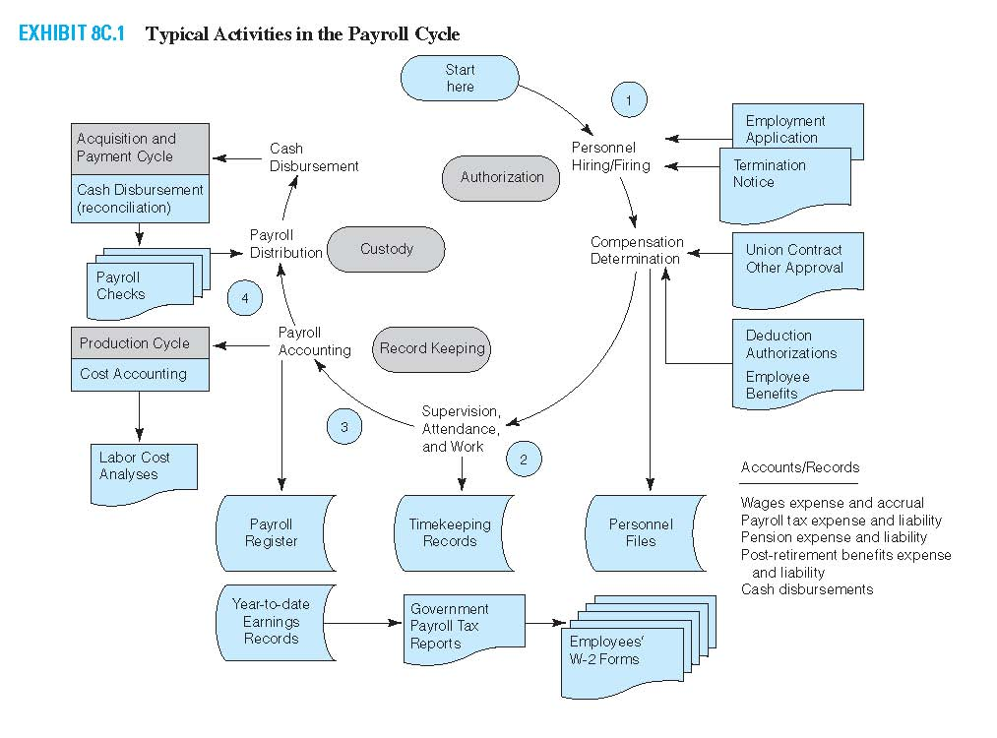
Exhibit 8C.1 Typical Activities in the Payroll Cycle
.
8-<number>

Slide 32
Payroll Cycle: Typical Activities
PERSONNEL AUTHORIZATION FORMS authorize all payroll-related transactions Employees should record their hours worked using TIME SHEETS
Supervisory personnel review time sheets and verify the distribution of hours worked on various jobs.
Payroll Department processes payroll and prepares a PAYROLL REGISTER and PAYROLL CHECKS
Cash Disbursements/Treasurer should review the Payroll Register and compare it to the Payroll Checks
Payroll Checks should be signed by an authorized party and distributed directly to employees
8-<number>

Slide 33
Payroll Cycle: Control Activities
Physical Controls
  Payroll Checks and signature plates kept in a secure location
  Payroll Checks distributed by a person not involved in processing or recording payroll
  Payroll Checks distributed to individuals with proper identification
  Unclaimed Payroll Checks stored in a secure location
Segregation of Duties
  The Personnel Department and the Hiring/Employing Department AUTHORIZE payroll transactions and payroll-related changes.
  Payroll is RECORDED by the Payroll Department and General Accounting
  The Cash Disbursements Department/Treasurer has CUSTODY of the Payroll Checks
Performance Reviews
  Payroll transaction data compared to prior-year data or budgeted/expected data.
  Review of Payroll Register for reasonableness
  Reconcile the Payroll bank account
8-<number>

Slide 34
Payroll Cycle: Management Reports and Files
Personnel files
Payroll register
Labor cost analysis
Clearing accounts
Government and tax reports
Year-to-date earnings records
W-2 reports
8-<number>

