Slide 1
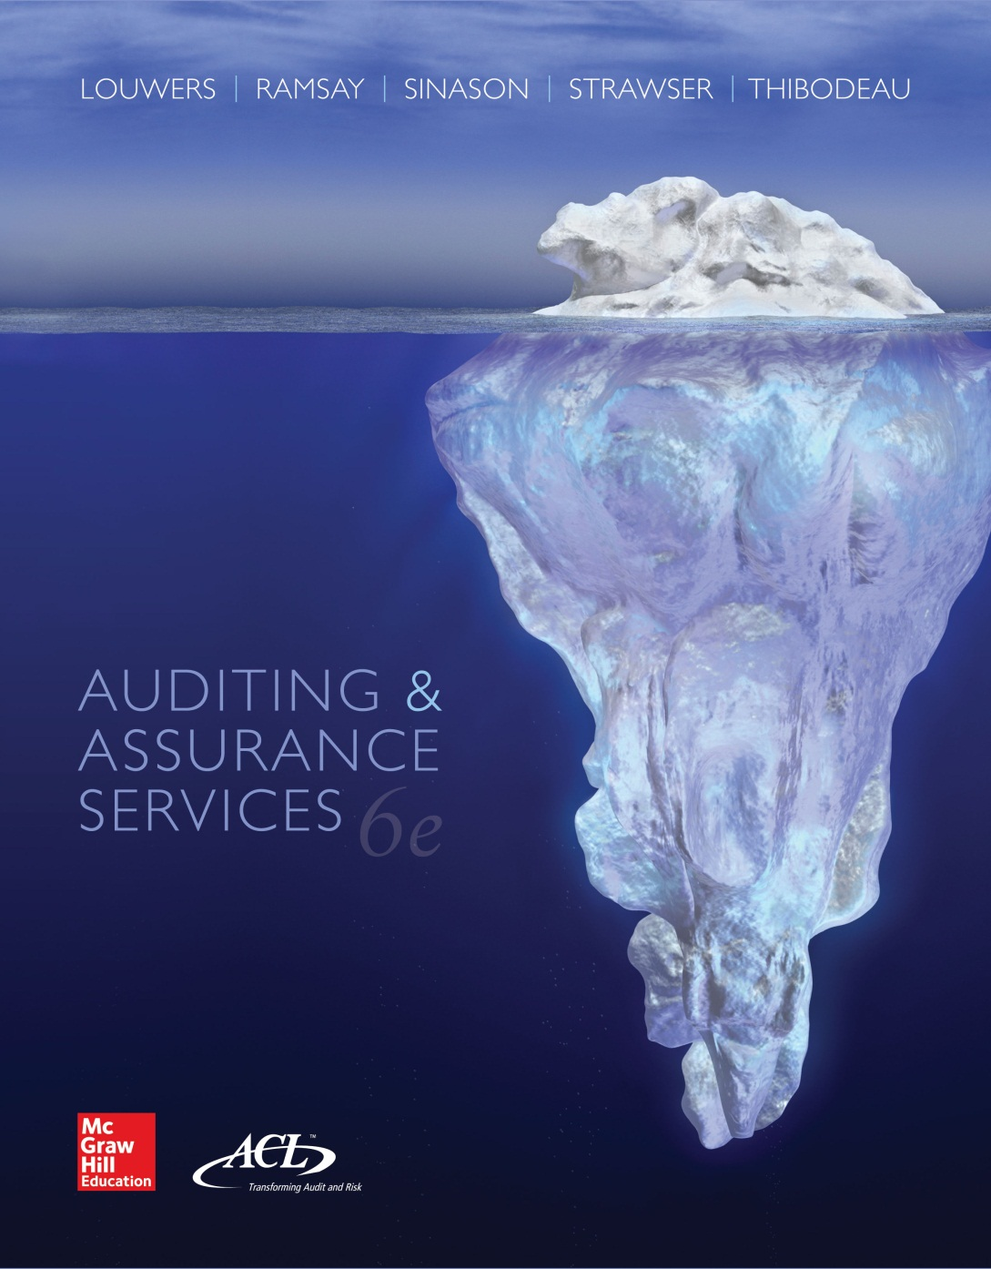
Auditing & Assurance Services, 6e

Slide 2
Chapter 03
Engagement Planning
"Vision without action is a daydream.
Action without vision is a nightmare.”
Japanese Proverb
3-<number>

Slide 3
Learning Objectives
List and describe the required pre-engagement activities that auditors undertake before beginning an audit engagement.
Understand the importance of planning the audit engagement so that it is conducted in accordance with professional standards.
Define materiality and explain its importance in the audit planning process.
List and describe the eight general types of audit procedures for gathering evidence.
List and discuss matters of planning that auditors should consider related to the client’s computer environment and describe how CAATs can be used to improve the efficiency of the audit process.
Define what is meant by the proper form and content of audit documentation.
3-<number>

Slide 4
Pre-Engagement Activities
Client Acceptance or Continuance
Communication between predecessor and prospective auditors
Compliance with Independence and Ethical Requirements
Engagement Letters
Termination Letter
3-<number>

Slide 5
Communication between Predecessor and Prospective Auditors
Attempt to communicate is required
If client permits, issues to discuss
  Disagreements about accounting principles or audit procedures.
  Communications the predecessor auditors gave the former client about fraud, illegal acts, and internal control recommendations.
  The predecessor auditors’ understanding about the reasons for the change of auditors (particularly about the predecessor auditors’ termination).
3-<number>

Slide 6
Compliance with Independence and Ethical Requirements
The responsibilities principle requires auditors to comply with appropriate ethical requirements for each audit engagement
Auditors must maintain independence in mental attitude and independence in fact
Independence in appearance relates to perceptions of auditors’ independence
A lack of independence can result in disciplinary action by regulators and/or professional organizations and litigation by those who relied on the financial statements
3-<number>

Slide 7
Engagement Letters
When a new client is accepted or when an audit engagement continues from year to year, an engagement letter should be prepared.
Acts as a contract between auditor and client.
Serves as a means of reducing the risk of misunderstandings with the client and as a means of avoiding legal liability for claims that the auditors did not perform the work promised
Should include:
  Objectives of the engagement
  Management’s responsibilities
  Auditors’ responsibilities
  Any limitations of the engagement
3-<number>

Slide 8
Audit Plan
A comprehensive list of the specific audit procedures that the audit team needs to perform to gather sufficient appropriate evidence on which to base their opinion on the financial statements
When planning the engagement, the auditor needs to develop and document a plan the describes the procedures to be performed to assess the risk of material misstatement at the financial statement and assertion level
The auditor must then carefully plan the nature, timing and extent of control tests and substantive tests that are designed to mitigate these risks to an acceptable level
3-<number>

Slide 9
Staffing the Audit Engagement
Teams usually consist of the:
  Audit engagement partner
  Audit manager
  IT audit specialist
  Tax partner
  Quality assurance partner
  Audit staff
For new client, companies with complex transactions and public companies, more experienced staff members are typically assigned.
3-<number>

Slide 10
Considering the Work of Internal Auditors
Must obtain an understanding of a client’s internal audit department and its work
Audit efficiency can be realized when the two groups work together
Prior to using the work of internal auditors, external auditors should consider internal auditors’ objectivity and competence
Internal auditors should not be delegated tasks that require extensive professional judgment
3-<number>

Slide 11
Use of Specialists
Specialists are persons skilled in fields other than accounting and auditing who are not members of the audit team
Auditors must know about the specialist’s professional qualifications, experience and reputation
Should be unrelated to the company being audited
Auditors should obtain an understanding of the specialist’s methods and assumptions
Specialists are not referred to in the audit report unless the specialists’ findings cause the auditors’ report to be modified
3-<number>

Slide 12
Use of IT Auditors
Specialized skills are often needed to evaluate the effect of computerized processing on the audit, to understand the flow of transactions, or to design and perform audit procedures
IT auditors are members of the audit team and are called in when the need for their skills arises
Audit managers and partners should possess sufficient knowledge to know when to call on specialists and to supervise their work
3-<number>

Slide 13
Time Budget
Used to maintain control of the audit by identifying problem areas early in the engagement, thereby ensuring that the engagement in completed on a timely basis
Interim audit work refers to procedures performed several weeks or months before the balance sheet date
Year-end audit work refers to procedures performed shortly before and after the balance sheet date
3-<number>

Slide 14
Time Reports
Everyone who works on the audit engagement is required to report the time taken to perform procedures for each phase of the audit
Helps in evaluating the efficiency of the audit team members
Compiling a record for billing the client
Compiling a record for planning the next audit
3-<number>

Slide 15
Materiality
Materiality refers to an amount (or transaction) that would influence the decisions of users (i.e., an amount (or event) that would make a difference). The emphasis is on user, rather than management or the audit team.
Materiality Criteria:
Quantitative Criteria:
  Absolute size
  Relative size
  Cumulative effects
Qualitative Criteria
  Nature of the item or issue
  Circumstances
  Uncertainty
Ultimately, materiality is a matter of professional judgment.
3-<number>

Slide 16
Using Materiality on the Audit
As a guide to planning substantive procedures—directing attention and audit work to those items or accounts that are important, uncertain, or susceptible to errors or frauds.
As a guide to evaluation of the evidence. Auditors use performance materiality to make sure that the aggregate of uncorrected and undetected immaterial misstatements does not exceed materiality for the financial statements as a whole.
As a guide for making decisions about the audit report.
3-<number>

Slide 17
Use of Audit Procedures
To gain an understanding of the client and the risks associated with the client (risk assessment procedures)
To test the operating effectiveness of client internal control activities (test of controls)
To produce evidence about management’s assertions related to the amounts and disclosures in a client’s financial statements (substantive procedures)
3-<number>

Slide 18
Substantive Audit Plan
Should contain a list of audit procedures for gathering evidence related to the relevant assertions identified for the significant financial statement accounts and disclosures of an audit client
Two ways to conduct substantive tests:
  Substantive analytical procedures
  Tests of details
3-<number>

Slide 19
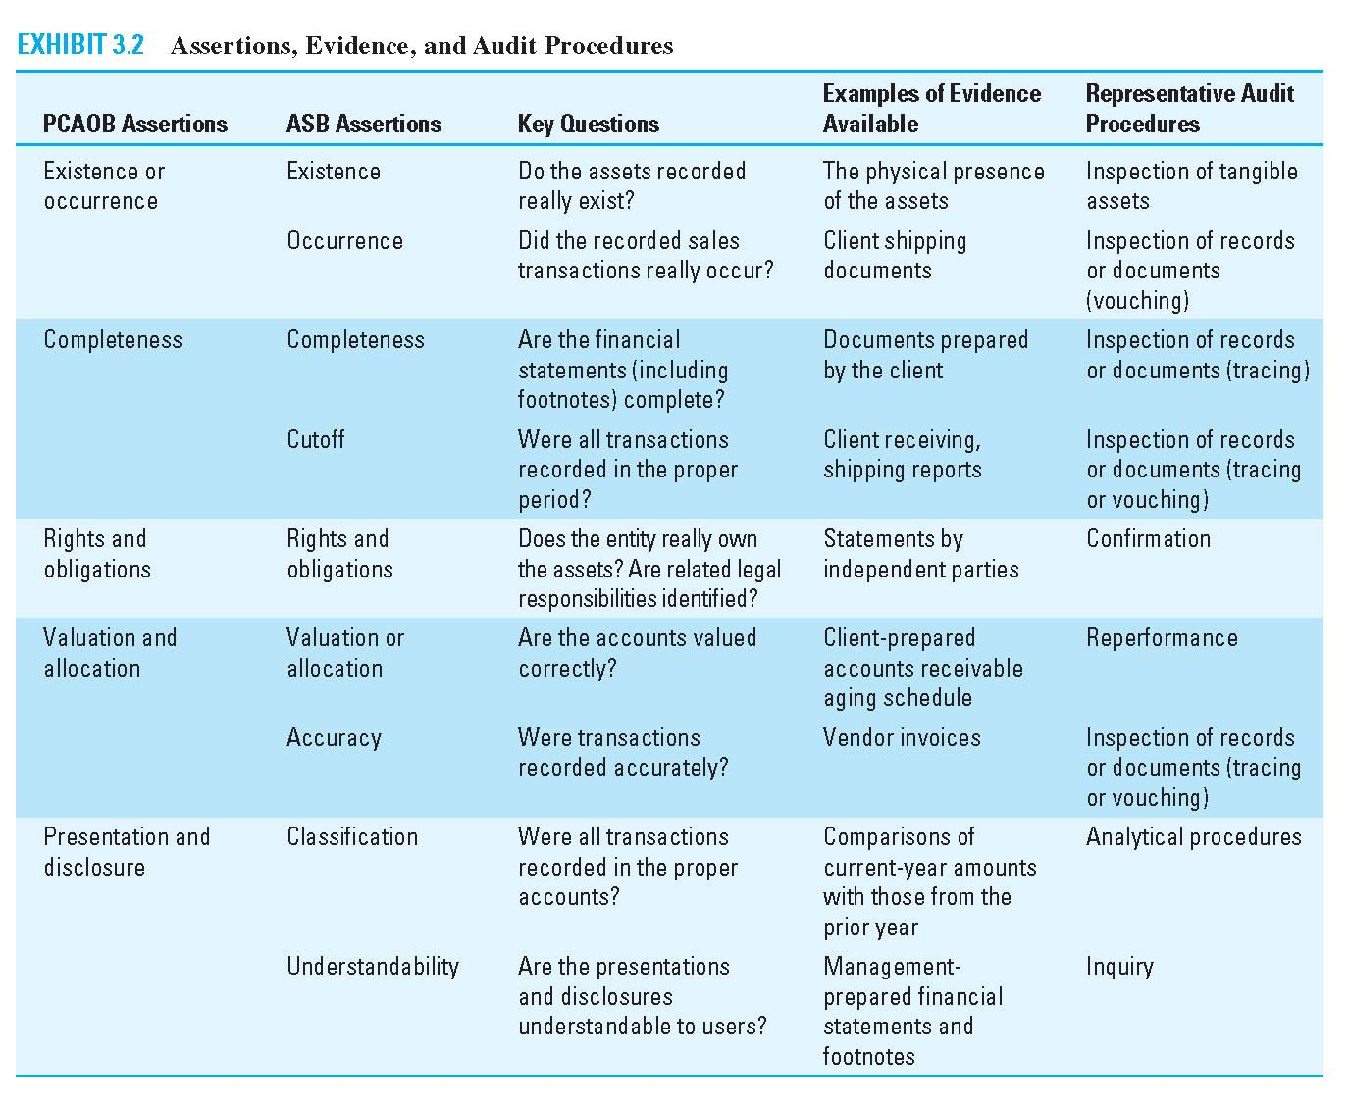
Exhibit 3.2 Assertions, Evidence and Audit Procedures
3-<number>

Slide 20
Types of Audit Procedures
Inspection of records and documents
  Vouching
  Tracing
  Scanning
Inspection of tangible assets
Observation
Inquiry
Confirmation
Recalculation
Reperformance
Analytical Procedures
3-<number>

Slide 21
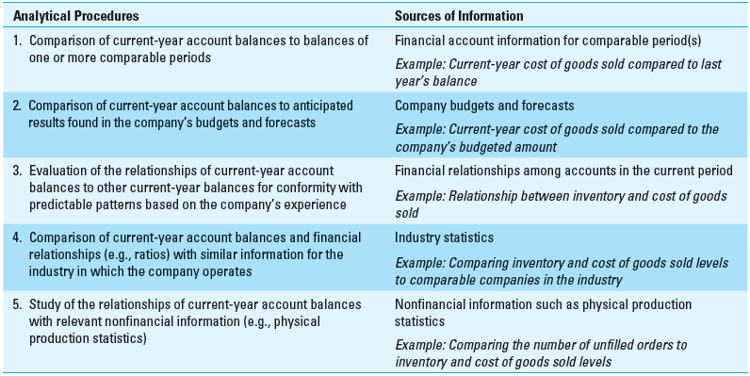
Analytical Procedures
3-<number>

Slide 22
Planning in a Computerized Environment
Temporary transaction trails
Uniform processing of transactions
Potential for errors and fraud
Potential for increased management supervision
Initiation or subsequent execution of transactions by computer
Use of cloud computing applications
3-<number>

Slide 23
Effect of Client’s Computer Processing on Audit Planning
Complexity of computer operations
Organizational structure of computer processing
Availability of data
Use of CAAT’s
Need for specialized skills
3-<number>

Slide 24
Computer Assisted Audit Tools and Techniques (CAATs)
With CAATS, the auditor is able to access and extract client information without disrupting data processing.
Some CAATs Procedures:
  Calculate field statistics (totals, high, low and average value)
  Perform complex recalculations
  Join and compare different data files
  Perform detailed analysis
    Stratification
    Gap and duplicate detection
    Sample selection
3-<number>

Slide 25
Audit Documentation
Definition
  The written record of the basis for the auditor’s conclusions that provides the support for the auditor's representations, whether those representations are contained in the auditor's report or otherwise.
Objectives
  Improve audit quality
  Enhance public confidence
3-<number>

Slide 26
Purposes of Audit Documentation
Integral part of audit quality
Documents the nature, timing and extent of work performed
Evidence of due care
Basis for conclusion
Facilitates planning, performance and supervision
Provides basis for review
3-<number>

Slide 27
Audit Documentation
Permanent files
  Information of continuing audit significance
  For example, key contracts, bylaws, organization chart, royalty and bond agreements
Current files
  Includes the entire engagement administration file for the year under audit
  Includes all documentation that is sufficient to support all conclusions on the audit
3-<number>

Slide 28
Audit Documentation Requirements
Audit documentation should be prepared in sufficient detail to enable an experienced auditor having no previous connection with the engagement to:
  Understand the nature timing, extent and results of procedures, evidence obtained and conclusions reached.
  Determine who performed the work, date of work, reviewer and date of review.
Audit documentation should provide a clear link to significant findings or issues and
  Demonstrate compliance with professional standards.
  Support basis for conclusions for each relevant assertion.
  Document that accounting records agree with financial statements.
3-<number>

Slide 29
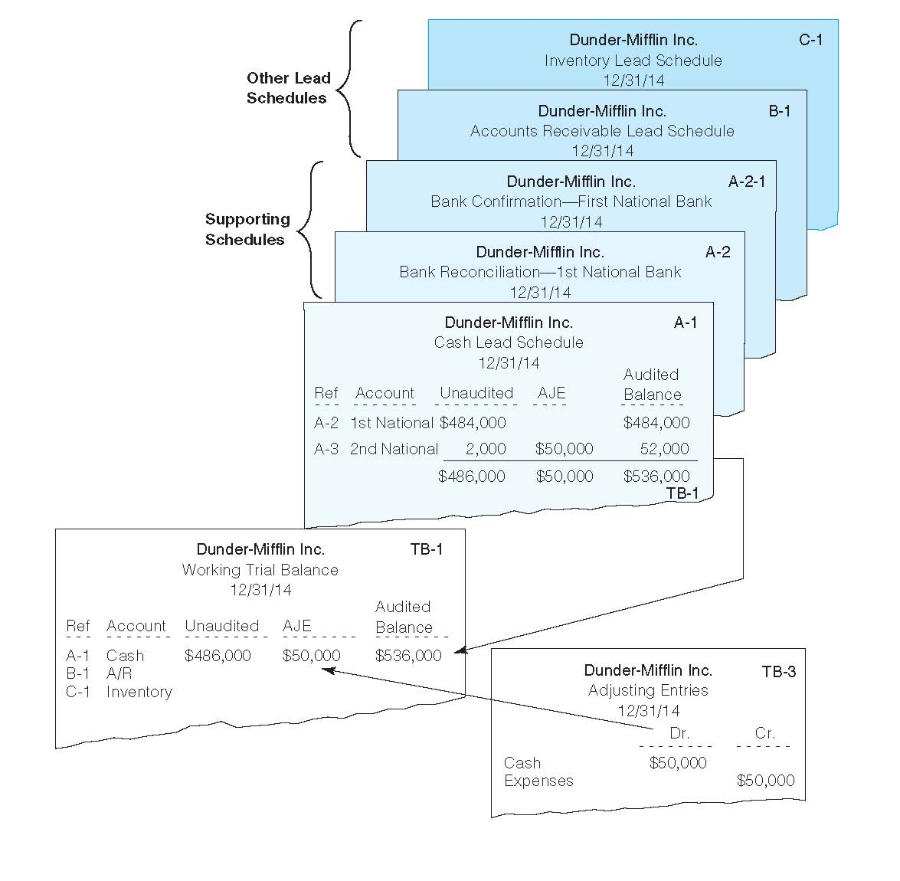
Exhibit 3.5 Current Audit Documentation File
3-<number>

Slide 30
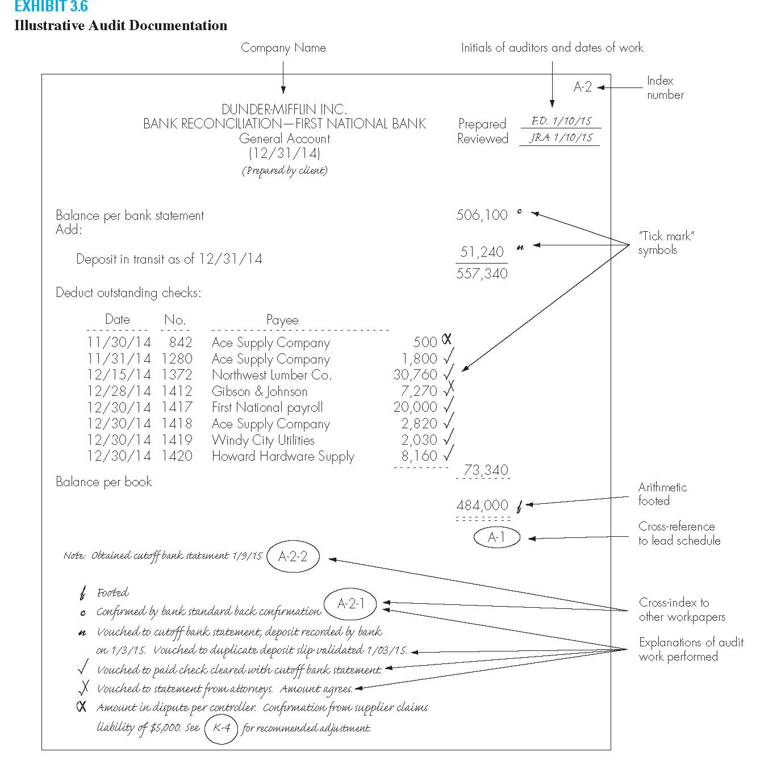
Exhibit 3.6 Illustrative Audit Documentation
Information on Each Workpaper
  Name, date, purpose, page number
  Procedures performed and conclusions reached by the auditor
    Evidence that auditor followed GAAS
    Audit Tick Mark Legend
  Preparer’s and Reviewers’ initials
3-<number>

Slide 31
Documentation Retention
Documentation must be retained seven years from report release date.
  If no report—from last day of fieldwork
Documentation to be retained include those documenting discussion and subsequent resolution of differences in professional judgments among team members
All documentation must be finalized within 45 days of the audit report’s release date
3-<number>

