Slide 1
Image Search
Elena Wang

Slide 2
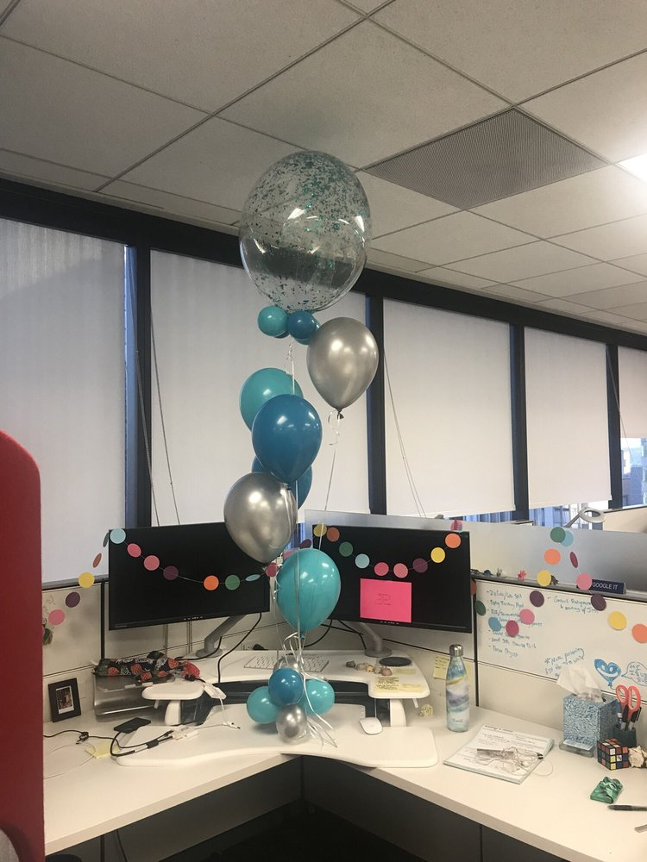
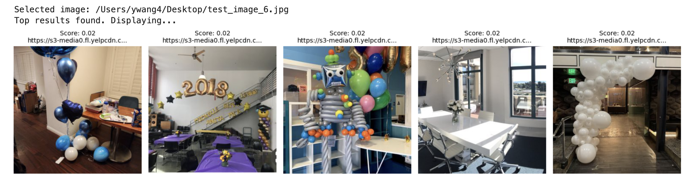
Happy New Year!
Query Image
List of similar images
https://www.yelp.com/biz/sparkys-balloons-san-francisco-6?osq=Party+Supplies
Image-> image search

Slide 3
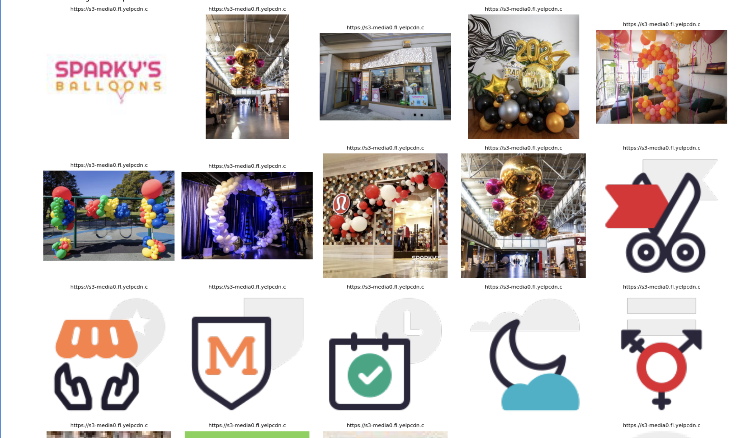
All the images

Slide 4
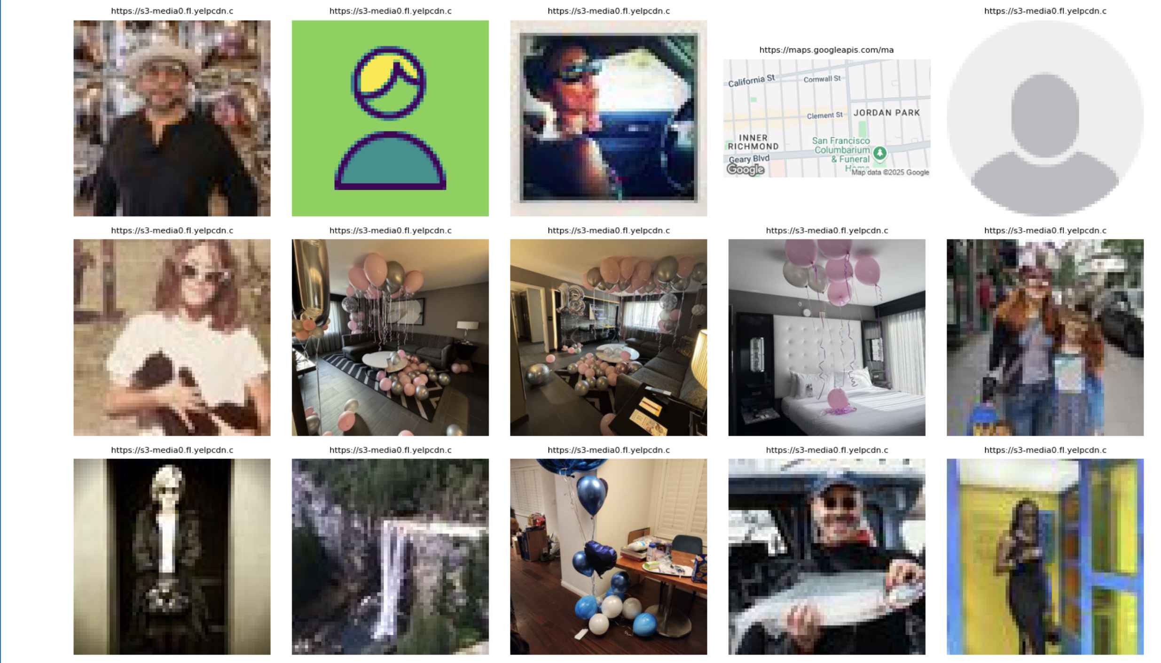
All the images

Slide 5
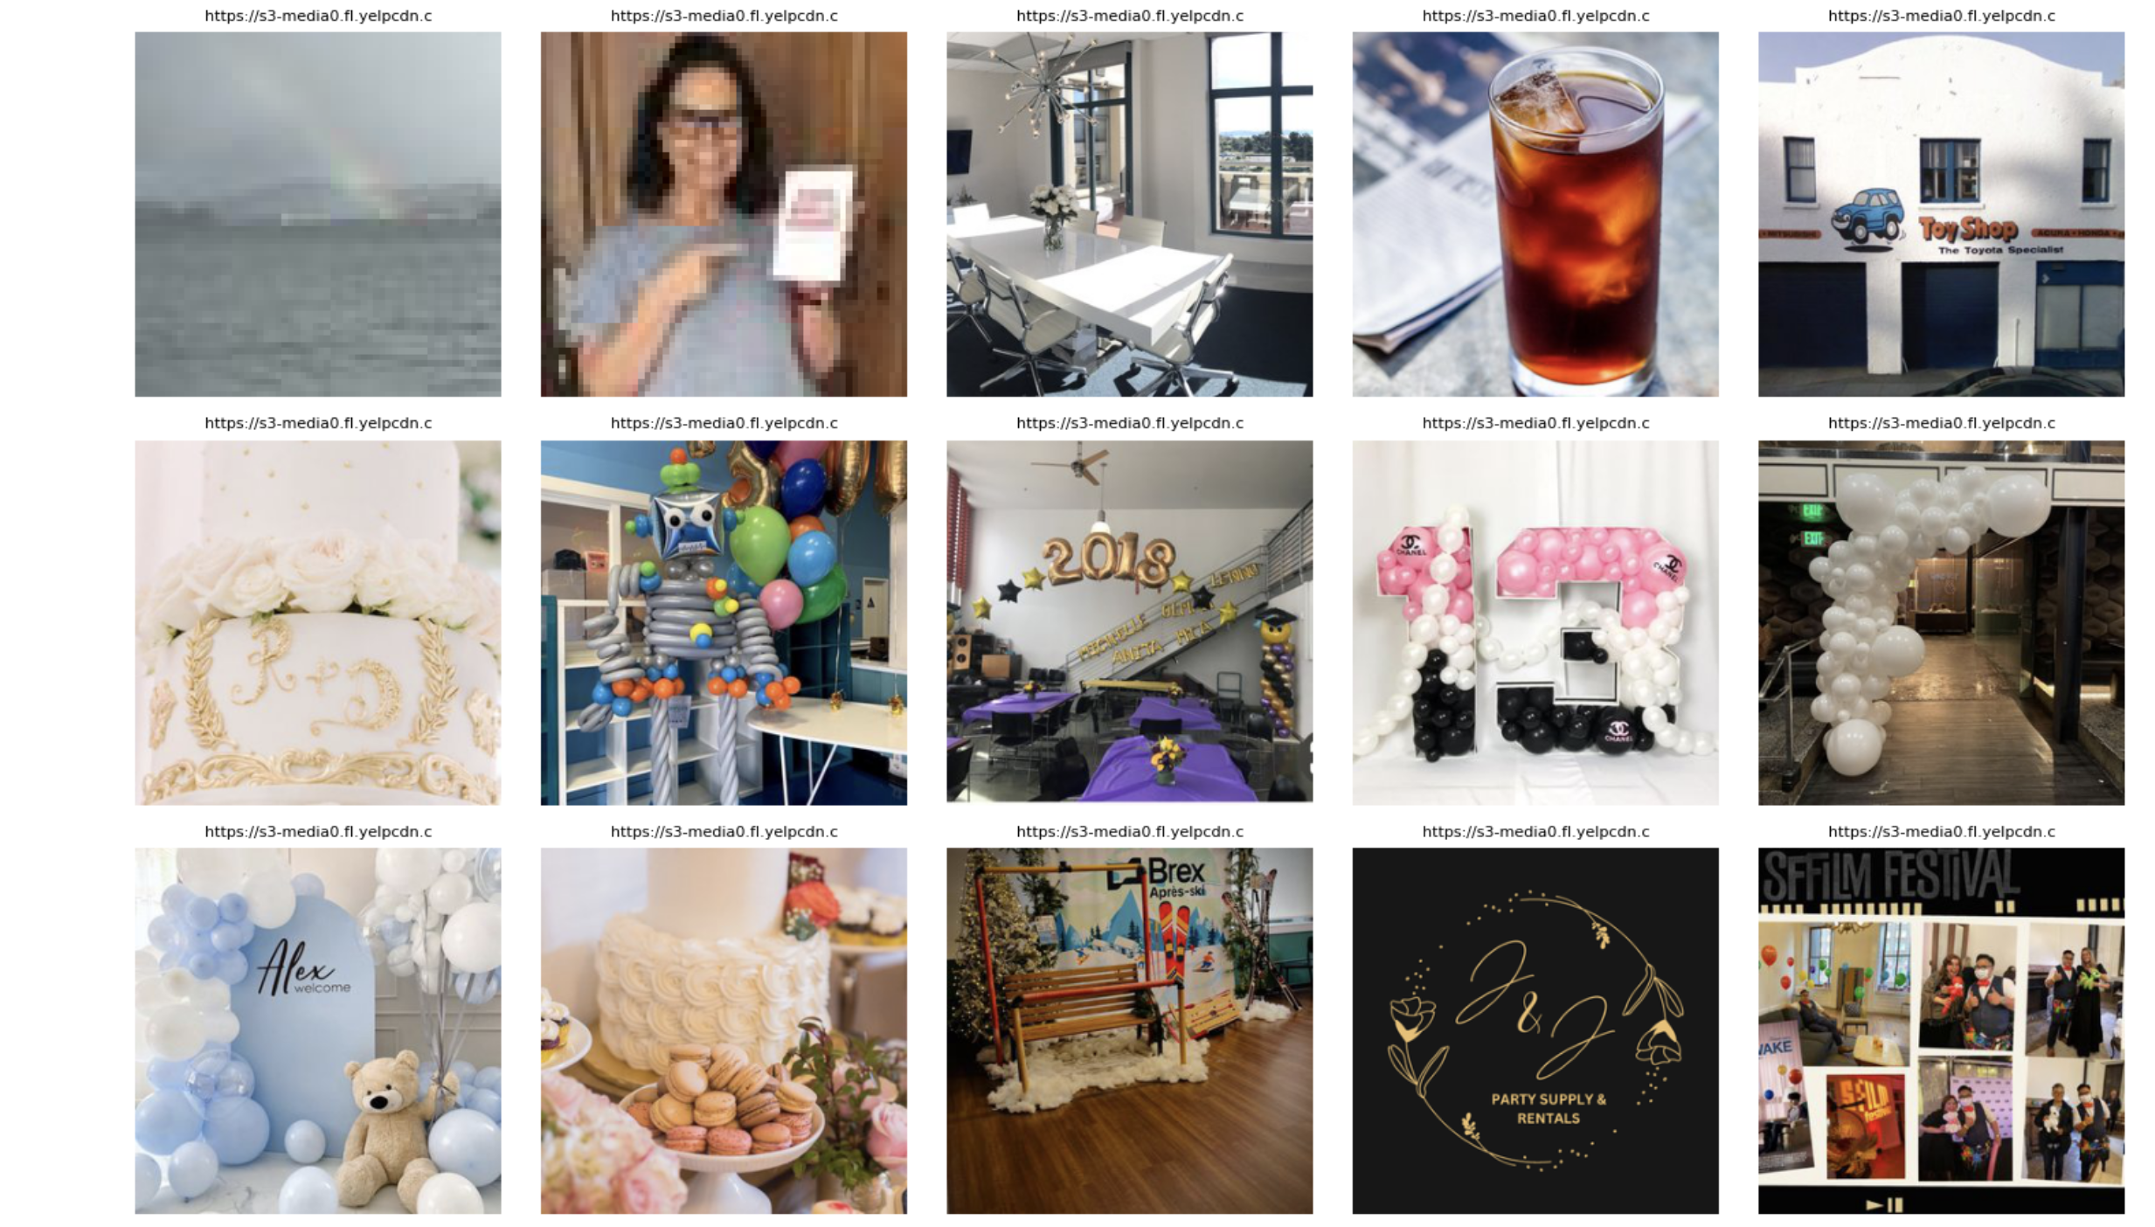
All the images

Slide 6
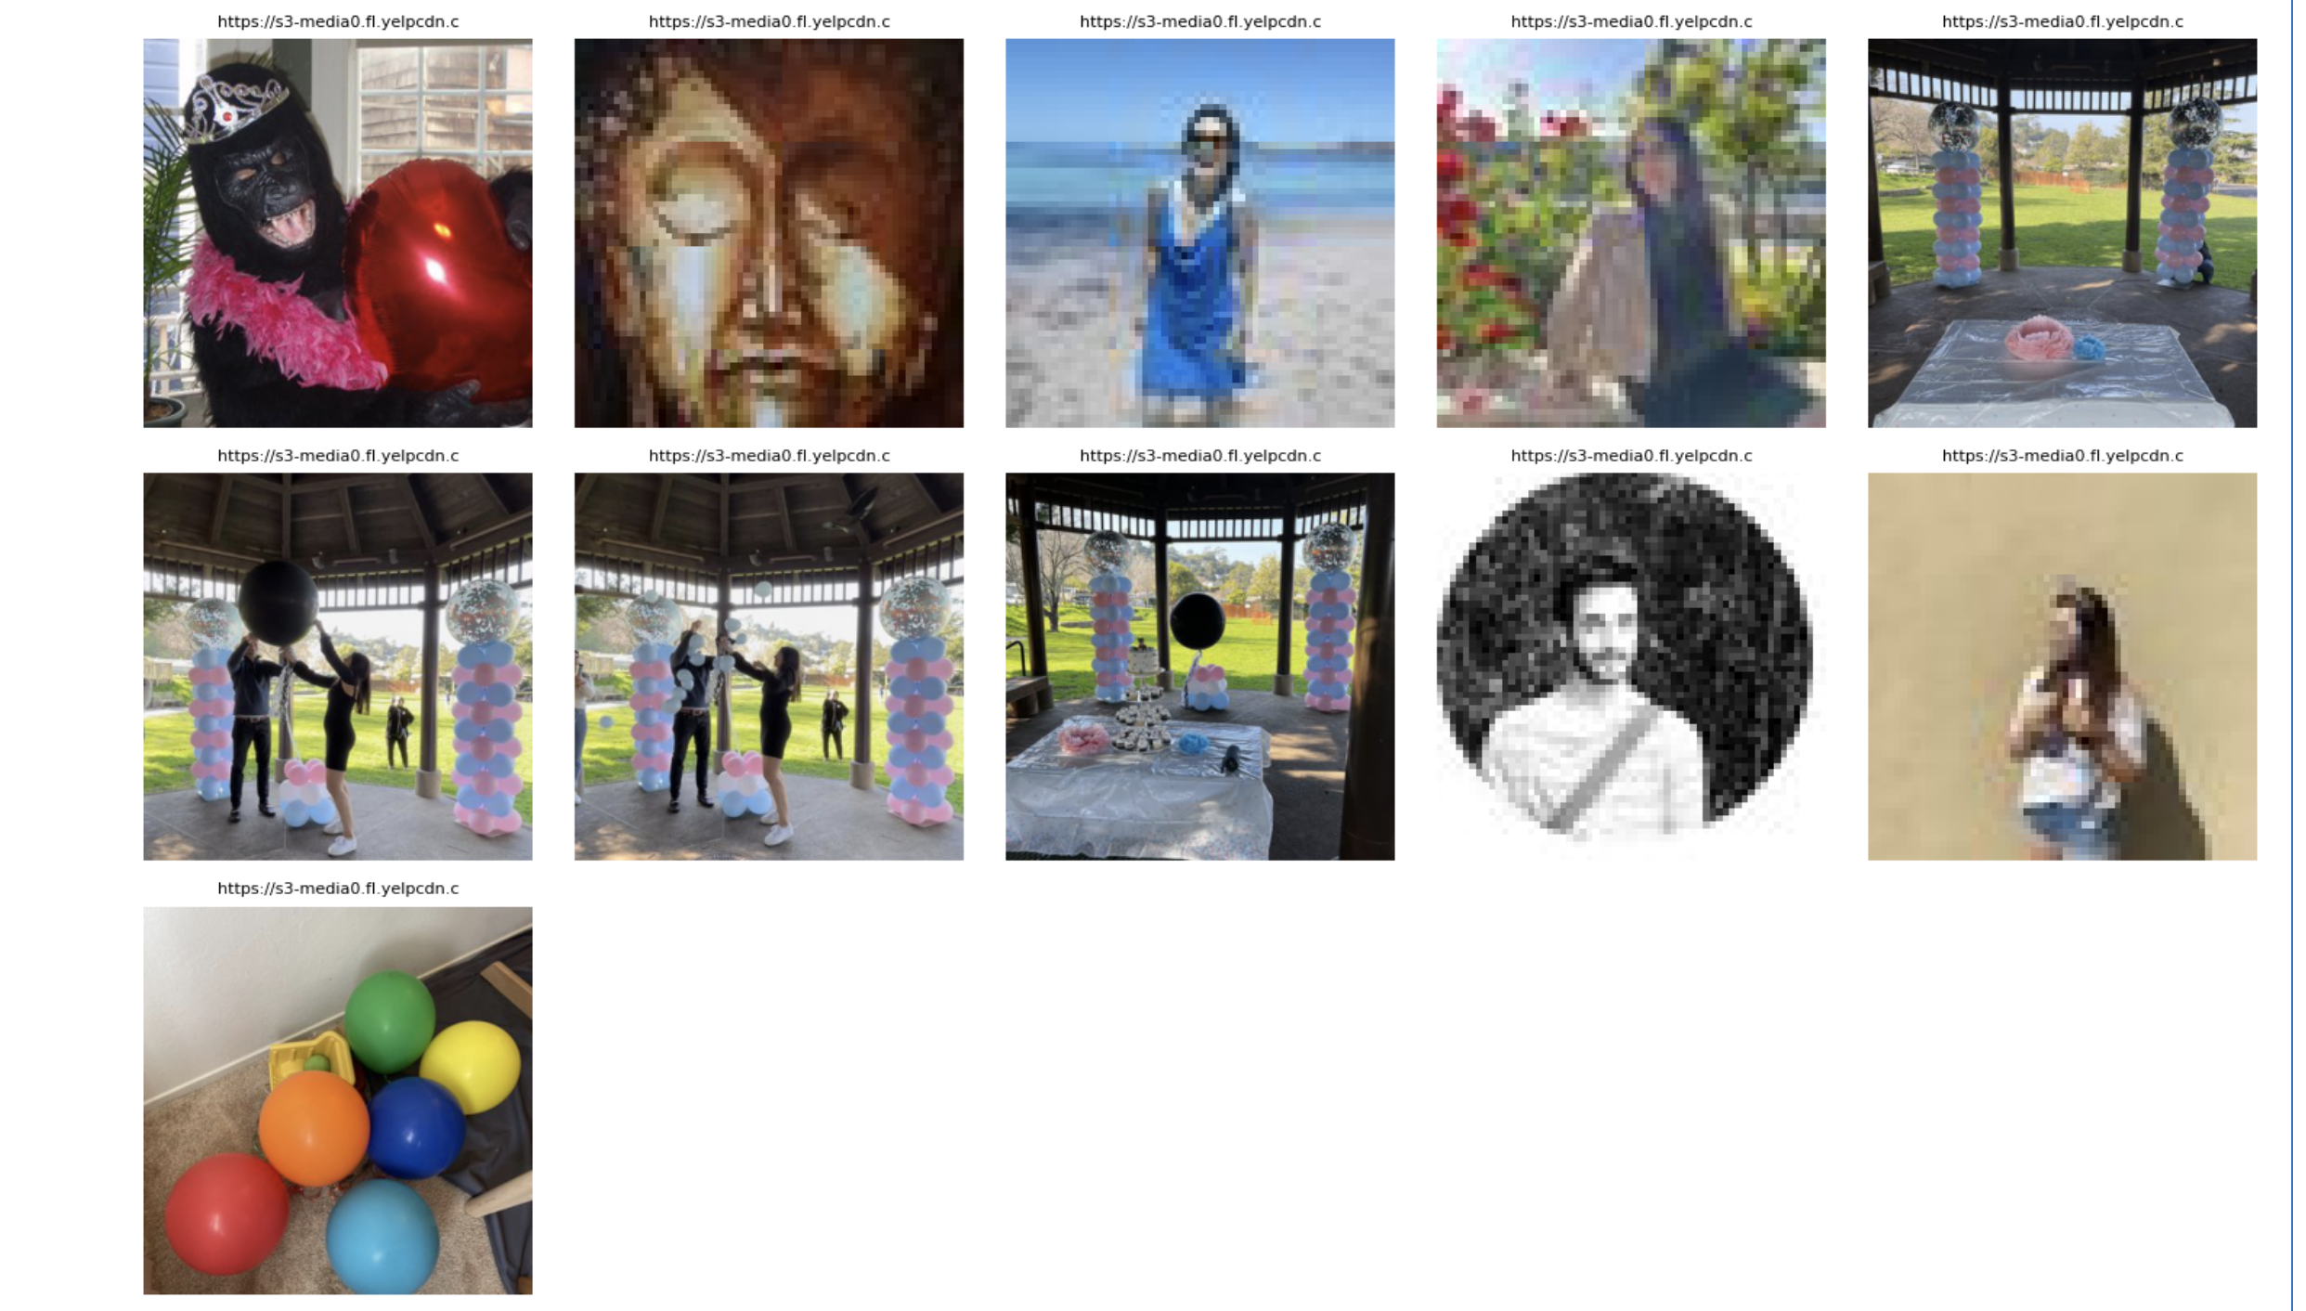
All the images

Slide 7
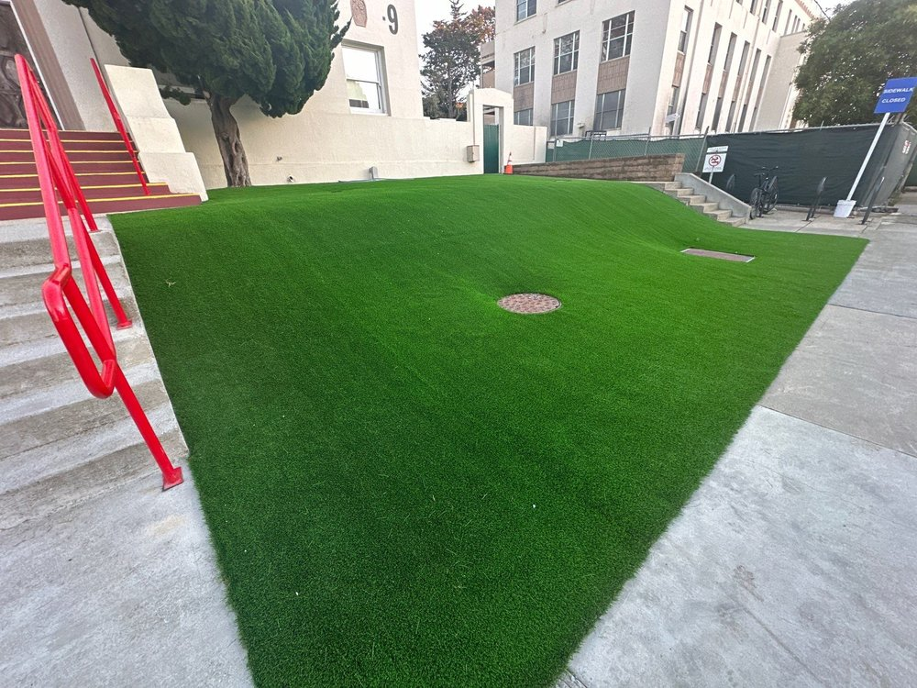
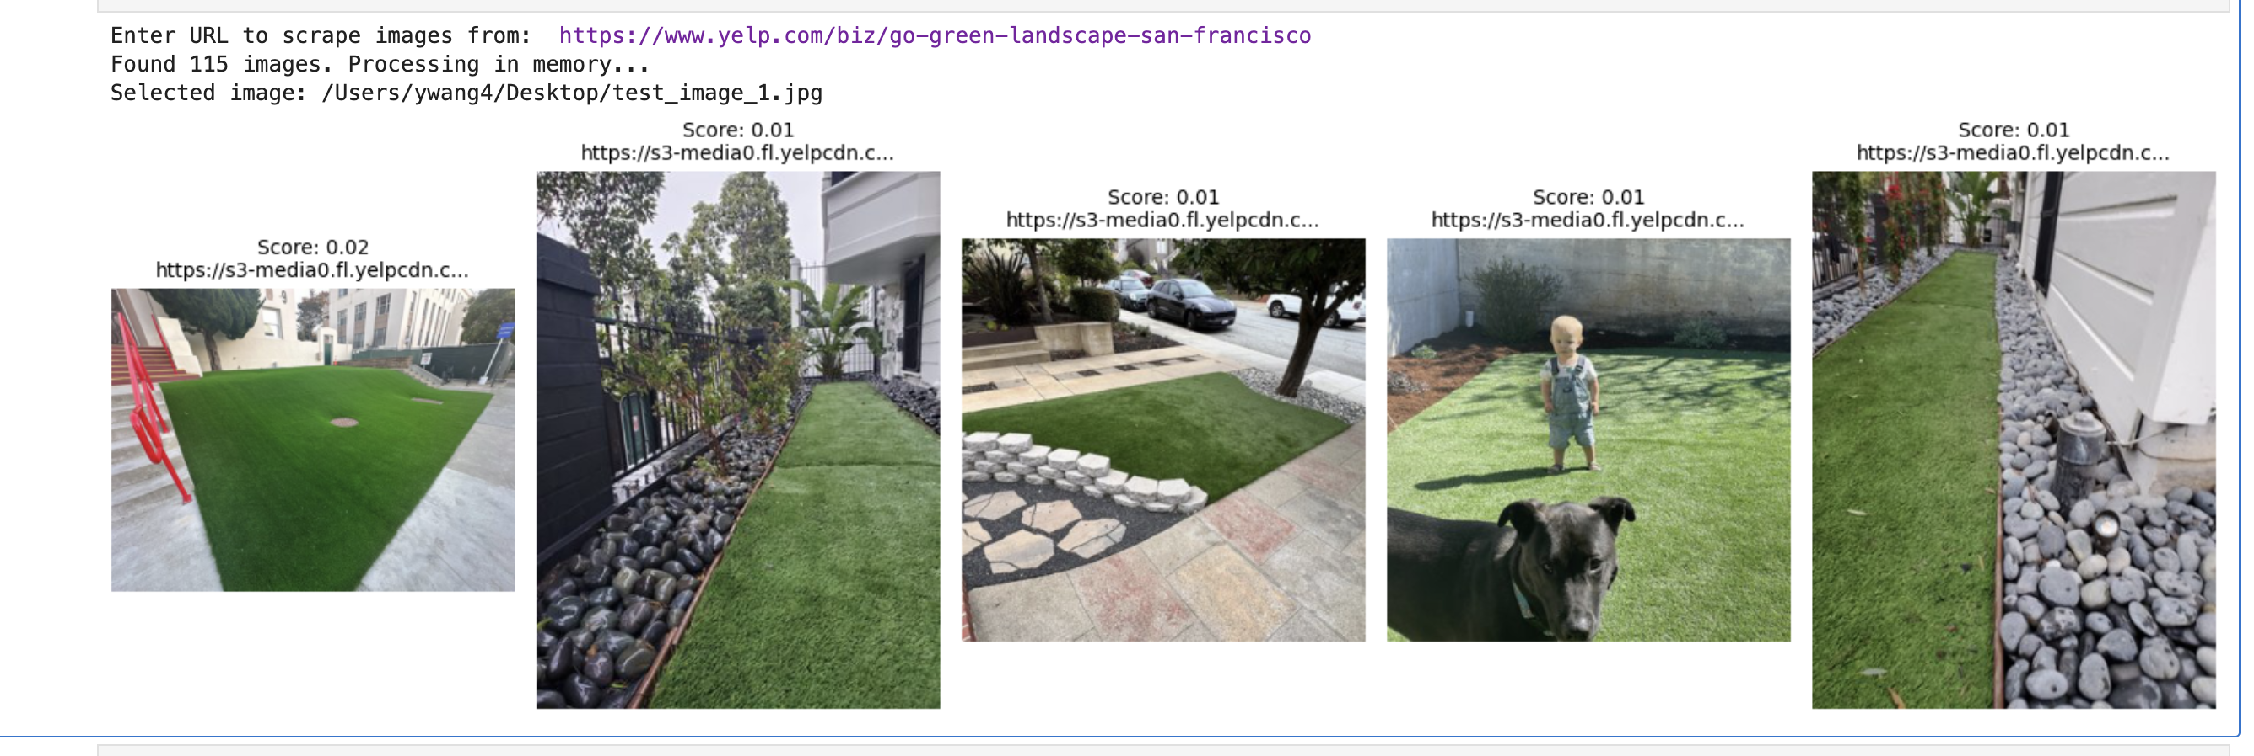
Image -> images search
Query Image
List of similar images

Slide 8
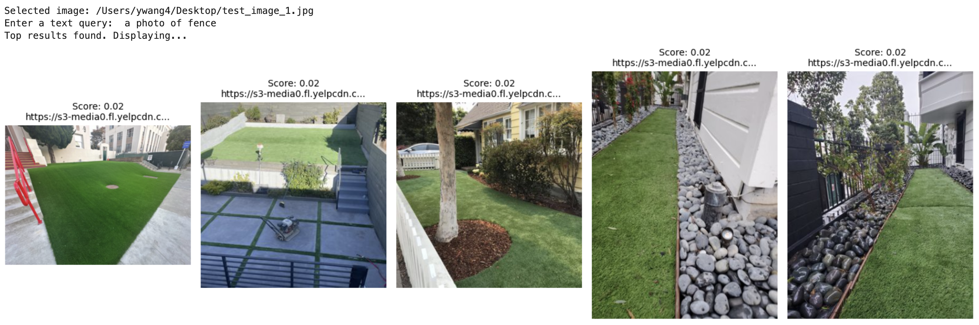
Text + Image -> images search
Query Image
Text Query
List of similar images

