Slide 1


Probabilistic and Systematic Coverage of
Consecutive Test-Method Pairs for
Detecting Order-Dependent Flaky Tests
Anjiang Wei Pu Yi Tao Xie
Darko Marinov Wing Lam
weianjiang@pku.edu.cn
Notes:
Hello everyone! My name is Anjiang Wei. Today I'm going to present my work on "Probabilistic and Systematic Coverage of Consecutive Test-Method Pairs for Detecting Order-Dependent Flaky Tests". This is a joint work done by me and my collaborators Pu, Tao, Darko and Wing. We are from Peking University, China, and University of Illinois, USA.

Slide 2
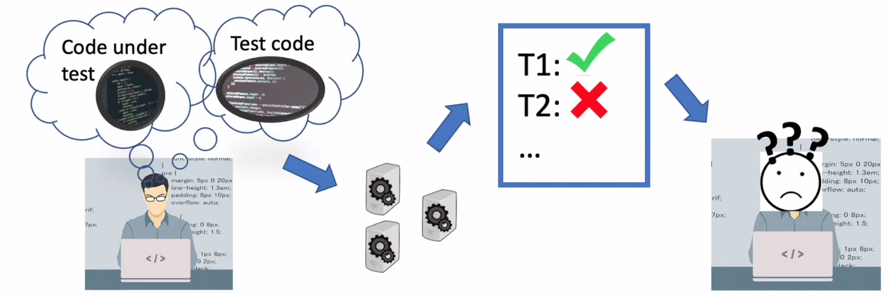
What are Flaky Tests?
A test is flaky if it can nondeterministically pass or fail for the same code
Misleads developers to debug nonexistent faults in recent changes
Reduces trust in tests
Notes:
Before I define "polluter tests", let me introduce "flaky tests". Unlike a typical test that passes or fails deterministically, a flaky test may pass or fail nondeterministically even for the same code. Flaky tests are harmful because they can mislead the developers to debug failures in wrong parts of the code. Further, they may reduce developers' trust in the tests.

Slide 3


Example of a Flaky Test
public void t1() { // testMRAppMasterSuccessLock
… // set up MapReduce job
MRAppMaster appMaster = new MRAppMasterTest(...);
try {
MRAppMaster.initAndStartAppMaster(appMaster, …);
} catch (IOException e) { … }
… // assert the state and some properties of appMaster
appMaster.stop(); // NullPointerException raised when run after t2
}
public void t2() { // testSigTermedFunctionality
JHEventHandlerForSigtermTest jheh =
new JHEventHandlerForSigtermTest(...);
jheh.addToFileMap(...); // pollute shared fileMap
… // have jheh handle a few events
jheh.stop();
… // assert whether the events were handled properly
}
Notes:
t1 and t2 are two tests (in two different classes) from widely used Hadoop project. To check an MR application, t1 first sets up some state, then creates an MR application, and starts the application. The NullPointerException arises when the test tries to stop the MR application. Specifically, the appMaster accesses the shared map data structure that tracks all jobs run by any application. When t1 is run after t2, then appMaster will attempt to stop a job created by the polluter, even though the job has already been stopped by t2.

Slide 4
What are Order-Dependent Tests?
Order-dependent tests are a prominent category of flaky tests
The order of unit tests is not fixed (e.g., in JUnit), so the victim (or brittle) test appears flaky
Victim
Victim, Polluter => Pass
Polluter, Victim => Fail
Polluter, Cleaner, Victim => Pass
Brittle
Brittle => Fail
State-Setter, Brittle => Pass
Most OD tests are victims rather than brittles (91% in iDFlakies dataset)
Essence: shared state pollution
Flake rates: the probability that an OD test would fail when run in (uniformly) sampled test orders
Notes:
Order-dependent tests are a prominent category of flaky tests. These tests most commonly involve a pair of a polluter test, which modifies the state shared among tests, and a victim test, which fails when run after the polluter test but passes otherwise. In this example, test2 is a polluter test since it modifies shared variable x, and test1 is a victim test since it would fail when run after test2. In many testing frameworks such as JUnit, the order of tests is not fixed. Therefore test1 can pass or fail, depending on the order.

Slide 5
Revisiting the example flaky test
A polluter-victim pair: t1 and t2 (in two test classes)
t2 has 11 cleaners in the same class
Another polluter test t3 has totally 31 cleaners in 8 different test classes
For t1, randomly sampling the orders that JUnit could run gives a flake rate of 4.5%
Notes:
testP has 11 cleaner tests in the same class. There is another polluter test testP’ for testV, which is in the same class with testP and shares the 11 cleaners. Interestingly, testP’ has another 20 cleaners, one in the same class as testV, and the other 19 in other six classes. Since the polluters have a lot of cleaners, the flake rate is as low as 4.5%.

Slide 6
Contributions
Prior work only used randomized orders to detect order-dependent tests due to high cost to explore all possible orders (n! permutations for n tests)
Developed a methodology to analytically obtain flake rates of order-dependent tests with rigorous probability analysis
Presented a simple change to the random sampling of test orders to increase the probability of detecting order-dependent tests
Proposed an algorithm to explore all consecutive test pairs with minimized cost, guaranteeing to detect all order-dependent tests that depend on one other test

Slide 7
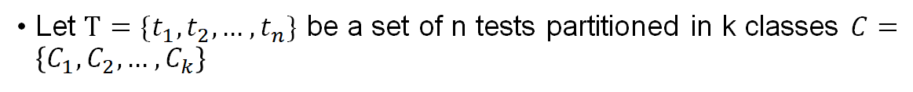
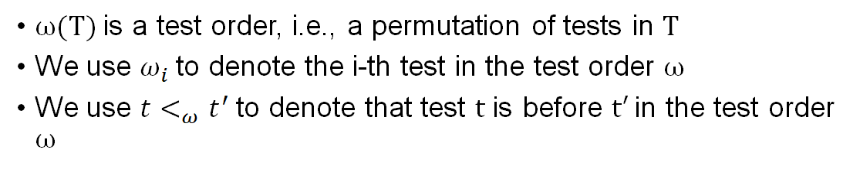
Preliminaries

Slide 8
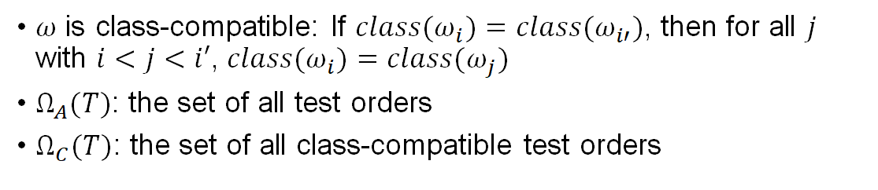
Preliminaries

Slide 9
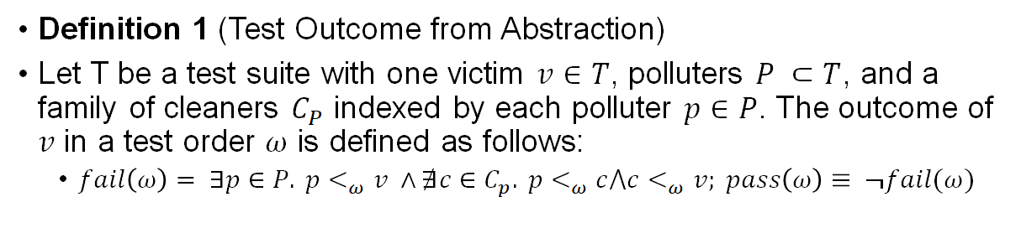
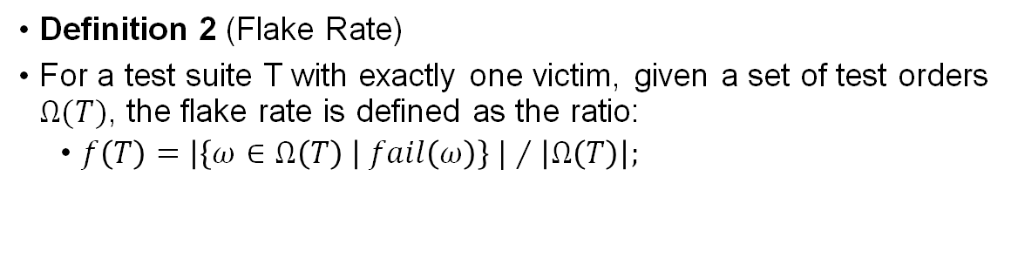
Formal Definitions

Slide 10
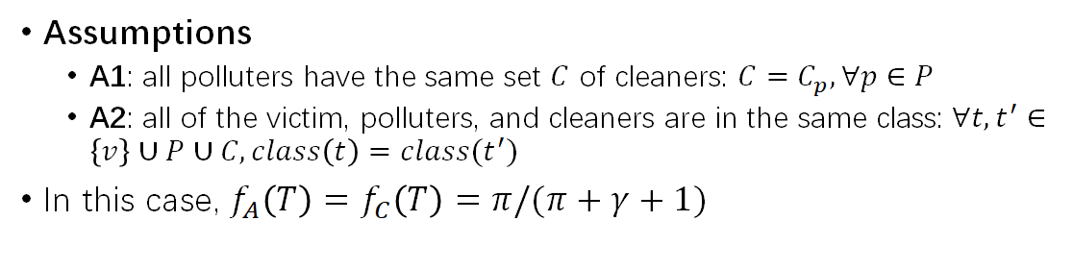
Computing Flake Rate (Special Case 1)

Slide 11
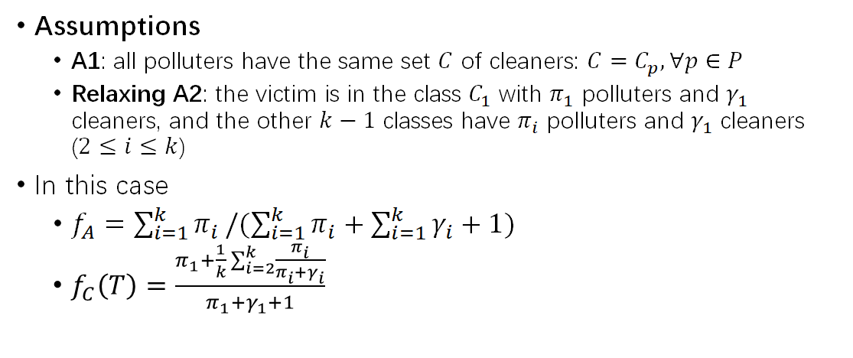
Computing Flake Rate (Special Case 2)

Slide 12
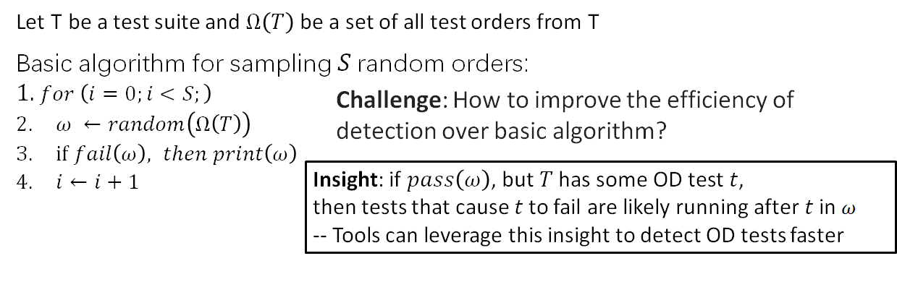
Basic algorithm

Slide 13
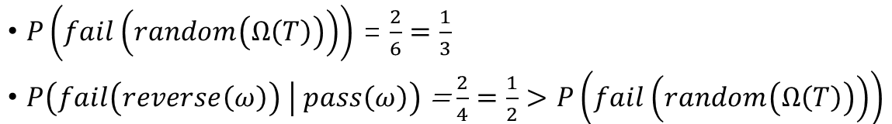
An Intuitive Example
•Three tests: P stands for Polluter, V stands for Victim, and C stands for Cleaner
PVC fail
PCV -> Reverse: VCP
CVP -> Reverse: PVC fail
CPV fail
VPC -> Reverse: CPV fail
VCP -> Reverse: PCV
Please refer to full paper for rigorous proof with formulas and sampling results

Slide 14
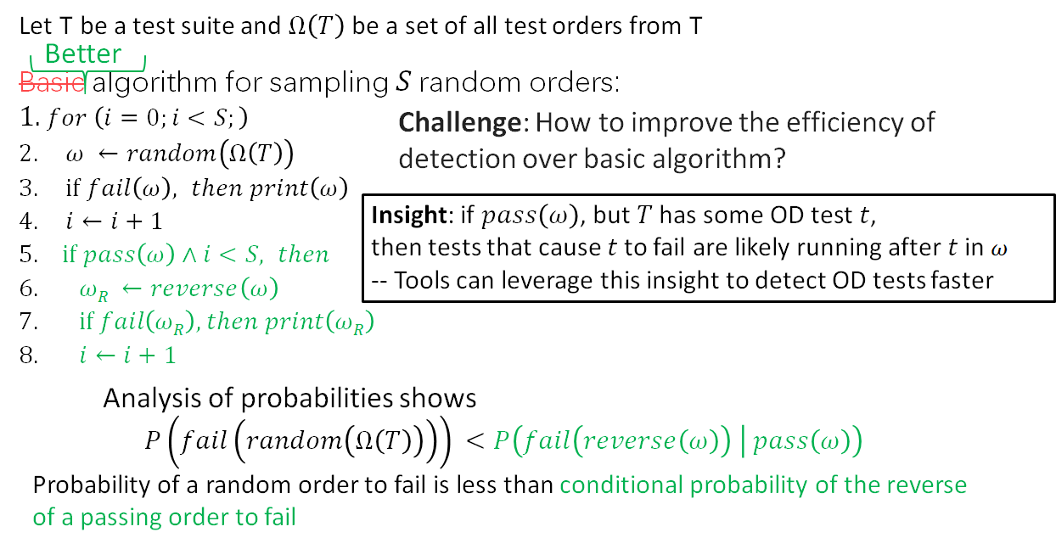
Running Reverse of Passing Order

Slide 15
Systematic Test-Pair Exploration
Motivation
Randomization-based sampling is inherently probabilistic and can fail to detect and OD test
Systematic exploration should explore all consecutive test pairs
Guaranteeing to detect all order-dependent tests that depend on one other test
Challenge
Cost: # of test orders, # of test methods
Constraint: cannot interleave tests from different test classes

Slide 16
Systematic Test-Pair Exploration
Solution
Based on the concept of Tuscan Square
Generate orders that cover inter-class test pairs and intra-class test pairs

Slide 17
Tuscan Squares
Given a natural number n, a Tuscan square consists of n rows each of which is a permutation of the numbers {1,2,...,n}
Every pair <i,j> of distinct numbers occurs consecutively in some row
A Tuscan square of size n is equivalent to a decomposition of the complete graph on n vertices into n Hamiltonian paths.
Notes:
Each arrow represents a pair to cover

Slide 18
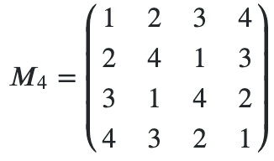
Tuscan Squares
A Tuscan Square of size n is equivalent to a decomposition of the complete graph on n vertices into n Hamiltonian paths. (e.g., n=4)
1
2
3
4
Notes:
Each arrow represents a pair to cover

Slide 19
Tuscan Squares
A Tuscan Square of size n is equivalent to a decomposition of the complete graph on n vertices into n Hamiltonian paths. (e.g., n=4)
1
2
3
4

Slide 20
Tuscan Squares
A Tuscan Square of size n is equivalent to a decomposition of the complete graph on n vertices into n Hamiltonian paths. (e.g., n=4)
1
2
3
4

Slide 21
Tuscan Squares
A Tuscan Square of size n is equivalent to a decomposition of the complete graph on n vertices into n Hamiltonian paths. (e.g., n=4)
1
2
3
4

Slide 22
Tuscan Squares
A Tuscan Square of size n is equivalent to a decomposition of the complete graph on n vertices into n Hamiltonian paths. (e.g., n=4)
1
2
3
4

Slide 23
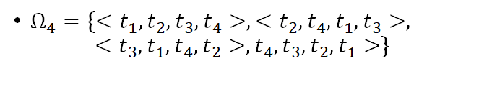
Special Case: All orders are class-compatible
Only one class, or many classes that each have only one test
Directly translate permutations from Tuscan squares into test orders that cover all test pairs
Example n = 4:

Slide 24
General Case
More than one class and at least one class has more than one test
High-level description of the algorithm:
For each class, generate intra-class test pairs using Tuscan Square. These test orders (all intra-class and some inter-class test pairs) are then appended to form test orders
Then generate more test orders to cover the remaining inter-class test pairs greedily
initialize a test order with a randomly selected not-covered test pair and then extend the test order with a randomly selected not-covered test pair as long as possible

Slide 25
Evaluation
# of test orders and # of tests are only 3.68% and 51.8%, that of a naive exploration algorithm that runs all pairs of tests
The overall cost is close to the theoretical optimal
44 new order-dependent tests are detected by running my algorithm on iDFlakies dataset

Slide 26
Conclusion
Presented the first analysis of the probability that randomized test orders detect order-dependent tests
Proposed a simple change for sampling random test orders to increase the probability of detecting OD tests
Proposed a novel algorithm that systematically explores all consecutive pairs of tests, guaranteeing to find all order-dependent tests that depend on one other test, with minimized cost
Our runs of some test orders generated by the algorithm detected 44 new order-dependent tests, not detected in prior work on the same evaluation dataset

Slide 27
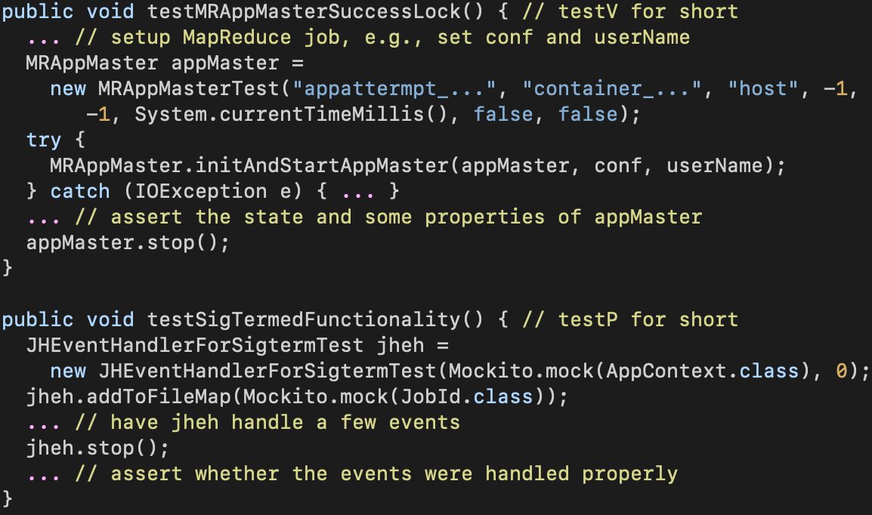
Example of a Flaky Test
A polluter-victim pair: testV and testP (in two test classes)
testP has 11 cleaners in the same class
Another polluter test testP’ has totally 31 cleaners in 8 different test classes
For testV, randomly sampling the orders that JUnit could run gives a flake rate of 4.5%
Notes:
testP has 11 cleaner tests in the same class. There is another polluter test testP’ for testV, which is in the same class with testP and shares the 11 cleaners. Interestingly, testP’ has another 20 cleaners, one in the same class as testV, and the other 19 in other six classes. Since the polluters have a lot of cleaners, the flake rate is as low as 4.5%.

