Slide 1









Preempting Flaky Tests via Non-Idempotent-Outcome Tests
Anjiang Wei, Pu Yi, Zhengxi Li, Tao Xie, Darko Marinov, Wing Lam
Funding acknowledgments​
anjiang@stanford.edu
62161146003
CCF-1763788 CCF-1956374

Slide 2

Developer Anecdote
… - static int add() {
+ static int add(r) {
- ts.addRow(“”);
+ ts.addRow(r); return ts.size();
…
Build code
Run tests
4:15 PM
Servers
test₀
Servers
test₁
test₂
…
test_{n}

Slide 3

Developer Anecdote
… - static int add() {
+ static int add(r) {
- ts.addRow(“”);
+ ts.addRow(r); return ts.size();
…
Build code
Run tests
4:15 PM
Servers
test₀
Pass
Servers
test₁
Merge Changes
test₂
…
test_{n}

Slide 4
Developer Anecdote
… - static int add() {
+ static int add(r) {
- ts.addRow(“”);
+ ts.addRow(r); return ts.size();
…
Build code
Run tests
4:15 PM
Servers
Fail
test₀
Servers
Debug Changes
test₁
test₂
…
test_{n}

Slide 5



Developer Anecdote
… - static int add() {
+ static int add(r) {
- ts.addRow(“”);
+ ts.addRow(r); return ts.size();
…
Build code
Run tests
4:15 PM
Servers
… - static int add() {
+ static int add(r) {
- ts.addRow(“”);
+ ts.addRow(r); return ts.size();
…
Servers
5:00 PM
Servers
… - static int add() {
+ static int add(r) {
- ts.addRow(“”);
+ ts.addRow(r); return ts.size();
…
Build code
Run tests
5:30 PM
Servers
6:15 PM
Servers

Slide 6
Developer Anecdote
Developer wastes time debugging & running tests and goes home 1 hour and 15 min later
… - static int add() {
+ static int add(r) {
- ts.addRow(“”);
+ ts.addRow(r); return ts.size();
…
Build code
Run tests
4:15 PM
Servers
… - static int add() {
+ static int add(r) {
- ts.addRow(“”);
+ ts.addRow(r); return ts.size();
…
Servers
5:00 PM
Servers
Flaky Test: a test that can non-deterministically pass and fail when run on the same code version
… - static int add() {
+ static int add(r) {
- ts.addRow(“”);
+ ts.addRow(r); return ts.size();
…
1 hour
15 min
Build code
Run tests
5:30 PM
Servers
6:15 PM
Servers

Slide 7

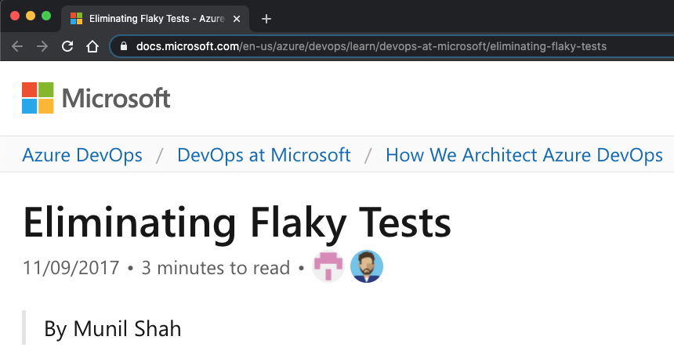
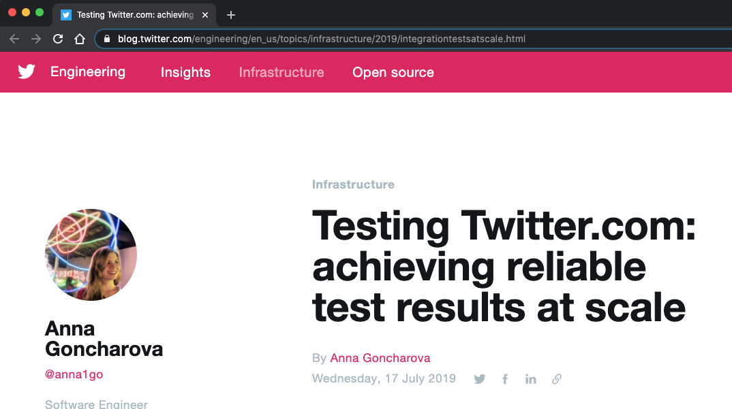
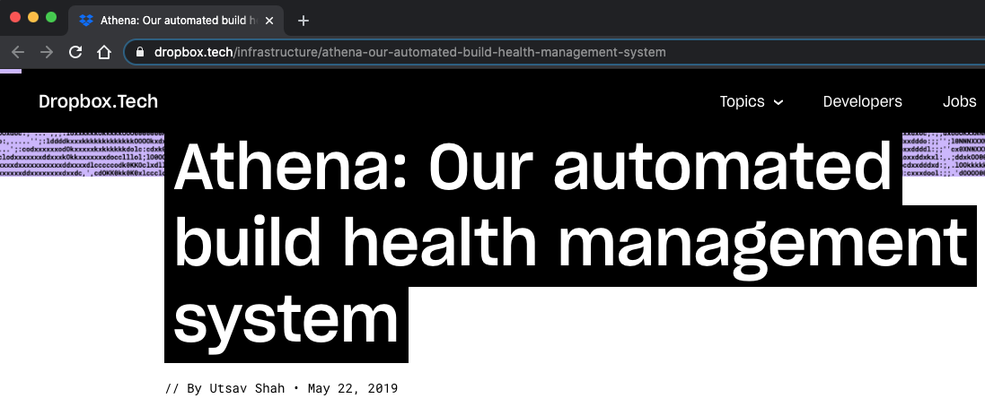
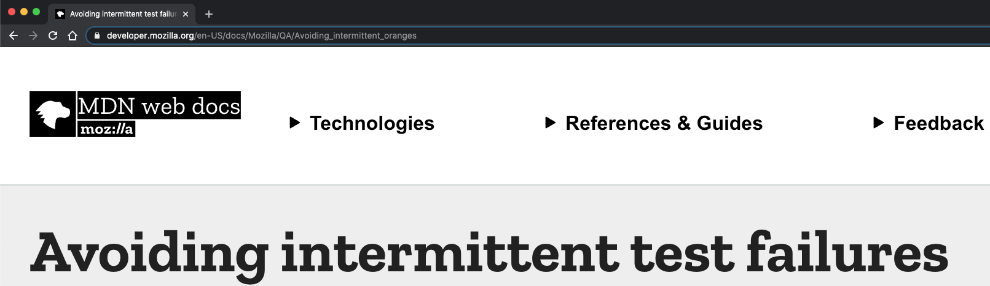
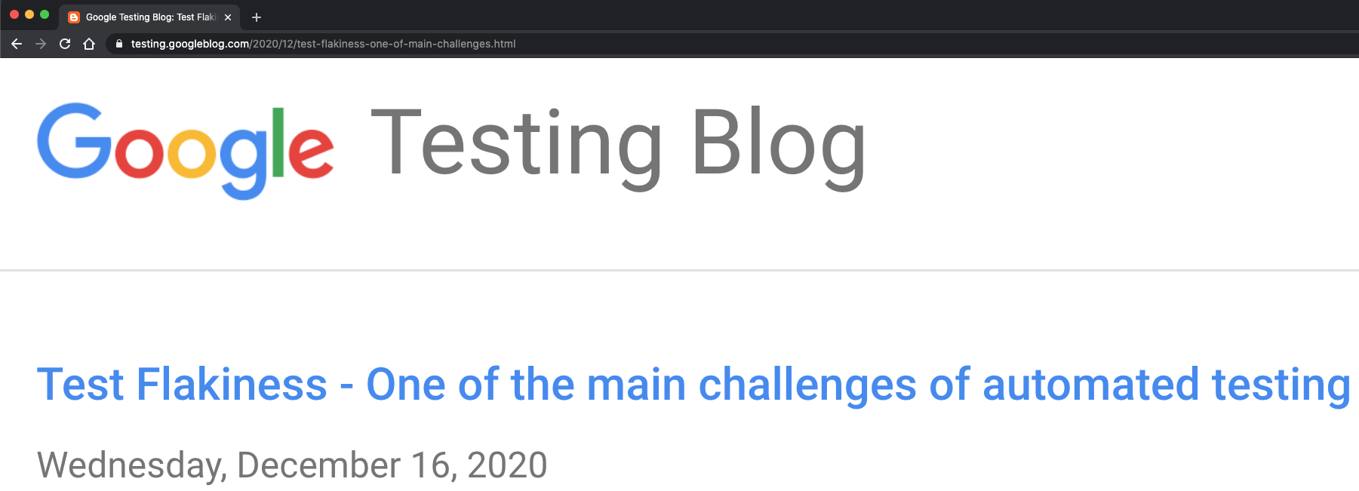
Public Outcry About Flaky Tests
Developer wastes time debugging & running tests and goes home 1 hour and 15 min later
… - static int add() {
+ static int add(r) {
- db.addRow(“”);
+ db.addRow(r); return db.size();
…
4:15 PM
Servers
… - static int add() {
+ static int add(r) {
- db.addRow(“”);
+ db.addRow(r); return db.size();
…
Servers
5:00 PM
Servers
… - static int add() {
+ static int add(r) {
- db.addRow(“”);
+ db.addRow(r); return db.size();
…
Flaky Test: a test that can non-deterministically pass and fail when run on the same version of the code
1 hour
15 min
5:30 PM
Servers
6:15 PM
Servers

Slide 8
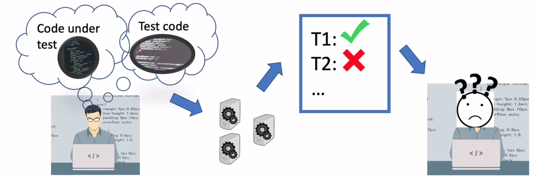
What are Flaky Tests?
A test is flaky if it passes and fails for the same code version
Misleads developers to debug nonexistent faults in recent changes
Reduces trust in tests
Order-dependent tests are a prominent category of flaky tests
An order-dependent test deterministically passes or fails in any given test order, passes in 1+ order, and fails in 1+ order

Slide 9
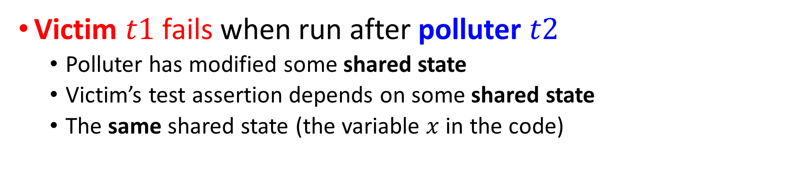
Background: Victim and Polluter
TestOrder1
// shared variable x is initialized to 0 void t1() { assert x == 0; } // victim void t2() { x = 1; } // polluter
t1
t2
TestOrder2
t2
t1
Victim $t1$ fails when run after polluter $t2$
Polluter has modified some shared state
Victim’s test assertion depends on some shared state
The same shared state (the variable $x$ in the code)

Slide 10
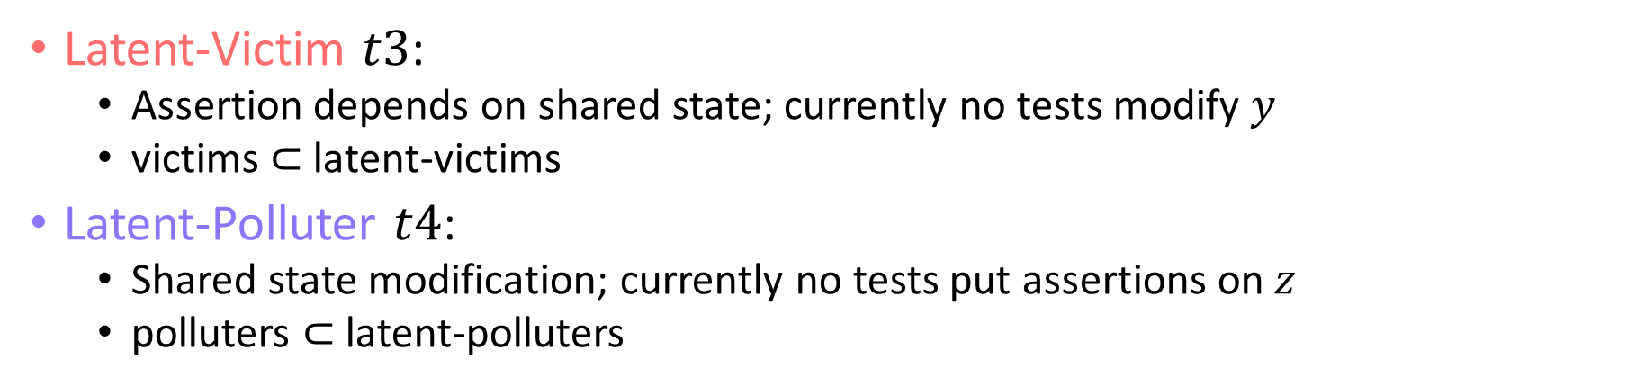
Background: Latent-Victim, Latent-Polluter
// shared variables x, y, z are initialized to 0 void t1() { assert x == 0; } // victim void t2() { x = 1; } // polluter void t3() { assert y == 0; } // latent-victim void t4() { z = 1; } // latent-polluter
Latent-Victim $t3$:
Assertion depends on shared state; currently no tests modify $y$
victims $⊂$ latent-victims
Latent-Polluter $t4$:
Shared state modification; currently no tests put assertions on $z$
polluters $⊂$ latent-polluters

Slide 11
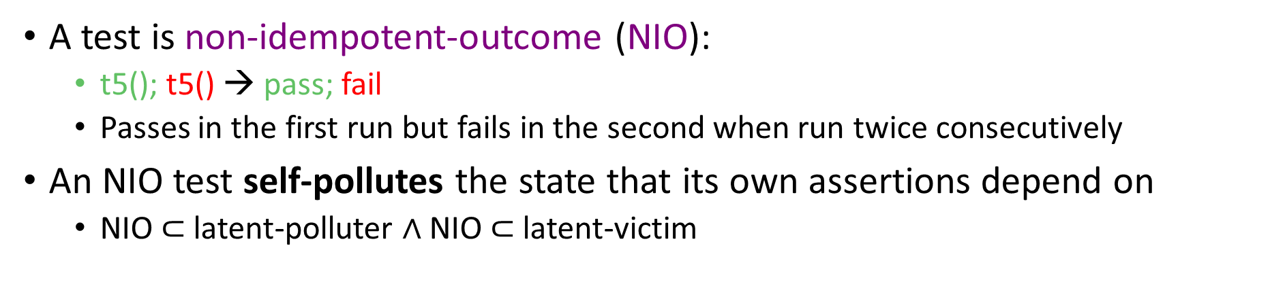
Non-Idempotent-Outcome (NIO) Test
// shared variables x, y, z, w are initialized to 0 void t1() { assert x == 0; } // victim void t2() { x = 1; } // polluter void t3() { assert y == 0; } // latent-victim void t4() { z = 1; } // latent-polluter void t5() { assert w = 0; w = 1;} // NIO
A test is non-idempotent-outcome (NIO):
t5(); t5() → pass; fail
Passes in the first run but fails in the second when run twice consecutively
An NIO test self-pollutes the state that its own assertions depend on
NIO $⊂$latent-polluter $∧$ NIO $⊂$ latent-victim

Slide 12
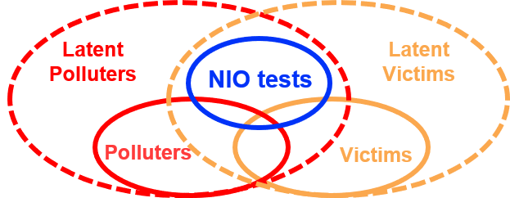
Why should we detect NIOs?
Typically, tests are not run twice
To preempt/prevent flaky tests
Why not fix latent-polluter?
Why not fix latent-victim?
Prior work
Gyori et al.¹ detect 575 latent-polluters
Manually filter 381 (66%) false positives (cannot reasonably become polluters)
Huo and Clause² detect latent-victims with dynamic taint analysis
Do not report how many can reasonably become victims
They do NOT fix any tests
NIOs are more worth fixing
Both latent-victims and latent-polluters at the same time
Easy to detect, no false positives
Well-accepted fixes
¹ Gyori et al., “Reliable testing: Detecting state-polluting tests to prevent test dependency”. ISSTA 2015
² Huo and Clause, “Improving oracle quality by detecting brittle assertions and unused inputs in tests”. In FSE 2014

Slide 13
Contributions
Definition of NIO tests
Deterministically change from pass to fail when run twice
Effective detection & empirical evaluation
Propose 3 modes for detection
127 Java test suites → 223 NIO tests
1006 Python projects → 138 NIO tests
Well-accepted fixes
Inspect every NIO test (no false positive)
Open pull requests for 268 tests
192 accepted, 70 pending, only 6 rejected

Slide 14

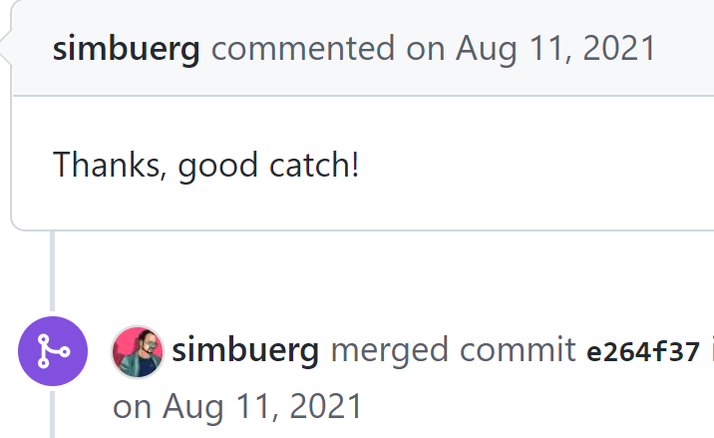
Real Example of NIO
Buggy Cleaning Code
TypeError: list indices must be integers or slices, not str
def cmd_mock():
def _cmd_mock(name: str):
cmd.__overrides__[name] = [‘/bin/true’]
yield _cmd_mock
- cmd.__overrides__ = []
+ cmd.__overrides__ = {}
def test_slurm_command(tmp_path, cmd_mock):
cmd_mock('srun')

Slide 15
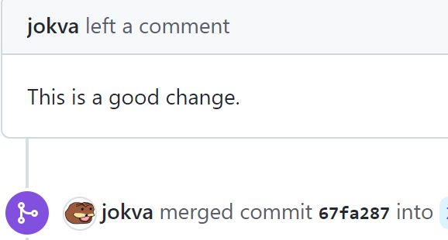
Real Example of NIO
def to_zero(tvd, northing, easting, surface_northing, surface_easting):
# perform some checking
- northing -= surface_northing
- easting -= surface_easting
+ northing = northing - surface_northing
+ easting = easting - surface_easting
return tvd, northing, easting
# initialization for global variables: g1,…,g5
g1 = ...
def test_zero():
# global variables passed in as arguments
v1, v2, v3 = to_zero(g1, g2, g3, g4, g5) np.testing.assert_equal (...) # assertion
Fix: Avoid Function Side Effect
AssertionError: Mismatched elements: 121 / 121 (100%)

Slide 16
Prevalence of NIO Tests
 | Java | Python
# Test Suites (total) | 127 | 1006
# Test Suites w/ NIO | 34 | 138
% Test Suites w/ NIO | 26% | 9%
# NIO Tests | 223 | 138
Conclusion:
NIO tests are prevalent enough that every project should run NIO detection at least once

Slide 17
Different Detection Modes
Three Different Modes
Isolated-method
Run1: t1, t1
Run2: t2, t2
Run3: t3, t3
Isolated-class
Run1: t1, t1, t2, t2
Run2: t3, t3
Entire-suite
Run1: t1, t1, t2, t2, t3, t3
Conclusion
All three modes detect similar tests
Isolated-method (223) > Isolated-class (212) > Entire-suite (210)
Entire-suite has the lowest overhead
Why differ? See paper for details​
Test Suite
TestClass A
TestClass B
t1
t2
t3

Slide 18
Experience with Fixing NIO Tests
We detect 361 (233 Java + 138 Python) NIO tests
We fix 268 NIO tests by opening Pull Requests
192 tests accepted
70 tests pending
6 tests are rejected
We do not fix 51 NIO tests
Cannot localize pollution
Difficult to clean the pollution
42 tests are N/A
Not NIO in the latest version (fixed/deleted/etc)
Conclusion
Developers are generally positive about fixes for NIO tests
Providing reproducing steps and explaining the motivation help

Slide 19
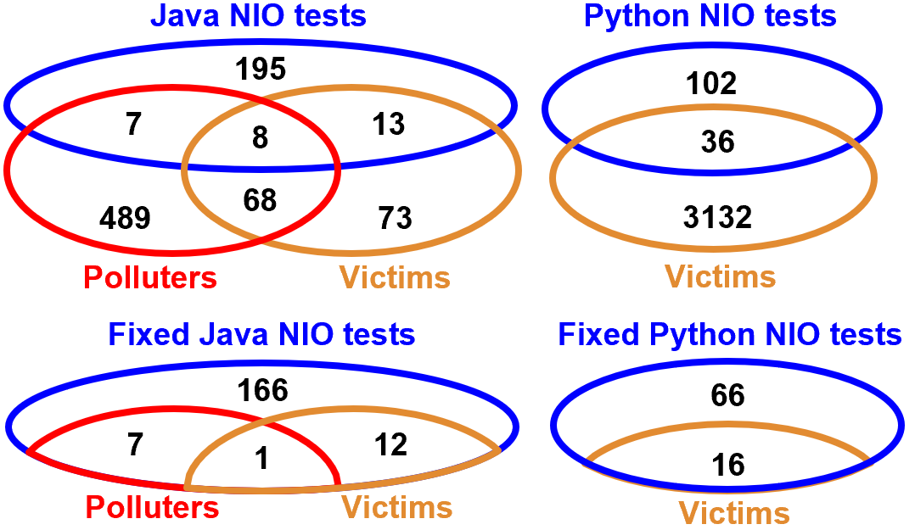
NIO vs. Polluter vs. Victim
NIO tests are related to but not subsumed by polluters and victims
Detecting NIO tests can be an effective way to preempt polluters and victims

Slide 20
Conclusions
We focus on Non-Idempotent-Outcome (NIO) tests
Deterministically change from pass to fail when run twice
Detect and fix NIO tests
Preempt order-dependent flaky tests
Importance: in the intersection of latent-polluters and latent-victims
Detect 361 NIO tests (223 Java + 138 Python)
Opened pull requests for 268 tests, with 192 accepted
Dataset publicly available:
https://sites.google.com/view/nio-tests
IDoFT dataset (all flaky tests): https://github.com/TestingResearchIllinois/idoft
Questions? Email: Anjiang Wei <anjiang@stanford.edu>

