Slide 1










A Theoretical Analysis of Random Regression Test Prioritization
Acknowledgements:
CCF-1763788
CCF-1956374
No. 62161146003
Pu (Luke) Yi, Hao Wang
Tao Xie, Darko Marinov, Wing Lam
lukeyi@pku.edu.cn
Notes:
Hello everyone! My apologies for not being able to present in person. My name is Pu but I usually go by Luke. Today I'm going to present my work on "A Theoretical Analysis of Random Regression Test Prioritization". This is a joint work done by me and my collaborators Hao, Tao, Darko and Wing. We are from Peking University, China, University of Illinoy, USA, and George Mason University, USA.

Slide 2
Regression Test Prioritization (RTP)
Order test suites (unorderd set), intuitively to find failures faster
Widely studied in research, seminal paper [1] has 1k5+ citations
Used in practice, e.g., at Google [2] and Microsoft [3]
T1
RTP
T3
T1
T3
T2
T2
Test Suite T
Test Order
[1] Rothermel et al. "Prioritizing test cases for regression testing" TSE 2001
[2] Elbaum et al. "Techniques for improving regression testing in continuous integration development environments" FSE 2015
[3] Srivastava and Thiagarajan “Effectively prioritizing tests in development environment” ISSTA 2002
Notes:
Let me first quickly introduce regression test prioritization, which is also called RTP. RTP is the approach to order test suites, which are unordered sets of tests, to a test execution order, aiming to intuitively find failures faster. Finding test failures faster enables the developers to start debugging earlier. RTP has been widely studied in research. Various RTP techniques have been proposed in the literature since the seminal papers from 20+ years ago that have garnered thousands of citations. RTP has also been used in practice. For example, Google and Microsoft report on using RTP in industry.

Slide 3
Background - Overview
RTP technique
Order 1
Failures
Test Suite
Order 2
Order 3
Detect
Optional
Historical
Information
…
Faults
Notes:
While RTP is widely studied in software testing conferences, I assume that most of the TACAS audience may not be familiar with RTP, so let me take some time to introduce the background before I go further. The background will cover these notions: test suite, RTP techniques, test orders, failures and faults. At the high level, RTP techniques take as input a test suite, and output a number of test orders. Running the test orders triggers failures, which then detect the underlying faults.

Slide 4
Background - Test Suite
Test suite T: a set (unordered) of tests
n = |T| is the number of tests in T
T1
T3
T2
…
Test Suite T
Notes:
Formally, a test suite, usually denoted as T, is an unordered set of tests. We denote n as the number of tests in T.

Slide 5
Background - RTP technique
RTP technique
Order 1
Test Suite
Order 2
Order 3
Optional
Historical
Information
…
Notes:
A RTP technique takes as input a test suite T and optionally historical information about prior runs of T, and produces as output test-suite orders, which are permutations of the tests in the test suite.
One thing worth mentioning is that many RTP techniques produce more than one order due to some randomness in the algorithm.

Slide 6
Background - Failure
Failure: a failing test
e.g., assertion fails, program crashes when executing the test
k: number of failures in T (k ≤ n)
k ≪ n in practice: a small fraction of tests fail in real test suites [1]
k ≤ 10 in 98% of the test suites
average(n) = 176
[1] Peng et al. "Empirically revisiting and enhancing IR-based test-case prioritization" ISSTA 2020
Notes:
After running the orders produced with RTP techniques, some failures may be triggered. A failure is simply a failing test. For example, during the execution of the test, some assertion fails or the program crashes. We denote k as the number of failures in the test suite T. Since each test may and may not fail, k is less than or equal to n, and in practice k is much less than n. In our evaluation dataset, k <= 10 in 98% of the test suites, while the average of n is 176.

Slide 7
Background - Fault
Fault: the root cause for the failure
Bugs in the code
Faults are static, while failures are dynamic
m: number of faults
Notes:
With the failures developers can track to reveal the faults. Faults are the root causes of failures, and are essentially the bugs in the code. Note that faults are static incorrectness in the code. In comparison, failures are dynamic, triggered when running the failing tests. We use m to denote the number of faults.

Slide 8
Failures Detect Faults
We call a failure detects a fault if the failure is caused by the fault [1]
Many failures may detect the same fault
One failure may detect many faults
t₁
t₂
t₃
t₄
t₅
F₁
F₂
F₃
 | Tests
Faults | t₁ | t₂ | t₃ | t₄ | t₅
F₁ |  |  | X
F₂ | X |  |  |  | X
F₃ |  |  |  | X | X
Failure-to-Fault Matrix
[1] Rothermel et al. "Test case prioritization: An empirical study" ICSM 1999
Notes:
We call a failure detects a fault when the fault is the root cause of the failure. Note that many failures may detect the same fault, and also one failure may detect many faults. The mapping between failures and faults can be complicated. Here is one example. You can see that t1 and t5 both detect F2, and t5 can detect both F2 and F3.
We call a matrix like this a Failure-to-Fault matrix, which is a m*n matrix, such that a cross in entry (i,j) means that test j fails and detects fault i. Since we only consider the faults detectable by the entire test suites, for each row there is at least one cross. And since some test may pass, certain columns may contain no crosses.
Note that in this example, most tests fail, but in practice most tests pass.

Slide 9
How to Compare Orders
The goal is to find faults faster, not just failures
Two metrics are widely used in research to quantify how fast a test order finds the faults on average
Input: an order and failure-to-fault matrix
Output: a score normalized to (0,1)
α - APFD (Average Percentage of Faults Detected) [1]
γ - APFDc (“Cost-cognizant” APFD) [2]
Cost is typically measured as test runtime
[1] Rothermel et al. "Prioritizing test cases for regression testing" TSE 2001
[2] Elbaum et al. “Incorporating varying test costs and fault severities into test case prioritization” ICSE 2001
Notes:
Now that we know RTP works, how do we compare different test orders in the same test suite with the same failure-to-fault matrix? Note that the goal is to find faults faster, not just failures, because faults are the essential bugs and failures are only the means to show them. For example, finding N failures that detect the same fault is not as valuable as finding 2 failures that detect two different faults. To quantify how fast a test order finds the failures on average, two metrics introduced two decades ago are most widely used: alpha, which is traditionally called APFD, average percentage of faults detected, and gamma, which is traditionally called APFDc, the “cost-cognizant” version of APFD. The cost can be measured in various ways, but most work uses the test runtime. These two metrics are both normalized to open unit interval, between 0 and 1, enabling comparing techniques across multiple test-suites.

Slide 10
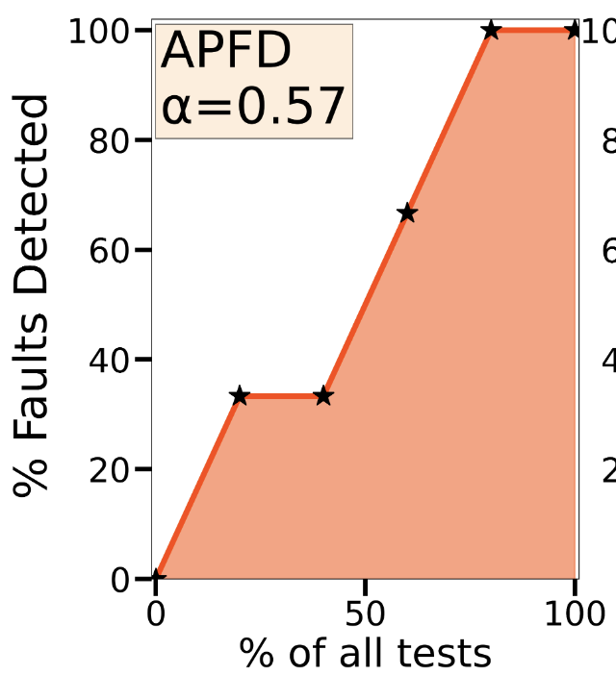
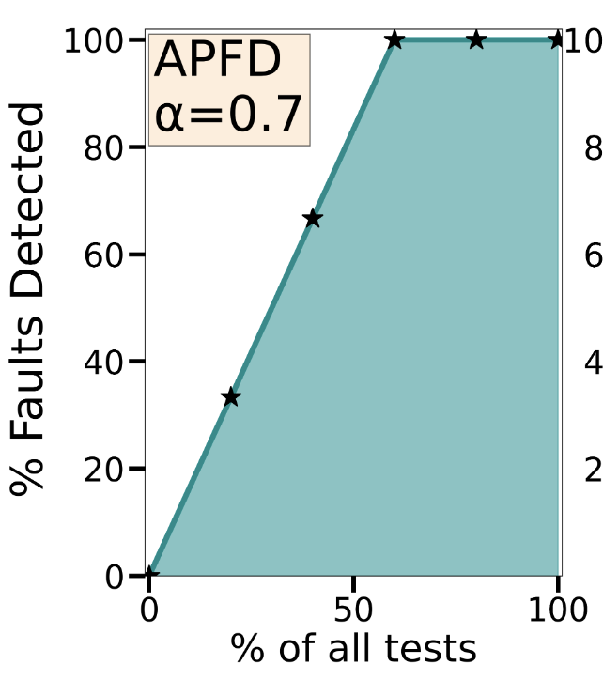
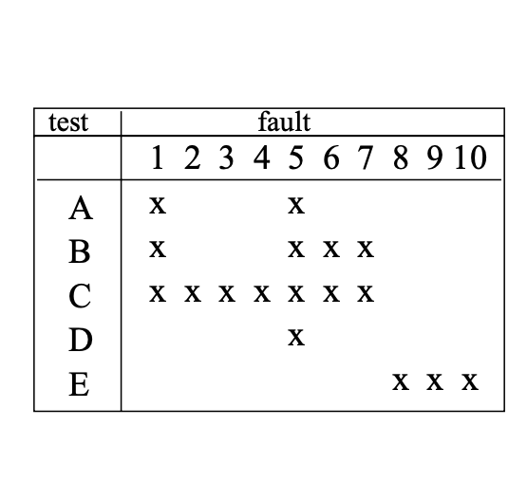
α - APFD (Average Percentage of Faults Detected)
t₄
t₅
t₁
t₂
t₅
t₃
t₃
 | Tests
Faults | t₁ | t₂ | t₃ | t₄ | t₅
F₁ |  |  | X
F₂ | X |  |  |  | X
F₃ |  |  |  | X | X
t₁
t₂
t₄
X: test that detects a fault first
t₁- t₂- t₃- t₄- t₅
>
t₄- t₃- t₁- t₂- t₅
Notes:
Let’s take a look at an example to show how we calculate alpha. In the table is the failure-to-fault matrix, and on the right are the two figures corresponding to two different test orders for the given matrix that plot the percentage of faults detected against the percentage of executed tests.
The order for the orange plot is t1-t2-t3-t4-t5. After the execution of t1, the curve jumps to 33% because t1 detects F2. Since t2 passes and detects no fault, the curve then goes plain. t3 and t4 then detect F1 and F3 respectively. In the end, although t5 can detect F2 and F3, they have both been detected by tests run before it, so the curve goes plain. But if in another order t5 runs first, the curve would directly jump from 0 to 66% because it detects 2 new faults first. alpha is defined as the area under the curve. It intuitively captures the average fault-finding rate in respect to the number of tests. The alpha of the first order is 0.57.
The order for the blue one is t4-t3-t1-t2-t5. Similarly, we can get that its alpha equals 0.7.
In this example, by alpha the second order is better because it on average finds faults faster in respect to the number of tests.

Slide 11
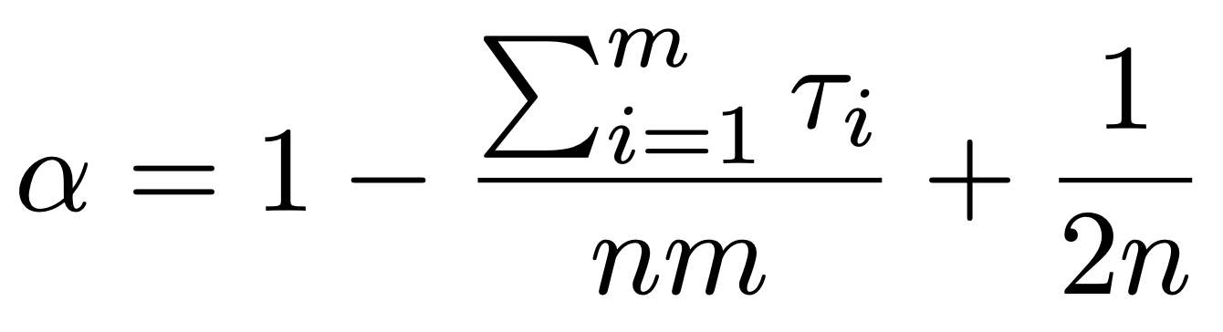
α - APFD (Average Percentage of Faults Detected)
Order: t₁- t₂- t₃- t₄- t₅
Position of the test to detect F_{i} first in the order
 | Tests
Faults | t₁ | t₂ | t₃ | t₄ | t₅
F₁ |  |  | X
F₂ | X |  |  |  | X
F₃ |  |  |  | X | X
X: test that detects a fault first
Notes:
alpha can be calculated with this formula, where tao_i is the position of the first test to detect fault i in the order. In the matrix, tao_i is the position of the first cross in row i.

Slide 12
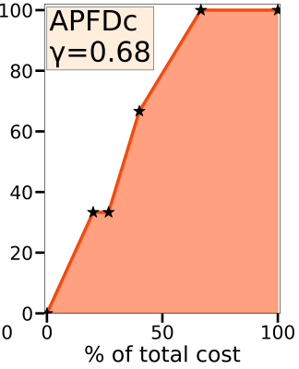
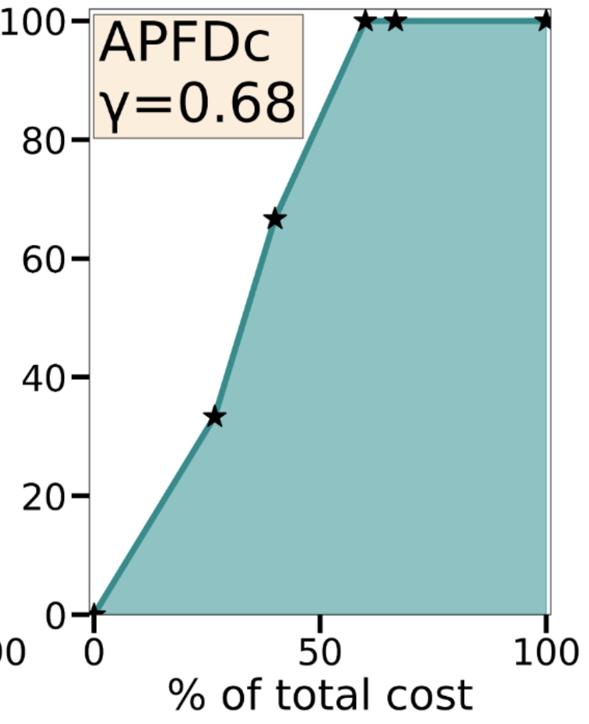
γ - APFDc (“Cost-cognizant” APFD)
t₄
t₅
t₃
t₅
t₄
 | Tests
Faults | t₁ | t₂ | t₃ | t₄ | t₅
F₁ |  |  | X
F₂ | X |  |  |  | X
F₃ |  |  |  | X | X
Costs | 60 | 20 | 40 | 80 | 100
t₃
t₂
t₁
t₁
t₂
t₁- t₂- t₃- t₄- t₅
X: test that detects a fault first
=
t₄- t₃- t₁- t₂- t₅
Notes:
Gamma, or APFDc, is similar to alpha, except that gamma captures the fault-finding rate in respect not to the number of tests, but to the cost of tests, which is usually measured by the runtime of tests.
In other words, if we change the x-axis to the percentage of the total cost, the area under the curve is then gamma.
We have seen that in this example, by alpha the first order is better, and now we can see that by gamma, these two orders are equally good because their gamma are both 0.68.
We leave out gamma’s formula because it is similar to that of alpha. Note that alpha can be viewed as a special case of gamma, when all the tests have the same cost. Our analysis is mostly general for both alpha and gamma, but in this talk I’ll focus on alpha because it is easier to follow.

Slide 13
How Are RTP Techniques Compared
Sample input test suites, and for each sample one or more output orders
1. Sample Distribution
Statistical Test: Does a technique produce orders that are statistically significantly better than the orders of others?
Box Plots: Visualize the distribution of samples
2. Sample Average
Notes:
Now we know how orders are compared, then how are two RTP techniques compared? Prior work compared a sample distribution, or a sample average of produced orders’ alpha or gamma. For sample distribution, people use statistical test that answers the question “does a technique produce orders that are statistically significantly better than the orders of other techniques”, and also use box plots which visually show certain properties of the sample distribution. Some work just compared the sample average, for example, the average gamma in the sampled orders.

Slide 14
Random RTP
Random RTP is a simple RTP technique that produces a random test order
Frequently used as a baseline for comparison in research
56 of 100 most cited RTP papers use random RTP as a baseline
2 of 4 most recent RTP papers in ICST/ISSTA 2021 also use random RTP as a baseline
All prior studies used sampling to estimate the performance of random RTP
Notes:
Random RTP is a simple RTP technique that gives a random test order. It is frequently used as a baseline for comparison. For example, our survey found that 56 of 100 most cited RTP papers used random RTP as a baseline, and 2 of 4 most recent RTP papers published in the latest leading testing conferences ICST & ISSTA 2021, also used random RTP as a baseline. Since random RTP can produce as many as n! different orders, all prior studies used sampling to estimate the performance of random RTP.

Slide 15
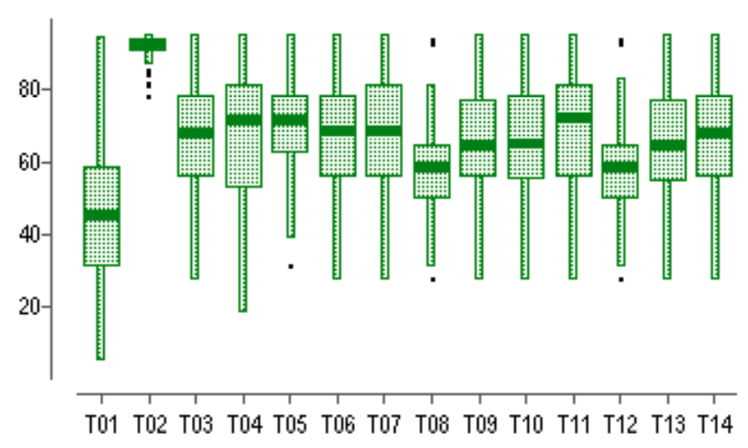
Inaccuracy Found in a Seminal RTP Paper [1]
We prove that the mean and median α of random orders should never be below 0.5 (for the entire population; a sample can be like this)!
α
50
Boxplot of the α of random orders
[1] Elbaum et al. “Prioritizing test cases for regression testing” ISSTA 2000
Notes:
Now, let’s look at the results in a seminal RTP paper published in 2000. Here, each boxplot corresponds to a technique, and the y-axis shows the alpha, or APFD. The line in the middle of the boxplots marks the mean or median of the sampled population. Here, the No.1 boxplot on the left is for random RTP. Well, everything looks seemingly fine in the figure, right?
EXCEPT that the results definitely underestimate the performance of random RTP. Through our analysis, we found that the mean or median alpha of random orders should never be below 0.5, and the boxplot clearly violates it.
This violation may stem from insufficient sampling, or some bug in the experimental code.
However, one may ask, random RTP is intuitively worse than other techniques, so why should we care?

Slide 16
Why Compare with Random RTP?
Random RTP can perform very good in certain scenarios
e.g., when there are many failures, random RTP is satisfactory
Negligible runtime overhead
Easy to implement
Can help detect order-dependent failures [1]
[1] Lam et al. "iDFlakies: A Framework for Detecting and Partially Classifying Flaky Tests" ICST 2019
Notes:
Why should we compare with random RTP? Well, there are four reasons. First of all, our analysis shows that random RTP can perform very good in certain scenarios, and in these scenarios one may not assume that some techniques perform better than random RTP. Second, the runtime overhead of the techniques is also important in practice. Random RTP incurs negligible overhead compared with some expensive state-of-the-art techniques. For example, some techniques are based on code coverage, which is expensive to obtain. Third, random RTP is easy to implement. In comparison, some techniques based on information retrieval require non-trivial implementation efforts. Finally, random test orders can help detect order-dependent flaky tests, which are a type of detrimental tests.

Slide 17
Why Theoretically Analyze Random RTP?
Formulas/algorithms for random RTP can avoid:
Inaccuracy in the sample
High cost to obtain many samples
The population size is O(n!)
Notes:
The preceding example tells us that estimating the performance of random RTP via sampling may be inaccurate. We also know that it is time-consuming to get enough samples. These drive us to instead theoretically analyze random RTP, which can yield an accurate evaluation of random RTP with running some quick algorithms or computing simple formulas.

Slide 18
Our Contributions: A Theoretical Analysis of Random RTP
 | Prior Work | Our Paper
How to compare with random RTP | Sample Distribution Sample Average | Probability Mass Function (PMF) Expected Value
Approach | Sampling | Formulas & Algorithms (when possible)
Accurate? | Potentially Not | Yes!
Fast? | Depends on Accuracy | Often
Notes:
Now that I introduced the background, let me switch to describe the main contributions of our paper.
Prior work used sample distribution or sample average for comparision with random RTP, our paper proposed to instead use PMF and expected values of the whole population.
Prior work used sampling, but we devised algorithms and closed-form formulas.
Sampling may potentially incur inaccuracy, while formulas and algorithms are always accurate.
The runtime of sampling depends on the desired accuracy, but our algorithms and formulas are often fast to run or compute.

Slide 19
Algorithm to Compute the PMF of APFD (α)
Input: a test suite T and failure-to-fault matrix M
Output: PMF (probability mass function, distribution) of α
The key term that changes in different orders
Position of the test to detect F_{i} first in the order
Notes:
I’ll first present our novel algorithm to compute the PMF of alpha. The problem is, given a test suite and failure-to-fault matrix, output the PMF, that is probability mass function or distribution of alpha. Before I begin, let’s first have a quick review of the definition of alpha. We can see that the key term, and the only term that changes in different orders, is sum of tao_i, where tao_i is the position of the test in the order to detect fault i first.

Slide 20
Is There a Closed-Form Formula for PMF of APFD (α)?
A narrower case: one-to-one failure-to-fault mapping
The problem becomes “count the number of partitions of distinct summands”
To the best of our knowledge, no closed-form formula is known for this problem
Position of the test to detect F_{i} first in the order
Notes:
One may ask, is an algorithm needed? Is there a closed-form formula for the PMF of alpha that can be directly computed? The answer is no, because if we consider a narrower case, where each failure maps to a distinct fault, the problem becomes “count the number of partitions of distinct summands”. To the best of our knowledge, this problem has no known closed-form formula.

Slide 21

Naive Algorithm
O(n!·n)
Enumerate all the O(n!) orders
Compute the α for every order
Aggregate them into one PMF
O(n!) orders
T3
T2
T5
…
T4
T1
Tn
Notes:
Now, let’s first see a naive algorithm for this problem. One can straightforwardly enumerate all n! test orders, for each order compute alpha, and aggregate then into one PMF. Each order takes O(n) to compute alpha, so this algorithm has as high as O(n!*n) complexity.

Slide 22

Improved Algorithm: Only Failing Tests’ Positions Matter
O(n^{k+1})
k failing tests’ positions matter for APFD; (n-k) passing tests’ positions do not
k ≪ n in practice: developers do not tolerate many failing tests in the test suites (T) (k ≤ 10 for 98% of cases in our evaluation dataset)
T3
O(n^{k}) positions for k failing tests
T2
T5
…
T4
T1
Tn
Notes:
A simple observation is that we need not enumerate at the granularity of permutations of all tests. Considering that the permutations with the same positions of failing tests have the same alpha. We can enumerate only the k failing tests’ positions, and there are O(n^k) sets of them. In this example test suite, where only T2 and T5 fail, we now only have to enumerate the positions of these 2 tests. If we enumerate k failing tests’ positions, calculate alpha for each case, and aggregate them, we get an algorithm with time complexity O(n^{k+1}). Considering that k is in most cases much less than n, this algorithm has been much better than the naive algorithm, but it is still not quick enough.

Slide 23

Our Algorithm: Enumerating the Relative Positions of Failing Tests
O(k!·?)
We first enumerate the k! relative positions of the k failing tests
Relative positions: < , > or < , >
T2
T5
T5
T2
T3
O(k!) relative positions of k failing tests
T2
T5
…
T4
T1
Tn
Notes:
How do we further optimize? Let’s try not rush to enumerate the absolute positions of k failing tests. Let’s first enumerate only their relative positions to each other, where there are k! cases. In this example, there are only two sets of the relative positions: <T2, T5> or <T5, T2>. Now, how do we proceed?

Slide 24
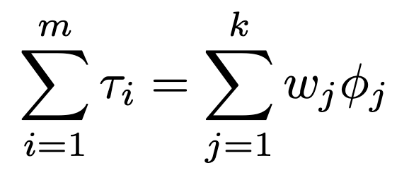
Our Algorithm: Representations of α’s Formula
# of faults the j-th failing test detects first
Position of the test that detects fault i first
Position of the j-th failing test
 | Tests
Faults | t₁ | t₂ | t₃ | t₄ | t₅
F₁ |  |  | X
F₂ | X |  |  |  | X
F₃ |  |  |  | X | X
Order: t₁- t₂- t₃- t₄- t₅
3 + 1 + 4 = 1*1 + 2*0 + 3*1 + 4*1 + 5*0
Notes:
We need first view alpha from a different perspective. Instead of iterating faults, we can switch to iterate over the failing tests. Note that on the left hand side, each summand is the position of a failing test. For the failing test j, if we denote its position in the order as phi_j, on the left hand side, how many times is phi_j added? The answer is the number of faults that test j detects first in the order, which we denote as w_j. This gives us the right hand side formula. In this example, where the test order is t1-t2-t3-t4-t5, and the failure-to-fault matrix is like this, when we iterate the faults like the left hand side, we iterate the rows and sum up the positions of the first cross in each row, which gives us 3+1+4. When we iterate the failures like the right hand side formula, we iterate over the columns and sum up the column ID times the number of crosses that are first in their rows, which gives us 1*1+2*0+3*1+4*1+5*0. One can see that both sides get the same results.

Slide 25



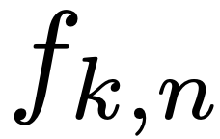
Our Algorithm: Representations of α’s Formula
# of faults the j-th failing test detects first
Position of the test that detects fault i first
Position of the j-th failing test
After the relative positions of the k failing tests are set
\ is set
- number of ways to assign , such that
a and
Goal: find
solved with O(n²mk) dynamic programming
Notes:
The right hand side formula may seem more complicated, but it helps.
Let’s take a closer look at why. Now that we have enumerated the relative positions of the k failing tests, for each fault, which test detects it first is determined, and then we know the number of faults each failing test detects first, so all the Ws are set. Then, we only need to worry about the assignment of phi. We denote f_{g,h}(s) as number of ways to assign φ, such that the assignment of the first g phis are valid, not greater than h and their weighted sum is s. The PMF of the sum that we care about is then f_{k,n}.
This can be solved with an O(n^2mk) dynamic programming algorithm.
More details about the dynamic programming algorithm is in the paper.

Slide 26

Our Algorithm: Computing the PMF of APFD (α)
O(n²mk·k!)
Enumerate k! relative positions of failing tests
For each set of relative positions, use O(n²mk) dynamic programming to compute the PMF of APFD (α)
Aggregate them into one PMF
Notes:
So now, we summerize our algorithm to compute the PMF of APFD alpha. We first…, then…, and finally…. The time complexity is …

Slide 27
Evaluation
Overall complexity - O(n²mk·k!)
k is small in practice
In the RTP dataset that contains the largest number of Java projects [1], 98% of the test suites have k ≤ 10
Our algorithm finishes under 30 sec for each of these test suites
[1] Peng et al. "Empirically revisiting and enhancing IR-based test-case prioritization" ISSTA 2020
Notes:
Now, can this algorithm gives us the results in reasonable time? Admittedly, k! is still a big factor, but in our evaluation RTP dataset that contains the largest number of Java projects, 98% test suites have k <= 10, indicating that k is in most real cases very small. We run our algorithm and it finishes under 30 seconds for each of these test suites.

Slide 28
Closed-Form Formulas for Expected α and γ
Expected α and γ are also used to compare RTP techniques
We derived closed-form formulas of expected values that can be computed in O(n) time
Linearity of expectation & symmetry
More details in the paper
Notes:
That’s all about the algorithm to compute the PMF of alpha. Because the expected values of alpha and gamma are also used to compare to RTP techniques, we derived their closed-form formulas as well. The closed-form formulas of the expected values can be computed in O(n) time. The key properties we exploited in our derivation are linearity of expectation and symmetry. We leave out the formulas and derivations in the talk, but you can find them in our paper.

Slide 29
Closed-Form Formulas for Practically-Constrained Orders
In practice, not all orders can be run [1]
The orders need to satisfy certain practical constraints
e.g., considering the hierarchical organization of test suites
By comparing the expected values, we found that one such constraint negatively affects the performance of random RTP
[1] Wei et al. "Probabilistic and systematic coverage of consecutive test-method pairs for detecting order-dependent flaky tests" TACAS 2021
Notes:
Additionally, we also consider the explected values of alpha and gamma with some practical constraint. In practice, not all the orders can be run, but only those that satisfy some practical constraint. We considered one such constraint, compared the expected values with and without the constraint, and found that it negatively affects the performance of random RTP. This is quite interesting and surprising, because the constraint dost not have anything to do with failures and faults. The details can be found in our paper.

Slide 30
Two Interesting Properties
(1) Mean/Median at Least Half:
E(α), E(γ), Median(α), Median(γ) ≥ 1/2
(2) Symmetric PMF:
If one of E(α), E(γ), Median(α), Median(γ) is 1/2,
all should be 1/2 and the PMFs are symmetric
Notes:
Moreover, we also derived two interesting properties and used them to check highly-cited RTP papers. We proved that first, the expected values and the median values of alpha and gamma should both be greater than or equal to half in all test suites and failure-to-fault matrices. We call this property mean/median at least half. And second, if one of them is half, all the others should also be half, and the PMF of alpha and gamma should be symmetric. We call this property symmetric PMF.

Slide 31
Literature Review
We surveyed 100 most cited papers in RTP
At least 4 papers violate (1) Mean/Median at Least Half
At least 3 papers violate (2) Symmetric PMF
The results in surveyed papers, obtained from sampling, are not reliable
Future studies should directly use our algorithm or the formulas to get the exact performance of random RTP
Notes:
We surveyed 100 most cited papers in RTP. We found that 4 papers’ results violate property Mean/Median at least half and 3 papers’ results violate property symmetric PMF, with some more that we are uncertain due to lack of data and description provided. Note that the papers violating these two properties include the seminal papers that have garnered thousands of citations. These findings indicate that the results obtained from sampling are indeed not reliable, and future studies should directly use our algorithm or formulas to get the exact performance of random RTP.

Slide 32
Contributions
The first theoretical analysis of random RTP
Devised an efficient algorithm to calculate PMF of APFD
Derived closed-form formulas for APFD and APFDc, for all orders and for practially-constrained orders
Found inaccurate results in highly-cited papers that are caused by insufficient sampling (or potentially bugs)
Future work
Extend the theory to analyze other RTP techniques
Design better RTP techniques guided by theory
Notes:
In summary, we have the following contributions.
We present…
We…
We…
We…
In the future, one can look to…

Slide 33
Takeaway
The results obtained from sampling are not reliable for random RTP
Rather than sampling, future RTP studies should directly use our algorithm or the formulas
Formal methods community could study more of RTP in particular and regression testing in general; most results are empirical from the software testing community
Contact: lukeyi@pku.edu.cn
Notes:
Here is the takeaway message that I summarized for you. Thanks everyone. Please feel free to ask any questions.

