Slide 1
方框的CSS樣式

Slide 2
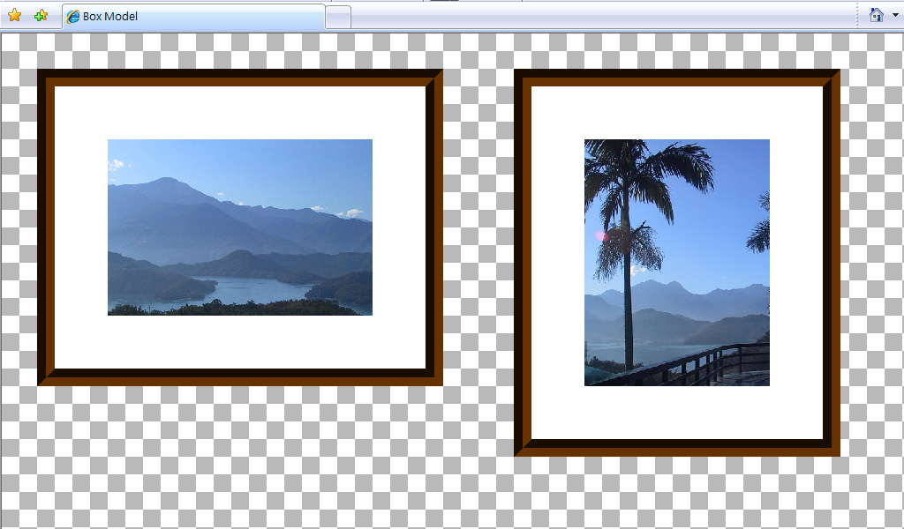
div {
margin: 40px;
border: 20px groove #630;
padding: 60px;
background-color: white;
float:left;
}
...
<div><img src="..." alt="" width="" /></div>

Slide 3
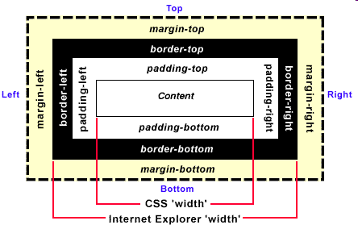
Box Model

Slide 4
Box相關屬性
height, width (內容高度與寬度)
  max-height, max-width
  min-height, min-width
margin (元素間距)
  margin-top, margin-right, margin-bottom, margin-left
border (邊框)
  border-width
    border-top-width, border-right-width, border-bottom-width, border-left-width
  border-style
    border-top-style, border-right-style, border-bottom-style, border-left-style
  border-color
    border-top-color, border-right-color, border-bottom-color, border-left-color
  border
    border-top, border-right, border-bottom, border-left
padding (內距)
  padding-top, padding-right, padding-bottom, padding-left

Slide 5
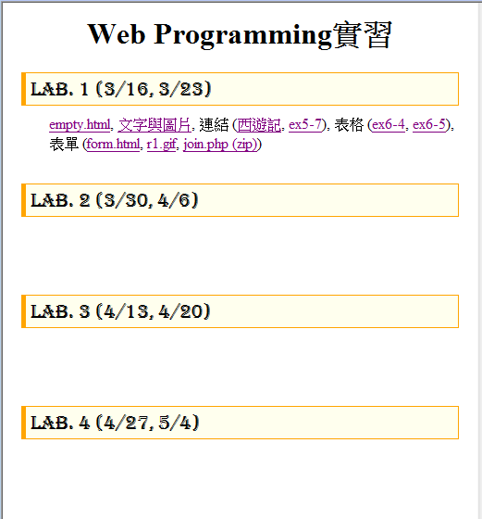
height, width (內容高度與寬度)
內容之高度與寬度
  height, width
  max-height, max-width
  min-height, min-width
dd {min-height: 4pc;}
http://www.im.ncnu.edu.tw/~ycchen/www2009/lab/

Slide 6
margin (元素間距)
margin: 20px; ➔ 上右下左各20px
margin: 30px 2em; ➔ 上下各30px, 右左各2em
margin: 0.5in 15px 1in; ➔ 上0.5in, 右左各15px, 下30px
margin: 40px 25% 1em 30px; ➔ 上40px, 右25%, 下1em, 左30px
margin-top: 15px;
margin-right: -30px;
margin-bottom: 20px;
margin-left: 10%;

Slide 7

元素置中顯示
h1 {
margin-left: auto;
margin-right: auto;
width:140px;
border: 1px solid blue;
}
<h1>CSS方框</h1>

Slide 8

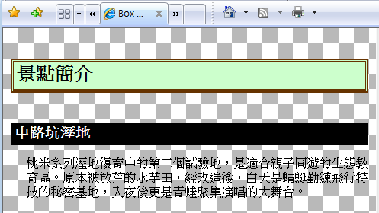
垂直間距之塌陷
marginc.html
h1 {
font-size:18pt;
margin:40px 10px;
border:5px double #630;
padding:3px;
background-color: #cfc;
}
h2 {
font-size:14pt;
margin:15px 10px;
padding:3px 5px;
background-color: black;
color: white;
}
<h1>景點簡介</h1>
<h2>中路坑溼地</h2>

Slide 9
border (邊框)
border-width (邊框厚度)
  border-top-width, border-right-width, border-bottom-width, border-left-width
border-color (邊框顏色)
  border-top-color, border-right-color, border-bottom-color, border-left-color
border-style (邊框樣式)
  border-top-style, border-right-style, border-bottom-style, border-left-style
border (厚度 樣式 顏色 同時設定)
  border-top, border-right, border-bottom, border-left

Slide 10

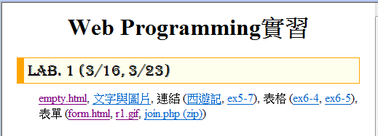
border-width (邊框厚度)
border-width
border-top-width, border-right-width, border-bottom-width, border-left-width
border-width: 1px;
border-left-width: 10px;
border-color: orange;
border-style: solid;
thin | medium | thick | <length>

Slide 11

border-color (邊框顏色)
border-color
border-top-color, border-right-color, border-bottom-color, border-left-color
border-color: red #00FF00 #00F rgb(128,0,128);

Slide 12
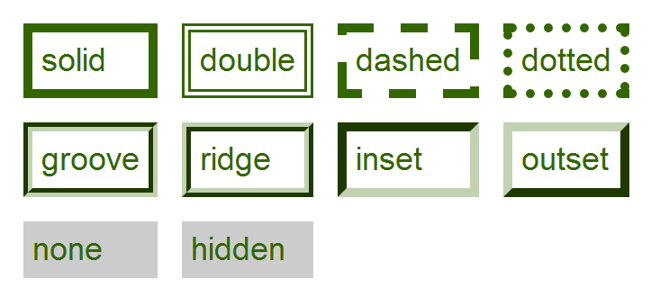
border-style (邊框樣式)
border-style: solid;
solid | double | dashed | dotted | groove | ridge | inset | outset | none | hidden

Slide 13

example
border-style: solid none none solid;
border-style: outset none;
border-style: none ridge none;
border-left-style: double;

Slide 14
border厚度 樣式 顏色 同時設定
border: width style color
border-left: width style color
border: 1px solid orange;
border-left: 10px solid orange;

Slide 15




border-radius
border-radius
  border-radius: 100px 40px 150px 0px;
  border-radius: 100px 40px 150px 20px / 60px 30px;
  border-radius: 100%
border-*-*-radius
  border-top-left-radius
  border-top-right-radius
  border-bottom-right-radius
  border-bottom-left-radius
  border-top-left-radius: 90px 50px;

Slide 16
padding (內距)
padding
  padding: 20px;
  padding: 20px 25% 1em 20px;
padding-top, padding-right, padding-bottom, padding-left
  padding-left: 1.5em;
  padding-top: 1pc;

