Slide 1
JavaScript基礎

Slide 2
WWW技術發展-JavaScript
(Dec. 1995) Netscape Navigator 2.0支援JavaScript
  可於Brower中解譯執行的程式語言
<script>
for (i=0;i<10;i++) {
document.write("<hr size="+2*i+" width=" + 40*i+" color='red'>");
}
alert("Welcome to JavaScript Test!\nSee you!");
</script>

Slide 3
Advantages of Using JavaScript
Validate user's input.
Perform aggregrate calculations.
Easily prompt a user for confirmation, alert, pop-up information.
Control of Web browser's behaviors and HTML page component's properties.
Conditionalize HTML.
Perform operations independent of server information.
Control of Dynamic HTML.

Slide 4
How to Put a JavaScript Into an HTML Page
<html>
<body>
<script type="text/javascript">
<!--
document.write("Hello World!");
//-->
</script>
</body>
</html>

Slide 5
Changing HTML Elements
<html>
...
<body>
<h1 id="h">My First Web Page</h1>
<p id="demo"></p>
<script type="text/javascript">
document.getElementById("h").innerHTML= "Hello World!";
document.getElementById("demo").innerHTML = Date();
</script>
</body>
</html>

Slide 6
Where to Put a JavaScript
Scripts in the head section:
  <html>
  <head>
  <script type="text/javascript">
  ...
  </script>
  </head>
Scripts in the body section
Scripts in both the body and the head section

Slide 7
Using an External JavaScript
<html>
<head>
<script type="text/javascript" src="xxx.js"></script>
</head>
<body>
</body>
</html>

Slide 8
Inline JavaScript
<script type="text/javascript">
var i=0;
</script>
</head>
<body>
<h2 onclick="alert('You click on me!');">Click here!</h2>
<a href="JavaScript:i++; alert('i = ' +i);void 0;">Count</a>
…
</body>

Slide 9
JavaScript Basics
JavaScript is Case Sensitive
JavaScript Statements
  var i;
  var j
  j=6; i=j+2;
JavaScript statements can be grouped in blocks, using { and }.

Slide 10
JavaScript Comments
Single line comments start with //.
  // This will write a header:
  document.write("<h1>This is a header</h1>");
  var i; //comments at the End of a Line
Multi line comments start with /* and end with */.
/*
The code below will write
one header and two paragraphs
*/

Slide 11
JavaScript Variables
Variable names are case sensitive.
Variable names must begin with
  a letter: var1
  underscore character: _var1
  dollar sign character: $var1
Variable names should not be the same as JavaScript keywords.

Slide 12
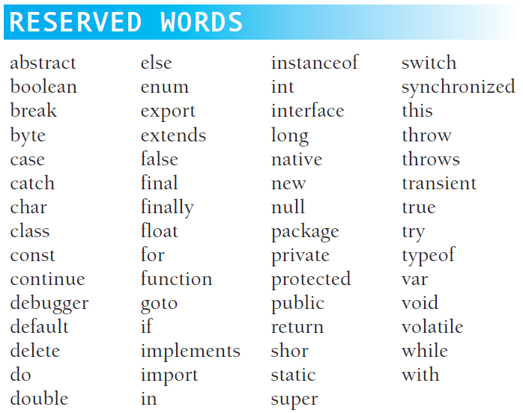

Slide 13
Declaring JavaScript Variables
Declare JavaScript variables with the var statement.
  var x;
  var carname;
Assign values to the variables when you declare them.
  var x=5;
  var carname="Volvo";
Assign values to variables that have not yet been declared
  x=5;
  carname="Volvo";
Redeclaring a JavaScript variable will not lose its original value.
  var x=5;
  var x;
var x, carname;
var x=5, carname="Volvo";

Slide 14
JavaScript Data Types
number
  var data = -20;
  var pi = 3.14159;
string
  var str1 = "Hello World!";
  var str2 = 'Hello World!';
boolean
  var isAdmin = true;
  var isLogin = false;
array
  var arr1 = new Array();
  arr1[0] = 1.414;
function
var hw = function () {
document.write("Hello World!");
};
object
var today = new Date();

Slide 15
Data Types相關函數
typeof( )
  var str1 = "Hello World!";
  typeof(str1) ➔ string
parseInt( )
  parseInt("329forYoung") ➔ 329
  parsetInt("329forYoung", 16) ➔ 12959 (=0x329f)
parseFloat( )
    parseFloat("3.29forYoung") ➔ 3.29
eval( )
  eval("3+2") ➔ 5

Slide 16
Number
var i = 15;
var j = -20;
var k = .38;
var x = 4.2e-3;
var y = 0xa5;
var z = 047;

Slide 17
String
  var strHW="Hello World!";
  var strHW1='Hello World!';
  var str1="Hello Mr. Smith's World";
  var str2='Hello Mr. Smith"s World';
  var str3="Hello Mr. Smith\"s World";
  var str4='Hello Mr. Smith\'s World';
Escape characters:
  \0, \b, \t, \n, \v, \f,\r, \", \', \\, \xXX, \uXXXX
Latin 1
Unicode

Slide 18
Boolean
var isOk = false;
var isAdmin = true;
var beTrue =1;
var beFalse = 0;

Slide 19
Array
Declare an array
  var arr1 = new Array();
  var arr2 = new Array(3);
  var arr3 = [];
  var arr4 = new Array(1.5, '2009', true);
  var arr5 = [1.5, '2009', true];
  arr1[0] = 45;
  arr1["暨大"]="www.ncnu.edu.tw";

Slide 20
運算子(Operator)
算術運算子(Arithmetic Operators)
Given that y=5,
Operator | Description | Example | Result
+ | Addition | x=y+2 | x=7
- | Subtraction | x=y-2 | x=3
* | Multiplication | x=y*2 | x=10
/ | Division | x=y/2 | x=2.5
% | Modulus (division remainder) | x=y%2 | x=1
++ | Increment | x=++y | x=6
-- | Decrement | x=--y | x=4

Slide 21
The + Operator Used on Strings
use + operator to add two or more string variables together.
  txt1="What a very ";
  txt2="nice day";
  txt3=txt1+txt2; // What a very nice day"

Slide 22
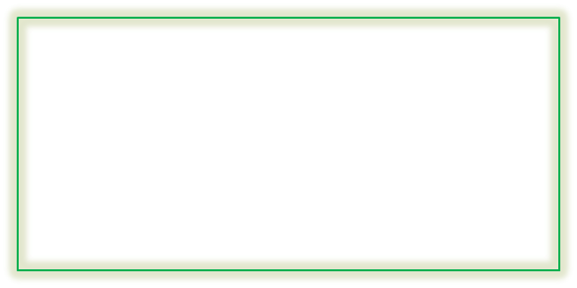
Adding Strings and Numbers
If you add a number and a string, the result will be a string.
var n=2;
var s="0.5";
var nps, spn, nms, smn;
nps = n+s; // "20.5", a string
spn = s+n; // "0.52", a string
nms = n*s; // 1, a number
smn = s*n; // 1, a number
typeof( ) operator
typeof(nps) ➔ "string"
typeof(smn) ➔ "number"

Slide 23
Other Adding types
Booleans + Numbers
  ➔ number
Booleans + Strings
  ➔ string
Booleans +Booleans
  ➔ number

Slide 24
比較運算子(Comparison Operators)
var x= 5;
Operator | Description | Example
== | is equal to | x==8 is false
=== | is exactly equal to (value and type) | x===5 is true x==="5" is false
!= | is not equal | x!=8 is true
> | is greater than | x>8 is false
< | is less than | x<8 is true
>= | is greater than or equal to | x>=8 is false
<= | is less than or equal to | x<=8 is true

Slide 25
邏輯運算子(Logical Operators)
Given that x=6 and y=3,
Operator | Description | Example
&& | and | (x < 10 && y > 1) is true
|| | or | (x==5 || y==5) is false
! | not | !(x==y) is true

Slide 26
條件運算子(Conditional Operator)
variablename = (condition) ? value1 : value2;
str1 = (gender=="m") ? "先生" : "女士";
str2 = (gender=="m") ? "先生" : (isMarried) ? "女士" : "小姐";

Slide 27
位元運算子(bitwise operator)
Operator | Description | Example
& | Bitwise AND. | 0x1234 & 0x00ff ➔ 0x0034
| | Bitwise OR | 9 | 10 ➔ 11
^ | Bitwise XOR. | 9 ^ 10 ➔ 3
~ | Bitwise NOT | ~0x0f ➔ -16
<< | Shift left. | 7 << 1 ➔ 14
>> | Shift right. | 7 >> 1 ➔ 3
>>> | Shift right, zero fill. | -1 >>> 2 ➔ 1073741823

Slide 28
指定運算子(Assignment Operators)
Given that x=10 and y=5,
Operator | Example | Same As | Result
= | x = y |  | x=5
+= | x += y | x = x+y | x=15
-= | x -= y | x = x-y | x=5
*= | x *= y | x = x*y | x=50
/= | x /= y | x = x/y | x=2
%= | x %= y | x = x%y | x=0
<<= | a <<= b | a = a<<b
>>= | a >>= b | a = a>>b
>>>= | a >>>= b | a = a>>>b
&= | a &= b | a = a&b
|= | a |= b | a = a|b
^= | a ^= b | a = a^b

Slide 29
Conditional Statements
if statements
if (condition) {
// statements if condition is TRUE
}
if (condition) {
//Statements if condition is TRUE;
}
else if (condition) {
//Statements if condition is TRUE;
}
else {
//Statements if no prior condition is true;
}
if (condition) {
//statements if condition is TRUE;
}
else {
//statements if condition is FALSE;
}

Slide 30
var name = "林志玲";
var gender ="f";
var isMarried=false;
var title ;
if (gender=="m") title = "先生";
if (gender=="f") title = "女士";
if (gender == "m") {
title = "先生";
}
else {
title = "女士";
}
if (gender == "m") {
title = "先生";
}
else if (isMarried) {
title = "女士";
}
else {
title= "小姐";
}
document.write(name + title +"您好!<br />");

Slide 31
switch
switch (expression or variable name) {
case label:
//statements if expression matches this label;
break;
case label:
//statements if expression matches this label;
break;
default:
//statements if expression does not match any label;
break;
}

Slide 32
var colorChoice ="紅";
switch (colorChoice) {
case "紅":
document.bgColor="red";
break;
case "綠":
document.bgColor="green";
break;
default:
document.bgColor="white";
break;
}

Slide 33
Loop Statement
for statement
for (intialize; conditional test; increment/decrement) {
//Statements to execute;
}
for (var i=1;i<10;i++) {
document.write('<hr color="red" size="10" \ width="'+i*50 +'">');
}

Slide 34
while
while (condition) {
  // Statements;
  // Increment/decrement;
}
var i=1;
var sqt=0;
while (sqt<1000) {
sqt = i*i;
i++;
}

Slide 35
do/while
do {
  // Statements;
  // Increment/decrement;
} while (condition)
var i=1;
var sqt;
do {
sqt = i*i;
i++;
} while (sqt<1000)

Slide 36
for/in
for (variable in object) {
//statements
}
for (var attr in document) {
document.write(attr+" = "+document[attr]+"<br />");
}

Slide 37
var arr1 = new Array();
arr1[0] = 2;
arr1[4] = "The 5th element";
arr1["暨大"]="www.ncnu.edu.tw";
arr1["im"] = "www.im.ncnu.edu.tw";
for (var ind in arr1) {
document.write(ind+" => " +arr1[ind] +"<br />");
}
if(!arr1[1]) {
alert("index 1不存在!");
}

Slide 38
with
with ( object ) {
//statements
}
function click() {
alert("click event!");
}
with (document) {
bgColor ="#ccffcc";
onclick = click;
alert(location);
}

Slide 39
break & continue
var i=1;
var sq;
while (i < 1000) {
sq = i*i;
if (i*i == 267289) break;
i++;
}
alert (i+"*"+i+" = 267289");
var i=1;
for (i=1;i <= 100;i++) {
document.write(i+"*"+i+" = "+ i*i+"<br />");
if ((i%10) !=0) continue;
document.write("<hr>");
}

Slide 40
function
function name (arg1, arg2, …) {
// statements
// return something, if any
}

Slide 41
function hr() {
document.write('<hr size="5" color="green" width="90%">');
}
function hr1(hrSize, hrColor, hrWidth) {
document.write('<hr size="'+hrSize+'" color="'+hrColor
+'" width="'+hrWidth+'">');
}
hr();
hr();
hr1("10", "red", "800");
hr1("20", "green", "75%");

Slide 42
function getH1() {
var h1;
h1 = document.getElementsByTagName("h1");
return h1[0].innerHTML;
}
function showH1() {
alert(getH1());
}
<body onload="showH1()">
<h1>JavaScript function - Example 2</h1>
…
</body>

Slide 43
function arguments
function sum( ) {
var s=0;
for (var i=0;i<arguments.length;i++) {
s += arguments[i];
}
return s;
}
var total1 = sum(1,10,100,1000);
var total2 = sum(3,30,300);

Slide 44
recursive function
function fb(i) {
if (i==1) return 0;
if (i==2) return 1;
return fb(i-2)+fb(i-1);
}

Slide 45
global vs. local variables
var j, n,m, p;
j = 1;
n= 10;
m=100;
function test(i, j) {
var m=1;
j++;
n=i+j+m;
return n;
}
p = test(5, 50);
document.write("j = " + j+"<br />");
document.write("n = " + n+"<br />");
document.write("m = " + m+"<br />");
document.write("p = " + p+"<br />");
j = 1
n = 57
m = 100
p = 57

Slide 46
object
var rgb = {r:"ff", g:"ff", b:"00"};
var employee = {
"name":"王小明", "age":12, "gender":"m", isMarried:false}
document.write(typeof(rgb)+"<br />");
document.write(typeof(employee)+"<br />");
document.bgColor="#"+rgb.r+rgb.g+rgb.b;
for (var attr in employee) {
document.write(attr +" = "+ employee[attr]+"<br />");
}

Slide 47
function as object
function circle(r) {
this.r = r;
this.area = Math.PI*r*r;
this.peri = 2*Math.PI*r;
this.print = function () {
document.write("radius = "+r+"<br />");
};
}
var ball = new circle(10);
document.write("Area: "+ball.area+"<br />");
document.write("Perimeter: "+ball.peri+"<br />");
ball.print();

