Slide 1

JavaScript Events

Slide 2
Old-style Event Handlers
<body onload="welcome()">
<form>
<input type="text" id="uid" onchange="check()" />
<button id="ok" onclick="okay();return false;">
Click me</button>
</form>
</body>
<script type="text/javascript">
function welcome() {
alert("Welcome to My Blog!");
}
function check() {
var uid = document.getElementById("uid");
if (uid.value == "") {
alert("不可空白!");
uid.value="user id";
}
}
function okay() {
var btn = document.getElementById("ok");
btn.style.color = "green";
return false;
}
</script>

Slide 3
Event handlers using DOM
<body>
<form>
<input type="text" id="uid" value="user id" />
<button id="ok">Click me</button>
</form>
</body>
<script type="text/javascript">
window.onload = init;
function init() {
alert("Welcome to My Blog!");
var uid = document.getElementById("uid");
uid.onchange=check;
var btn = document.getElementById("ok");
btn.onclick = okay;
}
function check() {
if (this.value == "") {
alert("不可空白!");
this.value="user id";
}
}
function okay() {
this.style.color = "green";
return false;
}
</script>

Slide 4
Event handlers using DOM
<script type="text/javascript">
window.onload = function() {
document.getElementById("uid").onchange = function() {
//…
}
document.getElementById("ok").onclick = function() {
//..
}
}

Slide 5
What We Learned
將window.onload設定為初始化函數之名稱
定義初始化函數
在初始化函數中，設定各元素事件處理函數名稱
  使用document.getElementById("element id")
  element.oneventname = eventhandlingfunction;
定義各事件處理函數
  在事件處理函數中，可使用this指至發生事件之元素

Slide 6
onabort | Loading of an image is interrupted
onblur | An element loses focus
onchange | The user changes the content of a field
onclick | Mouse clicks an object
ondblclick | Mouse double-clicks an object
onerror | An error occurs when loading a document or an image
onfocus | An element gets focus
onkeydown | A keyboard key is pressed
onkeypress | A keyboard key is pressed or held down
onkeyup | A keyboard key is released
onload | A page or an image is finished loading
onmousedown | A mouse button is pressed
onmousemove | The mouse is moved
onmouseout | The mouse is moved off an element
onmouseover | The mouse is moved over an element
onmouseup | A mouse button is released
onreset | The reset button is clicked
onresize | A window or frame is resized
onselect | Text is selected
onsubmit | The submit button is clicked
onunload | The user exits the page

Slide 7
Getting more event information
Firefox, Chrome, IE 9
  事件處理函數，加入參數
    function onclickHandling(e) {
    //e.type
    // e.screenX, e.screenY, e.clientX, e.clientY
    // e.button,
    }
I.E. 8以下
  不支援具有參數之事件處理函數
  使用window.event
http://www.w3.org/TR/DOM-Level-2-Events/events.html#Events-MouseEvent

Slide 8
Fix Event Incompatibilities
function onclickHandling(e) {
if (window.event)
e = window.event;
//e.screenX, e.screenY
//e.button
//…
}
function onclickHandling() {
if(arguments[0])
e = arguments[0];
else
e = window.event;
//e.screenX, e.screenY
//e.button
//…
}

Slide 9
Properties of Event
type
button
clientX, clientY
screenX, screenY
altKey, ctrlKey, shiftKey
keyCode
cancelBubble

Slide 10
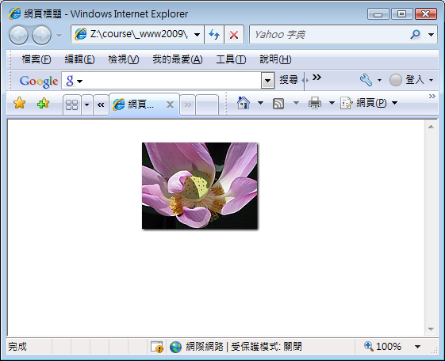
<style type="text/css">
img {
position: absolute;
}
</style>
…
<body>
<div id="content">
<img id="lily" src="lily.jpg" alt="" />
</div>
</body>
window.onload=function() {
document.onclick=mvImg;
}
function mvImg(e) {
if (window.event)
e=window.event;
var img=document.getElementById("lily");
img.style.top=(e.clientY-0.5*img.height)+"px";
img.style.left=(e.clientX-0.5*img.width)+"px";
}

Slide 11
Keyboard Events
<script type="text/javascript">
window.onload = function () {
document.getElementById("keyp").onkeypress=getKey;
document.getElementById("keyd").onkeydown=getKey;
}
function getKey(e) {
if (window.event)
e = window.event;
keynum = e.keyCode;
alert(keynum);
// return false;
}
</script>
…
<form>
keypress: <input type="text" id="keyp" /><br />
keydown: <input type="text" id="keyd" /><br />
</form>
⬅ 取消此事件

Slide 12
window.onload = function() {
document.onkeydown= getKey;
var img1 = document.getElementById("lily");
img1.style.top="300px"; img1.style.left="300px";
}
function getKey(e) {
var keynum;
if (window.event) e=window.event;
keynum=e.keyCode;
var img1 = document.getElementById("lily");
var mtop = parseInt(img1.style.top);
var mleft = parseInt(img1.style.left);
switch (keynum) {
case 37:
img1.style.left = Math.max(0, (mleft-10)) +"px";
break;
case 38:
img1.style.top =Math.max(0, (mtop-10)) +"px";
break;
case 39:
img1.style.left = Math.min(document.documentElement.clientWidth-img1.width, mleft+10)+"px";
break;
case 40:
img1.style.top = Math.min(document.documentElement.clientHeight-img1.height, mtop+10)+"px";
break;
}
}
▲
▲
▲
▼
<style type="text/css">
img {
position: absolute;
}
</style

Slide 13
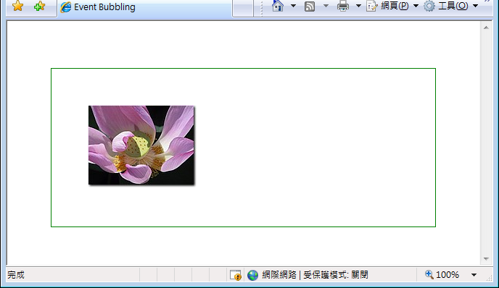
Event Bubbling
<body>
<div id="content">
<img id="lily" src="lily.jpg" />
</div>
</body>
window.onload = function () {
document.onclick=docClick;
document.getElementById("content").onclick=divClick;
document.getElementById("lily").onclick=imgClick;
}
function docClick() {
alert("document clicked!");
}
function divClick() {
alert("div clicked!");
}
function imgClick() {
alert("img clicked!");
}

Slide 14
event.cancelBubble
function imgClick(e) {
if (window.event)
e=window.event;
e.cancelBubble = true;
// e.stopPropagation();
alert("img clicked!");
}
* 未來將改用: (Firefox 3)
e.stopPropagation()

