Slide 1
Introduction to HTML/XHTML
Yen-Cheng Chen
National Chi Nan University
ycchen@ncnu.edu.tw

Slide 2
Introduction
WWW model
  http://ycchen.im.ncnu.edu.tw/www/wwwm.html
Server
  Apache
  IIS
Browser
  Firefox, Chrome
  Internet Explorer (10, 11)
URI (Uniform Resource Identifier) or URL
  http://ycchen.im.ncnu.edu.tw/www/url-example.html

Slide 3
HTML
<html>
<head>
<meta http-equiv="Content-Type" content="text/html; charset=utf-8">
<title>ex1-1</title>
</head>
<body>
<p>這是一份HTML文件</p>
</body>
</html>

Slide 4
XHTML
<!DOCTYPE html PUBLIC "-//W3C//DTD XHTML 1.0 Transitional//EN" "http://www.w3.org/TR/xhtml1/DTD/xhtml1-transitional.dtd">
<html xmlns="http://www.w3.org/1999/xhtml">
<head>
<meta http-equiv="Content-Type" content="text/html; charset=utf-8" />
<title>ex1-2</title>
</head>
<body>
<p>這是一份XHTML文件</p>
</body>
</html>

Slide 5
HTML5
<!DOCTYPE html>
<html>
<head>
<meta charset="UTF-8">
<title>網頁標題</title>
</head>
<body>
網頁內容
</body>
</html>

Slide 6
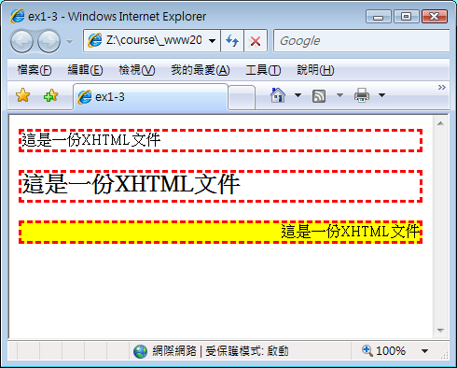
CSS (Cascading Style Sheets)
<!DOCTYPE html PUBLIC "-//W3C//DTD XHTML 1.0 Transitional//EN" "http://www.w3.org/TR/xhtml1/DTD/xhtml1-transitional.dtd">
<html xmlns="http://www.w3.org/1999/xhtml">
<head>
<title>ex1-3</title>
<meta http-equiv="Content-Type" content="text/html; charset=big5" />
<style type="text/css">
p {border: dashed 2pt red}
.pclass { text-align: right; background-color: #ffff00 }
</style>
</head>
<body>
<p>這是一份XHTML文件</p>
<p style="font-size: 32px; font-weight:bold;">
這是一份XHTML文件</p>
<p class="pclass">這是一份XHTML文件</p>
</body>
</html>

Slide 7
3 Layers of Web Page Design
Structural Layer
  HTML/XHTML
Presentation Layer
  CSS
Behavior Layer
  JavaScript
  http://ycchen.im.ncnu.edu.tw/www2011/npm.html
  http://www.w3schools.com/js/js_examples.asp

Slide 8
HTML元素與屬性
<element>contents</element>
  <p>This is the first paragraph</p>
<element />
  <br />
  <img src=“img1.png" />
<element attribute="value" …>
  <div id="banner">
  <a href="http://www.ncnu.edu.tw/" target="new">NCNU</a>
元素與屬性名稱請使用小寫字

Slide 9
HTML網頁結構
<html>
<head>
<title> Page Title</title>
</head>
<body>
<h1>Heading level 1</h1>
<p>The first paragraph is here.</p>
</body>
</html>

Slide 10
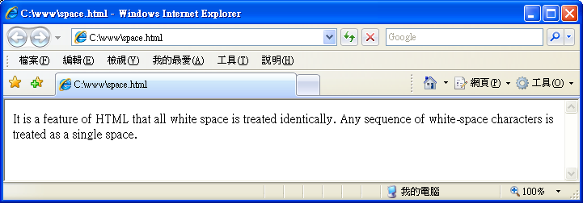
空白與換行
<p>
It is a feature of HTML that all white space is treated identically.
Any sequence of white-space characters is treated as a single space.
</p>

Slide 11
HTML Comments
<!-- This is a comment. -->
<!-- This is another comment.
2nd line
3rd line
<h1>Heading level 1</h1>
-->

Slide 12
XHTML
XML (Extensible Markup Language)
    <note>
    <to>Tove</to>
    <from>Jani</from>
    <heading>Reminder</heading>
    <body>Don't forget me this weekend!</body>
    </note>
DTD(Document Type Definition)
  定義XML文件之結構(元素與屬性)

Slide 13
Differences Between XHTML And HTML
XHTML elements must be properly nested
  <b><i>This text is bold and italic</b></i>
  <b><i>This text is bold and italic</i></b>
XHTML elements must always be closed
  <br> ➔ <br />
XHTML elements must be in lowercase
  <BODY> ➔ <body>
XHTML documents must have one root element
  <html>…</html>

Slide 14
Some More XHTML Syntax Rules
Attribute names must be in lower case
  <a HREF="..."> ➔ <a href="...">
Attribute values must be quoted
  <p align=right> ➔ <p align="right">
Attribute minimization is forbidden
  <input checked> ➔ <input checked="checked">
The id attribute replaces the name attribute
The XHTML DTD defines mandatory elements

Slide 15
The XHTML DTD defines mandatory elements
<!DOCTYPE Doctype goes here>
<html xmlns="http://www.w3.org/1999/xhtml">
<head>
<title>Title goes here</title>
</head>
<body>
</body>
</html>

Slide 16
Three XHTML DTDs
XHTML 1.0 Strict
  <!DOCTYPE html PUBLIC "-//W3C//DTD XHTML 1.0 Strict//EN" "http://www.w3.org/TR/xhtml1/DTD/xhtml1-strict.dtd">
XHTML 1.0 Transitional
  <!DOCTYPE html PUBLIC "-//W3C//DTD XHTML 1.0 Transitional//EN" "http://www.w3.org/TR/xhtml1/DTD/xhtml1-transitional.dtd">
XHTML 1.0 Frameset
  <!DOCTYPE html PUBLIC "-//W3C//DTD XHTML 1.0 Frameset//EN" "http://www.w3.org/TR/xhtml1/DTD/xhtml1-frameset.dtd">

Slide 17
XHTML Validation & Modularization
XHTML Validation
  http://validator.w3.org/
XHTML Modularization
  http://www.w3schools.com/w3c/w3c_xhtml.asp

Slide 18
Example:
<!DOCTYPE html PUBLIC "-//W3C//DTD XHTML 1.0 Transitional//EN" "http://www.w3.org/TR/xhtml1/DTD/xhtml1-transitional.dtd">
<html xmlns="http://www.w3.org/1999/xhtml">
<head>
<title>Yen-Cheng Chen (陳彥錚)</title>
<meta http-equiv="Content-Type" content="text/html; charset=big5" />
<meta name="keywords" content="Yen-Cheng Chen,陳彥錚, network management, wireless networks" />
<meta name="description" content="Yen-Cheng Chen's web site, including tech and teaching materials." />
<link rel="shortcut icon" href="favicon.ico" type="image/x-icon" />
</head>
<body>
<!-- Yen-Cheng Chen's web page goes here… -->
</body>
</html>

Slide 19
meta and HTTP headers
<meta http-equiv="Content-Type" content="text/html; charset=big5" />
<meta http-equiv="refresh" content ="300" />
定時重新整理
<meta http-equiv="refresh" content ="5; url=http://www.ncnu.edu.tw/" />
定時重新導向URL
<meta http-equiv="Cache-Control" content="no-cache" />
使用者瀏覽器不準抓cache留下資料(避免更新後版本問題)
<meta http-equiv="Expires" content ="Tue, 02 Mar 2010 01:47:40 GMT" />
可以cache但有設期限
<meta http-equiv="Date" content ="Tue, 02 Mar 2010 01:47:40 GMT" />
http://en.wikipedia.org/wiki/Meta_element

Slide 20
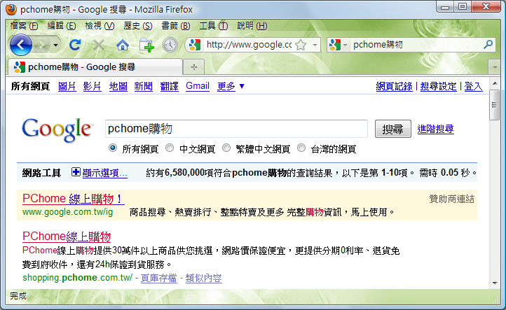

meta and Search Engines
<meta name="keywords" content="購物,NB,筆記型電腦,LV,PC,手機,相機,mp3,Gucci,Coach,psp,Wii,iPod" />
<meta name="description" content="PChome線上購物提供30萬件以上商品供您挑選，網路價保證便宜，更提供分期0利率、退貨免費到府收件，還有24h保證到貨服務。" />
<meta name="robots" content="index, follow" />
http://www.im.ncnu.edu.tw/robots.txt

