Slide 1
表格 (Table)

Slide 2
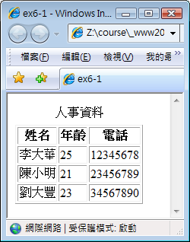
<table border="1">
<caption>人事資料</caption>
<tr>
<th>姓名</th>
<th>年齡</th>
<th>電話</th>
</tr>
<tr>
<td>李大華</td>
<td>25</td>
<td>12345678</td>
</tr>
<tr>
<td>陳小明</td>
<td>21</td>
<td>23456789</td>
</tr>
…
</table>

Slide 3
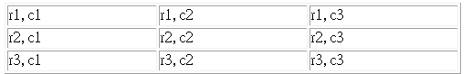
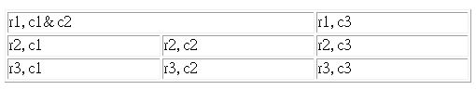
合併儲存格
合併欄 (colspan)
<table border="1" width="500">
<tr>
<td>r1, c1</td> <td>r1, c2</td> <td>r1, c3</td>
</tr>
<tr>
<td>r2, c1</td> <td>r2, c2</td> <td>r2, c3</td>
</tr>
<tr>
<td>r3, c1</td> <td>r3, c2</td> <td>r3, c3</td>
</tr>
</table>
<td colspan="2">r1, c1& c2</td>

Slide 4
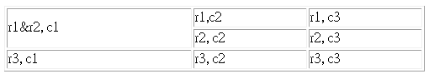
合併儲存格
合併列 (rowspan)
<table border="1" width="500">
<tr>
<td>r1, c1</td> <td>r1, c2</td> <td>r1, c3</td>
</tr>
<tr>
<td>r2, c1</td> <td>r2, c2</td> <td>r2, c3</td>
</tr>
<tr>
<td>r3, c1</td> <td>r3, c2</td> <td>r3, c3</td>
</tr>
</table>
<td rowspan="2">r1&r2, c1</td>
刪除

Slide 5
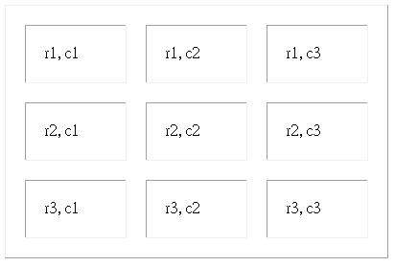
儲存格間距與內距
儲存格間距(cellspacing)
  <table cellspacing="20">…</table>
儲存格內距(cellpadding)
  <table cellpadding="20">…</table>
兩者為table之屬性，
非tr或td之屬性

Slide 6
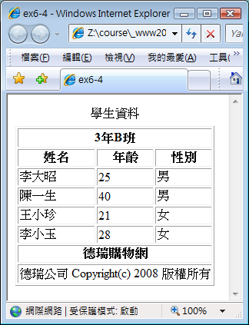
列分組
<thead>…</thead>
<tbody>…</tbody>
<tfoot>…</tfoot>
thead, tfoot各只能一個
tbody可以多個

Slide 7
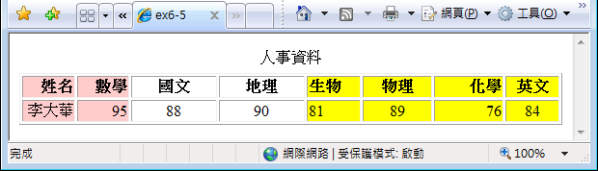
欄位分組
<table border="1">
<caption>人事資料</caption>
<colgroup span="2" width="10%" align="right" style="background-color:#fcc"></colgroup>
<colgroup span="2" width="100" align="center"></colgroup>
<colgroup style="background-color:yellow">
<col width="60" align="left" />
<col width="80" align="center" />
<col width="80" align="right" />
<col width="60" align="center" />
</colgroup>
<tr>
<th>姓名</th>
<th>數學</th>
<th>國文</th>
…

