Slide 1
表單 (Form)

Slide 2
<form>
<form id="…" action="…" method="…" enctype="…">
…
</form>
Ex.
<form id="joinForm" action="join.php" method="post">
…
</form>

Slide 3
method
method="get"
  URL: http://www.abc.com/join.php?uid=ycc&pwd=mypwd
  HTTP message entity: none
  不可超過256個字元
method="post"
  URL: http://www.abc.com/join.php
  HTTP message entity: uid=ycc&pwd=mypwd

Slide 4
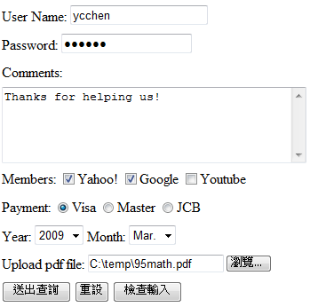
Form Example
text
password
textarea
checkbox
radio
select
file
submit, reset, button

Slide 5

<input type="text" … />
<input type="text" id="…" name="…" size="…" maxlength="…" value="…" />
Ex.
User Name:
<input type="text" id="uid" name="uid" size="8" maxlength="20" value="Your id" /><br />

Slide 6

<input type="password" … />
<input type="password" id="…" name="…" size="…" maxlength="…" value="…" />
Ex.
Password:
<input type="password" id="pwd" name="pwd" size="10" maxlength="20" /><br />

Slide 7
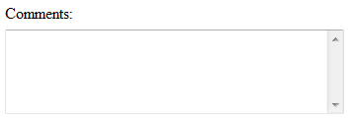
<textarea …>…</textarea>
<textarea id="…" name="…" cols="…" rows="…">
…</textarea>
ex.
Comments: <br />
<textarea id="cmts" name="cmts" cols="40" rows="5"> </textarea><br />

Slide 8
<input type="checkbox" … />
<input type="checkbox" id="…" name="…" value="…" checked="checked" />
ex.
Members:
<input type="checkbox" id="yahoo" name="yahoo" value="yahoo" /> Yahoo!
<input type="checkbox" id="google" name="google" value="google" checked="checked" /> Google
<input type="checkbox" id="youtube" name="youtube" value="youtube" /> Youtube<br/>

Slide 9
<input type="radio" … />
<input type="radio" id="…" name="…" value="…" checked="checked" />
ex.
Payment:
<input type="radio" id="pay" name="pay" value="Visa" checked="checked" />Visa
<input type="radio" id="pay" name="pay" value="Master" />Master
<input type="radio" id="pay" name="pay" value="JCB" />JCB

Slide 10

<select …><option …>…</option></select>
<select id="…" name="…">
<option value="…" selected="selected">…</option>
…
</select>
Ex.
Year:
<select id="year" name="year">
<option>2009</option>
<option value="2010">2010</option>
<option>2011</option>
<option selected="selected">2012</option>
</select>

Slide 11
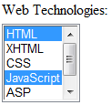
<select …><option …>…</option></select>
<select id="…" name="…" size="…" multiple="multiple">
<option value="…" selected="selected">…</option>
</select>
Ex.
Web Technologies:<br />
<select id="wts" name="wts" size="5" multiple="multiple">
<option selected="selected">HTML</option>
<option>XHTML</option>
<option>CSS</option>
<option selected="selected">JavaScript</option>
<option>ASP</option>
<option selected="selected">PHP</option>
</select>

Slide 12
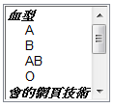
<optgroup label="…">…</optgroup>
<select name="個人資料" size="6" multiple="multiple">
<optgroup label="血型">
<option>A</option>
<option>B</option>
<option>AB</option>
<option>O</option>
</optgroup>
<optgroup label="會的網頁技術">
<option>JavaScript</option>
<option>VBScript</option>
<option>PHP</option>
<option>ASP.NET</option>
</optgroup>
</select>

Slide 13
<input type="file" … />
<form id="…" action="…" method="post" enctype="multipart/form-data">
<input type="file" id="…" name="…" />
</form>
ex.
<form id="join" action="join.php" method="post" enctype="multipart/form-data">
Upload pdf file: <input type="file" id="pdf" name="pdf" />
</form>
size="…" maxlength="…"

Slide 14
POST /ycchen/www2011/ex/join.php HTTP/1.1
Accept: image/gif, image/x-xbitmap, image/jpeg, image/pjpeg, application/x-shockwave-flash, application/vnd.ms-excel, application/vnd.ms-powerpoint, application/msword, */*
Referer: http://www.im.ncnu.edu.tw/~ycchen/www2009/ex/form.html
Accept-Language: zh-tw,zh-cn;q=0.5
Content-Type: multipart/form-data; boundary=---------------------------7d934db290122
UA-CPU: x86
Accept-Encoding: gzip, deflate
User-Agent: Mozilla/4.0 (compatible; MSIE 7.0; Windows NT 5.1; GTB5; .NET CLR 1.1.4322; .NET CLR 2.0.50727; InfoPath.1)
Host: www.im.ncnu.edu.tw
Content-Length: 1720496
Connection: Keep-Alive
Cache-Control: no-cache
-----------------------------7d934db290122
Content-Disposition: form-data; name="uid"
Your id
-----------------------------7d934db290122
Content-Disposition: form-data; name="pwd"
mypwd
-----------------------------7d934db290122
Content-Disposition: form-data; name="google"
google

Slide 15
-----------------------------7d934db290122
Content-Disposition: form-data; name="wts"
HTML
-----------------------------7d934db290122
Content-Disposition: form-data; name="wts"
XHTML
-----------------------------7d934db290122
Content-Disposition: form-data; name="pdf"; filename="C:\paper\IEEEMembershipApp.pdf"
Content-Type: application/pdf
%PDF-1.3
%....
35 0 obj
<<
/Linearized 1
/O 37
/H [ 1122 330 ]
/L 1719209
/E 701707
/N 3
/T 1718391

Slide 16
<input type="hidden" … />
<input type="hidden" id="…" name="…" value="…" />
ex.
<input type="hidden" id="isM" name="isM" value="true" />
<input type="hidden" id="page" name="page" value="17" />
為何需要Hidden

Slide 17
<input type="submit" />
<input type="submit" value="OK" />
<input type="reset" />
<input type="reset" value="Clear" />
<input type="button" value="Press this button" />

Slide 18

<input type="image" … />
<input type="image" src="…" alt="…" />
ex.
<input type="image" src="ok.jpg" alt="OK" />

Slide 19


<button><img …>…</button>
<button type="…" ><img …>…</button>
ex.
<button type="reset">
<img src="r1.gif" alt="reset" width="34" /><br />
Reset
</button>

Slide 20
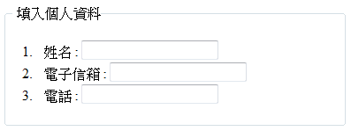
<fieldset><legend>…</legend></fieldset>
<fieldset>
<legend>填入個人資料</legend>
<ol>
<li>姓名 : <input type="text" id="name" name="name" /></li>
<li>電子信箱 : <input type="text" id="email" name="email" /></li>
<li>電話 : <input type="text" id="state" name="state" /></li>
</ol>
</fieldset>
ex7-4.html

Slide 21

<label>
<label for="male">Male</label>
<input type="radio" name="sex" id="male" /><br />
<label for="female">Female</label>
<input type="radio" name="sex" id="female" />
<label>Male<input type="radio" name="sex" /></label><br />
<label>Female<input type="radio" name="sex" /></label>

