Slide 1
COMPILER DESIGN
COMP 442/6421 – Compiler Design
Course description
Project description
Introduction to compilation
Joey Paquet, 2000-2019

Slide 2
COMP 442/6421 – Compiler Design
Course description
Joey Paquet, 2000-2019

Slide 3
Course description
COMP 442/6421 – Compiler Design
Instructor’s name: Joey Paquet
Position: Associate Professor, Department of Computer Science and Software Engineering
Teaching topics: Programming languages, Compiler design, Software engineering and programming methodology
Research topics: Design and implementation of programming languages, Parallel and/or distributed computing, Demand-driven computation models, Context-driven computation models
Contact information:
  Web: www.cse.concordia.ca/~paquet
  E-mail: paquet@cse.concordia.ca
  Office: EV 3-221
Joey Paquet, 2000-2019

Slide 4
Calendar description
COMP 442/6421 – Compiler Design
COMP 442/6421 - Compiler Design (4 credits)
Prerequisites (COMP442): COMP 228 or SOEN 228 or COEN 311; COMP 335; COMP 352 or COEN 352
Prerequisites (COMP6421): COMP 5201, 5361, 5511.
Compiler organization and implementation. Programming language constructs, their syntax and semantics. Syntax directed translation, code optimization. Run-time organization of programming languages. Project. Lectures: three hours per week. Laboratory: two hours per week.
Joey Paquet, 2000-2019

Slide 5
Course description
COMP 442/6421 – Compiler Design
Topic
  Compiler organization and implementation.
  Lexical, syntactic and semantic analysis, code generation.
Outline
  Design and implementation of a simple compiler.
  Lectures related to the project.
Grading
  Assignments (4) : 40%
  Final Examination : 30%
  Final Project : 30%
Letter grading scheme
  Only one grading scheme for undergraduate and graduate.
  Letter grading scheme is based on a normal curve based on the class average.
Undergraduate | Graduate
A+ | A+
A | A
A- | A-
B+ | B+
B | B
B- | B-
C+ | C
C | C
C- | C
D+ | C
D | C
D- | C
F | F
Joey Paquet, 2000-2019

Slide 6
Project description
COMP 442/6421 – Compiler Design
Design and coding of a simple compiler
  Individual work
  Divided in four assignments
  Final project is graded at the end of the semester, during a final demonstration
  Testing is VERY important
A complete compiler is a fairly complex and large program: from 10,000 to 1,000,000 lines of code.
Programming one will force you to go over your limits.
It uses many elements of the theoretical foundations of Computer Science.
It will probably be the most complex program you have ever written.
Joey Paquet, 2000-2019

Slide 7
COMP 442/6421 – Compiler Design
Introduction to compilation
Joey Paquet, 2000-2019

Slide 8
Introduction to compilation
COMP 442/6421 – Compiler Design
A compiler is a translation system.
It translates programs written in a high level language into a lower level language, generally machine (binary) language.
The initial source code is essentially a stream of characters.
The task of the compiler is to figure out its meaning and translate this meaning into a program that is understandable by the computer, preserving the same meaning.
source
code
target
code
compiler
Source language
Translator
Target language
Joey Paquet, 2000-2019

Slide 9
Introduction to compilation
COMP 442/6421 – Compiler Design
The only language that the processor understands is binary.
A binary program is segmented into words.
Every binary instruction word is segmented in portions that each have a different meaning.
  a: Operation: Register addition (from a symbol table or op-code table)
  b: First operand: register R1
  c: Second operand: register R3
  d: Destination: register R15
000100000100111111
a
b
c
d
Joey Paquet, 2000-2019

Slide 10
Introduction to compilation
COMP 442/6421 – Compiler Design
Assembly language was the first higher level programming language.
  000100000100111111 <=> Add R1,R3,R15
There is a one-to-one correspondence between lines of assembly code and the machine code lines.
A op-code table is sufficient to translate assembly language into machine code.
Compared to binary, it greatly improved the productivity of programmers. Why?
Though a great improvement, assembly is not ideal:
  Not easy to write
  Even less easy to read and understand
  Extremely architecture-dependent
Joey Paquet, 2000-2019

Slide 11
Introduction to compilation
COMP 442/6421 – Compiler Design
A compiler translates a given high-level language into assembler or machine code.
X=Y+Z; assign to X the value of
the result of adding Z to Y
L 3,Y Load working register with Y
A 3,Z Add Z to working register
ST 3,X Store the result in X
00001001001011 Load working register with Y
00010010010101 Add Z to working register
00100100101001 Store the result in X
Joey Paquet, 2000-2019

Slide 12
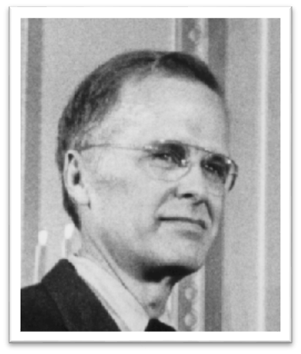
First compilers: Fortran
COMP 442/6421 – Compiler Design
The problems with assembly led to the development of the first compilers for higher-level programming languages. Notable among these is the compiler for the Fortran language.
IBM Mathematical Formula Translating System, later popularly know as Fortran.
Originally developed by a team lead by John Backus at IBM in the 1950s for scientific and engineering applications on the IBM704, introduced in 1954.
John Backus
General-purpose, procedural, imperative programming language that is especially suited to numeric computation and scientific computing.
Originally designed to improve on the economics of programming, as programming using low level languages had become to be more costly than the time it actually saved.
This was an incredible feat, as the theory of compilation was not available at the time.
Joey Paquet, 2000-2019

Slide 13
First compilers: Fortran
COMP 442/6421 – Compiler Design
The solution proposed by Fortran was to design a higher level programming language enabling scientists to write programs using a mathematical notation/language.
Great emphasis was put on the efficiency of the translated machine code, which is still the case today, explaining why Fortran programs are still considered as a benchmark for execution speed.
Emphasis was put on number computations. Only much later was it possible to have Fortran programs manipulate characters or strings, and eventually objects.
Joey Paquet, 2000-2019

Slide 14
First compilers: Fortran
COMP 442/6421 – Compiler Design
Features introduced by earlier versions of Fortran:
  Comments
  Assignment statement using complex expressions
  Control structures (conditional, loop)
  Subroutines and functions used similarly to the mathematical notion of function
  Formatting of input/output
  Machine-independent code
  Procedural programming
  Arrays
  Early development of compilers
  Showed the importance/possibility/relevance of higher-level programming languages
  Compiler development tools/techniques
  Optimizing compiler
Joey Paquet, 2000-2019

Slide 15
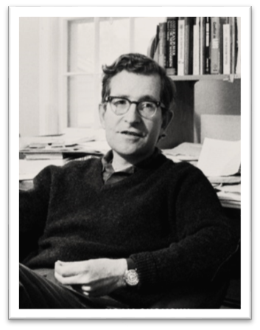
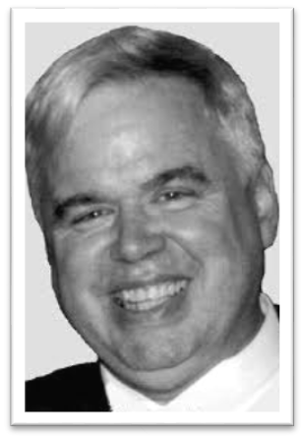
Paving down the road
COMP 442/6421 – Compiler Design
In parallel to that, Noam Chomsky, a linguist, was investigating on the structure of natural languages.
His studies led the way to the classification of languages according to their complexity (aka the Chomsky hierarchy) using the notion of generative grammar.
This was used by various theoreticians in the 1960s and early 1970s to design a fairly complete set of solutions to the parsing problem.
These solutions have been used ever since.
As parsing parsing solutions became well understood and formally defined, efforts were devoted to the development of parser generators.
One of the earliest and still most commonly used parser generators is YACC (Yet Another Compiler Compiler).
Developed by Stephen C. Johnson in 1975 at Bell Labs.
Nowadays, many tools exist that can automate the generation of compiler parts based on the theoretical foundations elucidated in the late 1960s and early 1970s.
Noam Chomsky
Stephen C. Johnson
Joey Paquet, 2000-2019

Slide 16
COMP 442/6421 – Compiler Design
Compilation vs. interpretation
Joey Paquet, 2000-2019

Slide 17
Compilation vs. interpretation
COMP 442/6421 – Compiler Design
Programming languages can be implemented (i.e. translated/executed) by any of the following three general methods:
  Compilation: programs are translated directly into machine language by a compiler, the output of which is later loaded and executed directly by a computer.
  Interpretation: programs are interpreted (i.e. simultaneously translated and executed) by an interpreter.
  Compilation/Interpretation Hybrid: programs are first translated into an intermediate representation by a compiler, the output of which is later executed by and interpreter.
No matter what model is used, the same language translation steps are applied, except at different times during the translation or execution.
Languages that delay much of the checking to run-time are called “dynamic languages”.
Joey Paquet, 2000-2019

Slide 18
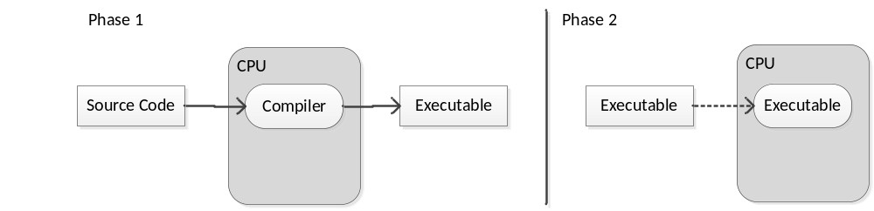
Compilation
COMP 442/6421 – Compiler Design
A compiler is a computer program (or set of programs) that transforms source code written in a computer language (the source language) into another computer language (the target language, often having a binary form known as object code).
The name "compiler" is primarily used for programs that translate source code from a high-level programming language to a lower level language (e.g., assembly language or machine code) before execution time.
Joey Paquet, 2000-2019

Slide 19
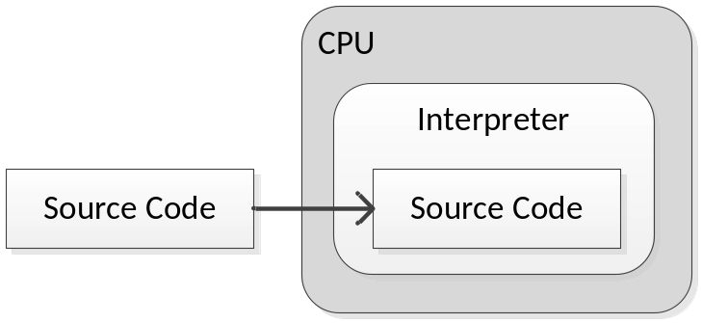
Interpretation
COMP 442/6421 – Compiler Design
An interpreted language is a programming language whose programs are not directly executed by the host CPU but rather executed (or said to be interpreted) by a software program known as an interpreter.
Initially, interpreted languages were compiled line-by-line; that is, each line was compiled as it was about to be executed, and if a loop or subroutine caused certain lines to be executed multiple times, they would be retranslated every time. This has become much less common.
In this case, all the program analysis phases must be happening at run-time, which can lead to unnecessary overhead.
Joey Paquet, 2000-2019

Slide 20
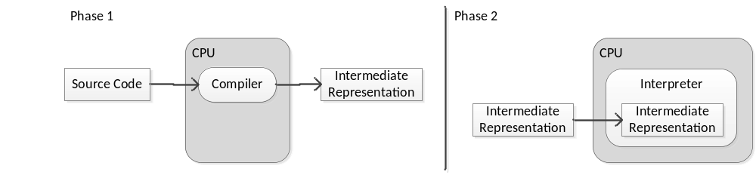
Hybrid compilation/interpretation
COMP 442/6421 – Compiler Design
Nowadays, most interpreted languages use an intermediate representation, as a bridge between compilation and interpretation.
In this case, a compiler may output some form of bytecode or threaded code, which is then executed by an interpreter. Examples include Python, Java, Perl and Ruby.
The intermediate representation can be compiled once and for all (as in Java), each time before execution (as in Perl or Ruby), or each time a change in the source is detected before execution (as in Python).
Joey Paquet, 2000-2019

Slide 21
Hybrid compilation/interpretation
COMP 442/6421 – Compiler Design
The source code of the program is often translated to a form that is more convenient to interpret, which may be some form of machine language for a virtual machine (such as Java's bytecode).
An important and time-consuming part of the source code analysis is done before the interpretation starts.
Some program errors are detected before execution starts, thus making the execution more robust.
Joey Paquet, 2000-2019

Slide 22
Which one is better?
COMP 442/6421 – Compiler Design
In the early days of computing, language design was heavily influenced by the decision to use compilation or interpretation as a mode of execution.
For example, some compiled languages require that programs must explicitly state the data type of a variable at the time it is declared or first used while some interpreted languages take advantage of the dynamic aspects of interpretation to make such declarations unnecessary.
Such language issues delay the type binding mechanism to run-time. This does not mean that other program analysis phases must also be delayed to run-time.
Theoretically, any language may be compiled or interpreted, so this designation is applied purely because of common implementation practice and not some underlying property of a language.
Many languages have been implemented using both compilers and interpreters, including Lisp, Pascal, C, Basic, and Python.
Joey Paquet, 2000-2019

Slide 23
Which one is better?
COMP 442/6421 – Compiler Design
Interpreting a language gives implementations some additional flexibility over compiled implementations. Features that are often easier to implement in interpreters than in compilers include (but are not limited to):
  platform independence (Java's byte code, for example)
  reflection and reflective usage of the evaluator
  dynamic typing and polymorphism
The main disadvantage of interpreting is a slower speed of program execution compared to direct machine code execution on the host CPU. A technique used to improve performance is just-in-time compilation which converts frequently executed sequences of interpreted instruction to host machine code.
Another disadvantage is that, as some part of the analysis/translation is done at runtime, it results in programs that are more likely to fail at runtime, i.e. the resulting programs are lest robust. This can be somehow alleviated by proper testing prior to development.
Joey Paquet, 2000-2019

Slide 24
COMP 442/6421 – Compiler Design
Compilation process
Joey Paquet, 2000-2019

Slide 25
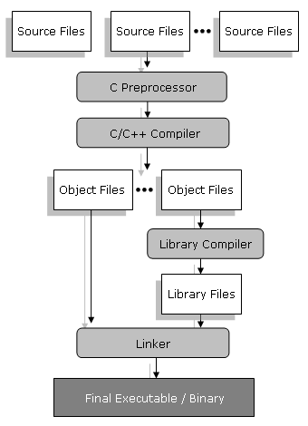
Compiler’s environment
COMP 442/6421 – Compiler Design
The compiler is most often one part of a translation/linkage system.
For example in C++, the translation process involves different tools:
  Preprocessor: translate directives that are generally about file inclusion or processing of macros.
  Template metaprocessor: process and translate template declarations into C++ code which is then fed to the compiler.
  Library compiler: process object files and generate dynamically linked libraries (dll).
  Linker: take the resulting object files, resolve their cross-references and generate a unified executable.
Joey Paquet, 2000-2019

Slide 26
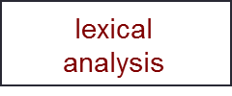
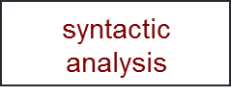
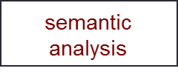
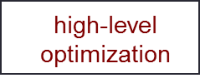


Phases of a compiler
COMP 442/6421 – Compiler Design
source code
token stream
syntax tree
annotated
tree
front-end
back-end
intermediate
code
target code
optimized
target code
Joey Paquet, 2000-2019

Slide 27
COMP 442/6421 – Compiler Design
Front end and Back end
Joey Paquet, 2000-2019

Slide 28
Front end
COMP 442/6421 – Compiler Design
The front end analyzes the source code to build an internal representation of the program, called the intermediate representation.
It also manages the symbol table, a data structure mapping each symbol in the source code to associated information such as type and scope.
The front-end is composed of: Lexical analysis, Syntactic analysis, Semantic analysis and High-level optimization.
In most compilers, most of the front-end is driven by the Syntactic analyzer.
It calls the Lexical analyzer for tokens and generates an abstract syntax tree when syntactic elements are recognized.
The generated tree (or other intermediate representation) is then analyzed and optimized in a separate process.
Heavily dependent on the source language compiled.
Independent from the target machine on which the code is eventually executed.
Joey Paquet, 2000-2019

Slide 29
Back end
COMP 442/6421 – Compiler Design
The term back end is sometimes confused with code generator because of the included functionality of generating assembly/machine code. Some literature uses middle end to distinguish the generic analysis and optimization phases in the back end from the machine-dependent code generator.
The back-end is composed of: Code generation and Low-level optimization.
Uses the intermediate representation generated by the front-end to generate target machine code, which can then potentially be optimized.
Heavily dependent on the target machine.
Independent on the source programming language compiled.
Joey Paquet, 2000-2019

Slide 30
COMP 442/6421 – Compiler Design
Compilation process phases
Joey Paquet, 2000-2019

Slide 31
Lexical analysis
COMP 442/6421 – Compiler Design
Lexical analysis is the process of converting a sequence of characters into a sequence of tokens.
A program or function which performs lexical analysis is called a lexical analyzer, lexer or scanner.
A scanner often exists as a single function which is called by the parser, whose functionality is to extract the next token from the source code.
The lexical specification of a programming language is defined by a set of rules which defines the scanner, which are understood by a lexical analyzer generator such as lex or flex. These are most often expressed as regular expressions.
The lexical analyzer (either generated automatically by a tool like lex, or hand-crafted) reads the source code as a stream of characters, identifies the lexemes in the stream, categorizes them into tokens, and outputs a token stream.
This is called "tokenizing."
If the scanner finds an invalid token, it will report a lexical error.
Joey Paquet, 2000-2019

Slide 32
Lexical analysis
COMP 442/6421 – Compiler Design
  Distance = rate * time;
  [id, distance], [assignop, =], [id, rate], [multop, *], [id, time], [semi, ;]
tokens | lexeme examples
keyword | while, to, do, int, main
identifier | i, max, total, i1, i2
literal | 123, 12.34, “Hello”
operator | =, +, *, and, >, <
punctuation | {, }, [, ], ;
Joey Paquet, 2000-2019

Slide 33
Syntactical analysis
COMP 442/6421 – Compiler Design
Syntax analysis involves parsing the token sequence to identify the syntactic structure of the program.
The parser's output is some form of intermediate representation of the program's structure, typically a parse tree, which replaces the linear sequence of tokens with a tree structure built according to the rules of a formal grammar which is used to define the language's syntax.
This is usually done using a context-free grammar which recursively defines components that can make up an valid program and the order in which they must appear.
The resulting parse tree is then analyzed, augmented, and transformed by later phases in the compiler.
Parsers are written by hand or generated by parser generators, such as Yacc, Bison, ANTLR or JavaCC, among other tools.
Joey Paquet, 2000-2019

Slide 34
Syntactical analysis
COMP 442/6421 – Compiler Design
input program
Distance = rate * time;
S
id
=
E
;
grammar
S ::= id = E;
E ::= E * E
E ::= id
E
*
E
id
id
Joey Paquet, 2000-2019

Slide 35
Semantic analysis
COMP 442/6421 – Compiler Design
Semantic analysis is the phase in which the compiler adds semantic information to the parse tree and builds the symbol table.
The symbol table is a dictionary containing information about all the identifiers defined in a program.
This phase performs semantic checks such as type checking (checking for type errors), or static binding (associating variable and function references with their definitions/types), or definite assignment (requiring all local variables to be initialized before use), rejecting semantically incorrect programs or issuing warnings.
This phase logically follows the parsing phase, and logically precedes the code generation phase, though it is often possible to fold multiple phases into one pass over the code in a compiler implementation, which is know as syntax-directed translation.
Not all rules defining programming languages can be expressed by context-free grammars alone, for example semantic validity such as type validity and proper declaration of identifiers. These rules can be formally expressed with attribute grammars that implement attribute migration across syntax tree nodes when necessary.
Joey Paquet, 2000-2019

Slide 36
Semantic analysis
COMP 442/6421 – Compiler Design
Once semantic analysis is done, semantic translation may traverse the parse tree and generate an intermediate code representation.
S
x
;
t1 = a;
t2 = y;
t3 = t1*t2;
t4 = z;
t5 = t3+t4;
x = t5;
=
E
x = a*y+z;
+
E
E
E
*
E
z
a
y
Joey Paquet, 2000-2019

Slide 37
High-level optimization
COMP 442/6421 – Compiler Design
High-level optimization involves an analysis phase for the gathering of program information from the intermediate representation derived by the front end.
Typical analyzes are data flow analysis to build use-define chains, dependence analysis, alias analysis, pointer analysis, etc.
Accurate analysis is the basis for any compiler optimization.
The call graph and control flow graph are usually also built during the analysis phase.
After analysis, the intermediate language representation is transformed into functionally equivalent but faster (or smaller) forms.
Popular optimizations are inline expansion, dead code elimination, constant propagation, loop transformation, register allocation or even automatic parallelization.
At this level, all activities are target machine independent.
Joey Paquet, 2000-2019

Slide 38
High-level optimization
COMP 442/6421 – Compiler Design
Simplistic example of high-level optimization applied on intermediate code
t1 = a;
t2 = y;
t3 = t1*t2;
t4 = z;
t5 = t3+t4;
x = t5;
t1 = a*y;
x = t1+z;
Joey Paquet, 2000-2019

Slide 39
Code generation
COMP 442/6421 – Compiler Design
The transformed intermediate language is translated into the output language, usually the native machine language of the system.
This involves resource and storage decisions, such as deciding which variables to fit into registers and memory and the selection and scheduling of appropriate machine instructions along with their associated addressing modes.
LE 4,a put a in register 4
ME 4,y multiply by y
AE 4,z add z
STE 4,x store register 4 in x
t1 = a*y;
x = t1+z;
Joey Paquet, 2000-2019

Slide 40
Low-level optimization
COMP 442/6421 – Compiler Design
The generated target code is analyzed for inefficiencies in the generated code, such as dead code or code redundancy.
Care is taken to exploit as much as possible the CPU’s capabilities and the target machine`s hardware architecture.
This phase is heavily architecture-dependent.
Joey Paquet, 2000-2019

Slide 41
Intermediate representations
COMP 442/6421 – Compiler Design
There are different approaches when considering the intermediate representations to be used.
An abstract intermediate representation (e.g. a tree) can be used in the front end to enable high-level representation/optimization.
A more concrete intermediate code representation may be used to facilitate code generation and lower level optimizations.
Lexical
Analyzer
Syntactic
Analyzer
Object
Code
Lexical
Analyzer
Syntactic
Analyzer
Intermediate
Code
Object
Code
Lexical
Analyzer
Syntactic
Analyzer
Intermediate
Representation
Object
Code
Lexical
Analyzer
Syntactic
Analyzer
Intermediate
Representation
Intermediate
Code
Object
Code
Front End
Back End
Joey Paquet, 2000-2019

Slide 42
Compilation/execution system support
COMP 442/6421 – Compiler Design
Symbol table
  Central repository of identifiers (variable or function names) used in the compiled program.
  Contains information such as the data type, function signature, or value in the case of constants.
  Used to identify undeclared or multiply declared identifiers, as well as type mismatches or invalid function calls, or use of invalid members for data structures or objects.
  Provides temporary variables for intermediate code generation.
Run-time system
  Some programming languages concepts raise the need for dynamic memory allocation. What are they?
  The running program must be able to manage its own memory use.
  Some will require a stack, others a heap. These are managed by the run-time system.
  Other language features may require to dynamically associate certain identifiers with a specific implementation at run-time. What are they?
  Such features require elaborated dynamic linking systems available at run-time.
Joey Paquet, 2000-2019

Slide 43
Writing of early compilers
COMP 442/6421 – Compiler Design
The first C compiler
It is much easier to write a compiler if a high-level language is available.
Here if we do one more iteration, we can have a C compiler written in C.
Or we may then use this compiler to build compilers for other languages.
minimal
C compiler
source
executable
C compiler
(minimal)
assembler
full
C compiler
source
C compiler
(minimal)
executable
C compiler
(full)
Joey Paquet, 2000-2019

Slide 44
Cross-compilation
COMP 442/6421 – Compiler Design
Using the same concept, we can also create compilers for other platforms:
Mac C compiler
source code
in Unix C
Unix C
compiler
Mac C complier
usable on Unix
Mac C compiler
source code
in Unix C
Mac C complier
usable on Unix
Mac C complier
usable on Mac
Joey Paquet, 2000-2019

Slide 45
Retargetable compilers
COMP 442/6421 – Compiler Design
Two methods:
  Make a strict distinction between front-end and back-end, then use different back-ends.
  Generate code for a virtual machine, then build a compiler or interpreter to translate virtual machine code to a specific machine code. That is what we do in the project.
Joey Paquet, 2000-2019

Slide 46
Summary
COMP 442/6421 – Compiler Design
The first compiler was the assembler, a one-to-one direct translator.
Complex compilers were written incrementally, first using assemblers.
All compilation techniques are well known since the 60’s and early 70’s.
The compilation process is divided into phases.
The input of a phase is the output of the previous phase.
It can be seen as a pipeline, where the phases are filters that successively transform the input program into an executable.
Joey Paquet, 2000-2019

Slide 47
References
COMP 442/6421 – Compiler Design
Backus, J. W.; H. Stern, I. Ziller, R. A. Hughes, R. Nutt, R. J. Beeber, S. Best, R. Goldberg, L. M. Haibt, H. L. Herrick, R. A. Nelson, D. Sayre, P. B. Sheridan (1957). The FORTRAN Automatic Coding System. Western joint computer conference: Techniques for reliability (Los Angeles, California: Institute of Radio Engineers, American Institute of Electrical Engineers, ACM): 188–198. doi:10.1145/1455567.1455599.
Naomi Hamilton (Computerworld), The A-Z of Programming Languages: YACC - The contribution YACC has made to the spread of Unix and C is a sense of pride for Stephen C. Johnson. July 2008.
C.N. Fischer, R.K. Cytron, R.J. LeBlanc Jr., Crafting a Compiler, Adison-Wesley, 2009. Chapter 1, 2.
Joey Paquet, 2000-2019

