Slide 1
COMPILER DESIGN
COMP 442/6421 – Compiler Design
Bottom-up parsing
Concepts
LR parsing table construction
Joey Paquet, 2000-2019

Slide 2
COMP 442/6421 – Compiler Design
Concepts of bottom-up parsing
Joey Paquet, 2000-2019

Slide 3
Top-down vs. bottom-up parsing
COMP 442/6421 – Compiler Design
Top-down parsers construct a derivation from the root to the leaves of a parse tree
Bottom-up parsers construct a reverse derivation from the leaves up to the root of the parse tree
  can handle a larger class of grammars
  most parser generators use bottom-up methods
  requires less grammar transformations (generally no transformation at all)
Joey Paquet, 2000-2019

Slide 4
Bottom-up parsing: concepts
COMP 442/6421 – Compiler Design
Often called “shift-reduce” parsers because they implement two main operations:
  shift: pushes the lookahead symbol onto the stack and reads another token
  reduce: matches a group of adjacent symbols β on the stack with the right-hand-side of a production and replaces β with the left-hand-side of the production (reverse application of a production). We reduce only if β is a handle.
  handle: A handle of a sentential form is a portion of a sentential form that matches the right-hand-side of a production, and whose reduction to the non-terminal on the left-hand-side of the production represents one step along the reverse and rightmost derivation.
Joey Paquet, 2000-2019

Slide 5
LL vs. LR parsing
COMP 442/6421 – Compiler Design
id + id * id
⇐ F + id * id
⇐ T + id * id
⇐ E + id * id
⇐ E + F * id
⇐ E + T * id
⇐ E + T * F
⇐ E + T
⇐ E
LR(k) stands for
  scan Left to right
  compute Rightmost derivation
  using k lookahead tokens
LL(k) stands for
  scan Left to right
  compute Leftmost derivation
  using k lookahead tokens
E
⇒ E + T
⇒ T + T
⇒ F + T
⇒ id + T
⇒ id + T * F
⇒ id + F * F
⇒ id + id * F
⇒ id + id * id
Joey Paquet, 2000-2019

Slide 6
LR parsers
COMP 442/6421 – Compiler Design
LR parsers can be constructed to recognize virtually all programming language constructs for which a context-free grammar can be written
The LR method is the most general non-backtracking shift-reduce parsing method known, yet it can be implemented as efficiently as other shift-reduce methods
The class of grammars that can be parsed using LR methods is a proper superset of the class of grammars that can be parsed with LL predictive parsers
An LR parser can detect a syntactic error as soon as it is possible to do so on a left-to-right scan of the input
Joey Paquet, 2000-2019

Slide 7
LR parsers
COMP 442/6421 – Compiler Design
SLR: simple LR
  easiest to implement, but the least powerful. May fail to produce a parsing table for some grammars.
CLR: canonical LR
  most powerful, general and expensive LR method.
LALR: lookahead LR
  intermediate in power and cost. Will work for most programming language constructs.
Joey Paquet, 2000-2019

Slide 8
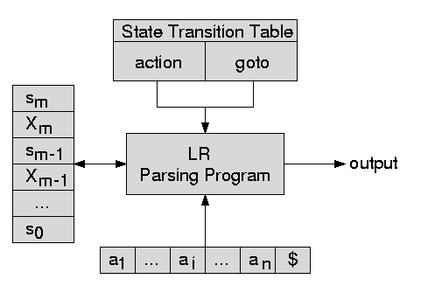
LR parsers
COMP 442/6421 – Compiler Design
parsing
table
parsing stack
token
stream
Joey Paquet, 2000-2019

Slide 9
LR parsers
COMP 442/6421 – Compiler Design
All LR parsers are table-driven, which is derived from an FSA generated from the context-free grammar representing the language
The same algorithm is used to parse, independently on the specific LR parsing method used
Only the nature of the LR method used to generate the table distinguishes the parsing method used.
All LR methods use a table that has two parts:
  action: dictates whether a shift or reduce operation is needed
  goto: dictates a state transition after a reduce operation
Joey Paquet, 2000-2019

Slide 10
LR parsing algorithm
COMP 442/6421 – Compiler Design
4 cases:
  action is a shift
  action is a reduce
  action is accept
  parsing error
push(0)
x = top()
a = nextToken()
repeat forever
if ( action[x,a] == shift s’ )
push(a)
push(s’)
a = nextToken()
else if ( action[x,a] == reduce A→β )
multiPop(2*|β|)
s’ = top()
push(A)
push(goto[s’,A])
write(A→β)
else if ( action[x,a] == accept )
return true
else
return false
Joey Paquet, 2000-2019

Slide 11
LR parsing table: example
COMP 442/6421 – Compiler Design
state | action |  |  |  |  |  | goto
 | id | + | * | ( | ) | $ | E | T | F
0 | s5 |  |  | s4 |  |  | 1 | 2 | 3
1 |  | s6 |  |  |  | acc
2 |  | r2 | s7 |  | r2 | r2
3 |  | r4 | r4 |  | r4 | r4
4 | s5 |  |  | s4 |  |  | 8 | 2 | 3
5 |  | r6 | r6 |  | r6 | r6
6 | s5 |  |  | s4 |  |  |  | 9 | 3
7 | s5 |  |  | s4 |  |  |  |  | 10
8 |  | s6 |  |  | s11
9 |  | r1 | s7 |  | r1 | r1
10 |  | r3 | r3 |  | r3 | r3
11 |  | r5 | r5 |  | r5 | r5
1 | E → E + T
2 | E → T
3 | T → T * F
4 | T → F
5 | F → (E)
6 | F → id
 | FOLLOW
E | {+,),$}
T | {+,*,),$}
F | {+,*,),$}
Joey Paquet, 2000-2019

Slide 12
LR parsing: example
COMP 442/6421 – Compiler Design
 | stack | input | action | derivation
1 | 0 | id+id*id$ | shift 5 | id+id*id
2 | 0id5 | +id*id$ | reduce (F→id) | ⇐ F+id*id
3 | 0F3 | +id*id$ | reduce (T→F) | ⇐ T+id*id
4 | 0T2 | +id*id$ | reduce (E→T) | ⇐ E+id*id
5 | 0E1 | +id*id$ | shift 6 | ⇐ E+id*id
6 | 0E1+6 | id*id$ | shift 5 | ⇐ E+id*id
7 | 0E1+6id5 | *id$ | reduce (F→id) | ⇐ E+F*id
8 | 0E1+6F3 | *id$ | reduce (T→F) | ⇐ E+T*id
9 | 0E1+6T9 | *id$ | shift 7 | ⇐ E+T*id
10 | 0E1+6T9*7 | id$ | shift 5 | ⇐ E+T*id
11 | 0E1+6T9*7id5 | $ | reduce (F→id) | ⇐ E+T*F
12 | 0E1+6T9*7F10 | $ | reduce (T→T*F) | ⇐ E+T
13 | 0E1+6T9 | $ | reduce (E→E+T) | ⇐ E
14 | 0E1 | $ | accept
Joey Paquet, 2000-2019

Slide 13
COMP 442/6421 – Compiler Design
Construction of an LR parsing table
Joey Paquet, 2000-2019

Slide 14
LR parsing tables
COMP 442/6421 – Compiler Design
Representation of the states of a DFA
The states:
  represent what has been parsed in the recent past on the way to recognize a handle
  control how the DFA will respond to the next token in input
  a stack is used to keep track of the yet unresolved part of the path taken by the parse
The goal is to find and reduce handles.
To keep track of how far we have gotten through the growth of a handle, we use items.
Joey Paquet, 2000-2019

Slide 15
Constructing LR parsing tables: items
COMP 442/6421 – Compiler Design
An item is a production with a place marker inserted somewhere in its right-hand-side, indicating the current parsing state in the production, e.g. E→E+T has 4 items:
Symbols to the left of the dot are already on the stack, those to the right are expected to be coming in input.
A shift action taken by the parser represents the moving of the dot within a right-hand-side, transitioning to a new state in the DFA.
A reduce action taken by the parser represents the inverse application of a grammar rule once we have come to the end of its right-hand-side.
[E → •E+T]
[E → E•+T]
[E → E+•T]
[E → E+T•]
Joey Paquet, 2000-2019

Slide 16
Constructing LR parsing tables: items
COMP 442/6421 – Compiler Design
Initial item: an item beginning with a dot.
Completed item: an item ending with a dot. These are candidates for reduction. When we have a completed item, a handle has been recognized. We can then reduce this handle to its corresponding left hand side non-terminal.
Moving the dot one symbol further in the right hand side corresponds to a state transition in the DFA.
Starting from state 0 (starting symbol), and computing the closure (i.e. all different possible expansions using the grammar rules) we find all possible state transitions from this state using items (i.e. the item set of a state).
Then for each group of items with the same symbol to the right of the dot in the item set, we apply a transition to another state (i.e. moving the dot one step). If the state is new (i.e. the sentential form to the left of the dot have not been encountered yet), we compute its closure and further transitions.
This proceeds until no more new states can be generated and all handles have been processed.
Joey Paquet, 2000-2019

Slide 17
Constructing the item sets
COMP 442/6421 – Compiler Design
State 0 : V[ε] : [S→•E] state 1 : V[E]
closure(S→•E) : [E→•E+T] state 1
[E→•T] state 2 : V[T]
[T→•T*F] state 2
[T→•F] state 3 : V[F]
[F→•(E)] state 4 : V[(]
[F→•id] state 5 : V[id]
State 1 : V[E] : [S→E•] accept
[E→E•+T] state 6 : V[E+]
State 2 : V[T] : [E →T•] handle
[T→T•*F] state 7 : V[T*]
State 3 : V[F] : [T→F•] handle
Joey Paquet, 2000-2019

Slide 18
Constructing the item sets
COMP 442/6421 – Compiler Design
State 4 : V[(] : [F→(•E)] state 8 : V[(E]
closure(F→(•E)) : [E→•E+T] state 8
[E→•T] state 2
[T→•T*F] state 2
[T→•F] state 3
[F→•(E)] state 4
[F→•id] state 5
State 5 : V[id] : [F→id•] handle
State 6 : V[E+] : [E→ E+•T] state 9 : V[E+T]
closure(E→ E+•T) : [T→•T*F] state 9
[T→•F] state 3
[F→•(E)] state 4
[F→•id] state 5
Joey Paquet, 2000-2019

Slide 19
Constructing the item sets
COMP 442/6421 – Compiler Design
State 7 : V[T*] : [F→T*•F] state 10 : V[T*F]
closure(F→T*•F) : [F→•(E)] state 4
[F→•id] state 5
State 8 : V[(E] : [F→(E•)] state 11 : V[(E)]
[E→ E•+T] state 6
State 9 : V[E+T] : [E→ E+T•] handle
[T→T•*F] state 7
State 10 : V[T*F] : [F→T*F•] handle
State 11 : V[(E)]: [F→ (E)•] handle
Joey Paquet, 2000-2019

Slide 20
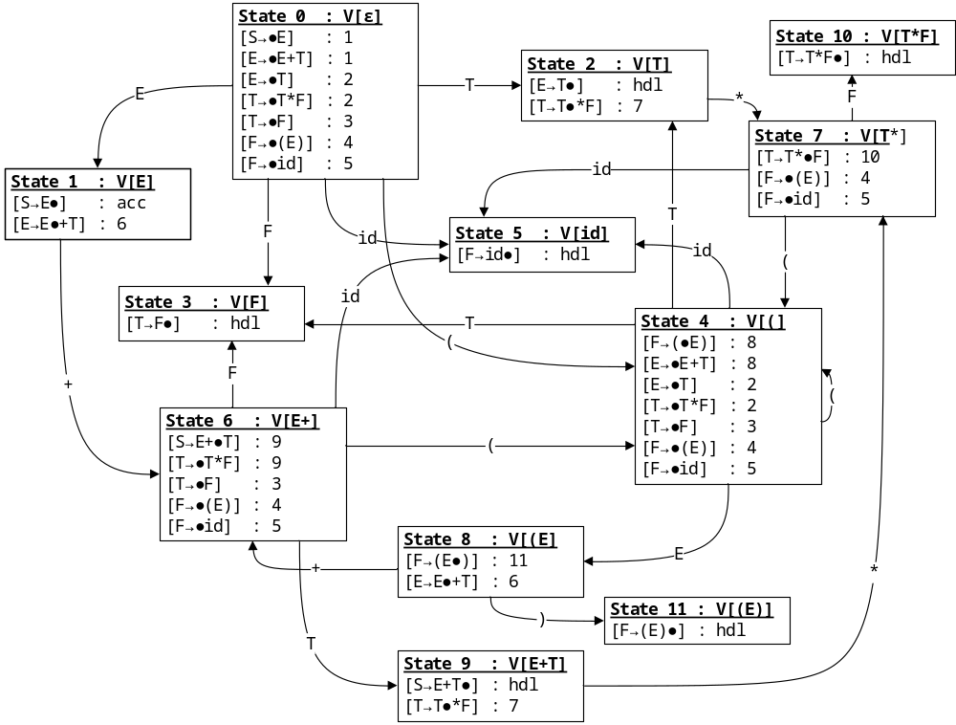
Resulting DFA
COMP 442/6421 – Compiler Design
Joey Paquet, 2000-2019

Slide 21
Filling the table
COMP 442/6421 – Compiler Design
(1) goto table
for each state
for each transition A→ α•β... that ( is not a completed item AND
has a non-terminal symbol after the dot )
put state(V[αβ]) in column β
(2) action table : shift actions
for each state
for each transition A→ α•β... that ( is not a completed item AND
has a terminal symbol after the dot )
put a shift action state(V[αβ]) in column β
(3) action table : reduce actions
for each state
for each transition that ( is a completed item A→ β•)
for all elements f of FOLLOW(A)
put a reduce n action in column f where n is the production number
(4) action table : accept action
find the completed start symbol item S→ α• and its corresponding state s
put an accept action in TT[s,$]
Joey Paquet, 2000-2019

Slide 22
Filling the table
COMP 442/6421 – Compiler Design
state | action |  |  |  |  |  | goto
 | id | + | * | ( | ) | $ | E | T | F
0 | s5 |  |  | s4 |  |  | 1 | 2 | 3
1 |  | s6 |  |  |  | acc
2 |  | r2 | s7 |  | r2 | r2
3 |  | r4 | r4 |  | r4 | r4
4 | s5 |  |  | s4 |  |  | 8 | 2 | 3
5 |  | r6 | r6 |  | r6 | r6
6 | s5 |  |  | s4 |  |  |  | 9 | 3
7 | s5 |  |  | s4 |  |  |  |  | 10
8 |  | s6 |  |  | s11
9 |  | r1 | s7 |  | r1 | r1
10 |  | r3 | r3 |  | r3 | r3
11 |  | r5 | r5 |  | r5 | r5
1 | E → E + T
2 | E → T
3 | T → T * F
4 | T → F
5 | F → (E)
6 | F → id
 | FOLLOW
E | {+,),$}
T | {+,*,),$}
F | {+,*,),$}
Joey Paquet, 2000-2019

Slide 23
References
COMP 442/6421 – Compiler Design
C.N. Fischer, R.K. Cytron, R.J. LeBlanc Jr., Crafting a Compiler, Adison-Wesley, 2009. Chapter 6.
Joey Paquet, 2000-2019

