Slide 1
COMPILER DESIGN
COMP 442/6421 – Compiler Design
Bottom-up parsing: Canonical LR and LALR
Error recovery in LR parsing
Parsing: concluding comments
Joey Paquet, 2000-2019

Slide 2
Problems with LR parsers
COMP 442/6421 – Compiler Design
The SLR parser breaks down when there are conflicts between shift/recude:
  Shift-reduce conflict: it cannot decide whether to shift or reduce
  Reduce-reduce conflict: A given configuration implies more than one possible reduction, e.g.
S → if E then S
| if E then S else S
State 3 : S → id• FOLLOW(S) = {$}
V[id] E → id• FOLLOW(E) = {$,+,=}
Z → S
S → E = E
S → id
E → E + id
E → id
Joey Paquet, 2000-2019

Slide 3
Canonical LR parsers
COMP 442/6421 – Compiler Design
For example, the previous example problem is not without solution:
  if the next token is either + or =, reduce id to E
  if the next token is $, reduce id to S
Solution: use lookahead sets in the items generation process to eliminate ambiguities
Joey Paquet, 2000-2019

Slide 4
Canonical LR parsing: item sets generation
COMP 442/6421 – Compiler Design
State 0: [Z → •S :{$}] : [Z → •S :{$}] : V[S] : State 1
V[ε] [S → •id :{$}] [S → •E=E :{$}] : V[E] : State 2
[S → •E=E :{$}] [E → •E+id :{=,+}] : V[E] : State 2
[E → •E+id :{=}] [E → •id] :{=,+}] : V[id] : State 3
[E → •id :{=}] [S → •id :{$}] : V[id] : State 3
[E → •E+id :{+}]
[E → •id :{+}]
State 1: [Z → S• :{$}] : [Z → S• :{$}] : accept : Final State
V[S]
State 2: [S → E•= E :{$}] : [S → E•=E :{$}] : V[E=] : State 4
V[E] [E → E•+id :{=,+} [E → E•+id :{=,+}] : V[E+] : State 5
State 3: [E → id• :{=,+}] : [E → id• :{=,+}] : : handle (r4)
V[id] [S → id• :{$}] [S → id• :{$}] : : handle (r2)
State 4: [S → E=•E :{$}] : [S → E=•E :{$}] : V[E=E] : State 6
V[E=] [E → •E+id :{$}] [E → •E+id :{+,$}] : V[E=E] : State 6
[E → •id :{$}] [E → •id :{+,$}] : V[E=id] : State 7
[E → •E+id :{+}]
[E → •id :{+}]
Joey Paquet, 2000-2019

Slide 5
Canonical LR parsing: item sets generation
COMP 442/6421 – Compiler Design
State 5: [E → E+•id :{=,+}] : [E → E+•id :{=,+}] : V[E+id] : State 8
V[E+]
State 6: [S → E=E• :{$}] : [S → E=E• :{$}] : : handle (r1)
V[E=E] [E → E•+id :{+,$}] [E → E•+id :{+,$}] : V[E=E+] : State 9
State 7: [E → id• :{+,$}] : [E → id• :{+,$}] : : handle (r4)
V[E=id]
State 8: [E → E+id• :{=,+}] : [E → E+id• :{=,+}] : : handle (r3)
V[E+id]
State 9: [E → E+•id :{+,$}] : [E → E+•id :{+,$}] : V[E=E+id] : State 10
V[E=E+]
State 10: [E → E+id• :{+,$}] : [E → E+id• :{+,$}] : : handle (r3)
V[E=E+id]
Joey Paquet, 2000-2019

Slide 6
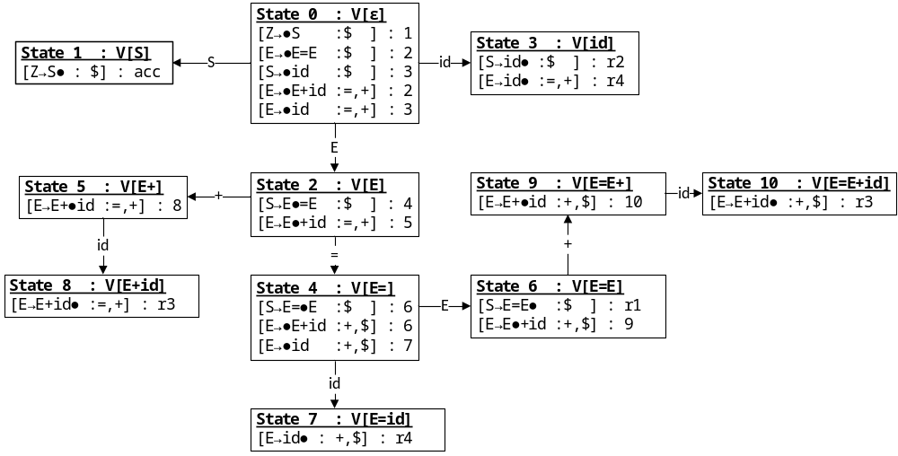
Canonical LR parsing: corresponding DFA
COMP 442/6421 – Compiler Design
Joey Paquet, 2000-2019

Slide 7
Canonical LR parsing: parsing table
COMP 442/6421 – Compiler Design
state | action |  |  |  | goto
 | id | = | + | $ | S | E
0 | s3 |  |  |  | 1 | 2
1 |  |  |  | acc
2 |  | s4 | s5
3 |  | r4 | r4 | r2
4 | s7 |  |  |  |  | 6
5 | s8
6 |  |  | s9 | r1
7 |  |  | r4 | r4
8 |  | r3 | r3
9 | s10
10 |  |  | r3 | r3
0 | Z → S
1 | S → E = E
2 | S → id
3 | E → E + id
4 | E → id
Joey Paquet, 2000-2019

Slide 8
LALR
COMP 442/6421 – Compiler Design
Problem: CLR generates more states than SLR, e.g. for a typical programming language, the SLR table has hundreds of states whereas a CLR table has thousands of states
Solution: merge similar states, i.e. states that have the same item sets, but not necessarily with the same lookahead sets. Merge such states into one state, and merge the lookahead sets of items that are duplicated.
Joey Paquet, 2000-2019

Slide 9
LALR
COMP 442/6421 – Compiler Design
A. State 0: {[Z → •S:{$}],[S → •id:{$}],[S → •E=E:{$}],
[E → •E+id:{=,+}],[E → •id]:{=,+}]}
B. State 1: {[Z → S•:{$}]}
C. State 2: {[S → E•=E:{$}],[E → E•+id:{=,+}]}
D. State 3: {[E → id•:{=,+}],[S → id•:{$}]}
E. State 4: {[S → E=•E:{$}],[E → •E+id:{+,$}],[E → •id:{+,$}]}
F. State 5: {[E → E+•id:{=,+}]}
State 9: {[E → E+•id:{+,$}]}
G. State 6: {[S → E=E•:{$}],[E → E•+id:{+,$}]}
H. State 7: {[E → id•:{+,$}]}
I. State 8: {[E → E+id•:{=,+}]}
State 10: {[E → E+id•:{+,$}]}
State 0: {[Z → •S:{$}],[S → •id:{$}],[S → •E=E:{$}],
[E → •E+id:{=,+}],[E → •id]:{=,+}]}
State 1: {[Z → S•:{$}]}
State 2: {[S → E•=E:{$}],[E → E•+id:{=,+}]}
State 3: {[E → id•:{=,+}],[S → id•:{$}]}
State 4: {[S → E=•E:{$}],[E → •E+id:{+,$}],[E → •id:{+,$}]}
State 5: {[E → E+•id:{=,+,$}]}
State 6: {[S → E=E•:{$}],[E → E•+id:{+,$}]}
State 7: {[E → id•:{+,$}]}
State 8: {[E → E+id•:{=,+,$}]}
Joey Paquet, 2000-2019

Slide 10
LALR parsing table
COMP 442/6421 – Compiler Design
state | action |  |  |  | goto
 | id | = | + | $ | S | E
0 | s3 |  |  |  | 1 | 2
1 |  |  |  | acc
2 |  | s4 | s5
3 |  | r4 | r4 | r2
4 | s7 |  |  |  |  | 6
5 | s8
6 |  |  | s5 | r1
7 |  |  | r4 | r4
8 |  | r3 | r3 | r3
1 | Z → S
2 | S → E = E
3 | S → id
4 | E → E + id
5 | E → id
Joey Paquet, 2000-2019

Slide 11
COMP 442/6421 – Compiler Design
Error recovery in LR parsing
Joey Paquet, 2000-2019

Slide 12
Error detection in LR parsers
COMP 442/6421 – Compiler Design
An error is detected when the parser consults the action table and finds an empty entry
Each empty entry potentially represents a different and specific syntax error
If we come onto an empty entry on the goto table, it means that there is an error in the table itself
Joey Paquet, 2000-2019

Slide 13
Error recovery in LR parsers
COMP 442/6421 – Compiler Design
onError()
1. pop() until a state s is on top of the stack and T is not empty
where
s has at least one entry in the goto table under non-terminal N
S is the set of states in the goto table for s
T is the set of terminals for which the elements of S
have a shift or accept entry in the action table
2. lookahead = nextToken() until lookahead x is in T
3. push the N corresponding to x and its corresponding state in S
4. resume parse
Joey Paquet, 2000-2019

Slide 14
Error recovery in LR parsers
COMP 442/6421 – Compiler Design
This method of error recovery attempts to eliminate the remainder of the current phrase derivable from a non-terminal A which contains a syntactic error.
Part of that A was already parsed, which resulted in a sequence of states on top of the stack.
The remainder of this phrase is still in the input.
The parser attempts to skip over the remainder of this phrase by looking for a symbol on the input that can legitimately follow A.
By removing states from the stack, skipping over the input, and pushing GOTO(s, A) on the stack, the parser pretends that it has successfully reduced an instance of A and resumes normal parsing.
Example: in many programming languages, statements end with a “;”
  if an error is found in a statement, the stack is popped until we get V[<statement>] on top of the stack
  nextToken() until the next “;” is found
  resume parse
Joey Paquet, 2000-2019

Slide 15
Error recovery in LR parsers: example
COMP 442/6421 – Compiler Design
state | action |  |  |  |  |  | goto
 | id | + | * | ( | ) | $ | E | T | F
0 | s5 | e1 | e1 | s4 | e1 | e0 | 1 | 2 | 3
1 | e2 | s6 | ee | e2 | e3 | acc
2 | e2 | r2 | s7 | e2 | r2 | r2
3 | e2 | r4 | r4 | e2 | r4 | r4
4 | s5 | e1 | e1 | s4 | e1 | e0 | 8 | 2 | 3
5 | e2 | r6 | r6 | e2 | r6 | r6
6 | s5 | e4 | e4 | s4 | e4 | e0 |  | 9 | 3
7 | s5 | e5 | e5 | s4 | e5 | e0 |  |  | 10
8 | e2 | r1 | s7 | e2 | s11 | e0
9 | e2 | r1 | s7 | e2 | r1 | r1
10 | e2 | r3 | r3 | e2 | r3 | r3
11 | e2 | r5 | r5 | e2 | r5 | r5
1 | E → E + T
2 | E → T
3 | T → T * F
4 | T → F
5 | F → (E)
6 | F → id
Joey Paquet, 2000-2019

Slide 16
Error recovery in LR parsers: example
COMP 442/6421 – Compiler Design
 | stack | input | action
1 | 0 | id)id*id)$ | shift 5
2 | 0id5 | )id*id)$ | reduce (F → id)
3 | 0F3 | )id*id)$ | reduce (T → F)
4 | 0T2 | )id*id)$ | reduce (E → T)
5 | 0E1 | )id*id)$ | e3
6 | 0T2 | *id)$ | shift 7
7 | 0T2*7 | id)$ | shift 5
8 | 0T2*7id5 | )$ | reduce (F → id)
9 | 0T2*7F10 | )$ | reduce (T → T * F)
10 | 0T2 | )$ | reduce (E → T)
11 | 0E1 | )$ | e3
12 | 0E1 | $ | accept
e0 | unexpected end of program
e1 | missing operand
e2 | missing operator
e3 | mismatched parenthesis
e4 | missing term
e5 | factor expected
e6 | + or ) expected
ee | parser error
1 | E → E + T
2 | E → T
3 | T → T * F
4 | T → F
5 | F → (E)
6 | F → id
Joey Paquet, 2000-2019

Slide 17
COMP 442/6421 – Compiler Design
Parsing: general comments
Joey Paquet, 2000-2019

Slide 18
Parser generators
COMP 442/6421 – Compiler Design
For real-life programming languages, construction of the table is extremely laborious and error-prone (several thousands of states)
Table construction follows strictly defined rules that can be implemented as a program called a parser generator
Yacc (Yet Another Compiler-Compiler) generates a LALR(1) parser code and table
Grammar is given in input in (near) BNF
Detects conflicts and resolves some conflicts automatically
Requires a minimal number of changes to the grammar
Each right hand side is associated with a custom semantic action to generate the symbol table and code
Joey Paquet, 2000-2019

Slide 19
Which method to use?
COMP 442/6421 – Compiler Design
We have seen
  Top-down: recursive descent predictive, table-driven predictive
  Bottom-up: SLR, CLR, LALR
  Parser generator
For real-life languages, the recursive descent parser lacks maintainability
The need for changing the grammar is a disadvantage for predictive parsers
Code generation and error detection is more difficult and less accurate in top-down parsers
Most compilers are implemented using the LR method, using parser generators
Other more recent ones are also generating top-down parsing methods (e.g. JavaCC)
Joey Paquet, 2000-2019

