Slide 1
COMPILER DESIGN
COMP 442/6421 – Compiler Design
Code generation
Joey Paquet, 2000-2019

Slide 2
Variable declarations and value access/assignment
COMP 442/6421 – Compiler Design
Integer variable declaration:
where x is an alias to the fixed address of x. Such aliases are (unique) labels generated during the parse and stored in the symbol table. Note that the labelling method of referring to values has great limitations, as it assumes that every variable in the program is unique and permanently allocated.
To load or change the content of an integer variable:
where x is the label of variable x, r1 is the register containing the value of variable x and r0 is assumed to contain 0 (offset).
int x;
x res 4
lw r1,x(r0)
sw x(r0),r1
Joey Paquet, 2000-2019

Slide 3
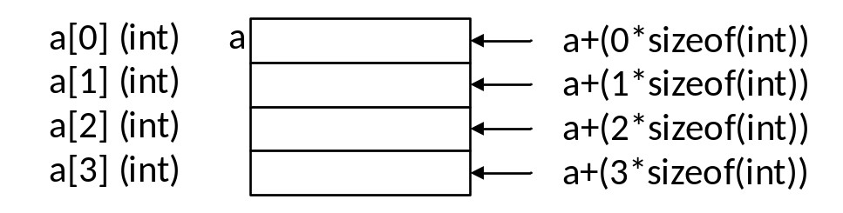
Variable declarations and access
COMP 442/6421 – Compiler Design
Array of integers variable declaration:
Accessing elements of an array of integers, using offsets:
int a[4];
a res 16
x = a[2];
addi r1,r0,8
lw r2,a(r1)
sw x(r0),r2
Joey Paquet, 2000-2019

Slide 4
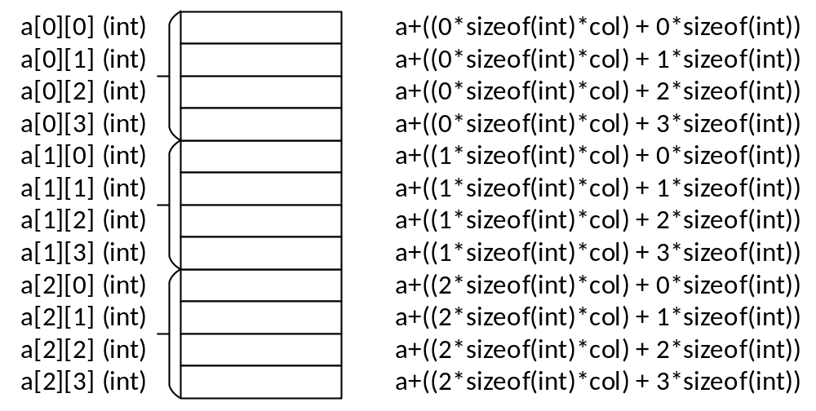
Variable declarations and access
COMP 442/6421 – Compiler Design
Multidimensional arrays of integers:
To access specific elements, a more elaborated offset calculation needs to be implemented, and the offset value be put in a register before accessing.
int a[3][4];
a res 48
Joey Paquet, 2000-2019

Slide 5
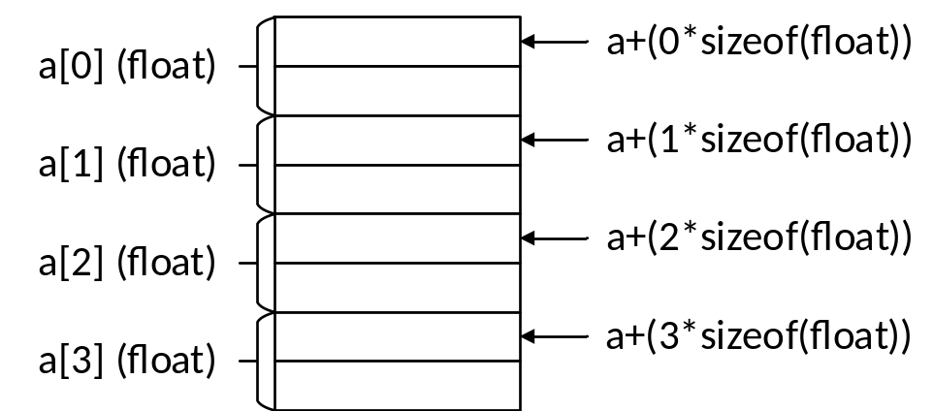
Variable declarations and access
COMP 442/6421 – Compiler Design
For arrays of elements of aggregate type, or arrays where each element takes more than one memory cell:
  The offset calculation needs to take into account to size of each element.
  For example, assuming a float takes 8 bytes (2 words):
float f[4];
f res 32
Joey Paquet, 2000-2019

Slide 6
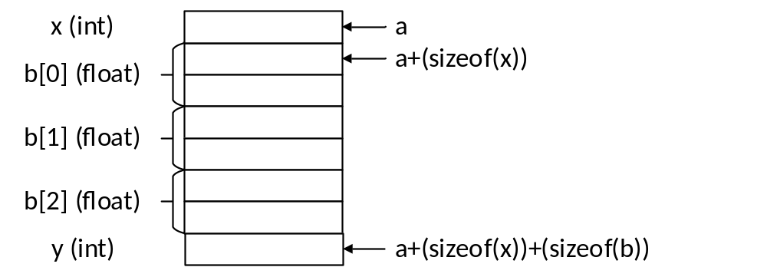
Variable declarations and access
COMP 442/6421 – Compiler Design
For an object variable declaration, each data member is stored contiguously in the order in which it is declared.
The offsets are calculated according to the total size of the data members preceding the member to access.
class MyClass{
int x;
float b[3]
int y;
}
Myclass a;
a res 32
addi r1,r0,4
addi r1,r1,16
lw r2,a(r1)
sw x(r0),r2
x = a.b[2]…
a + (sizeof(x)) + sizeof(float)*2)
Joey Paquet, 2000-2019

Slide 7
Arithmetic operations
COMP 442/6421 – Compiler Design
a+b
lw r1,a(r0)
lw r2,b(r0)
add r3,r1,r2
t1 res 4
sw t1(r0),r3
a+8
lw r1,a(r0)
addi r2,r1,8
t2 res 4
sw t2(r0),r2
a*b
lw r1,a(r0)
lw r2,b(r0)
mul r3,r1,r2
t3 res 4
sw t3(r0),r3
a*8
lw r1,a(r0)
muli r2,r1,8
t4 res 4
sw t4(r0),r2
Joey Paquet, 2000-2019

Slide 8
Relational operators
COMP 442/6421 – Compiler Design
a==b
lw r1,a(r0)
lw r2,b(r0)
ceq r3,r1,r2
t5 res 4
sw t5(r0),r3
a==8
lw r1,a(r0)
ceqi r2,r1,8
t6 res 4
sw t6(r0),r2
Joey Paquet, 2000-2019

Slide 9
Logical operators
COMP 442/6421 – Compiler Design
The Moon machine’s and, or and not operators are bitwise operators.
In order to have logical operators, we need to code them with the assumption that false is 0 and anything else is true.
a and b
lw r1,a(r0)
lw r2,b(r0)
t7 res 4
bz r1, zero1
bz r2, zero1
addi r3,r0,1
j endand1
zero1 addi r3,r0,0
endand1 sw t7(r0),r3
not a
lw r1,a(r0)
t8 res 4
bz r1,zero2
addi r1,r0,1
sw t8(r0),r1
j endnot1
zero2 sw t8(r0),r0
endnot1
Joey Paquet, 2000-2019

Slide 10
Expressions
COMP 442/6421 – Compiler Design
Each operator’s code generation in the previous examples is the result of translating a subtree with two leaves as the operands and one intermediate node as the operator.
For composite expressions, the temporary results become operands of operators higher in the tree.
a+b*c
lw r1,a(r0) [1]
lw r2,b(r0) [2]
lw r3,c(r0) [3]
mul r4,r2,r3 [4]
t8 res 4 [4]
sw t8(r0),r4 [4]
lw r5,t8(r0) [5]
add r6,r1,r5 [5]
t9 res 4 [5]
sw t9(r0),r6 [5]
+
[5: t9]
id (v_{a})
[4: t8]
*
[1: r1]
id (v_{b})
id (v_{c})
[2: r2]
[3: r3]
Joey Paquet, 2000-2019

Slide 11
Assignment operation
COMP 442/6421 – Compiler Design
a := b;
lw r1,b(r0)
sw a(r0),r1
a := 8;
sub r1,r1,r1
addi r1,r1,8
sw a(r0),r1
a := b+c;
{code for b+c. yields tn as a result}
lw r1,tn(r0)
sw a(r0),r1
Joey Paquet, 2000-2019

Slide 12
Conditional statements
COMP 442/6421 – Compiler Design
if a>b then a:=b; else a:=0;
[1] [2] [3] [4] [5] [6]
{code for "a>b“, yields tn as a result} [1]
lw r1,tn(r0) [2]
bz r1,else1 [2]
{code for "a:=b”} [3]
j endif1 [4]
else1 [4] {code for "a:=0”} [5]
endif1[6] {code continuation}
Joey Paquet, 2000-2019

Slide 13
Loop statements
COMP 442/6421 – Compiler Design
while a<b do a:=a+1;
[1] [2] [3] [4] [5]
gowhile1 [1] {code for "a<b". yields tn as a result} [2]
lw r1,tn(r0) [3]
bz r1,endwhile1 [3]
{code for statblock (a:=a+1)} [4]
j gowhile1 [5]
endwhile1[5] {code continuation}
Joey Paquet, 2000-2019

Slide 14
Translating functions
COMP 442/6421 – Compiler Design
There are two essential parts in translating programs that use functions:
  translating function definitions.
  translating function calls.
First, the compiler encounters a function header. It can either be a function prototype (if the language has them) or the header of a full function definition.
In both cases, a record can be created in the appropriate symbol table, and a local symbol table can be created if it is a new function. This does not lead to any code generation.
In the case of a function definition, the code is generated for the variable declarations (or their offsets are calculated) and statements inside the body of the function, which is preceded by parameter-passing instructions, and followed by return value passing instructions.
Joey Paquet, 2000-2019

Slide 15
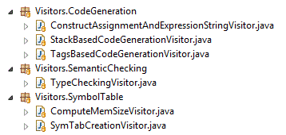
Translating functions
COMP 442/6421 – Compiler Design
The address field in the symbol table entry of the function contains the address (or label) of the first memory cell assigned to the executable code of the function.
This address/label will be used to jump to the function’s code when a function call is encountered and translated.
Function calls raise the need for semantic checking. At compile-time, the number and type of actual parameters must match with the information stored in the symbol table for that function.
Once the semantic check is successful, semantic translation can occur for the function call.
For modularity purposes, it is better to have all semantic checks in separate phases that runs prior to the code generation.
Joey Paquet, 2000-2019

Slide 16
Function declarations
COMP 442/6421 – Compiler Design
int fn ( int a, int b ){ statlist };
[1] [2] [3] [4] [5]
fnres res 4 [1]
fnp1 res 4 [2]
fn sw fnp1(r0),r2 [2]
fnp2 res 4 [3]
sw fnp2(r0),r3 [3]
{code for var. decl. & statement list} [4]
{assuming tn contains return value} [4]
lw r1,tn(r0)
sw fnres(r0),r1
jr r15 [5]
Joey Paquet, 2000-2019

Slide 17
Function declarations
COMP 442/6421 – Compiler Design
fn is an alias to the memory cell containing the first instruction of the function.
fnres contains the return value of fn.
Parameters are copied to registers at function call and copied in the local variables when the function execution begins.
This limits the possible number of parameters to the number of registers available.
r15 is reserved for linking back to the instruction following the jump at function call (see the following slides for function calls).
The above code assumes that the parameters are passed using registers, and that they are eventually stored in memory cells identified with a tag name.
  Limited by the number of registers available.
  Can only pass a value that fits into a register (or pass an address).
  This is a simple solution, but with severe limitations.
  For a better solution, see slides 22-24.
Joey Paquet, 2000-2019

Slide 18
Function calls
COMP 442/6421 – Compiler Design
For languages not allowing recursive function calls, only one occurrence of any function can be running at any given time if we are using this model.
In this case, all variables local to the function are statically allocated at compile time. The only things there are to manage are:
  the jump to the function code.
  the passing of parameters upon calling and return value upon completion.
  the jump back to the instruction following the function call.
Even though this works for only one function being called at a time, it is extremely restrictive.
Joey Paquet, 2000-2019

Slide 19
Function calls: simples case: no parameters
COMP 442/6421 – Compiler Design
…fn()…
...
{code for calling function}
jl r15,fn
{code continuation in the calling function}
...
fn {code for called function}
...
jr r15
...
Joey Paquet, 2000-2019

Slide 20
Function calls: passing parameters
COMP 442/6421 – Compiler Design
Parameters may be passed using registers.
With this solution, the number of parameters passed cannot exceed the total number of registers.
The return value can also be passed using a register, typically r1.
Again, simplistic parameter and return value passing method. Works only in restricted cases.
Joey Paquet, 2000-2019

Slide 21
Function calls: passing parameters (registers)
COMP 442/6421 – Compiler Design
x = fn(p1,p2);
...
{code for the calling function}
lw r2,p1(r0)
lw r3,p2(r0)
jl r15,fn
{assignment: assumes r1 contains return value}
sw x(r0),r1
{code continuation in the calling function}
...
fn {refer to param[i] as ri+1 in fn code}
sw fnp2(r0),r3
sw fnp1(r0),r2
...
{assuming tn contains return value}
lw r1,tn(r0)
jr r15
Joey Paquet, 2000-2019

Slide 22
Function calls: passing parameters: multiple function call instances
COMP 442/6421 – Compiler Design
To avoid the limitation of the allowed number of parameters to the number of registers, parameters can be stored statically in a tagged memory cell (one for each parameter).
These methods are only usable for languages where only one instance of a function can be running at the same time.
For example, with recursive function calls, the problem is that several instances of the same function can be running at the same time, hence there is a need to store a separate state of each function instances of the same function.
To enable more than one function instance to run at the same time, all the variables and parameters of a running function are stored in a stack frame which is dynamically allocated on a function call stack.
This involves the elaboration of a primitive run-time system as part of the compiled code.
Another problem with multiple function instances is that r15 is used to store the return address after a call. If there is more than one consecutive call (i.e. prog calls f1, then f1 calls f2), then the return address needs to be stored in the function call stack frame.
Joey Paquet, 2000-2019

Slide 23
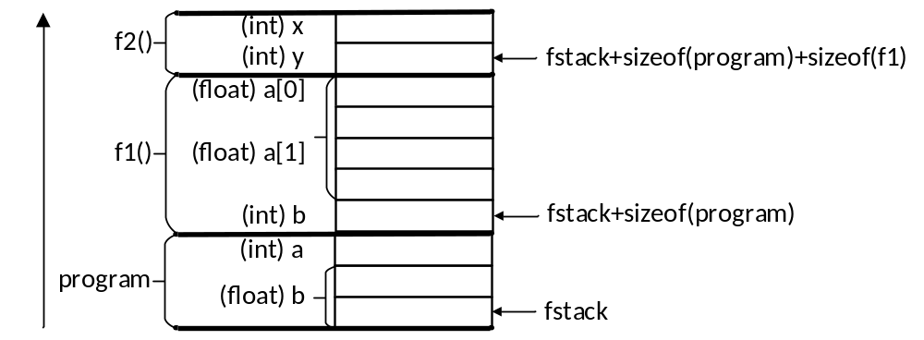
Function calls: function call stack and stack frames
COMP 442/6421 – Compiler Design
If multiple call instances are allowed, a function call stack is required:
  The function call stack is a fixed-size memory area statically reserved.
  For each function call, a stack frame is created on the function call stack.
  The stack frame contains the values of all the local variables declared in the function.
  The size of a stack frame is the sum of the sizes of all the function’s local variables.
  The location of the top of the stack is managed by adding/subtracting stack frame sizes as an accumulated offset from the initial address of the stack.
  Then, when the functions’ code uses its local variables, it refers to them as stored on the current function’s stack frame.
  When the function returns, its stack frame is “removed”, i.e. the function call stack offset is decremented by its function call stack frame size.
Joey Paquet, 2000-2019

Slide 24
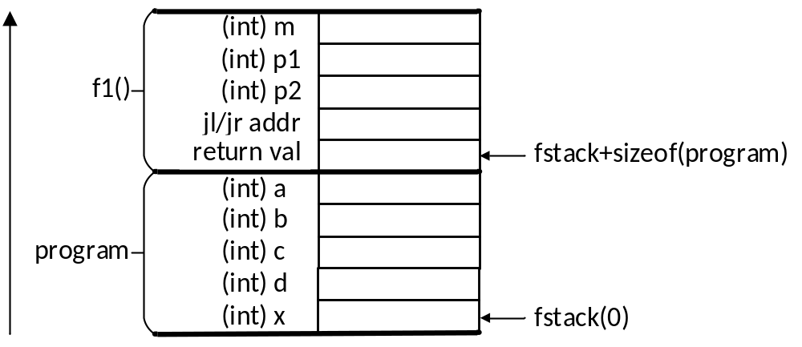
Function calls: function call stack
COMP 442/6421 – Compiler Design
Function stack frames also need to contain space necessary to store values used in the function call mechanism, i.e. not only the local variables, but also:
  The address stored in r15 by jl as the function is called.
  The return value in a place predictable by the calling function. For example, from the perspective of the calling function, the return value may always be stored at:
    fstack + sizeof(myframe) + sizeof(typeof(return value))
  The parameters in a place predictable by the calling function, e.g. for f1’s parameters:
    fstack + sizeof(myframe) + sizeof(typeof(return value))
    + 4 + sizeof(typeof(parameter2))
    fstack + sizeof(myframe) + sizeof(typeof(return value))
    + 4 + sizeof(typeof(parameter1)) + sizeof(typeof(parameter2))
int f1(int p1, int p2){
int m1;
m1 = 5;
p1 = p1 * m1;
p2 = p2 * m1;
return(p1 + p2);
}
program{
int a;
int b;
int c;
int d;
int x;
a = 1;
b = 2;
c = 3;
d = 4;
x = a + f1(b,c) * d;
put(x);
} // result = 101
Joey Paquet, 2000-2019

Slide 25
Function calls: function call stack: compute variables/block sizes and offsets
COMP 442/6421 – Compiler Design
For code generation the most important thing is to proceed in stages. Do not try to resolve all code generation in a single batch.
  The first step is to compute the size of all variables involved in the compiled program.
  These can be stored in the symbol tables.
  Memory also needs to be reserved for intermediate results, and literal values used in the compiled program.
  Then you can compute the offset of each element in a reserved block.
=====================================================
| table: global scope size: 0 |
=====================================================
| func | program | void |
| =====================================================
| | table: program scope size: 40 |
| =====================================================
| | var | a | int | 4 | 0 |
| | var | b | int | 4 | 4 |
| | var | c | int | 4 | 8 |
| | litval | t1 | int | 4 | 12 |
| | litval | t2 | int | 4 | 16 |
| | litval | t3 | int | 4 | 20 |
| | tempvar | t4 | int | 4 | 24 |
| | tempvar | t5 | int | 4 | 28 |
| | litval | t6 | int | 4 | 32 |
| | tempvar | t7 | int | 4 | 36 |
| =====================================================
=====================================================
program{
int a;
int b;
int c;
a = 1;
put(a);
b = 2;
put(b);
c = 3;
put(c);
a = a + b c;
put(a + 6);
} // result = 13
Joey Paquet, 2000-2019

Slide 26
Function calls: function call stack: compute variables/block sizes and offsets
COMP 442/6421 – Compiler Design
=====================================================
| class | class1 |
| =====================================================
| | table: class1 scope size: 12 |
| =====================================================
| | var | float1 | float | 8 | 0 |
| | var | int1 | int | 4 | 8 |
| =====================================================
| | func | int | func1 |
| =====================================================
| | table: func1 scope size: 216 |
| =====================================================
| | param | int235 | int | 120 | 0 |
| | param | float4 | float | 80 | 120 |
| | var | float7 | float | 8 | 200 |
| | tempvar | t1 | int | 4 | 208 |
| | tempvar | t2 | int | 4 | 212 |
| | litval | t3 | int | 4 | 216 |
| =====================================================
| | func | program | void |
| =====================================================
| | table: program scope size: 856 |
| =====================================================
| | var | int532 | int | 120 | 0 |
| | var | float101 | class1 | 120 | 120 |
| | var | float3 | float | 8 | 240 |
| | var | int3 | int | 4 | 248 |
| | tempvar | t7 | int | 4 | 252 |
| | litval | t8 | int | 4 | 256 |
| | tempvar | t9 | int | 4 | 260 |
| | tempvar | t10 | int | 4 | 264 |
| | tempvar | t11 | int | 4 | 268 |
| | tempvar | t12 | int | 4 | 272 |
| | tempvar | t13 | int | 4 | 276 |
| =====================================================
=====================================================
class class1{
float float1;
int int1;
}
int func1(int int235[2][3][5], float float4[10]){
float float7;
a=a+b*3;
}
program{
int int532[5][3][2];
class1 class110[10];
float float3;
int int3;
a=a+b*c;
x=a+b*c;
a=x+z*y
}
Joey Paquet, 2000-2019

Slide 27
read and write: “calling the operating system”
COMP 442/6421 – Compiler Design
Some function calls interact with the operating system, e.g. when a program does input/output
In these cases, there are several possibilities depending on the resources offered by the operating system, e.g.:
  treatment via special predefined ASM operations/subroutines
  access to the OS via calls or traps
In the Moon processor, we have two special operators: putc and getc
They respectively output some data to the screen and input data from the keyboard
They are used to directly translate read() and write() statements (see the Moon manual)
See the Visitor sample implementation code for code generation for read/write.
There are also a variety of libraries provided with the Moon code:
  lib.m: read/write strings to console/from keyboard, string/integer conversion, string operations
  util.m: read/write integer to console/from keyboard, string operations.
Joey Paquet, 2000-2019

Slide 28
Code generation: suggested sequence
COMP 442/6421 – Compiler Design
Suggested sequence:
  variable declarations (integers first)
  expressions (one operator at a time)
  assignment statement
  read and write statements
  conditional statement
  loop statement
Tricky parts:
  function calls
  expressions involving arrays and classes (offset calculation)
  floating point numbers (non-native in Moon)
  calls to multiple instances of the same function at a time, e.g. recursive function calls
  expressions involving access to object members (offset calculations)
  calls to member functions (access to object’s data members)
Joey Paquet, 2000-2019

Slide 29
Hints for final stages leading to the project demonstration
COMP 442/6421 – Compiler Design
You will not fail the project if you did not implement code generation for all aspects of the language.
But, you might fail if your compiler is not working at all.
This is why you should proceed in stages and make sure each successive stage is correct before going further.
Be careful to not break what was previously working.
This is the main reason why you should have numerous tests in place, ideally organized in automated regression testing. Unit testing is a good way to achieve that.
Make sure you have a compiler that works properly for a subset of the problem.
For the parts that you did not implement, think of a solution. You may get some marks if you are able to clearly explain how to do what is missing during your project demonstration.
Joey Paquet, 2000-2019

