Slide 1
COMPILER DESIGN
COMP 442/6421 – Compiler Design
Table-driven syntax-directed translation
Joey Paquet, 2000-2019

Slide 2
COMP 442/6421 – Compiler Design
Top-down table-driven syntax-directed translation
Joey Paquet, 2000-2019

Slide 3
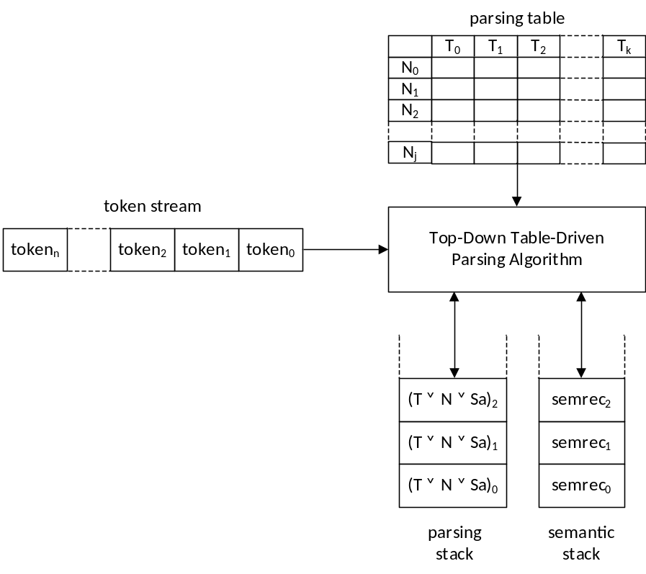
Top-down table-driven syntax-directed translation
COMP 442/6421 – Compiler Design
Augment the parser algorithm to implement attribute migration.
  Introduce additional symbols in the grammar’s right hand sides for semantic actions that process semantic attributes.
  The grammar becomes an attribute grammar.
  When such a symbol is on top of the stack, execute the semantic action.
Problem: the attributes have to be pushed and popped at a different pace compared to symbols on the parsing stack.
Solution: use an additional stack (the semantic stack) to store the attributes.
    The semantic actions typically pop semantic records from the semantic stack, do some processing, then push a semantic record on the stack.
Joey Paquet, 2000-2019

Slide 4
Top-down table-driven syntax-directed translation
COMP 442/6421 – Compiler Design
Attribute Grammar
r1: | E → TAE’B
r2: | E’₁ → +TCE’₂D
r3: | E’ → εE
r4: | T → FFT’G
r5: | T’₁ → *FHT’₂I
r6: | T’ → εJ
r7: | F → idK
r8: | F → (E)L
Semantic Actions
A: | {E’i = Ts}
B: | {Es = E’s}
C: | {E’₂i = makeFamily(+,E’₁i,Ts)}
D: | {E’₁s = E’₂s}
E: | {E’s = E’i}
F: | {T’i = Fs}
G: | {Ts = T’s}
H: | {T’₂i = makeFamily(*,T’₁i,Fs)}
I: | {T’₁s = T’₂s}
J: | {T’s = T’i}
K: | {Fs = makeNode(id)}
L: | {Fs = Es}
 | id | ( | ) | + | * | $
E | r1 | r1
E’ |  |  | r3 | r2 |  | r3
T | r4 | r4
T’ |  |  | r6 | r6 | r5 | r6
F | r7 | r8
Joey Paquet, 2000-2019

Slide 5
Attribute migration
COMP 442/6421 – Compiler Design
id1+id2*id3$
E
B:{Es = E's}
T
A:{E'i = Ts}
E'
D:{E's = E's}
G:{Ts = T's}
C:{E’₂i = makeFamily(+,E’₁i,Ts)}}
+
T
E'
F
T'
G:{Ts = T's}
E:{E's = E'i}
F:{T'i = Fs}
ε
F
T'
K:{Fs = makeNode(id)}}
J:{T's = T'i}
F:{T'i = Fs}
ε
K:{Fs = makeNode(id)}}
I:{T's = T's}
id
id
*
F
T'
H:{T’₂i = makeFamily(*,T’₁i,Fs)}}
K:{Fs = makeNode(id)}}
J:{T's = T'i}
id
ε
Joey Paquet, 2000-2019

Slide 6
Attribute migration
COMP 442/6421 – Compiler Design
id1*id2+id3$
E
B:{Es = E's}
T
A:{E'i = Ts}
E'
D:{E's = E's}
G:{Ts = T's}
C:{E’₂i = makeFamily(+,E’₁i,Ts)}}
+
T
E'
F
T'
E:{E's = E'i}
F:{T'i = Fs}
G:{Ts = T's}
ε
K:{Fs = makeNode(id)}}
I:{T's = T's}
id
F
T'
F:{T'i = Fs}
*
F
T'
H:{T’₂i = makeFamily(*,T’₁i,Fs)}}}
K:{Fs = makeNode(id)}}
J:{T's = T'i}
J:{T's = T'i}
K:{Fs = makeNode(id)}}
id
ε
id
ε
Joey Paquet, 2000-2019

Slide 7
Parsing example using semantic stack for attribute migration
COMP 442/6421 – Compiler Design
 | parsing stack | input | action | semantic stack
1 | $E | id₁*id₂+id₃$ | R1
2 | $BE'AT | id₁*id₂+id₃$ | R4
3 | $BE'AGT'FF | id₁*id₂+id₃$ | R7
4 | $BE'AGT'FKid | id₁*id₂+id₃$
5 | $BE'AGT'FK | *id₂+id₃$ | K | F₁s[id₁.val]
6 | $BE'AGT'F | *id₂+id₃$ | F | T'₁i[id₁.val]
7 | $BE'AGT' | *id₂+id₃$ | R5 | T'₁i[id₁.val]
8 | $BE'AGIT'HF* | *id₂+id₃$ |  | T'₁i[id₁.val]
9 | $BE'AGIT'HF | id₂+id₃$ | R7 | T'₁i[id₁.val]
10 | $BE'AGIT'HKid | id₂+id₃$ |  | T'₁i[id₁.val]
11 | $BE'AGIT'HK | +id₃$ | K | T'₁i[id₁.val] F₂s[id₂.val]
12 | $BE'AGIT'H | +id₃$ | H | T'₂i[id₁.val * id₂.val]
13 | $BE'AGIT' | +id₃$ | R6 | T'₂i[id₁.val * id₂.val]
14 | $BE'AGIJ | +id₃$ | J | T'₂s[id₁.val * id₂.val]
15 | $BE'AGI | +id₃$ | I | T'₁s[id₁.val * id₂.val]
16 | $BE'AG | +id₃$ | G | T₁s[id₁.val * id₂.val]
17 | $BE'A | +id₃$ | A | E'₁i[id₁.val * id₂.val]
Joey Paquet, 2000-2019

Slide 8
Parsing example using semantic stack for attribute migration
COMP 442/6421 – Compiler Design
 | parsing stack | input | action | semantic stack
18 | $BE' | +id₃$ | R2 | E'₁i[id₁.val * id₂.val]
19 | $BDE'CT+ | +id₃$ |  | E'₁i[id₁.val * id₂.val]
20 | $BDE'CT | id₃$ | R4 | E'₁i[id₁.val * id₂.val]
21 | $BDE'CGT'FF | id₃$ | R7 | E'₁i[id₁.val * id₂.val]
22 | $BDE'CGT'FKid | id₃$ |  | E'₁i[id₁.val * id₂.val]
23 | $BDE'CGT'FK | $ | K | E'₁i[id₁.val * id₂.val] F₃s[id₃.val]
24 | $BDE'CGT'F | $ | F | E'₁i[id₁.val * id₂.val] T'₃i[id₃.val]
25 | $BDE'CGT' | $ | R6 | E'₁i[id₁.val * id₂.val] T'₃i[id₃.val]
26 | $BDE'CGJ | $ | J | E'₁i[id₁.val * id₂.val] T'₃s[id₃.val]
27 | $BDE'CG | $ | G | E'₁i[id₁.val * id₂.val] T₂s[id₃.val]
28 | $BDE'C | $ | C | E'₂i[id₁.val * id₂.val + id₃.val]
29 | $BDE' | $ | R3 | E'₂i[id₁.val * id₂.val + id₃.val]
30 | $BDE | $ | E | E'₂s[id₁.val * id₂.val + id₃.val]
31 | $BD | $ | D | E'₁s[id₁.val * id₂.val + id₃.val]
32 | $B | $ | B | E₁s[id₁.val * id₂.val + id₃.val]
33 | $ | $ | accept | E₁s[id₁.val * id₂.val + id₃.val]
Joey Paquet, 2000-2019

Slide 9
References
COMP 442/6421 – Compiler Design
Fischer, Cytron, Leblanc. Crafting a Compiler, Chapter 7. Addison-Wesley. 2010.
Robert Paul Corbett. Static Semantics and Compiler Error Recovery. PhD thesis, University of California Berkeley. 1985.
Joey Paquet, 2000-2019

