Slide 1
COMPILER DESIGN
COMP 442/6421 – Compiler Design
Generating an Abstract Syntax Tree
using Syntax-Directed Translation
Joey Paquet, 2018-2019

Slide 2
Abstract Syntax Tree: Definition
COMP 442/6421 – Compiler Design
An abstract syntax tree (AST) is a tree representation of the abstract syntactic structure of source code.
Each node of the tree denotes a syntactic construct occurring in the source code.
The syntax is "abstract" i.e. it does not represent every detail appearing in the concrete syntax used in the source code.
Such details are removed because they do not convey any form of meaning and are thus superfluous for further processing.
For instance, punctuation such as commas, semicolons, and grouping parentheses have been removed, and a syntactic construct like an if-then-else may be denoted by means of a single node with three branches.
This distinguishes abstract syntax trees from concrete syntax trees, which are traditionally designated as parse trees.
Once built, additional information is added to the AST by means of subsequent processing steps such as semantic analysis and code generation.
Joey Paquet, 2018-2019

Slide 3
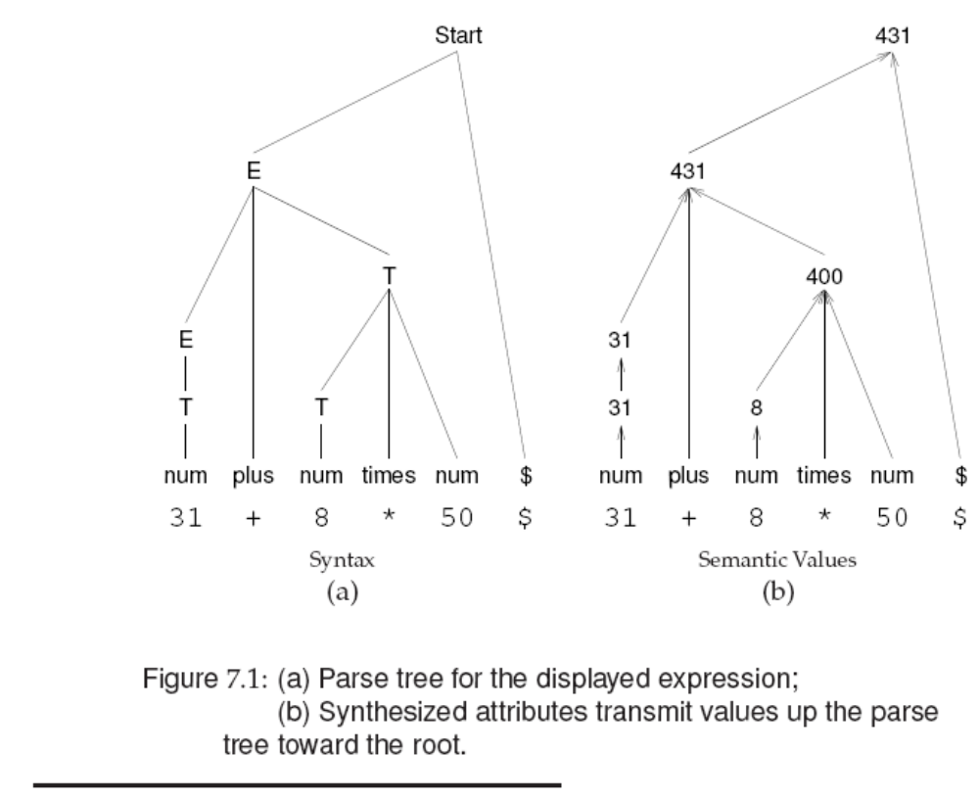
Abstract Syntax Tree: Goal
COMP 442/6421 – Compiler Design
Goals:
to aggregate information gathered during the parse in order to get a broader understanding of the meaning of whole syntactic constructs;
to represent the entire program in a data structure that can later be repeatedly traversed for further analysis steps.
At the leaves of the tree is fine-grained syntactical concepts/information.
Intermediate nodes represent higher-level constructs created by aggregation of the information conveyed by its branches’ subtrees.
The root note contains all the information for the entire program and its composing syntactical constructs.
Joey Paquet, 2018-2019

Slide 4
COMP 442/6421 – Compiler Design
AST data structure: requirements, design, implementation
Joey Paquet, 2018-2019

Slide 5
Abstract Syntax Tree: data structure requirements
COMP 442/6421 – Compiler Design
The AST structure is constructed bottom-up:
  A list of siblings nodes is generated and each is pushed on a semantic stack.
  The list elements are later popped from the semantic stack and adopted by a parent node.
The AST structure should allow for adding of siblings at either end of the list.
Some AST nodes require a fixed number of children
  Arithmetic operators
  if-then-else statement
Some AST nodes require zero or more number of children
  Parameter lists
  Statements in a statement block
In order to be generally applicable, an AST node data structure should allow for any number of children.
Joey Paquet, 2018-2019

Slide 6
Abstract Syntax Tree: data structure requirements/design
COMP 442/6421 – Compiler Design
According to depth-first-search tree traversal.
Each node needs connection to:
  Parent: to migrate information upwards in the tree
    Link to parent
  Siblings: to iterate through (1) a list of operands or (2) members of a group, e,g, members of a class, or statements in a statement block.
    Link to right sibling (thus creating a linked list of siblings)
    Link to leftmost sibling (in case one needs to traverse the list as a sibling is being processed).
  Children: to generate/traverse the tree
    Link to leftmost child (who represents the head of the linked list of children, which are each other’s siblings).
Joey Paquet, 2018-2019

Slide 7
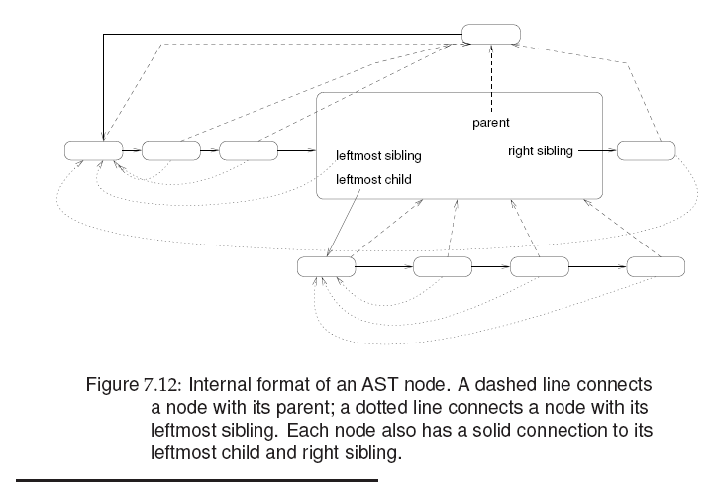

Abstract Syntax Tree: data structure design
COMP 442/6421 – Compiler Design
Joey Paquet, 2018-2019

Slide 8
Abstract Syntax Tree: data structure implementation
COMP 442/6421 – Compiler Design
makeNode(t)
factory method that creates/returns a node whose members are adapted to the type of the parameter t. For example:
  makeNode(intNum i): instantiates a node that represents a numeric literal value. Offers a get method to get the value it represents.
  makeNode(id n): instantiates a node that represents an identifier. Offers get/set methods to get/set the symbol table entry it represents, which stores information such as its type/protection/scope.
  makeNode(op o): instantiates a node that represents composite structures such as operators, statements, or blocks. There should be one for each such possible different nodes for each different kind of composite structures in the language. Each offers get/set methods appropriate to what they represent.
  makeNode(): instantiates a null node in order to represent, e.g. the end of siblings list.
Joey Paquet, 2018-2019

Slide 9
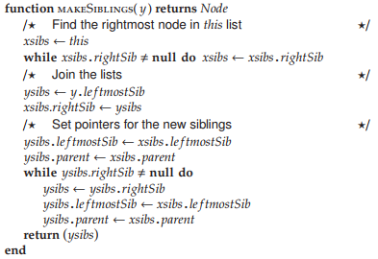
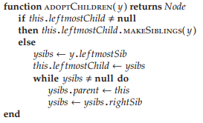
Abstract Syntax Tree: data structure implementation
COMP 442/6421 – Compiler Design
x.makeSiblings(y)
inserts a new sibling node y in the list of siblings of node x.
x.adoptChildren(y)
adopts node y and all its siblings under the parent x.
Joey Paquet, 2018-2019

Slide 10

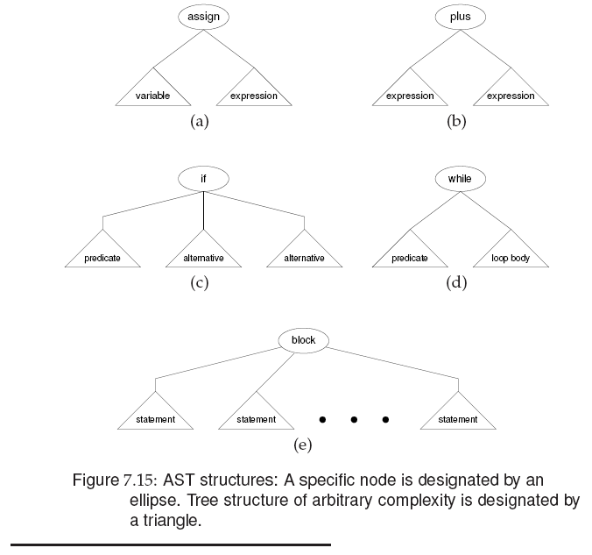
Abstract Syntax Tree: data structure implementation
COMP 442/6421 – Compiler Design
makeFamily(op, kid₁, kid₂, …, kid_{n})): generates a family with n children under a parent op. For example:
One such function to create each kind
of sub-tree, or one single variadic
function.
Some (many) programming languages do
not allow variadic functions.
Joey Paquet, 2018-2019

Slide 11
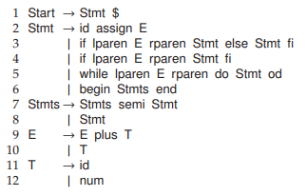
Insert semantic actions in the grammar/parser
COMP 442/6421 – Compiler Design
Example simple grammar:
Joey Paquet, 2018-2019

Slide 12
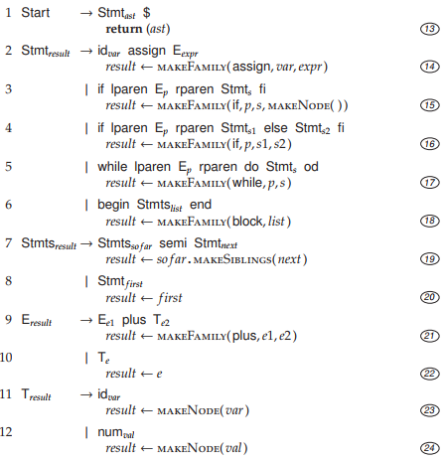
Insert semantic actions in the grammar/parser
COMP 442/6421 – Compiler Design
Example grammar with semantic actions added.
AST leaf nodes are created when the parse reaches leaves in the parse tree (23, 24) (makeNode).
Siblings lists are constructed as lists are processed inside a structure (19) (makeSiblings).
Subtrees are created when an entire structure has been parsed (14, 15, 16, 17, 18, 21) (makeFamily).
Some semantic actions are only migrating information across the tree (20).
Joey Paquet, 2018-2019

Slide 13
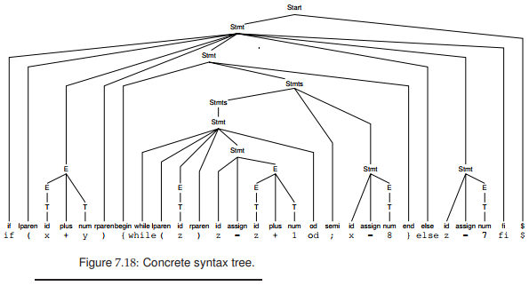
Example: parse tree
COMP 442/6421 – Compiler Design
Joey Paquet, 2018-2019

Slide 14
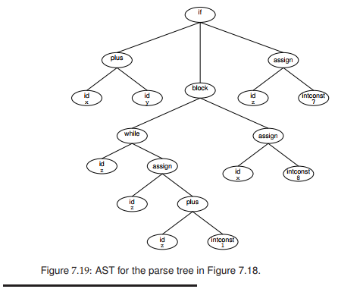
Example: corresponding AST
COMP 442/6421 – Compiler Design
Joey Paquet, 2018-2019

Slide 15
AST generation using Syntax-Directed Translation
COMP 442/6421 – Compiler Design
A Language Semantic Concept is a building block of the meaning of a program
  literal value, variable, function definition, class and/or data structure, statement, expression, etc.
In an AST, each concept is represented by a node.
Atomic concepts (Ca) are represented by AST leaf nodes (CaN).
  Literal value, identifier, etc.
Composite concepts (Cc) represent higher-level concepts that aggregate n subordinate concepts (Cs).
Composite concepts are represented by an AST subtree (CsN) with n AST subtrees as children.
Joey Paquet, 2018-2019

Slide 16
AST generation using Syntax-Directed Translation
COMP 442/6421 – Compiler Design
Upon reaching a parse tree leaf node where semantic information for atomic concept Ca is present
  call makeNode() to generate an AST node CaN for atomic concept Ca
  put the semantic information in CaN
  push CaN on the semantic stack
As soon as a parsing subtree has gathered all necessary semantic information for composite concept Cc
  call makeNode() to generate an AST node CcN for composite concept Cc
  for each subordinate concept Cs of Cc
    pop the top of the semantic stack, yielding a node CsN representing Cs
    make CsN a child of CcN
  push CcN onto the semantic stack
When the parse finishes, the semantic stack should contain only one node representing the full AST of the parsed program
Joey Paquet, 2018-2019

Slide 17
COMP 442/6421 – Compiler Design
AST creation in a recursive-descent predictive parser
Joey Paquet, 2018-2019

Slide 18
AST generation: implementation in recursive-descent predictive parser
COMP 442/6421 – Compiler Design
AST variables represents tree nodes that are created, migrated and grafted/adopted in order to construct an abstract syntax tree.
Parse(){
AST Es //blank AST created
//before the call
lookahead = NextToken()
if (E(Es);Match('$')) //passed as a reference
//to parsing functions
//that will create the tree
return(true);
else
return(false);
}
Joey Paquet, 2018-2019

Slide 19
AST generation: implementation in recursive-descent predictive parser
COMP 442/6421 – Compiler Design
Each parsing function potentially (i.e. not necessarily all of them) defines its own AST nodes used locally that represents its own subtree.
Ts,E's are ASTs produced/used by the T() and E’() functions and returned by them to the E() function.
E(AST &Es){
AST Ts,E's
if (lookahead is in [0,1,(])
if (T(Ts);E'(Ts,E's);) // E' inherits Ts from T
write(E->TE')
Es = E's // Synthetised attribute sent up
return(true) // by way of the Es reference
else // parameter of E()
return(false)
else
return(false)
}
Joey Paquet, 2018-2019

Slide 20
AST generation: implementation in recursive-descent predictive parser
COMP 442/6421 – Compiler Design
E’(AST &Ti, type &E's){
AST Ts,E'2s
if (lookahead is in [+])
if (Match('+');T(Ts);E'(Ts,E'2s)) // (3) E' inherits Ts from T
write(E'->TE')
E's = makeFamily(+,Ti,E'2s) // (1) AST subtree creation
return(true) // sent up in the parse tree
else // by way of the E’s parameter
return(false)
else if (lookahead is in [$,)]
write(E'->epsilon)
E's = Ti // (2) Synth. attr. is inherited
return(true) // from T (sibling, not child)
else // and sent up
return(false)
}
Some semantic actions will do some semantic checking and/or semantic aggregation, such as a tree node adopting a child node, or inferring the type of an expression from two child operands (1).
Some semantic actions are simply migrating an AST subtree upwards in the parse tree (2), or sideways to a sibling tree (3).
Joey Paquet, 2018-2019

Slide 21
AST generation: implementation in recursive-descent predictive parser
COMP 442/6421 – Compiler Design
T(AST &Ts){
AST Fs, T's
if (lookahead is in [0,1,(])
if (F(Fs);T'(Fs,T's);) // T' inherits Fs from F
write(T->FT')
Ts = T's // Synthetized attribute sent up
return(true)
else
return(false)
else
return(false)
}
Joey Paquet, 2018-2019

Slide 22
AST generation: implementation in recursive-descent predictive parser
COMP 442/6421 – Compiler Design
T’(AST &Fi, type &T's){
AST Fs, T'2s
if (lookahead is in [*])
if (Match('*');F(Fs);T'(Fs,T'2s)) // T' inherits Fs from F
write(T'->*FT')
T's = makeFamily(*,Fi,T'2s) // AST subtree creation
return(true) // using left operand migrated
else // from left sibling parse tree
return(false) // received as Fi parameter
else if (lookahead is in [+,$,)]
write(T'->epsilon)
T's = Fi // Synthetized attribute is
// inhertied from F sibling
// and sent up the tree
return(true)
else
return(false)
}
Joey Paquet, 2018-2019

Slide 23
AST generation: implementation in recursive-descent predictive parser
COMP 442/6421 – Compiler Design
F(AST &Fs){
AST Es
if (lookahead is in [id])
if (Match('id'))
write(F->id)
Fs = makeNode(id) // create a leaf node
return(true) // and send it up the parse tree
else
return(false)
else if (lookahead is in [(])
if (Match('(');E(Es);Match(')'))
write(F->(E))
Fs = Es // Synthetized attribute from E
return(true) // i.e. AST of whole expression
else return(false) // sent up in the parse tree
else return(false) // as AST subtree representing
} // the ‘(E)’ successfully parsed
Joey Paquet, 2018-2019

Slide 24
Attribute migration: example
COMP 442/6421 – Compiler Design
a+b*c
+
AST
Es
a
*
E
E’s
makeFamily
b
c
Ts
T₁
Ti
E’₁
E’s
T’s
E’s
Fs
F₁
Fi
T’₁
T’s
+
Ts
T₂
Ti
E’₂
E’s
Fs
makeNode
ε
T’s
ε
id(v_{a}:τ)
makeFamily
Fs
F₂
Fi
T’₂
T’s
parse tree
Fs
T’s
makeNode
id(v_{b}:τ)
*
Fs
F₃
Fi
T’₃
T’s
Fs
ε
makeNode
id(v_{c}:τ)
Joey Paquet, 2000-2018-2019

Slide 25
COMP 442/6421 – Compiler Design
Abstract Syntax Tree structural elements
Joey Paquet, 2018-2019

Slide 26
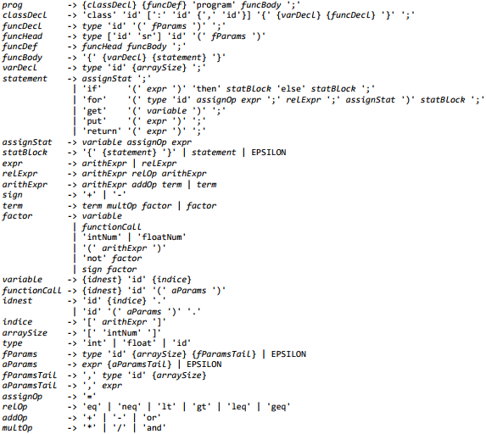
Grammar
COMP 442/6421 – Compiler Design
Joey Paquet, 2018-2019

Slide 27
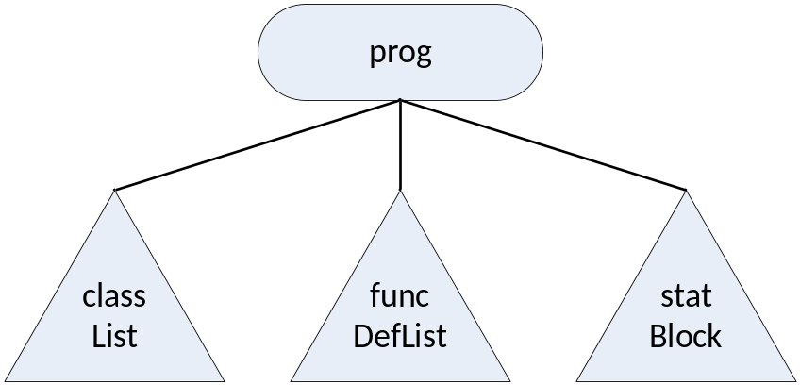
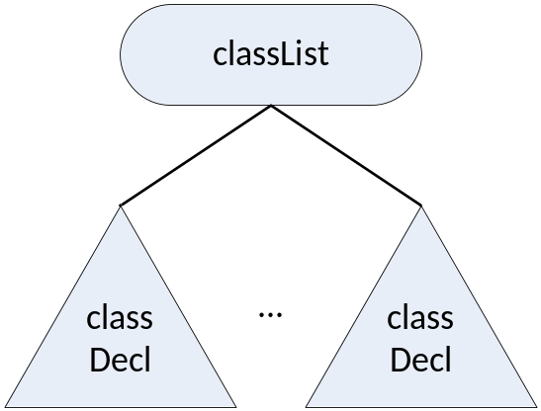
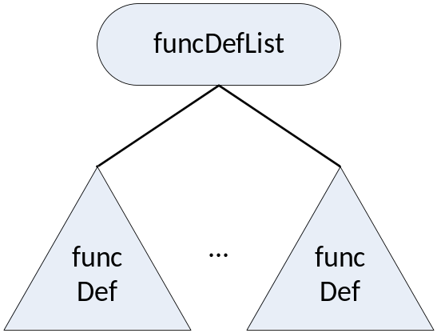
Abstract Syntax Tree structural elements
COMP 442/6421 – Compiler Design
Joey Paquet, 2018-2019

Slide 28
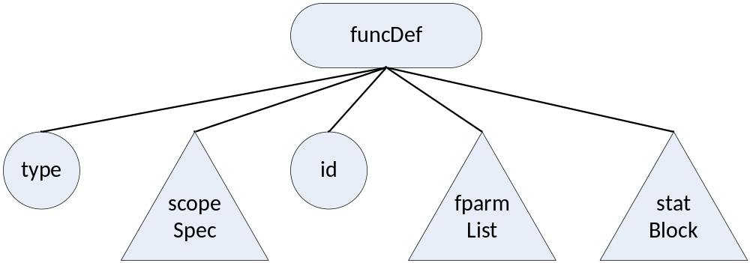
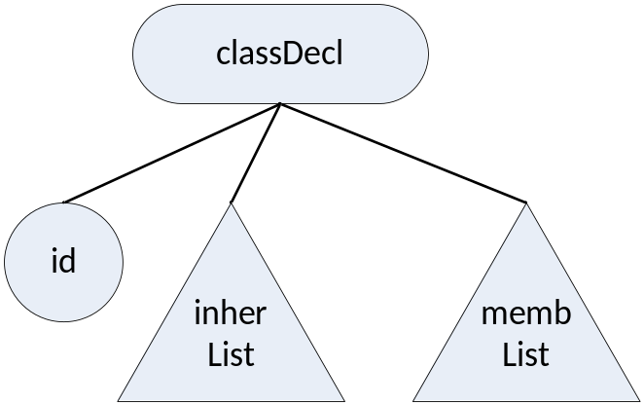
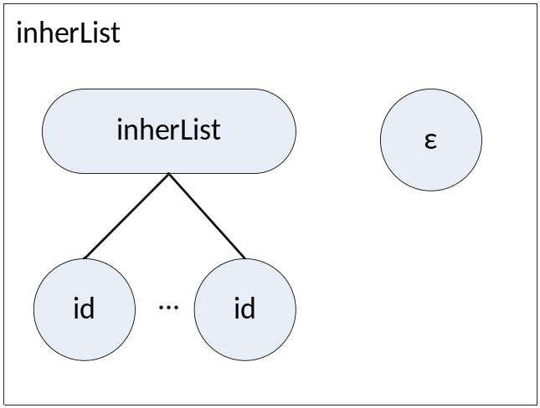
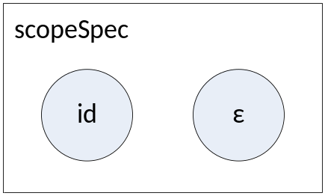
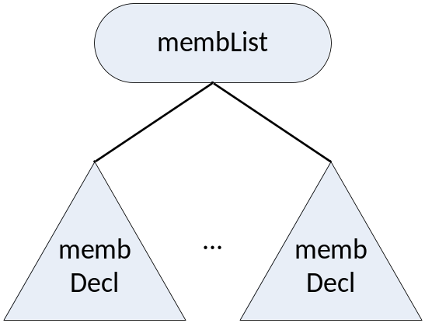
Abstract Syntax Tree structural elements
COMP 442/6421 – Compiler Design
Joey Paquet, 2018-2019

Slide 29
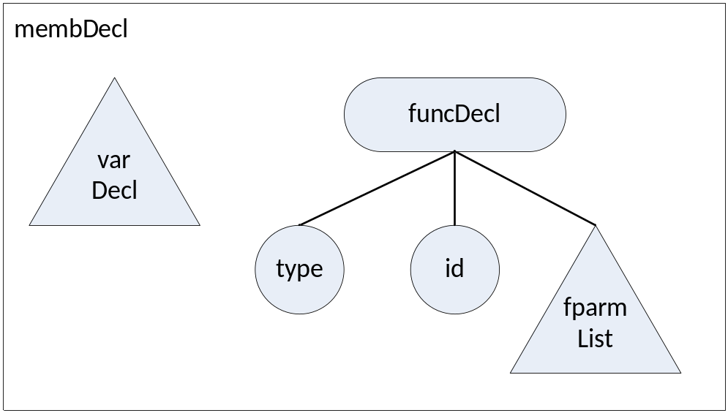
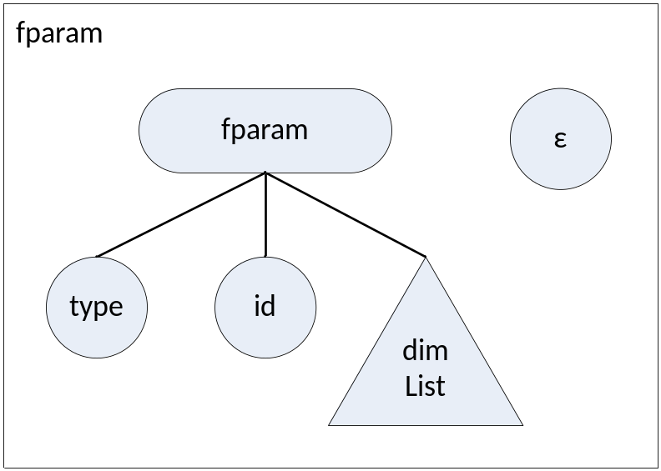
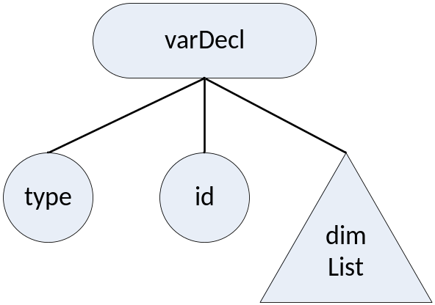
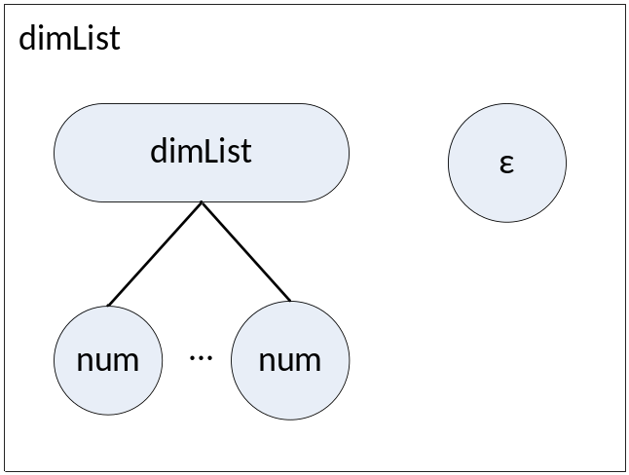
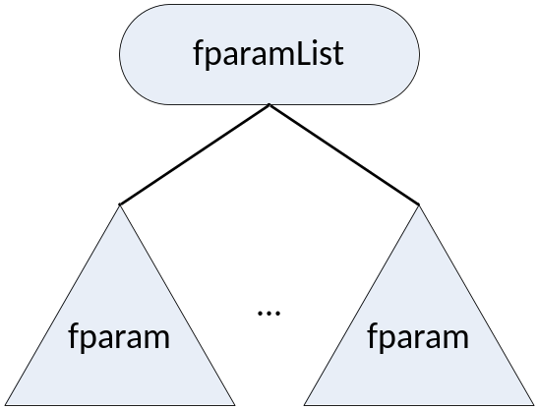
Abstract Syntax Tree structural elements
COMP 442/6421 – Compiler Design
Joey Paquet, 2018-2019

Slide 30
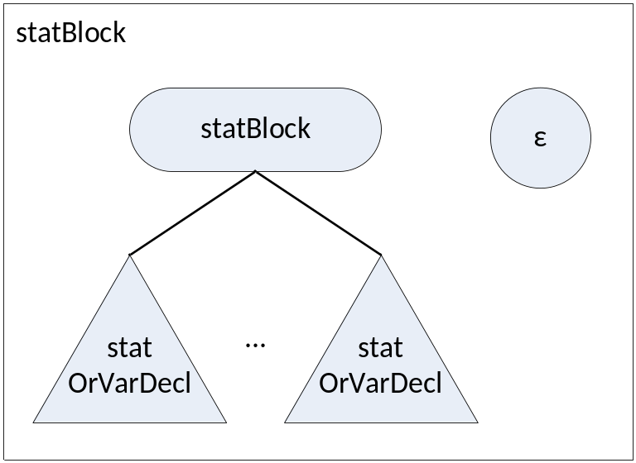
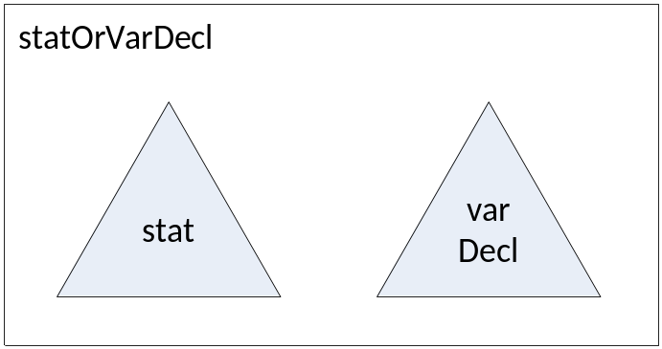
Abstract Syntax Tree structural elements
COMP 442/6421 – Compiler Design
Joey Paquet, 2018-2019

Slide 31
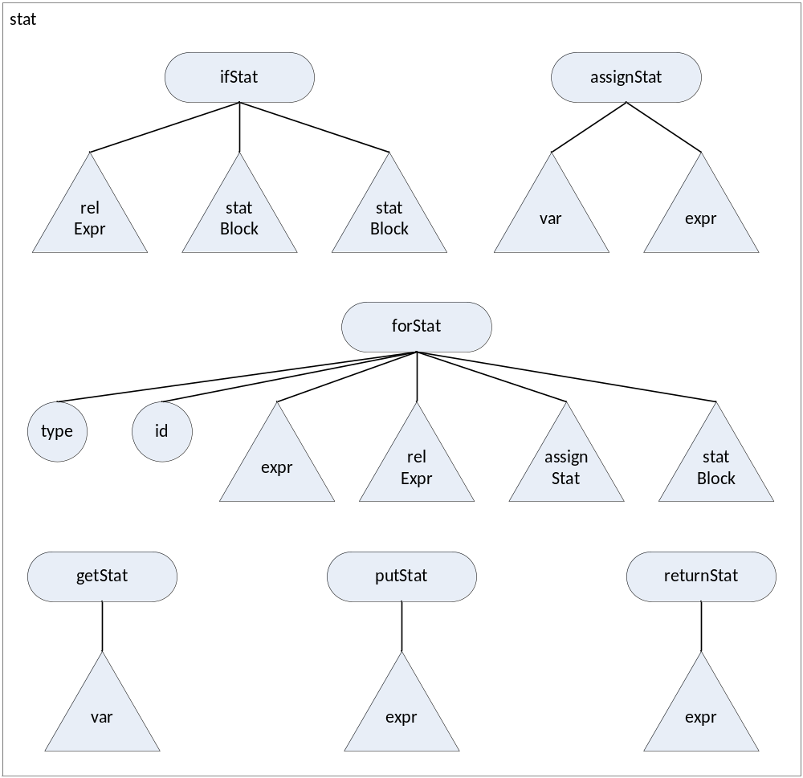
Abstract Syntax Tree structural elements
COMP 442/6421 – Compiler Design
Joey Paquet, 2018-2019

Slide 32
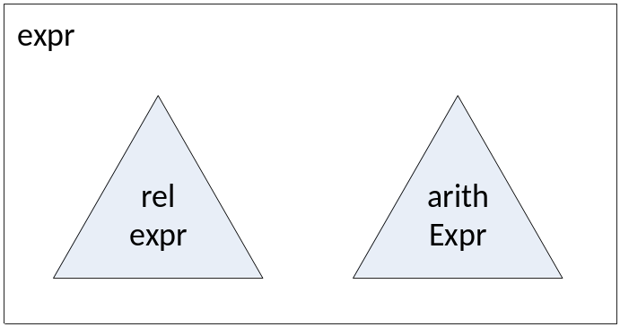
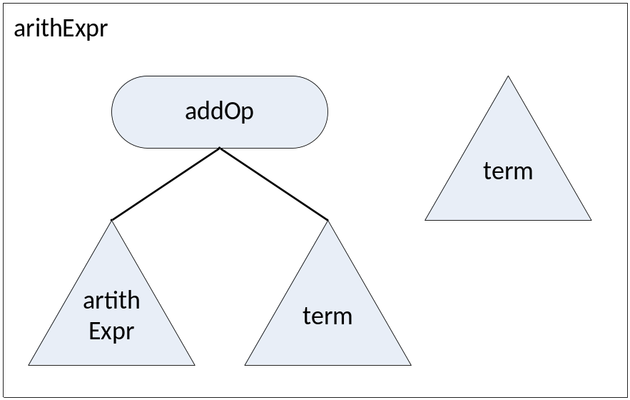
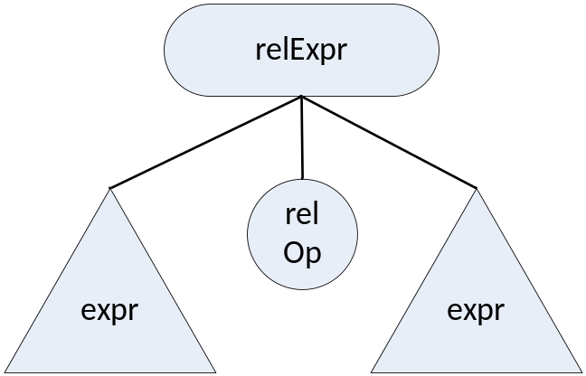
Abstract Syntax Tree structural elements
COMP 442/6421 – Compiler Design
Joey Paquet, 2018-2019

Slide 33
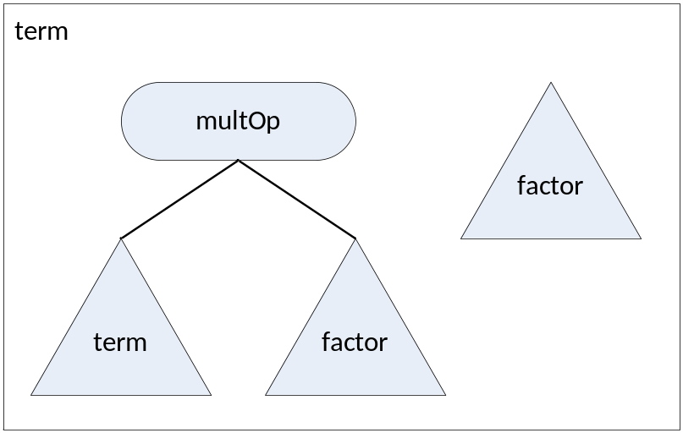
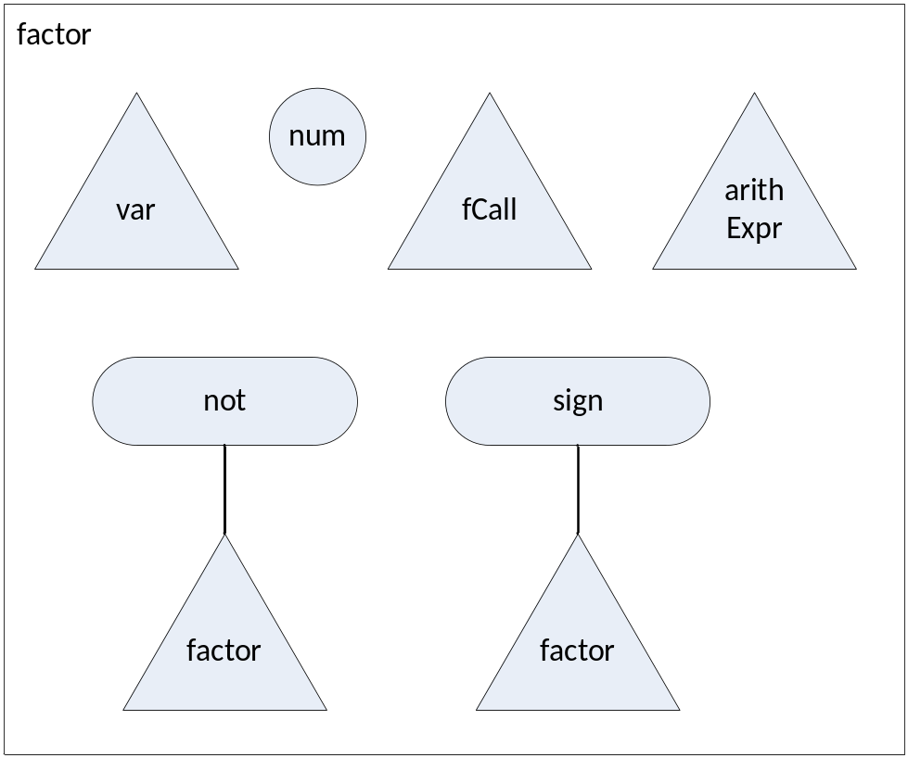
Abstract Syntax Tree structural elements
COMP 442/6421 – Compiler Design
Joey Paquet, 2018-2019

Slide 34
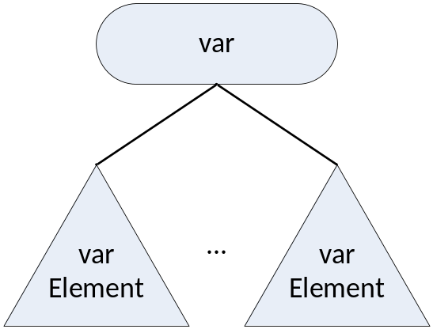
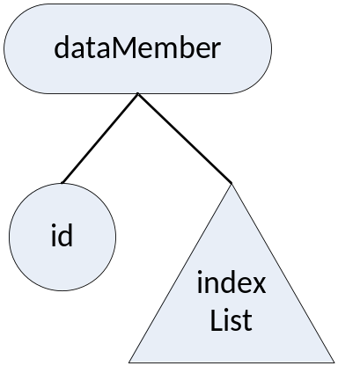
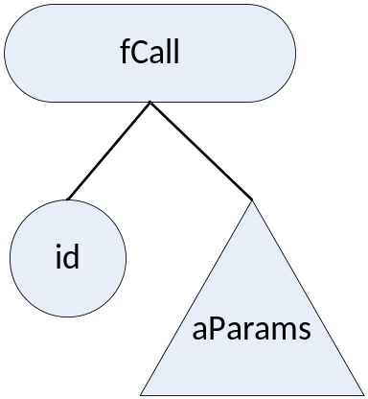
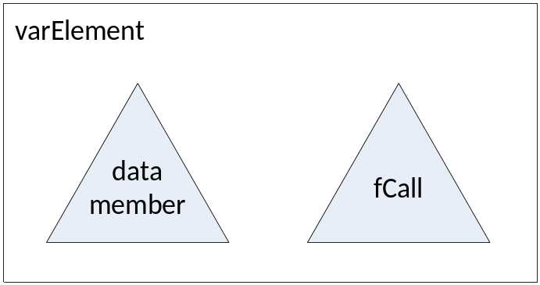
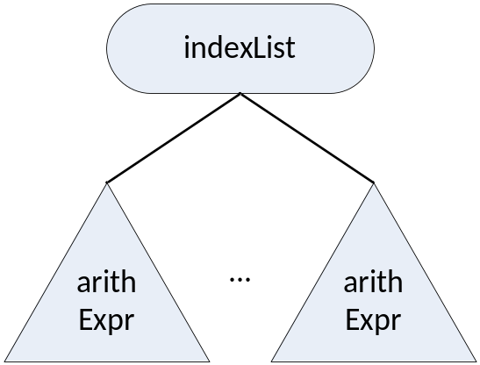
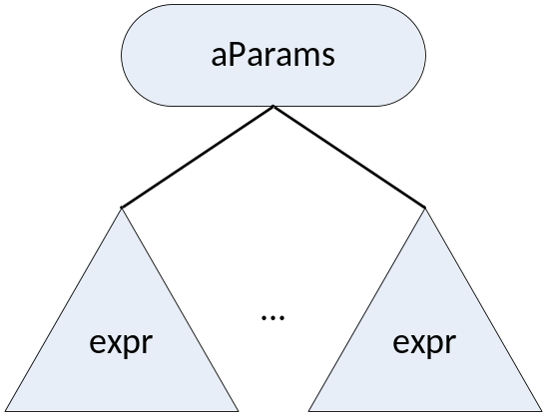
Abstract Syntax Tree structural elements
COMP 442/6421 – Compiler Design
Joey Paquet, 2018-2019

Slide 35
References
COMP 442/6421 – Compiler Design
Wikipedia. Abstract Syntax Tree.
C.N. Fischer, R.K. Cytron, R.J. LeBlanc Jr., Crafting a Compiler, Adison-Wesley, 2009. Chapter 7.
Joey Paquet, 2018-2019

