Slide 1
2022 NEAF Training Course
Digital Image Process
Date: 2022/7/28 Instructor: Yuhan Zhao

Slide 2
手裡只有鐵鎚的人
看什麼都是釘子
-- CK Ting

Slide 3
Outline
Image Basics
Widely Used DIP Methods
Histogram Equalization
Blur: mean blur, median blur, gaussian blur
Binary
HSV filter
Morphological: erosion, dilation, open, close
Find contours

Slide 4
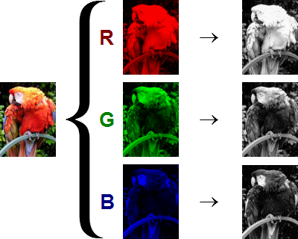
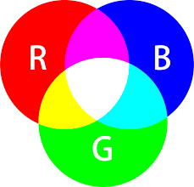
Image Basics

Slide 5
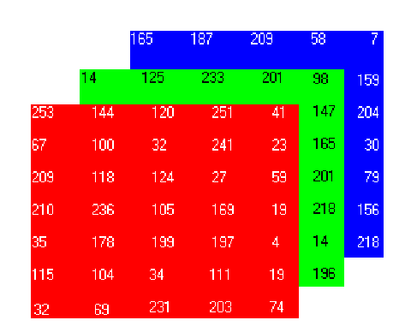
Image Basics
0
255

Slide 6
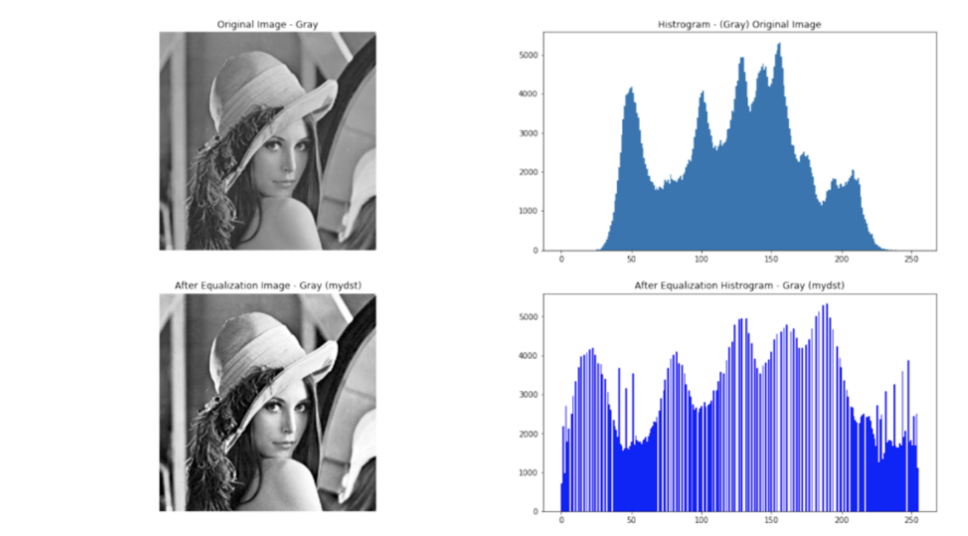
Widely Used DIP Methods
Histogram Equalization

Slide 7
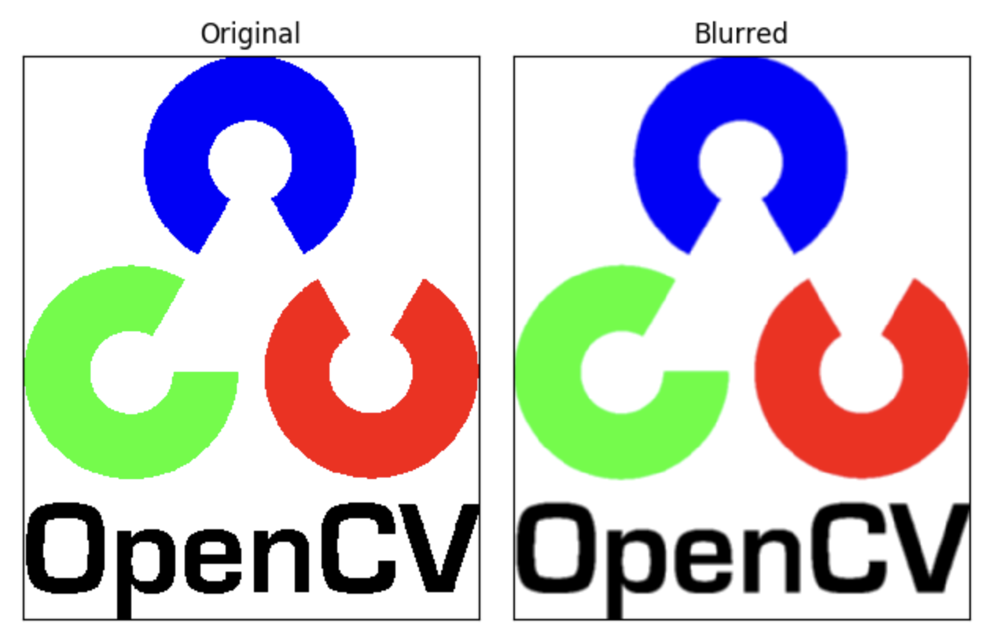
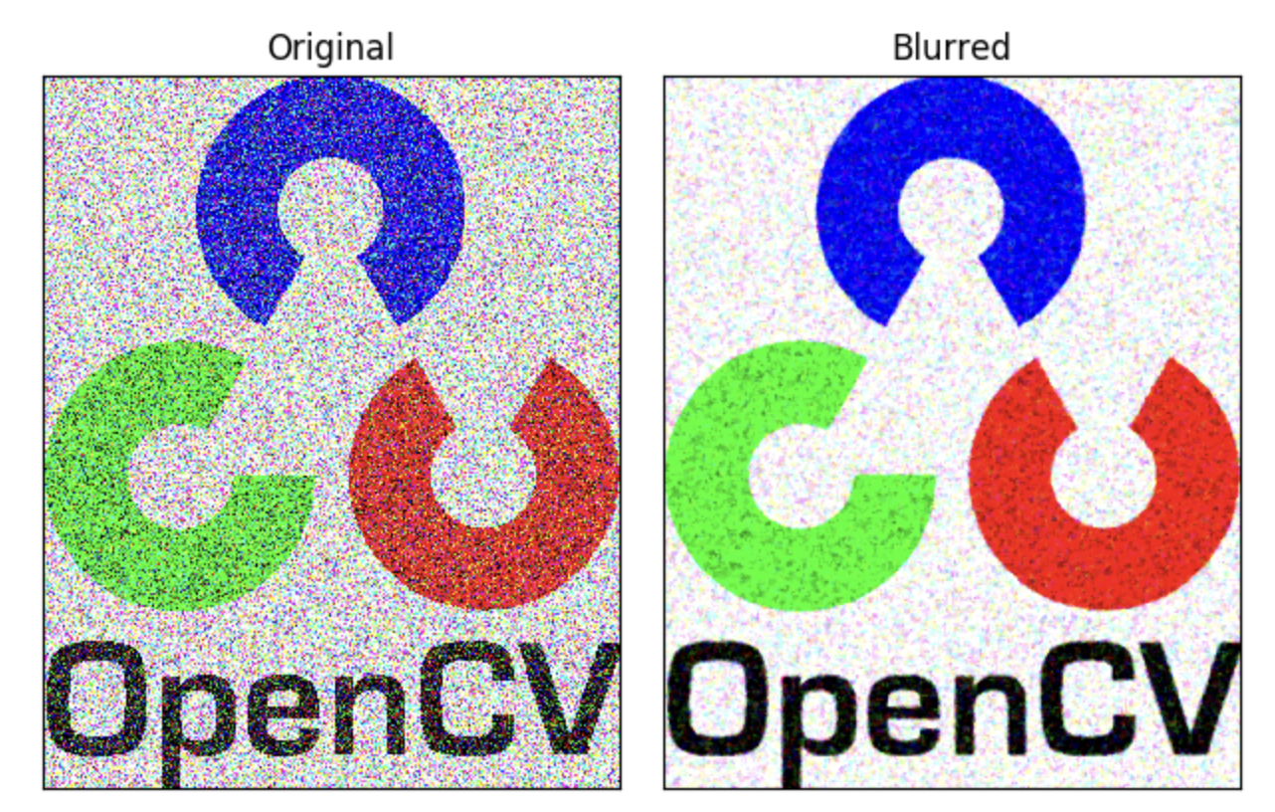
Widely Used DIP Methods
Blur: mean blur, median blur, gaussian blur

Slide 8

Widely Used DIP Methods
Binary

Slide 9
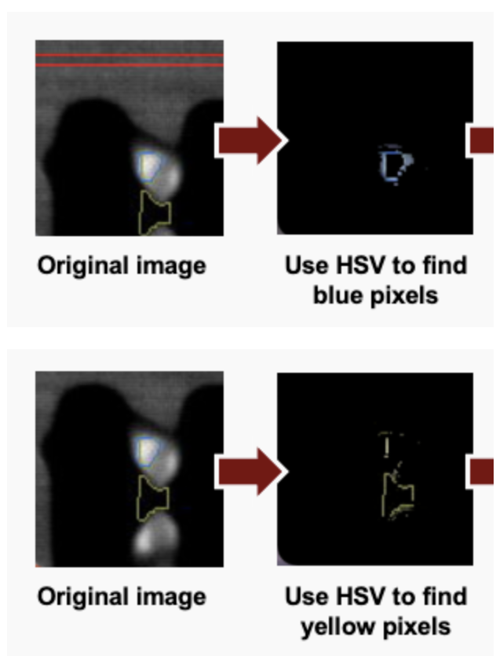
Widely Used DIP Methods
HSV filter

Slide 10
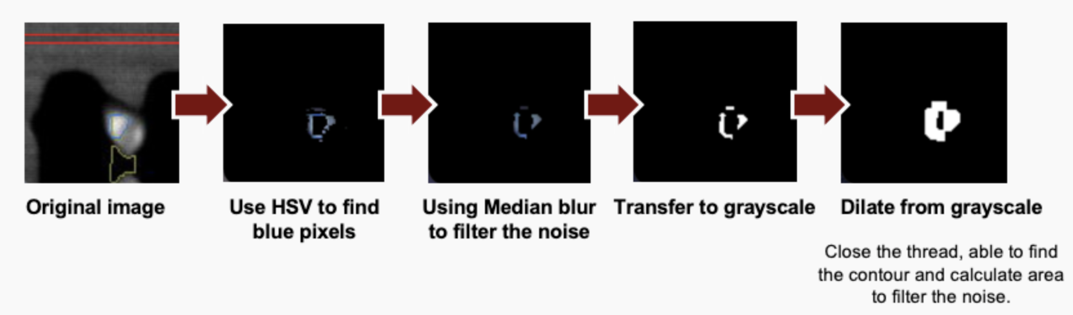
Widely Used DIP Methods
Morphological: erosion, dilation, open, close

Slide 11
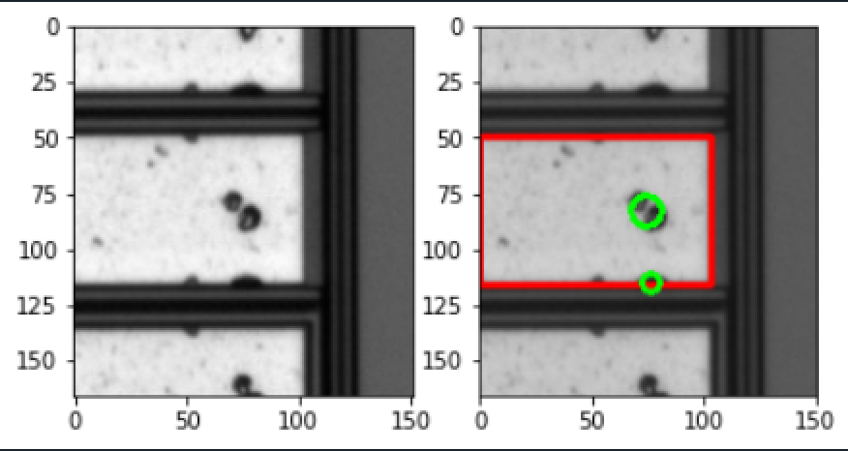
Widely Used DIP Methods
Find contours

Slide 12
Thanks for your attentions.
Enjoy your trip!

