Slide 1
TWITTER(X) SENTIMENT ANALYSIS
Team Members
Sarvagya Gupta 112115140
Soham Sanghavi 112115156
Yash Tilokani 112115167
Chetan Vaidada 112115169

Slide 2
CONTENTS
Aim
Sentiment Analysis
Procedure
NLP Pipeline
Classification Algorithm
Result
Conclusion

Slide 3
AIM
The primary objective is to establish a presence on the Twitter platform, where we will actively engage with the community by conducting searches for tweets that include specific keywords. Once these tweets are identified, we will implement a sentiment analysis process to assess the emotional tone of each tweet, categorizing them as either positive or negative based on the sentiments expressed in the content. This initiative will allow us to gain insights into public sentiment surrounding these keywords and enable us to respond and interact effectively with Twitter users.

Slide 4
SENTIMENT ANALYSIS
Sentiment analysis is contextual mining of text which identifies and extracts subjective information in source material, and helping a business to understand the social sentiment of their brand, product or service while monitoring online conversations.
It is the most common text classification tool that analyses an incoming message and tells whether the underlying sentiment is positive, negative or neutral.

Slide 5
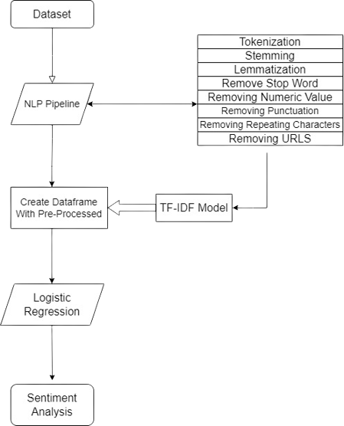
Procedure
First we take dataset from kaggle and perform data-preprocessing .
Then we perform NLP pile-line methods like Tokenization, Stemming, Lemmatization, Removal of stop-words, numeric value, punctuation, Repeating Characters and URL.
After performing NLP Pipeline methods we spilt the dataset into training and testing and perform logistic regression as the F1 Score of Logistic regression comes to be highest among all algorithms.

Slide 6
NPL Pipeline
Tokenization: It involves breaking down a text into small units called tokens. These tokens can be words, sentences, or characters.
Stemming: Stemming is the process of reducing words to their base or root form to simplify text analysis by removing prefixes or suffixes.
Lemmatization: Lemmatization is the process of grouping together the different inflected forms of a word so they can be analyzed as a single item. Lemmatization is similar to stemming but it brings context to the words
Removing of Punctuation, Numeric value, URLs , Stop-Words and Repeating Characters

Slide 7
Classification Algorithm
Logistic regression is a valuable classification algorithm for Twitter sentiment analysis. It efficiently categorizes tweets as positive or negative based on key steps: data preprocessing, feature extraction (using TF-IDF or word embeddings), label encoding, model training, prediction, and evaluation.
The model provides interpretable results, making it useful for understanding the factors influencing sentiment. It's computationally efficient and serves as a strong baseline for sentiment analysis. However, for more complex sentiment tasks involving nuanced text patterns, advanced techniques like deep learning models may be preferred. In summary, logistic regression is a practical and interpretable choice for sentiment analysis in Twitter data.

Slide 8
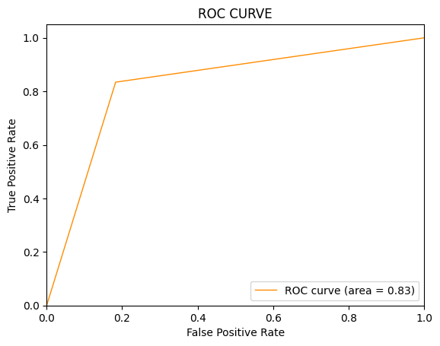
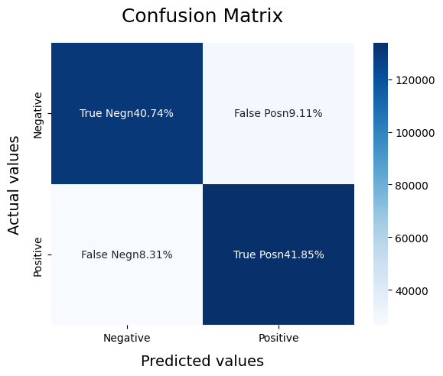
Result

Slide 9
Conclusion
The Twitter sentiment analysis is done using Logistic Regression demonstrated that it is possible to build an accurate model for categorizing tweets by sentiment. With the potential for real-world applications, the project highlights the importance of responsible AI development and ongoing efforts to enhance model accuracy and understanding of nuanced human language.

Slide 10
THANK YOU

