Slide 1
MapReduce Job Manager With Dynamic Load Balancing
Himanshu Gusain | Tushar Murarka | Deepak Yadav | Debadutta Godnaik
IIT2015090 | IIT2015091 | IIT20150124 | ISM2015501

Slide 2
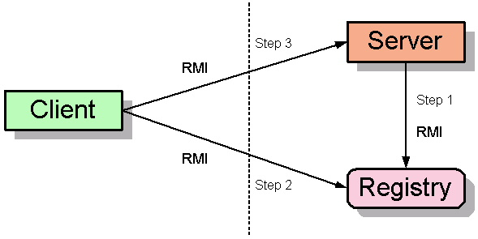
Remote Method Invocation

Slide 3
Method call from Data Nodes
Getting status via Heartbeats
Master Node
(Server Heartbeat)
DataNode0
DataNode1
DataNode2
DataNode3
DataNodes call Heartbeat method hosted on Master Node after every 5 second

Slide 4
Master asks for resources status
Resource Monitoring Module
DataNodes send the resource info
Master Node
DataNode0
DataNode1
DataNode2
DataNode3

Slide 5
Methodology
Client submits the mapreduce job along with mapper-reducer class and input file.
Main Node gets information of the blocks of the input file.
Mapper task allocation is done using our custom allocation algorithm.
Once all the mapper tasks are allocated and completed, allocation of reducer task is done on one of the datanodes.
After completion of reducer task output is written on the hdfs.

Slide 6
Thank You

