Slide 1
Mining the Success for Movies
Student Project Data Mining HWS17
Team 6

Slide 2
Original Data Set
movies_metadata.csv
main data set with all the metadata
credits.csv
contains actors, directors, …

Slide 3
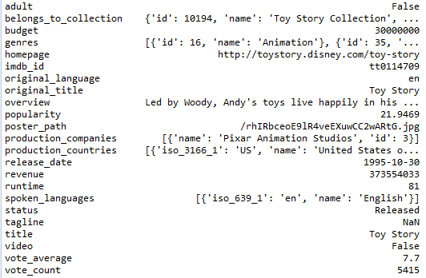
Original Data Set – Metadata
Dropped columns
homepage: String
imdb_id: String
original_language: String
original_title: String
overview: String
popularity: Numeric
poster_path: String
spoken_languages: String
tagline: String
title: String
video: Boolean
vote_average: Numeric
vote_count: Numeric

Slide 4
Original Data Set – Metadata
Kept columns
adult: Boolean
belongs_to_collection: String
budget: Numeric
genres: String
production_companies: String
production_countries: String
release_date: DateTime
revenue: Numeric
runtime: Numeric

Slide 5
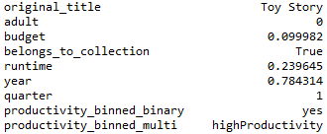
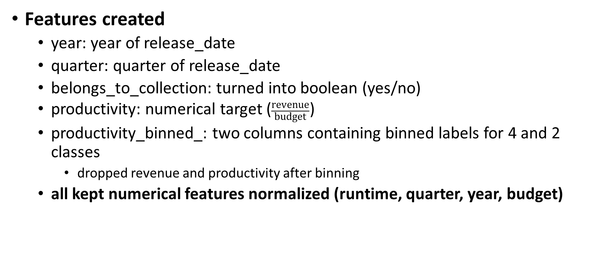
Original Data Set
Features created
year: year of release_date
quarter: quarter of release_date
belongs_to_collection: turned into boolean (yes/no)
productivity: numerical target ($\frac{\text{revenue}}{\text{budget}}$)
productivity_binned_: two columns containing binned labels for 4 and 2 classes
dropped revenue and productivity after binning
all kept numerical features normalized (runtime, quarter, year, budget)

Slide 6
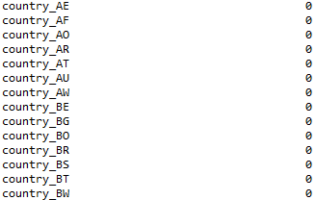
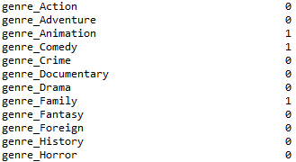
Original Data Set
Features created
genres: turned into one-hot-encoding (19)
production_countries: turned into one-hot-encoding (77)
company_: production_companies turned into one-hot-encoding
actor_: one-hot-encoding of actors from credits.csv
director_: one-hot-encoding of directors from credits.csv

Slide 7
Original Data Set – Issues with the dataset
Productivity
many missing values for revenue and budget
checking of present values has shown inconsistencies
different currencies
different scales
different assumptions (US only vs. worldwide)
solution: mining of budget and revenue data from imdb.com and thenumbers.com
new data set contains ~3,900 rows

Slide 8
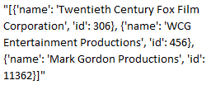
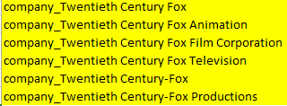




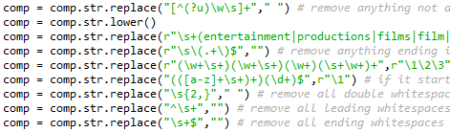
Original Data Set – Issues with the dataset
Company
company names are not normalized
solution: used regular expressions to correct and combine the names as good as possible

Slide 9
Original Data Set – Machine Learning
Approaches
Models: k-NN, Naïve Bayes, Decision Tree, Random Forest, SVM, NeuralNet
Feature Selection: try-and-error of different combinations of columns
Hyperparameter Selection: GridSearch
Evaluation: Cross-Validation using GridSearch, F1 (macro) measure

Slide 10
Original Data Set – Machine Learning
Approaches
Models: k-NN, Naïve Bayes, Decision Tree, Random Forest, SVM, NeuralNet
Feature Selection: try-and-error of different combinations of columns
Hyperparameter Selection: GridSearch
Evaluation: Cross-Validation using GridSearch, F1 (macro) measure
Models are only guessing yes.
Label balance: 76% yes, 24% no
no/minor improvements with upsampling, downsampling

Slide 11
Original Data Set – Machine Learning
Approaches
Models: k-NN, Naïve Bayes, Decision Tree, Random Forest, SVM, NeuralNet
Feature Selection: try-and-error of different combinations of columns
Hyperparameter Selection: GridSearch
Evaluation: Cross-Validation using GridSearch, F1 (macro) measure
Models are only guessing yes.
Label balance: 76% yes, 24% no
no/minor improvements with upsampling, downsampling
Fail … ?

