Slide 1
Chapter 12: Query Processing

Slide 2
Chapter 12: Query Processing
Overview
Measures of Query Cost
Selection Operation
Sorting
Join Operation
Other Operations
Evaluation of Expressions

Slide 3

Basic Steps in Query Processing
1. Parsing and translation
2. Optimization
3. Evaluation

Slide 4
Basic Steps in Query Processing (Cont.)
Parsing and translation
  translate the query into its internal form. This is then translated into relational algebra.
  Parser checks syntax, verifies relations
Evaluation
  The query-execution engine takes a query-evaluation plan, executes that plan, and returns the answers to the query.

Slide 5
Basic Steps in Query Processing : Optimization
A relational algebra expression may have many equivalent expressions
  E.g., σ_{salary<75000}(∏_{salary}(instructor)) is equivalent to
  ∏_{salary}(σ_{salary<75000}(instructor))
Each relational algebra operation can be evaluated using one of several different algorithms
  Correspondingly, a relational-algebra expression can be evaluated in many ways.
Annotated expression specifying detailed evaluation strategy is called an evaluation-plan.
  E.g., use an index on salary to find instructors with salary < 75000,
  or perform complete relation scan and discard instructors with salary ≥ 75000

Slide 6
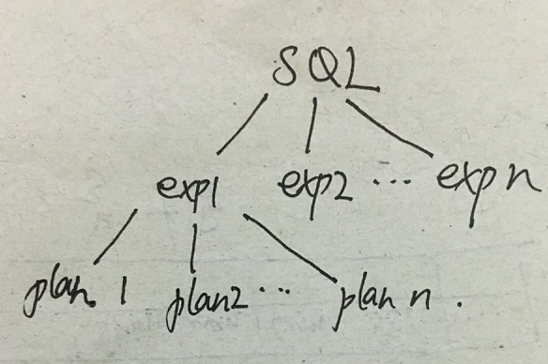
Basic Steps: Optimization (Cont.)
Query Optimization: Amongst all equivalent evaluation plans choose the one with lowest cost.
  Cost is estimated using statistical information from the
  database catalog
    e.g. number of tuples in each relation, size of tuples, etc.

Slide 7
Basic Steps: Optimization (Cont.)
In this chapter we study
  How to measure query costs
  Algorithms for evaluating relational algebra operations
  How to combine algorithms for individual operations in order to evaluate a complete expression
In Chapter 13
  We study how to optimize queries, that is, how to find an evaluation plan with lowest estimated cost

Slide 8
Measures of Query Cost
Cost is generally measured as total elapsed time for answering query
  Many factors contribute to time cost
    disk accesses, CPU, or even network communication
Typically disk access is the predominant cost, and is also relatively easy to estimate. Measured by taking into account
  Number of seeks * average-seek-cost
  Number of blocks read * average-block-read-cost
  Number of blocks written * average-block-write-cost
    Cost to write a block is greater than cost to read a block
      data is read back after being written to ensure that the write was successful

Slide 9
Measures of Query Cost (Cont.)
For simplicity we just use the number of block transfers from disk and the number of seeks as the cost measures
  t_{T} – time to transfer one block
  t_{S} – time for one seek
  Cost for b block transfers plus S seeks
  b * t_{T} + S * t_{S}
We ignore CPU costs for simplicity
  Real systems do take CPU cost into account
We do not include cost to writing output to disk in our cost formulae

Slide 10
Measures of Query Cost (Cont.)
Several algorithms can reduce disk IO by using extra buffer space
In the best case, all data can be read into the buffers, and the disk does not need to be accessed again.
In the worst case, we assume that the buffer can hold only a few blocks of data—approximately one block per relation.
we generally assume the worst case.

Slide 11
Selection Operation
File scan
select * from instructor where name="Einstein";
Algorithm A1 (linear search). Scan each file block and test all records to see whether they satisfy the selection condition.
  Cost estimate = b_{r} block transfers + 1 seek
    b_{r} denotes number of blocks containing records from relation r
  If selection is on a key attribute, can stop on finding record
    cost = (b_{r} /2) block transfers + 1 seek
  Linear search can be applied regardless of
    selection condition or
    ordering of records in the file, or
    availability of indices
Note: binary search generally does not make sense since data is not stored consecutively
  except when there is an index available,
  and binary search requires more seeks than index search

Slide 12
Selections Using Indices
Index scan – search algorithms that use an index
  selection condition must be on search-key of index.
A2 (primary index, equality on key).
Example query:
select * from instructor where ID=“007“, a primary index on ID ;
Retrieve a single record that satisfies the corresponding equality condition
  访问索引树的开销: h * (t_{T} + t_{S})
  访问记录的开销: 1 * (t_{T} + t_{S})
  Cost = (h + 1) * (t_{T} + t_{S})
 | index | file
seek | h | 1
transfer | h | 1

Slide 13
Selections Using Indices
Index scan – search algorithms that use an index
  selection condition must be on search-key of index.
A3 (primary index, equality on nonkey)
  Example query:
  select * from instructor where name="Einstein", a primary index on name;
Retrieve multiple records.
  Records will be on consecutive blocks
    Let b = number of blocks containing matching records
 | index | file
seek | h | 1
transfer | h | b

Slide 14
Selections Using Indices
访问索引树的开销: h * (t_{T} + t_{S})
访问记录的开销: t_{S} + t_{T} * b, 因为是主索引必定顺序存储
Cost = h * (t_{T} + t_{S}) + t_{S} + t_{T} * b
 | index | file
seek | h | 1
transfer | h | b

Slide 15
Selections Using Indices
A4 (secondary index, equality on nonkey).
Example query: select * from instructor where name="Einstein", a primary index on ID, a secondary index on name
访问索引树的开销: h * (t_{T} + t_{S})
访问记录的开销: n* (t_{T} + t_{S}), n匹配的记录数目, each of n matching records may be on a different block
Cost = (h + n) * (t_{T} + t_{S})
Can be very expensive
若在候选键上的等值
      Cost = (h + 1) * (t_{T} + t_{S})
 | index | file
seek | h | n
transfer | h | n

Slide 16
Selections Involving Comparisons
Can implement selections of the form σ_{A≤V} (r) or σ_{A ≥ V}(r) by using
  a linear file scan,
  or by using indices in the following ways:
A5 (primary index, comparison). (Relation is sorted on A)
    Example query:
      select * from instructor where ID<=“9999", a primary index on ID
    Algorithm: For σ_{A≤V} (r) just scan relation sequentially till first tuple > v; do not use index
    Example query:
      select * from instructor where ID>=“9999", a primary index on ID
Algorithm: For σ_{A ≥ V}(r) use index to find first tuple ≥ v and scan relation sequentially from there

Slide 17
Selections Involving Comparisons
A6 (secondary index, comparison).
    Example query:
      select * from instructor where name>="Einstein", a primary index on ID, secondary index on name
    Algorithm: For σ_{A ≥ V}(r) use index to find first index entry ≥ v and scan index sequentially from there, to find pointers to records.
    Example query:
      select * from instructor where name<="Einstein", a primary index on ID, secondary index on name.
    Algorithm: For σ_{A≤V} (r) just scan leaf pages of index finding pointers to records, till first entry > v.
    In either case, retrieve records that are pointed to
      requires an I/O for each record
      Linear file scan may be cheaper

Slide 18
Join Operation
Several different algorithms to implement joins
  Nested-loop join
  Block nested-loop join
  Indexed nested-loop join
  Merge-join
  Hash-join
Choice based on cost estimate
Examples use the following information

Slide 19
Nested-Loop Join
  Example query:
    select * from student, takes where student.ID=takes.ID
  To compute the theta join r _{θ} s = σ_{θ} (r x s)
  for each tuple t_{r} in r do begin
  for each tuple t_{s} in s do begin
  test pair (t_{r},t_{s}) to see if they satisfy the join condition θ
  if they do, add t_{r} • t_{s} to the result.
  end
  end
r is called the outer relation and s the inner relation of the join.
Requires no indices and can be used with any kind of join condition.
Expensive since it examines every pair of tuples in the two relations.

Slide 20
example
relation | records | blocks
student | 5,000 | 100
takes | 10,000 | 400
_{Student block}
r₁
r₂
r₃
……
r₁₀₀
_{Takes} _{block}
s₁
_{S2}
s₃
…….
s₄₀₀
records
001
002
003
…..
…..
…..
…..
050
  Example query:
    select * from student, takes where student.ID=takes.ID

Slide 21
服务 001, 访问的磁盘块顺序?
  r1, s1, s2,…., s400
服务 002, 访问的磁盘块顺序?
  同上
_{Student block}
r₁
r₂
r₃
……
r₁₀₀
_{Takes} _{block}
s₁
_{S2}
s₃
…….
s₄₀₀
records
001
002
003
…..
…..
…..
…..
050
record ID | seeks | transfers
001
002
003
050
total of r1
total

Slide 22
服务 001, 访问的磁盘块顺序?
  r1, s1, s2,…., s400
服务 002, 访问的磁盘块顺序?
  同上
_{Student block}
r₁
r₂
r₃
……
r₁₀₀
_{Takes} _{block}
s₁
_{S2}
s₃
…….
s₄₀₀
records
001
002
003
…..
…..
…..
…..
050
record ID | seeks | transfers
001 | 1+1 | 1+400
002 | 1 | 400
… | … | 400
050 | 1 | 400
total of r1 | 51 | 20001
total | 5100 | 2000100

Slide 23
Nested-Loop Join (Cont.)
Assuming worst case memory availability cost estimate is
  with student as outer relation:
    block transfers： 5000 ∗ 400 + 100 = 2,000,100,
    Seeks： 5000 + 100 = 5100
  with takes as the outer relation
    block transfers： 10000 ∗ 100 + 400 = 1,000,400
    Seeks： 10,400
Cost=n_{r}*b_{s}+b_{r} 块传输+n_{r}+b_{r}次搜索
Block nested-loops algorithm (later slide) is preferable.

Slide 24
Nested-Loop Join (Cont.)
In the worst case, if there is enough memory only to hold one block of each relation, the estimated cost is
If the smaller relation s fits entirely in memory, use that as the inner relation.
Worst case | r | s
transfers | b_{r} | n_{r} ∗ b_{s}
seeks | b_{r} | n_{r}
better case | r | s
transfers | b_{r} | b_{s}
seeks | 1 | 1

Slide 25
Block Nested-Loop Join
Variant of nested-loop join in which every block of inner relation is paired with every block of outer relation.
for each block B_{r} of r do begin
for each block B_{s} of s do begin
// 以下2个循环内存执行
for each tuple t_{r} in B_{r} do begin
for each tuple t_{s} in B_{s} do begin
Check if (t_{r},t_{s}) satisfy the join condition
if they do, add t_{r} • t_{s} to the result.
end
end
end
end

Slide 26
example
relation | records | blocks
student | 5,000 | 100
takes | 10,000 | 400
_{Student block}
r₁
r₂
r₃
……
r₁₀₀
_{Takes} _{block}
s₁
_{S2}
s₃
…….
s₄₀₀
records
001
002
003
…..
…..
…..
…..
050
  Example query:
    select * from student, takes where student.ID=takes.ID

Slide 27
Block Nested-Loop Join (Cont.)
Worst case estimate:
Best case: the smaller relation fits entirely in memory.
Worst case | r | s
transfers | b_{r} | b_{r} ∗ b_{s}
seeks | b_{r} | b_{r}
Best case | r | s
transfers | b_{r} | b_{s}
seeks | 1 | 1

Slide 28
Block Nested-Loop Join (Cont.)
Improvements to nested loop and block nested loop algorithms:
  In block nested-loop, use M — 2 disk blocks as blocking unit for outer relations, where M = memory size in blocks; use remaining two blocks to buffer inner relation and output
    Cost = ⎡b_{r} / (M-2)⎤ ∗ b_{s} + b_{r} block transfers +
    2 ⎡b_{r} / (M-2)⎤ seeks
  If equi-join attribute forms a key of inner relation, stop inner loop on first match
  Scan inner loop forward and backward alternately, to make use of the blocks remaining in buffer
  Use index on inner relation if available (next slide)

Slide 29
Indexed Nested-Loop Join
Index lookups can replace file scans if
  join is an equi-join or natural join and
  an index is available on the inner relation’s join attribute
    Can construct an index just to compute a join.
  Example query:
    select * from student, takes where student.ID=takes.ID
  An index on takes.ID
Algorithm: For each tuple t_{r} in the outer relation r, use the index to look up tuples in s that satisfy the join condition with tuple t_{r}.
Worst case: buffer has space for only one page of r, and, for each tuple in r, we perform an index lookup on s.

Slide 30
example
relation | records | blocks
student | 5,000 | 100
takes | 10,000 | 400
_{Student block}
r₁
r₂
r₃
……
r₁₀₀
_{Takes} _{block}
s₁
_{S2}
s₃
…….
s₄₀₀
records
001
002
003
…..
…..
…..
…..
050
  Example query:
    select * from student, takes where student.ID=takes.ID
    An index (B+-tree) on takes.ID
    At most 20 entries in leaf node.
    h=4

Slide 31

Indexed Nested-Loop Join
 | r | B⁺ _Tree + s
transfers | b_{r} | n_{r*}(h+1)
seeks | b_{r} | n_{r*}(h+1)

Slide 32
Indexed Nested-Loop Join
Worst case: buffer has space for only one page of r, and, for each tuple in r, we perform an index lookup on s.
Cost of the join: b_{r} (t_{T} + t_{S}) + n_{r} ∗ c
  Where c is the cost of traversing index and fetching all matching s tuples for one tuple or r
  c can be estimated as cost of a single selection on s using the join condition.
If indices are available on join attributes of both r and s,
use the relation with fewer tuples as the outer relation.

Slide 33
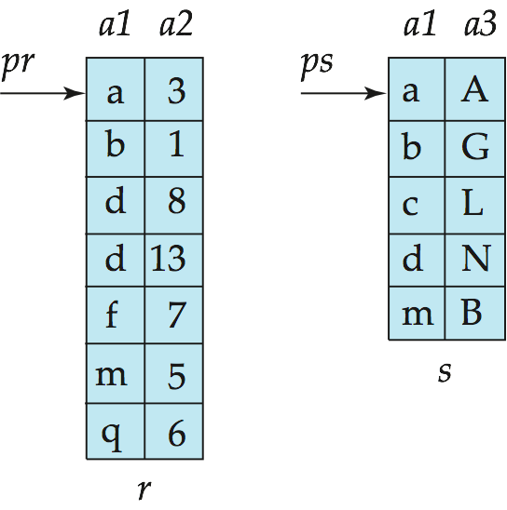
Merge-Join
Sort both relations on their join attribute (if not already sorted on the join attributes).
Merge the sorted relations to join them
  Join step is similar to the merge stage of the sort-merge algorithm.
  Main difference is handling of duplicate values in join attribute — every pair with same value on join attribute must be matched
  Detailed algorithm in book

Slide 34
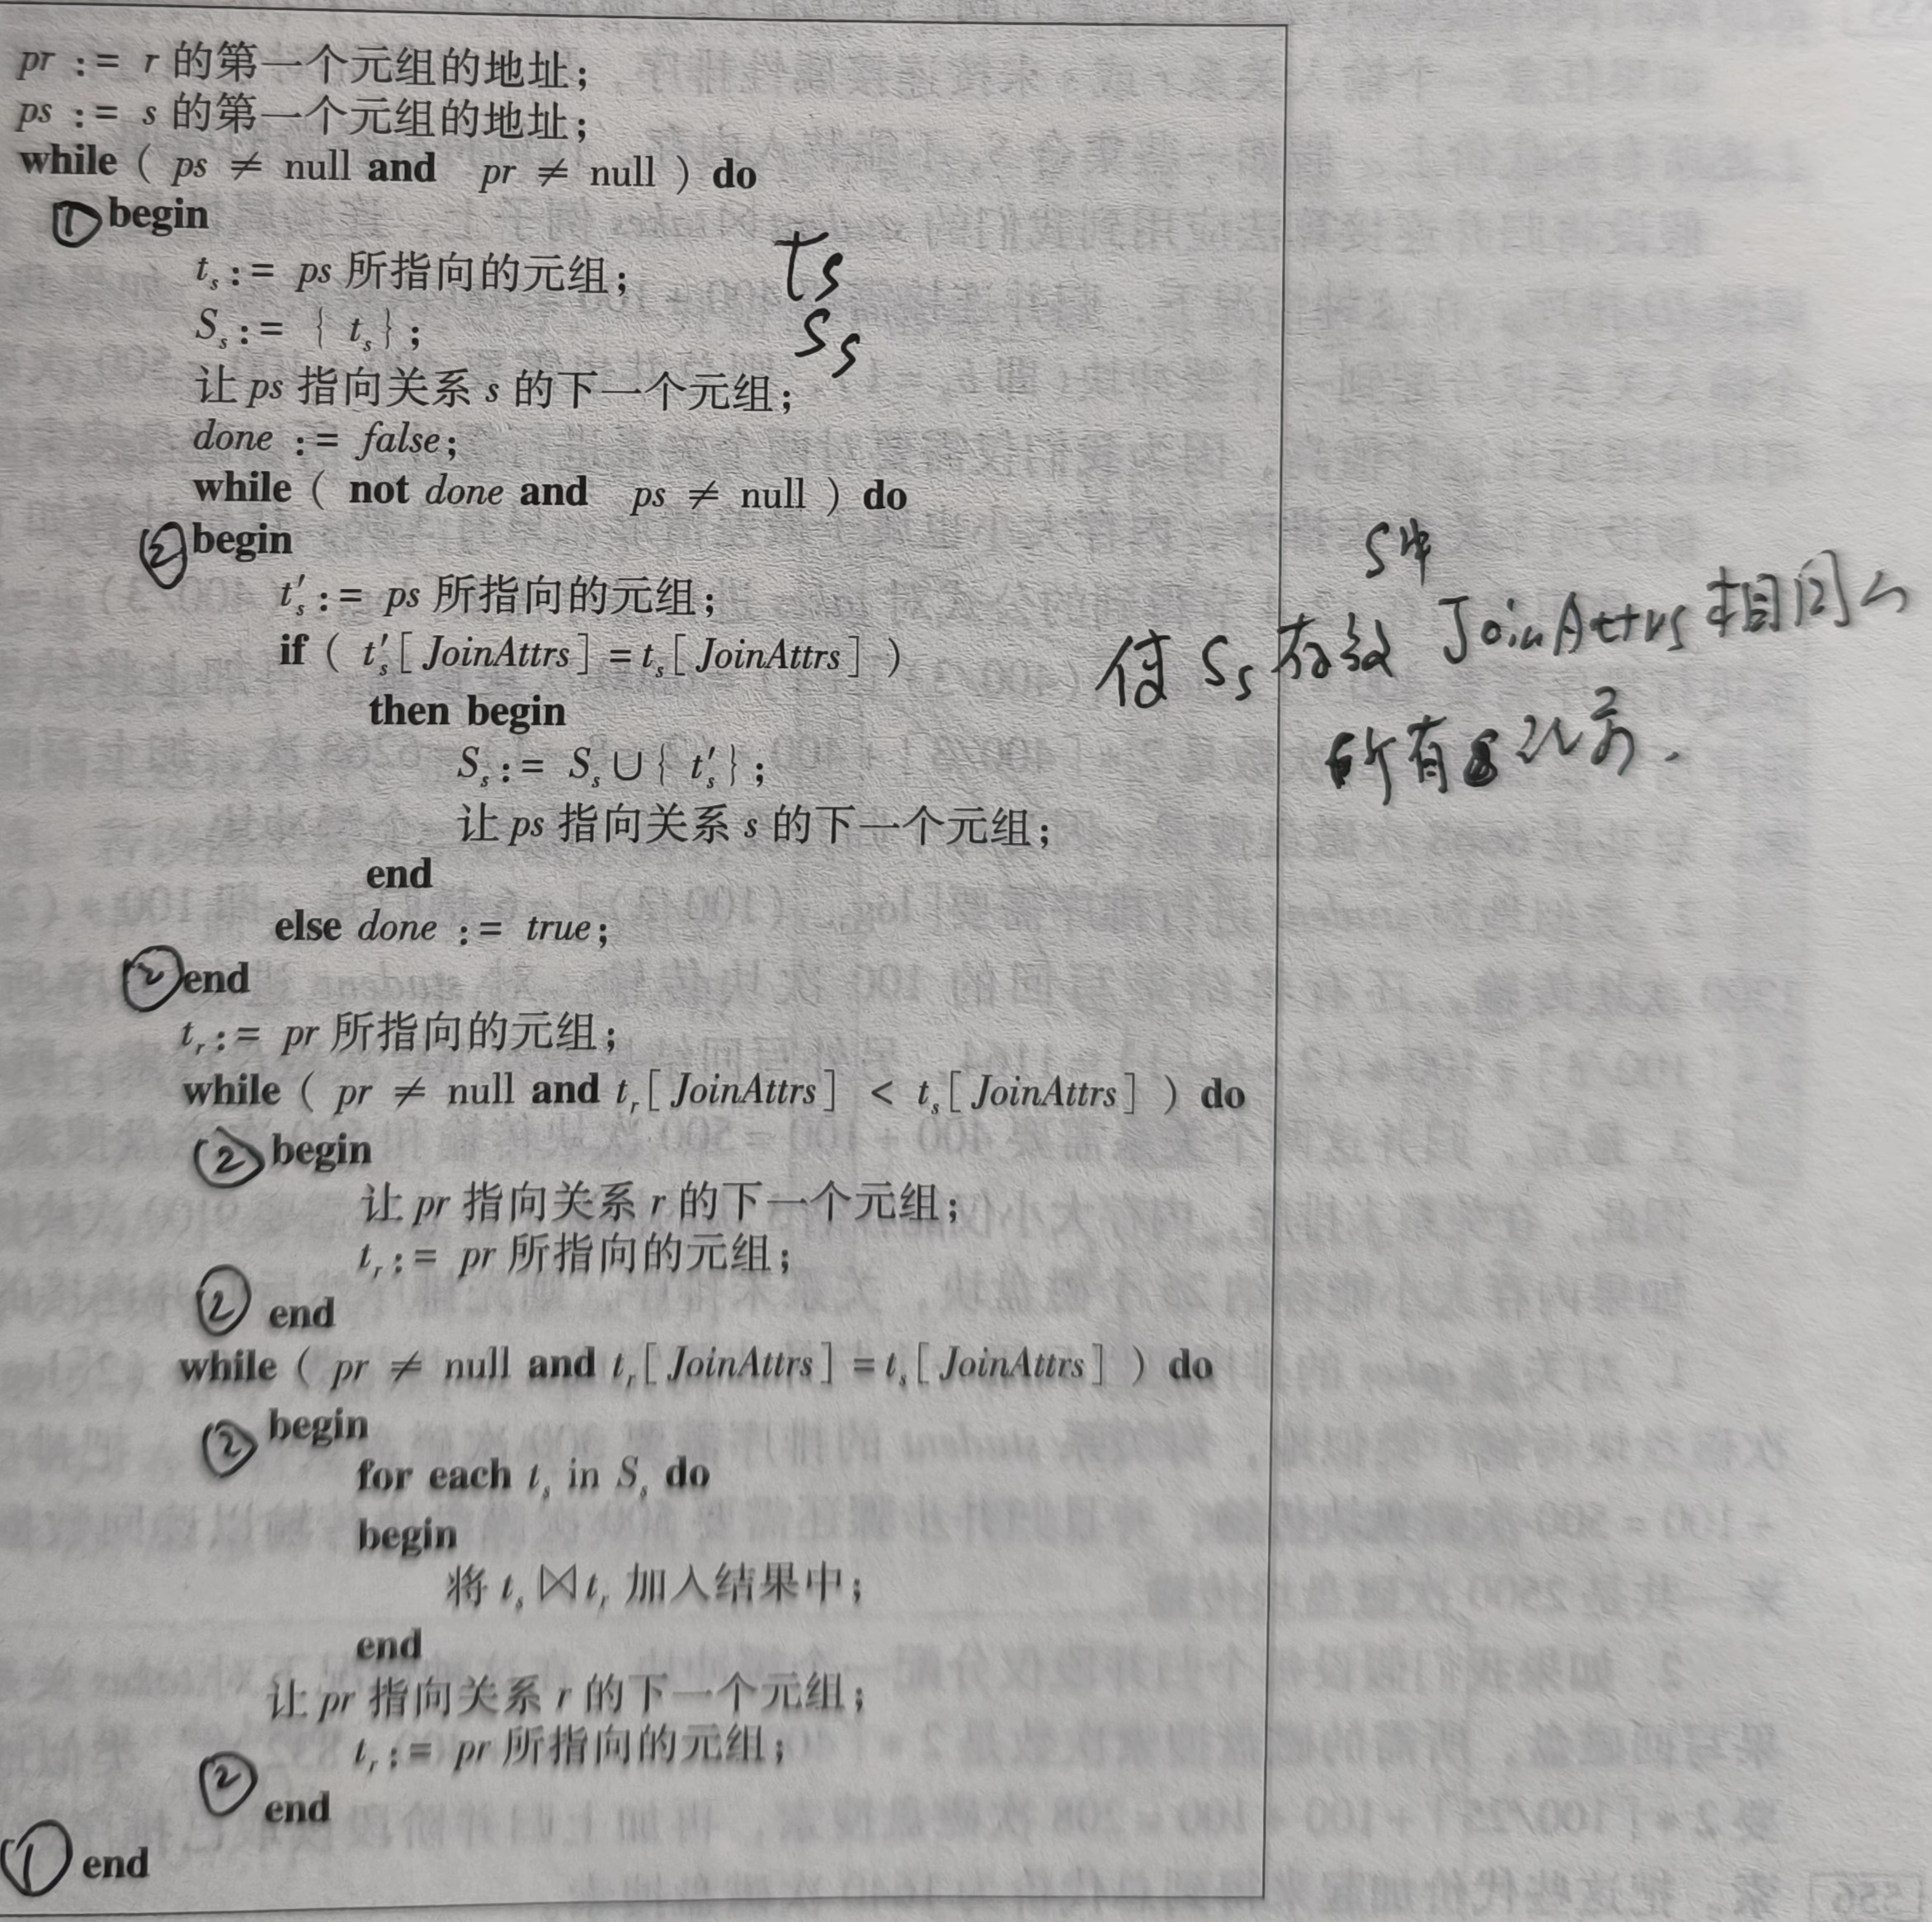
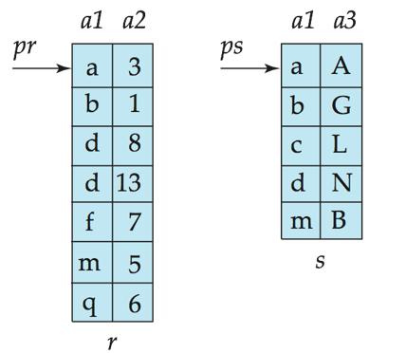

Slide 35
Merge-Join (Cont.)
Can be used only for equi-joins and natural joins
Each block needs to be read only once (assuming all tuples for any given value of the join attributes fit in memory
Cost= sorting cost+ merging cost
size of work buffer : b_{b} blocks. merging cost is:
 | r | s
disk traverse | 1 | 1
transfers | b_{r} | b_{s}
seeks | b_{r}/ b_{b} | b_{s}/ b_{b}

Slide 36
Hash-Join 了解
Applicable for equi-joins and natural joins.
A hash function h is used to partition tuples of both relations
h maps JoinAttrs values to {0, 1, ..., n}, where JoinAttrs denotes the common attributes of r and s used in the natural join.
  r₀, r₁, . . ., r_{n} denote partitions of r tuples
    Each tuple t_{r} ∈ r is put in partition r_{i} where i = h(t_{r} [JoinAttrs]).
  s₀, s₁. . ., s_{n} denotes partitions of s tuples
    Each tuple t_{s} ∈s is put in partition s_{i}, where i = h(t_{s} [JoinAttrs]).
Note: In book, r_{i} is denoted as H_{ri,} s_{i} is denoted as H_{si} and
n is denoted as n_{h.}

Slide 37
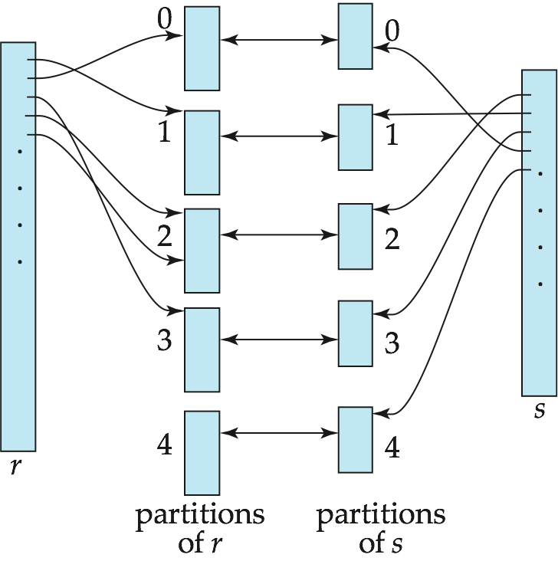
Hash-Join (Cont.)

Slide 38
Hash-Join (Cont.)
r tuples in r_{i} need only to be compared with s tuples in s_{i} Need not be compared with s tuples in any other partition, since:
  an r tuple and an s tuple that satisfy the join condition will have the same value for the join attributes.
  If that value is hashed to some value i, the r tuple has to be in r_{i} and the s tuple in s_{i}.

Slide 39
Hash-Join Algorithm
The hash-join of r and s is computed as follows.
1. Partition the relation s using hashing function h.
2. Partition r similarly.
3. For each i:
  (a) Load s_{i} into memory and build an in-memory hash index f on it using the join attribute. This hash index f is different from h.
  (b) Read the tuples in r_{i} from the disk one by one. For each tuple t_{r} locate each matching tuple t_{s} in s_{i} using the in-memory hash index f. Output the concatenation of their attributes.
Relation s is called the build input and r is called the probe input.

Slide 40
Hash-Join algorithm (Cont.)
The value n (桶子个数) and the hash function h is chosen such that each s_{i} should fit in memory.
  Typically n is chosen as ⎡b_{s}/M⎤ * f where f is a “fudge factor”,经验系数 typically around 1.2， b_{s} 是每个划分分配的缓冲区的数据块数大小
  The probe relation partitions r_{i} need not fit in memory
Recursive partitioning required if number of partitions n is greater than number of pages M of memory.
  Rarely required: e.g., with block size of 4 KB, recursive partitioning not needed for relations of < 1GB with memory size of 2MB, or relations of < 36 GB with memory of 12 MB
  b_{s}<M² 时，不存在递归划分，选择满足这个条件的relation作为build input ,就可以避免递归划分。

Slide 41
Cost of Hash-Join
If recursive partitioning is not required: cost of hash join is
3(b_{r} + b_{s}) block transfers +
2( ⎡b_{r} / b_{b}⎤ + ⎡b_{s} / b_{b}⎤) seeks
If the entire build input can be kept in main memory no partitioning is required
  Cost estimate goes down to b_{r} + b_{s} block transfers +
  2 seeks

Slide 42
Example of Cost of Hash-Join
instructor teaches
Assume that memory size is 20 blocks
b_{instructor}= 100 and b_{teaches} = 400.
instructor is to be used as build input. Partition it into five partitions, each of size 20 blocks. This partitioning can be done in one pass.
Similarly, partition teaches into five partitions,each of size 80. This is also done in one pass.
Assuming buffer block is 3,the total cost, ignoring cost of writing partially filled blocks:
  3(100 + 400) = 1500 block transfers +
  2( ⎡100/3⎤ + ⎡400/3⎤) = 336 seeks

Slide 43
Evaluation of Expressions
So far: we have seen algorithms for individual operations
Alternatives for evaluating an entire expression tree
  Materialization: generate results of an expression whose inputs are relations or are already computed, materialize (store) it on disk. Repeat.
  Pipelining: pass on tuples to parent operations even as an operation is being executed
We study above alternatives in more detail

Slide 44
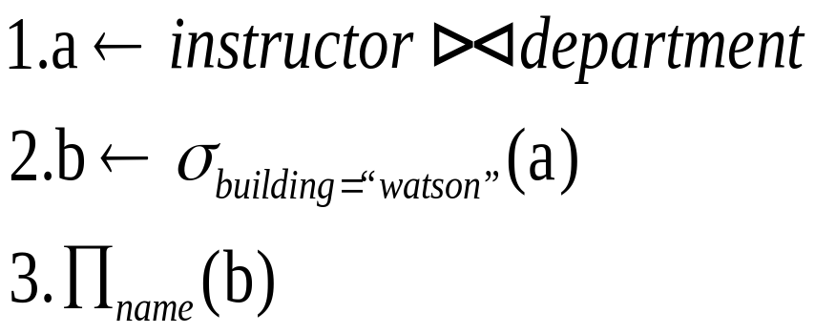
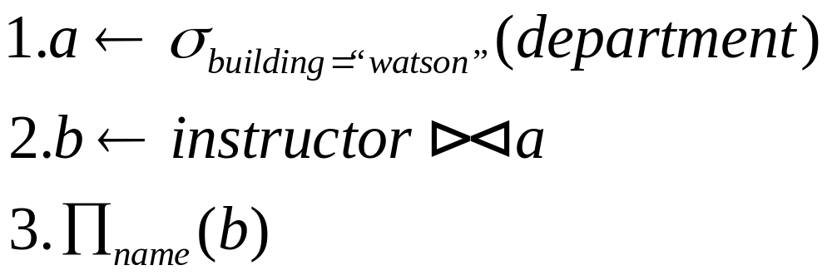
Materialization
Materialized evaluation: evaluate one operation at a time, starting at the lowest-level. Use intermediate results materialized into temporary relations to evaluate next-level operations.
Example query：
  Select name
  from instructor natural join department
  Where building=“watson”

Slide 45

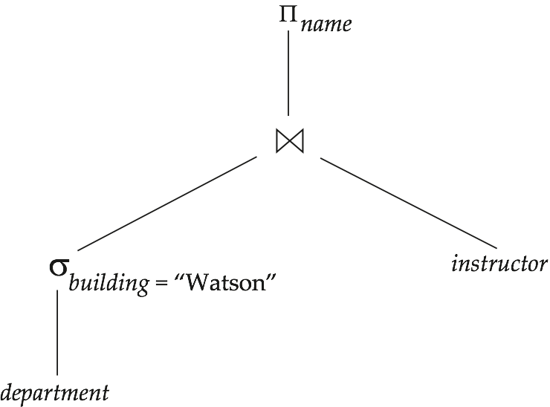
Materialization
E.g., in figure below, compute and store
then compute the store joining with instructor, and finally compute the projection on name.

Slide 46
Materialization (Cont.)
Materialized evaluation is always applicable
Cost of writing results to disk and reading them back can be quite high
  Our cost formulas for operations ignore cost of writing results to disk, so
    Overall cost = Sum of costs of individual operations +
    cost of writing intermediate results to disk
Double buffering: use two output buffers for each operation, when one is full write it to disk while the other is getting filled
  Allows overlap of disk writes with computation and reduces execution time

Slide 47
Pipelining
Pipelined evaluation : evaluate several operations simultaneously, passing the results of one operation on to the next.
E.g., in previous expression tree, don’t store result of
  instead, pass tuples directly to the join.. Similarly, don’t store result of join, pass tuples directly to projection.
Much cheaper than materialization: no need to store a temporary relation to disk.

Slide 48
Pipelining
Pipelining may not always be possible – e.g., sort, hash-join.
For pipelining to be effective, use evaluation algorithms that generate output tuples even as tuples are received for inputs to the operation.
Pipelines can be executed in two ways:
  demand driven
  and producer driven
Alternative name: pull and push models of pipelining

Slide 49
Pipelining (Cont.)
In demand driven or lazy evaluation
  system repeatedly requests next tuple from top level operation
  Each operation requests next tuple from children operations as required, in order to output its next tuple
  In between calls, operation has to maintain “state” so it knows what to return next

Slide 50
In producer-driven or eager pipelining
  Operators produce tuples eagerly and pass them up to their parents
    Buffer maintained between operators, child puts tuples in buffer, parent removes tuples from buffer
    if buffer is full, child waits till there is space in the buffer, and then generates more tuples
  System schedules operations that have space in output buffer and can process more input tuples

Slide 51
End of Chapter

