Slide 1

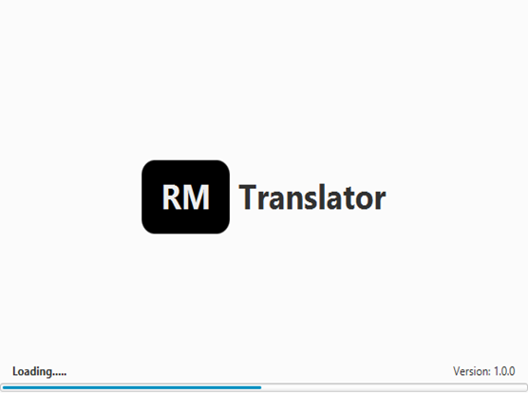
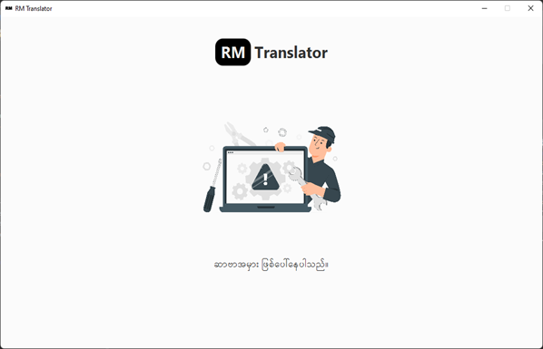
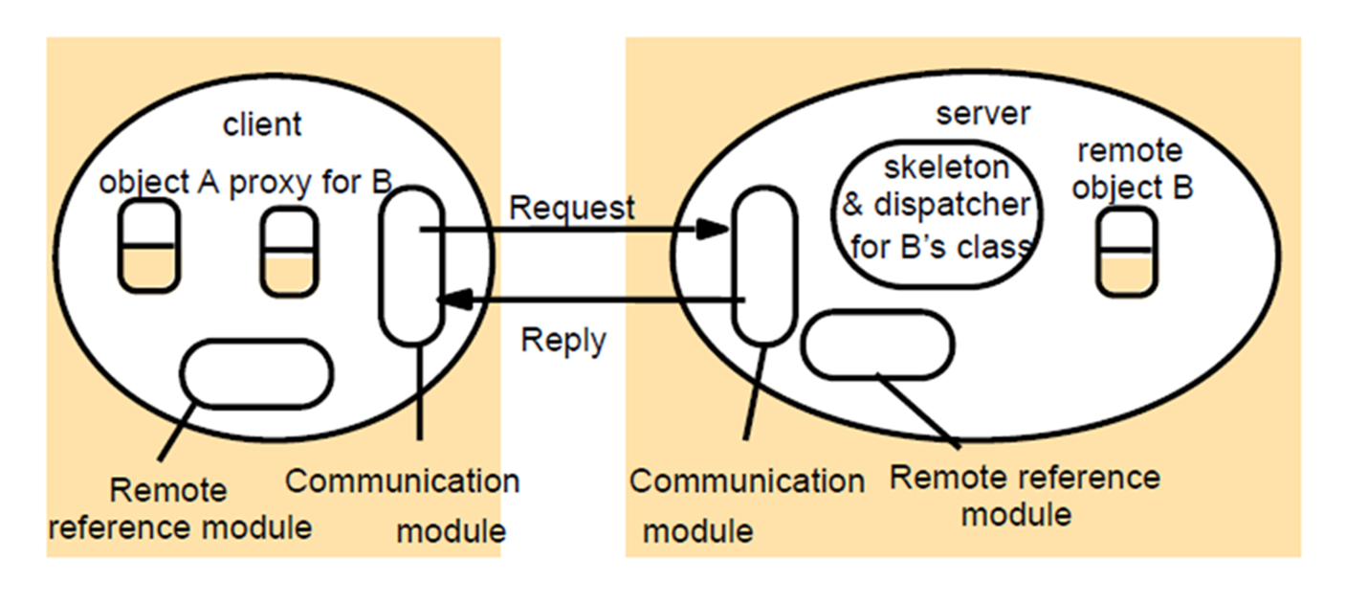
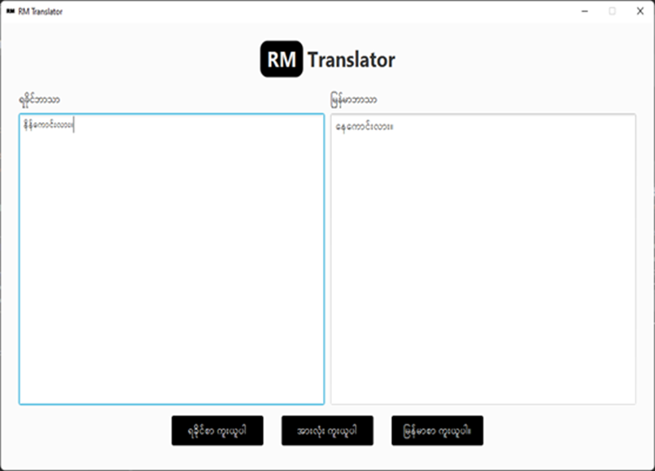
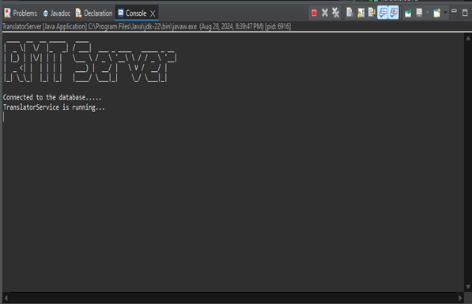
01
UNIVERSITY OF COMPUTER STUDIES (PATHEIN)
02
GROUP MEMBERS
Implementation
Implementation
Implementation
Introduction
Background Theory
Server Site
Client Side
Conclusion
03
References
04
05
06
07
08
09
10
In Myanmar, it can be challenging for people who speak languages like Rakhine, Shan, Mon, etc., to communicate with those who speak Myanmar due to language differences.
Our translation system based on Distributed Systems RMI is designed to make it easier to translate Rakhine to Myanmar, helping people understand each other better.
This system not only facilitates better understanding between Rakhine and Myanmar speakers but also promotes inclusivity and cohesion within the country.
This system will improve communication and bring people closer together.
Focuses on conveying the meaning and impact of the original text in the target language.
Aims to preserve the exact form and structure of the original text.
This approach is more focused on maintaining the exact wording and grammatical structure.
Remote method invocation(RMI): RMI is a java API that allows an object residing in one Java virtual machine(JVM) to invoke methods on an object in another JVM.
Stubs and Skeletons:
Stubs act as a client-side proxy that forwards method calls to the remote object.
Skeletons (in older RMI versions) receive method calls on the server side and dispatch them to the actual remote object.
The core component on the server site is the translation engine.
Manages a database of Rakhine-Myanmar text pairs, which are used to train and improve the translation models.
The server exposes an API that clients can call to submit text for translation.
Processes incoming requests, applies the translation engine, and responds with translated text to the client.
The server defines one or more remote interfaces, which declare the methods that can be invoked remotely.
When a client invokes a method, the RMI runtime on the server receives the request.
The most important thing is to run the server first and then the server will start.
User Interface(UI): Provides a simple and intuitive interface for users to input text and view translated text.
As soon as the user insert language on the text form and translate automatically and immediately.
Connects to the server side API to send text and receive translations.
If the client use this translator without running the server, an error message will be displayed.
Manages requests to the server, processes responses, and updates the UI with the translation.
User can copy translated Rakhine language, Myanmar language, and both of these languages.
The R-M Translator bridges the language gap between Rakhine and Myanmar speakers.
Its provides accurate, real-time translations using advanced knowledge-base and a user- friendly interface.
Explore the system and experience the benefits of seamless cross-language communication.
Ongoing improvements to the translation model with additional data.
In the future, we will try to add native speaking and linguistic experts to validate translation
11
Distributed Systems Concepts and Design”, by George Coulouris, Jean Dollimore, Tim Kindberg and Gordon Blair, 5th Edition, ISBN-10: 0-13-214301-1
https://github.com/Rabbit-Converter/Rabbit
MG KYAW ZAYA (LEADER) VIIICS-41
MG TUN KYAWAY SOE VIIICS-32
MA HNIN THANDAR TUN VIIICS-33
MG MIN KHANT ZAW VIIICS-36
MG KYAW WIN TUN VIIICS-42
MA HSU HSU LIN VIIICS-43
MA KHIN SOE SOE AUNG VIIICS-49
MA KYE SIN WIN NAING VIIICS-50
MA TOE TOE AYE VIIICS-52
MG AUNG MYO THU VIIICT-10
Loading Page
Error Page
RAKHINE⬄MYANMAR TRANSLATOR
Semester-VIII(Group-IV)
Supervised By
Dr.Khin Lay Thwin
Professor
Faculty of Computer Science
Translation Page
Server Running.....
The role of proxy skeleton and in remote method invocation

Slide 2
01
UNIVERSITY OF COMPUTER STUDIES (PATHEIN)
02
GROUP MEMBERS
Implementation
Implementation
Implementation
Introduction
Background Theory
Server Site
Client Side
Conclusion
03
References
04
05
06
07
08
09
10
In Myanmar, it can be challenging for people who speak languages like Rakhine, Shan, Mon, etc., to communicate with those who speak Myanmar due to language differences.
Our translation system based on Distributed Systems RMI is designed to make it easier to translate Rakhine to Myanmar, helping people understand each other better.
This system not only facilitates better understanding between Rakhine and Myanmar speakers but also promotes inclusivity and cohesion within the country.
This system will improve communication and bring people closer together.
Focuses on conveying the meaning and impact of the original text in the target language.
Aims to preserve the exact form and structure of the original text.
This approach is more focused on maintaining the exact wording and grammatical structure.
Remote method invocation(RMI): RMI is a java API that allows an object residing in one Java virtual machine(JVM) to invoke methods on an object in another JVM.
Stubs and Skeletons:
Stubs act as a client-side proxy that forwards method calls to the remote object.
Skeletons (in older RMI versions) receive method calls on the server side and dispatch them to the actual remote object.
The core component on the server site is the translation engine.
Manages a database of Rakhine-Myanmar text pairs, which are used to train and improve the translation models.
The server exposes an API that clients can call to submit text for translation.
Processes incoming requests, applies the translation engine, and responds with translated text to the client.
The server defines one or more remote interfaces, which declare the methods that can be invoked remotely.
When a client invokes a method, the RMI runtime on the server receives the request.
The most important thing is to run the server first and then the server will start.
User Interface(UI): Provides a simple and intuitive interface for users to input text and view translated text.
As soon as the user insert language on the text form and translate automatically and immediately.
Connects to the server side API to send text and receive translations.
If the client use this translator without running the server, an error message will be displayed.
Manages requests to the server, processes responses, and updates the UI with the translation.
User can copy translated Rakhine language, Myanmar language, and both of these languages.
The R-M Translator bridges the language gap between Rakhine and Myanmar speakers.
Its provides accurate, real-time translations using advanced knowledge-base and a user- friendly interface.
Explore the system and experience the benefits of seamless cross-language communication.
Ongoing improvements to the translation model with additional data.
In the future, we will try to add native speaking and linguistic experts to validate translation
11
Distributed Systems Concepts and Design”, by George Coulouris, Jean Dollimore, Tim Kindberg and Gordon Blair, 5th Edition, ISBN-10: 0-13-214301-1
https://github.com/Rabbit-Converter/Rabbit
MG KYAW ZAYA (LEADER) VIIICS-41
MG TUN KYAWAY SOE VIIICS-32
MA HNIN THANDAR TUN VIIICS-33
MG MIN KHANT ZAW VIIICS-36
MG KYAW WIN TUN VIIICS-42
MA HSU HSU LIN VIIICS-43
MA KHIN SOE SOE AUNG VIIICS-49
MA KYE SIN WIN NAING VIIICS-50
MA TOE TOE AYE VIIICS-52
MG AUNG MYO THU VIIICT-10
Loading Page
Error Page
RAKHINE⬄MYANMAR TRANSLATOR
Semester-VIII(Group-IV)
Supervised By
Dr.Khin Lay Thwin
Professor
Faculty of Computer Science
Translation Page
Server Running.....
The role of proxy skeleton and in remote method invocation

Slide 3
01
UNIVERSITY OF COMPUTER STUDIES (PATHEIN)
02
GROUP MEMBERS
Implementation
Implementation
Introduction
Implementation
Background Theory
Server Site
Client Side
Conclusion
03
04
References
05
06
07
08
09
In Myanmar, it can be challenging for people who speak languages like Rakhine, Shan, Mon, etc., to communicate with those who speak Myanmar due to language differences.
Our translation system based on Distributed Systems RMI is designed to make it easier to translate Rakhine to Myanmar, helping people understand each other better.
This system not only facilitates better understanding between Rakhine and Myanmar speakers but also promotes inclusivity and cohesion within the country.
This system will improve communication and bring people closer together.
10
Focuses on conveying the meaning and impact of the original text in the target language.
Aims to preserve the exact form and structure of the original text.
This approach is more focused on maintaining the exact wording and grammatical structure.
Remote method invocation(RMI): RMI is a java API that allows an object residing in one Java virtual machine(JVM) to invoke methods on an object in another JVM.
Stubs and Skeletons:
Stubs act as a client-side proxy that forwards method calls to the remote object.
Skeletons (in older RMI versions) receive method calls on the server side and dispatch them to the actual remote object.
The core component on the server site is the translation engine.
Manages a database of Rakhine-Myanmar text pairs, which are used to train and improve the translation models.
The server exposes an API that clients can call to submit text for translation.
Processes incoming requests, applies the translation engine, and responds with translated text to the client.
The server defines one or more remote interfaces, which declare the methods that can be invoked remotely.
When a client invokes a method, the RMI runtime on the server receives the request.
The most important thing is to run the server first and then the server will start.
User Interface(UI): Provides a simple and intuitive interface for users to input text and view translated text.
As soon as the user insert language on the text form and translate automatically and immediately.
Connects to the server side API to send text and receive translations.
If the client use this translator without running the server, an error message will be displayed.
Manages requests to the server, processes responses, and updates the UI with the translation.
User can copy translated Rakhine language, Myanmar language, and both of these languages.
The R-M Translator bridges the language gap between Rakhine and Myanmar speakers.
Its provides accurate, real-time translations using advanced knowledge-base and a user- friendly interface.
Explore the system and experience the benefits of seamless cross-language communication.
Ongoing improvements to the translation model with additional data.
In the future, we will try to add native speaking and linguistic experts to validate translation
11
Distributed Systems Concepts and Design”, by George Coulouris, Jean Dollimore, Tim Kindberg and Gordon Blair, 5th Edition, ISBN-10: 0-13-214301-1
https://github.com/Rabbit-Converter/Rabbit
MG KYAW ZAYA (LEADER) VIIICS-41
MG TUN KYAWAY SOE VIIICS-32
MA HNIN THANDAR TUN VIIICS-33
MG MIN KHANT ZAW VIIICS-36
MG KYAW WIN TUN VIIICS-42
MA HSU HSU LIN VIIICS-43
MA KHIN SOE SOE AUNG VIIICS-49
MA KYE SIN WIN NAING VIIICS-50
MA TOE TOE AYE VIIICS-52
MG AUNG MYO THU VIIICT-10
Loading Page
Error Page
RAKHINE⬄MYANMAR TRANSLATOR
Semester-VIII(Group-IV)
Supervised By
Dr.Khin Lay Thwin
Professor
Faculty of Computer Science
Translation Page
Server Running.....
The role of proxy skeleton and in remote method invocation

Slide 4
01
UNIVERSITY OF COMPUTER STUDIES (PATHEIN)
02
GROUP MEMBERS
Implementation
Implementation
Introduction
Implementation
Background Theory
Server Site
Client Side
Conclusion
03
References
04
05
06
07
08
09
In Myanmar, it can be challenging for people who speak languages like Rakhine, Shan, Mon, etc., to communicate with those who speak Myanmar due to language differences.
Our translation system based on Distributed Systems RMI is designed to make it easier to translate Rakhine to Myanmar, helping people understand each other better.
This system not only facilitates better understanding between Rakhine and Myanmar speakers but also promotes inclusivity and cohesion within the country.
This system will improve communication and bring people closer together.
10
Focuses on conveying the meaning and impact of the original text in the target language.
Aims to preserve the exact form and structure of the original text.
This approach is more focused on maintaining the exact wording and grammatical structure.
Remote method invocation(RMI): RMI is a java API that allows an object residing in one Java virtual machine(JVM) to invoke methods on an object in another JVM.
Stubs and Skeletons:
Stubs act as a client-side proxy that forwards method calls to the remote object.
Skeletons (in older RMI versions) receive method calls on the server side and dispatch them to the actual remote object.
The core component on the server site is the translation engine.
Manages a database of Rakhine-Myanmar text pairs, which are used to train and improve the translation models.
The server exposes an API that clients can call to submit text for translation.
Processes incoming requests, applies the translation engine, and responds with translated text to the client.
The server defines one or more remote interfaces, which declare the methods that can be invoked remotely.
When a client invokes a method, the RMI runtime on the server receives the request.
The most important thing is to run the server first and then the server will start.
User Interface(UI): Provides a simple and intuitive interface for users to input text and view translated text.
As soon as the user insert language on the text form and translate automatically and immediately.
Connects to the server side API to send text and receive translations.
If the client use this translator without running the server, an error message will be displayed.
Manages requests to the server, processes responses, and updates the UI with the translation.
User can copy translated Rakhine language, Myanmar language, and both of these languages.
The R-M Translator bridges the language gap between Rakhine and Myanmar speakers.
Its provides accurate, real-time translations using advanced knowledge-base and a user- friendly interface.
Explore the system and experience the benefits of seamless cross-language communication.
Ongoing improvements to the translation model with additional data.
In the future, we will try to add native speaking and linguistic experts to validate translation
11
Distributed Systems Concepts and Design”, by George Coulouris, Jean Dollimore, Tim Kindberg and Gordon Blair, 5th Edition, ISBN-10: 0-13-214301-1
https://github.com/Rabbit-Converter/Rabbit
MG KYAW ZAYA (LEADER) VIIICS-41
MG TUN KYAWAY SOE VIIICS-32
MA HNIN THANDAR TUN VIIICS-33
MG MIN KHANT ZAW VIIICS-36
MG KYAW WIN TUN VIIICS-42
MA HSU HSU LIN VIIICS-43
MA KHIN SOE SOE AUNG VIIICS-49
MA KYE SIN WIN NAING VIIICS-50
MA TOE TOE AYE VIIICS-52
MG AUNG MYO THU VIIICT-10
Loading Page
Error Page
RAKHINE⬄MYANMAR TRANSLATOR
Semester-VIII(Group-IV)
Supervised By
Dr.Khin Lay Thwin
Professor
Faculty of Computer Science
Translation Page
Server Running.....
The role of proxy skeleton and in remote method invocation

Slide 5
01
UNIVERSITY OF COMPUTER STUDIES (PATHEIN)
02
GROUP MEMBERS
Implementation
Implementation
Introduction
Implementation
Background Theory
Server Site
Client Side
Conclusion
03
References
04
05
06
07
08
09
In Myanmar, it can be challenging for people who speak languages like Rakhine, Shan, Mon, etc., to communicate with those who speak Myanmar due to language differences.
Our translation system based on Distributed Systems RMI is designed to make it easier to translate Rakhine to Myanmar, helping people understand each other better.
This system not only facilitates better understanding between Rakhine and Myanmar speakers but also promotes inclusivity and cohesion within the country.
This system will improve communication and bring people closer together.
10
Focuses on conveying the meaning and impact of the original text in the target language.
Aims to preserve the exact form and structure of the original text.
This approach is more focused on maintaining the exact wording and grammatical structure.
Remote method invocation(RMI): RMI is a java API that allows an object residing in one Java virtual machine(JVM) to invoke methods on an object in another JVM.
Stubs and Skeletons:
Stubs act as a client-side proxy that forwards method calls to the remote object.
Skeletons (in older RMI versions) receive method calls on the server side and dispatch them to the actual remote object.
The core component on the server site is the translation engine.
Manages a database of Rakhine-Myanmar text pairs, which are used to train and improve the translation models.
The server exposes an API that clients can call to submit text for translation.
Processes incoming requests, applies the translation engine, and responds with translated text to the client.
The server defines one or more remote interfaces, which declare the methods that can be invoked remotely.
When a client invokes a method, the RMI runtime on the server receives the request.
The most important thing is to run the server first and then the server will start.
User Interface(UI): Provides a simple and intuitive interface for users to input text and view translated text.
As soon as the user insert language on the text form and translate automatically and immediately.
Connects to the server side API to send text and receive translations.
If the client use this translator without running the server, an error message will be displayed.
Manages requests to the server, processes responses, and updates the UI with the translation.
User can copy translated Rakhine language, Myanmar language, and both of these languages.
The R-M Translator bridges the language gap between Rakhine and Myanmar speakers.
Its provides accurate, real-time translations using advanced knowledge-base and a user- friendly interface.
Explore the system and experience the benefits of seamless cross-language communication.
Ongoing improvements to the translation model with additional data.
In the future, we will try to add native speaking and linguistic experts to validate translation
11
Distributed Systems Concepts and Design”, by George Coulouris, Jean Dollimore, Tim Kindberg and Gordon Blair, 5th Edition, ISBN-10: 0-13-214301-1
https://github.com/Rabbit-Converter/Rabbit
MG KYAW ZAYA (LEADER) VIIICS-41
MG TUN KYAWAY SOE VIIICS-32
MA HNIN THANDAR TUN VIIICS-33
MG MIN KHANT ZAW VIIICS-36
MG KYAW WIN TUN VIIICS-42
MA HSU HSU LIN VIIICS-43
MA KHIN SOE SOE AUNG VIIICS-49
MA KYE SIN WIN NAING VIIICS-50
MA TOE TOE AYE VIIICS-52
MG AUNG MYO THU VIIICT-10
Loading Page
Error Page
RAKHINE⬄MYANMAR TRANSLATOR
Semester-VIII(Group-IV)
Supervised By
Dr.Khin Lay Thwin
Professor
Faculty of Computer Science
Translation Page
Server Running.....
The role of proxy skeleton and in remote method invocation

Slide 6
01
UNIVERSITY OF COMPUTER STUDIES (PATHEIN)
02
GROUP MEMBERS
Implementation
Implementation
Introduction
Implementation
Background Theory
Server Site
Client Site
Conclusion
03
References
04
05
06
07
08
09
In Myanmar, it can be challenging for people who speak languages like Rakhine, Shan, Mon, etc., to communicate with those who speak Myanmar due to language differences.
Our translation system based on Distributed Systems RMI is designed to make it easier to translate Rakhine to Myanmar, helping people understand each other better.
This system not only facilitates better understanding between Rakhine and Myanmar speakers but also promotes inclusivity and cohesion within the country.
This system will improve communication and bring people closer together.
10
Focuses on conveying the meaning and impact of the original text in the target language.
Aims to preserve the exact form and structure of the original text.
This approach is more focused on maintaining the exact wording and grammatical structure.
Remote method invocation(RMI): RMI is a java API that allows an object residing in one Java virtual machine(JVM) to invoke methods on an object in another JVM.
Stubs and Skeletons:
Stubs act as a client-side proxy that forwards method calls to the remote object.
Skeletons (in older RMI versions) receive method calls on the server side and dispatch them to the actual remote object.
The core component on the server site is the translation engine.
Manages a database of Rakhine-Myanmar text pairs, which are used to train and improve the translation models.
The server exposes an API that clients can call to submit text for translation.
Processes incoming requests, applies the translation engine, and responds with translated text to the client.
The server defines one or more remote interfaces, which declare the methods that can be invoked remotely.
When a client invokes a method, the RMI runtime on the server receives the request.
The most important thing is to run the server first and then the server will start.
User Interface(UI): Provides a simple and intuitive interface for users to input text and view translated text.
As soon as the user insert language on the text form and translate automatically and immediately.
Connects to the server side API to send text and receive translations.
If the client use this translator without running the server, an error message will be displayed.
Manages requests to the server, processes responses, and updates the UI with the translation.
User can copy translated Rakhine language, Myanmar language, and both of these languages.
The R-M Translator bridges the language gap between Rakhine and Myanmar speakers.
Its provides accurate, real-time translations using advanced knowledge-base and a user- friendly interface.
Explore the system and experience the benefits of seamless cross-language communication.
Ongoing improvements to the translation model with additional data.
In the future, we will try to add native speaking and linguistic experts to validate translation
11
Distributed Systems Concepts and Design”, by George Coulouris, Jean Dollimore, Tim Kindberg and Gordon Blair, 5th Edition, ISBN-10: 0-13-214301-1
https://github.com/Rabbit-Converter/Rabbit
MG KYAW ZAYA (LEADER) VIIICS-41
MG TUN KYAWAY SOE VIIICS-32
MA HNIN THANDAR TUN VIIICS-33
MG MIN KHANT ZAW VIIICS-36
MG KYAW WIN TUN VIIICS-42
MA HSU HSU LIN VIIICS-43
MA KHIN SOE SOE AUNG VIIICS-49
MA KYE SIN WIN NAING VIIICS-50
MA TOE TOE AYE VIIICS-52
MG AUNG MYO THU VIIICT-10
Loading Page
Error Page
RAKHINE⬄MYANMAR TRANSLATOR
Semester-VIII(Group-IV)
Supervised By
Dr.Khin Lay Thwin
Professor
Faculty of Computer Science
Translation Page
Server Running.....
The role of proxy skeleton and in remote method invocation

Slide 7
01
UNIVERSITY OF COMPUTER STUDIES (PATHEIN)
02
GROUP MEMBERS
Implementation
Implementation
Introduction
Implementation
Background Theory
Server Site
Client Side
Conclusion
03
References
04
05
06
07
08
09
In Myanmar, it can be challenging for people who speak languages like Rakhine, Shan, Mon, etc., to communicate with those who speak Myanmar due to language differences.
Our translation system based on Distributed Systems RMI is designed to make it easier to translate Rakhine to Myanmar, helping people understand each other better.
This system not only facilitates better understanding between Rakhine and Myanmar speakers but also promotes inclusivity and cohesion within the country.
This system will improve communication and bring people closer together.
10
Focuses on conveying the meaning and impact of the original text in the target language.
Aims to preserve the exact form and structure of the original text.
This approach is more focused on maintaining the exact wording and grammatical structure.
Remote method invocation(RMI): RMI is a java API that allows an object residing in one Java virtual machine(JVM) to invoke methods on an object in another JVM.
Stubs and Skeletons:
Stubs act as a client-side proxy that forwards method calls to the remote object.
Skeletons (in older RMI versions) receive method calls on the server side and dispatch them to the actual remote object.
The core component on the server site is the translation engine.
Manages a database of Rakhine-Myanmar text pairs, which are used to train and improve the translation models.
The server exposes an API that clients can call to submit text for translation.
Processes incoming requests, applies the translation engine, and responds with translated text to the client.
The server defines one or more remote interfaces, which declare the methods that can be invoked remotely.
When a client invokes a method, the RMI runtime on the server receives the request.
The most important thing is to run the server first and then the server will start.
User Interface(UI): Provides a simple and intuitive interface for users to input text and view translated text.
As soon as the user insert language on the text form and translate automatically and immediately.
Connects to the server side API to send text and receive translations.
If the client use this translator without running the server, an error message will be displayed.
Manages requests to the server, processes responses, and updates the UI with the translation.
User can copy translated Rakhine language, Myanmar language, and both of these languages.
The R-M Translator bridges the language gap between Rakhine and Myanmar speakers.
Its provides accurate, real-time translations using advanced knowledge-base and a user- friendly interface.
Explore the system and experience the benefits of seamless cross-language communication.
Ongoing improvements to the translation model with additional data.
In the future, we will try to add native speaking and linguistic experts to validate translation
11
Distributed Systems Concepts and Design”, by George Coulouris, Jean Dollimore, Tim Kindberg and Gordon Blair, 5th Edition, ISBN-10: 0-13-214301-1
https://github.com/Rabbit-Converter/Rabbit
MG KYAW ZAYA (LEADER) VIIICS-41
MG TUN KYAWAY SOE VIIICS-32
MA HNIN THANDAR TUN VIIICS-33
MG MIN KHANT ZAW VIIICS-36
MG KYAW WIN TUN VIIICS-42
MA HSU HSU LIN VIIICS-43
MA KHIN SOE SOE AUNG VIIICS-49
MA KYE SIN WIN NAING VIIICS-50
MA TOE TOE AYE VIIICS-52
MG AUNG MYO THU VIIICT-10
Loading Page
Error Page
RAKHINE⬄MYANMAR TRANSLATOR
Semester-VIII(Group-IV)
Supervised By
Dr.Khin Lay Thwin
Professor
Faculty of Computer Science
Translation Page
Server Running.....
The role of proxy and skeleton in remote method invocation

Slide 8
01
UNIVERSITY OF COMPUTER STUDIES (PATHEIN)
02
GROUP MEMBERS
Implementation
Implementation
Implementation
Introduction
Background Theory
Server Site
Client Side
Conclusion
03
References
04
05
06
07
08
09
In Myanmar, it can be challenging for people who speak languages like Rakhine, Shan, Mon, etc., to communicate with those who speak Myanmar due to language differences.
Our translation system based on Distributed Systems RMI is designed to make it easier to translate Rakhine to Myanmar, helping people understand each other better.
This system not only facilitates better understanding between Rakhine and Myanmar speakers but also promotes inclusivity and cohesion within the country.
This system will improve communication and bring people closer together.
10
Focuses on conveying the meaning and impact of the original text in the target language.
Aims to preserve the exact form and structure of the original text.
This approach is more focused on maintaining the exact wording and grammatical structure.
Remote method invocation(RMI): RMI is a java API that allows an object residing in one Java virtual machine(JVM) to invoke methods on an object in another JVM.
Stubs and Skeletons:
Stubs act as a client-side proxy that forwards method calls to the remote object.
Skeletons (in older RMI versions) receive method calls on the server side and dispatch them to the actual remote object.
The core component on the server site is the translation engine.
Manages a database of Rakhine-Myanmar text pairs, which are used to train and improve the translation models.
The server exposes an API that clients can call to submit text for translation.
Processes incoming requests, applies the translation engine, and responds with translated text to the client.
The server defines one or more remote interfaces, which declare the methods that can be invoked remotely.
When a client invokes a method, the RMI runtime on the server receives the request.
The most important thing is to run the server first and then the server will start.
User Interface(UI): Provides a simple and intuitive interface for users to input text and view translated text.
As soon as the user insert language on the text form and translate automatically and immediately.
Connects to the server side API to send text and receive translations.
If the client use this translator without running the server, an error message will be displayed.
Manages requests to the server, processes responses, and updates the UI with the translation.
User can copy translated Rakhine language, Myanmar language, and both of these languages.
The R-M Translator bridges the language gap between Rakhine and Myanmar speakers.
Its provides accurate, real-time translations using advanced knowledge-base and a user- friendly interface.
Explore the system and experience the benefits of seamless cross-language communication.
Ongoing improvements to the translation model with additional data.
In the future, we will try to add native speaking and linguistic experts to validate translation
11
Distributed Systems Concepts and Design”, by George Coulouris, Jean Dollimore, Tim Kindberg and Gordon Blair, 5th Edition, ISBN-10: 0-13-214301-1
https://github.com/Rabbit-Converter/Rabbit
MG KYAW ZAYA (LEADER) VIIICS-41
MG TUN KYAWAY SOE VIIICS-32
MA HNIN THANDAR TUN VIIICS-33
MG MIN KHANT ZAW VIIICS-36
MG KYAW WIN TUN VIIICS-42
MA HSU HSU LIN VIIICS-43
MA KHIN SOE SOE AUNG VIIICS-49
MA KYE SIN WIN NAING VIIICS-50
MA TOE TOE AYE VIIICS-52
MG AUNG MYO THU VIIICT-10
Loading Page
Error Page
RAKHINE⬄MYANMAR TRANSLATOR
Semester-VIII(Group-IV)
Supervised By
Dr.Khin Lay Thwin
Professor
Faculty of Computer Science
Translation Page
Server Running.....
The role of proxy skeleton and in remote method invocation

Slide 9
01
UNIVERSITY OF COMPUTER STUDIES (PATHEIN)
02
GROUP MEMBERS
Implementation
Implementation
Implementation
Introduction
Background Theory
Server Site
Client Side
Conclusion
03
References
04
05
06
07
08
09
10
In Myanmar, it can be challenging for people who speak languages like Rakhine, Shan, Mon, etc., to communicate with those who speak Myanmar due to language differences.
Our translation system based on Distributed Systems RMI is designed to make it easier to translate Rakhine to Myanmar, helping people understand each other better.
This system not only facilitates better understanding between Rakhine and Myanmar speakers but also promotes inclusivity and cohesion within the country.
This system will improve communication and bring people closer together.
Focuses on conveying the meaning and impact of the original text in the target language.
Aims to preserve the exact form and structure of the original text.
This approach is more focused on maintaining the exact wording and grammatical structure.
Remote method invocation(RMI): RMI is a java API that allows an object residing in one Java virtual machine(JVM) to invoke methods on an object in another JVM.
Stubs and Skeletons:
Stubs act as a client-side proxy that forwards method calls to the remote object.
Skeletons (in older RMI versions) receive method calls on the server side and dispatch them to the actual remote object.
The core component on the server site is the translation engine.
Manages a database of Rakhine-Myanmar text pairs, which are used to train and improve the translation models.
The server exposes an API that clients can call to submit text for translation.
Processes incoming requests, applies the translation engine, and responds with translated text to the client.
The server defines one or more remote interfaces, which declare the methods that can be invoked remotely.
When a client invokes a method, the RMI runtime on the server receives the request.
The most important thing is to run the server first and then the server will start.
User Interface(UI): Provides a simple and intuitive interface for users to input text and view translated text.
As soon as the user insert language on the text form and translate automatically and immediately.
Connects to the server side API to send text and receive translations.
If the client use this translator without running the server, an error message will be displayed.
Manages requests to the server, processes responses, and updates the UI with the translation.
User can copy translated Rakhine language, Myanmar language, and both of these languages.
The R-M Translator bridges the language gap between Rakhine and Myanmar speakers.
Its provides accurate, real-time translations using advanced knowledge-base and a user- friendly interface.
Explore the system and experience the benefits of seamless cross-language communication.
Ongoing improvements to the translation model with additional data.
In the future, we will try to add native speaking and linguistic experts to validate translation
11
Distributed Systems Concepts and Design”, by George Coulouris, Jean Dollimore, Tim Kindberg and Gordon Blair, 5th Edition, ISBN-10: 0-13-214301-1
https://github.com/Rabbit-Converter/Rabbit
MG KYAW ZAYA (LEADER) VIIICS-41
MG TUN KYAWAY SOE VIIICS-32
MA HNIN THANDAR TUN VIIICS-33
MG MIN KHANT ZAW VIIICS-36
MG KYAW WIN TUN VIIICS-42
MA HSU HSU LIN VIIICS-43
MA KHIN SOE SOE AUNG VIIICS-49
MA KYE SIN WIN NAING VIIICS-50
MA TOE TOE AYE VIIICS-52
MG AUNG MYO THU VIIICT-10
Loading Page
Error Page
RAKHINE⬄MYANMAR TRANSLATOR
Semester-VIII(Group-IV)
Supervised By
Dr.Khin Lay Thwin
Professor
Faculty of Computer Science
Translation Page
Server Running.....
The role of proxy skeleton and in remote method invocation

Slide 10
01
UNIVERSITY OF COMPUTER STUDIES (PATHEIN)
02
GROUP MEMBERS
Implementation
Implementation
Implementation
Introduction
Background Theory
Server Site
Client Side
03
Conclusion
References
04
05
06
07
08
09
10
In Myanmar, it can be challenging for people who speak languages like Rakhine, Shan, Mon, etc., to communicate with those who speak Myanmar due to language differences.
Our translation system based on Distributed Systems RMI is designed to make it easier to translate Rakhine to Myanmar, helping people understand each other better.
This system not only facilitates better understanding between Rakhine and Myanmar speakers but also promotes inclusivity and cohesion within the country.
This system will improve communication and bring people closer together.
Focuses on conveying the meaning and impact of the original text in the target language.
Aims to preserve the exact form and structure of the original text.
This approach is more focused on maintaining the exact wording and grammatical structure.
Remote method invocation(RMI): RMI is a java API that allows an object residing in one Java virtual machine(JVM) to invoke methods on an object in another JVM.
Stubs and Skeletons:
Stubs act as a client-side proxy that forwards method calls to the remote object.
Skeletons (in older RMI versions) receive method calls on the server side and dispatch them to the actual remote object.
The core component on the server site is the translation engine.
Manages a database of Rakhine-Myanmar text pairs, which are used to train and improve the translation models.
The server exposes an API that clients can call to submit text for translation.
Processes incoming requests, applies the translation engine, and responds with translated text to the client.
The server defines one or more remote interfaces, which declare the methods that can be invoked remotely.
When a client invokes a method, the RMI runtime on the server receives the request.
The most important thing is to run the server first and then the server will start.
User Interface(UI): Provides a simple and intuitive interface for users to input text and view translated text.
As soon as the user insert language on the text form and translate automatically and immediately.
Connects to the server side API to send text and receive translations.
If the client use this translator without running the server, an error message will be displayed.
Manages requests to the server, processes responses, and updates the UI with the translation.
User can copy translated Rakhine language, Myanmar language, and both of these languages.
The R-M Translator bridges the language gap between Rakhine and Myanmar speakers.
Its provides accurate, real-time translations using advanced knowledge-base and a user- friendly interface.
Explore the system and experience the benefits of seamless cross-language communication.
Ongoing improvements to the translation model with additional data.
In the future, we will try to add native speaking and linguistic experts to validate translation
11
Distributed Systems Concepts and Design”, by George Coulouris, Jean Dollimore, Tim Kindberg and Gordon Blair, 5th Edition, ISBN-10: 0-13-214301-1
https://github.com/Rabbit-Converter/Rabbit
MG KYAW ZAYA (LEADER) VIIICS-41
MG TUN KYAWAY SOE VIIICS-32
MA HNIN THANDAR TUN VIIICS-33
MG MIN KHANT ZAW VIIICS-36
MG KYAW WIN TUN VIIICS-42
MA HSU HSU LIN VIIICS-43
MA KHIN SOE SOE AUNG VIIICS-49
MA KYE SIN WIN NAING VIIICS-50
MA TOE TOE AYE VIIICS-52
MG AUNG MYO THU VIIICT-10
Loading Page
Error Page
RAKHINE⬄MYANMAR TRANSLATOR
Semester-VIII(Group-IV)
Supervised By
Dr.Khin Lay Thwin
Professor
Faculty of Computer Science
Translation Page
Server Running.....
The role of proxy skeleton and in remote method invocation

Slide 11
01
UNIVERSITY OF COMPUTER STUDIES (PATHEIN)
02
GROUP MEMBERS
Implementation
Implementation
Implementation
Introduction
Background Theory
Server Site
Client Side
Conclusion
03
References
04
05
06
07
08
09
10
In Myanmar, it can be challenging for people who speak languages like Rakhine, Shan, Mon, etc., to communicate with those who speak Myanmar due to language differences.
Our translation system based on Distributed Systems RMI is designed to make it easier to translate Rakhine to Myanmar, helping people understand each other better.
This system not only facilitates better understanding between Rakhine and Myanmar speakers but also promotes inclusivity and cohesion within the country.
This system will improve communication and bring people closer together.
Focuses on conveying the meaning and impact of the original text in the target language.
Aims to preserve the exact form and structure of the original text.
This approach is more focused on maintaining the exact wording and grammatical structure.
Remote method invocation(RMI): RMI is a java API that allows an object residing in one Java virtual machine(JVM) to invoke methods on an object in another JVM.
Stubs and Skeletons:
Stubs act as a client-side proxy that forwards method calls to the remote object.
Skeletons (in older RMI versions) receive method calls on the server side and dispatch them to the actual remote object.
The core component on the server site is the translation engine.
Manages a database of Rakhine-Myanmar text pairs, which are used to train and improve the translation models.
The server exposes an API that clients can call to submit text for translation.
Processes incoming requests, applies the translation engine, and responds with translated text to the client.
The server defines one or more remote interfaces, which declare the methods that can be invoked remotely.
When a client invokes a method, the RMI runtime on the server receives the request.
The most important thing is to run the server first and then the server will start.
User Interface(UI): Provides a simple and intuitive interface for users to input text and view translated text.
As soon as the user insert language on the text form and translate automatically and immediately.
Connects to the server side API to send text and receive translations.
If the client use this translator without running the server, an error message will be displayed.
Manages requests to the server, processes responses, and updates the UI with the translation.
User can copy translated Rakhine language, Myanmar language, and both of these languages.
The R-M Translator bridges the language gap between Rakhine and Myanmar speakers.
Its provides accurate, real-time translations using advanced knowledge-base and a user- friendly interface.
Explore the system and experience the benefits of seamless cross-language communication.
Ongoing improvements to the translation model with additional data.
In the future, we will try to add native speaking and linguistic experts to validate translation
11
Distributed Systems Concepts and Design”, by George Coulouris, Jean Dollimore, Tim Kindberg and Gordon Blair, 5th Edition, ISBN-10: 0-13-214301-1
https://github.com/Rabbit-Converter/Rabbit
MG KYAW ZAYA (LEADER) VIIICS-41
MG TUN KYAWAY SOE VIIICS-32
MA HNIN THANDAR TUN VIIICS-33
MG MIN KHANT ZAW VIIICS-36
MG KYAW WIN TUN VIIICS-42
MA HSU HSU LIN VIIICS-43
MA KHIN SOE SOE AUNG VIIICS-49
MA KYE SIN WIN NAING VIIICS-50
MA TOE TOE AYE VIIICS-52
MG AUNG MYO THU VIIICT-10
Loading Page
Error Page
RAKHINE⬄MYANMAR TRANSLATOR
Semester-VIII(Group-IV)
Supervised By
Dr.Khin Lay Thwin
Professor
Faculty of Computer Science
Translation Page
Server Running.....
The role of proxy skeleton and in remote method invocation

Slide 12
THANK YOU SO MUCH

