Slide 1
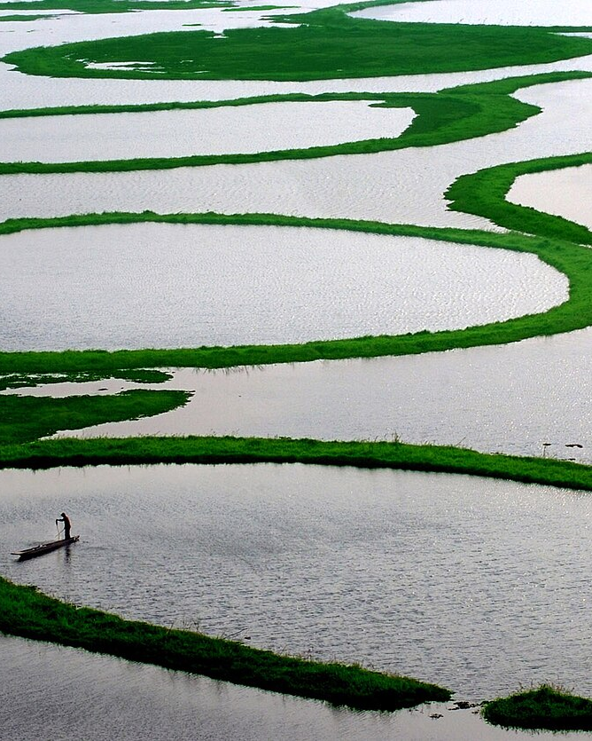
Problem Statement
RE-IMAGINING MANIPUR — HACKATHON 2026
One-Stop Digital Tourist Guide for Manipur
PS 8 — also delivering PS 1, 2, 3, 5, 6 and 7
OneStop Manipur
One stop for everyone in Manipur's tourism
Team Number:
Team Name:
Live prototype: onestop-manipur.vercel.app
Loktak Lake · Photo: Sudiptorana, CC BY-SA 4.0
Notes:
[0:00–0:20] We are team ___. We took Problem Statement 8, the One-Stop Digital Tourist Guide, because it contains the others: discovery, AI planning, language, homestays, food and events. Our answer is OneStop Manipur, and it is live today.

Slide 2
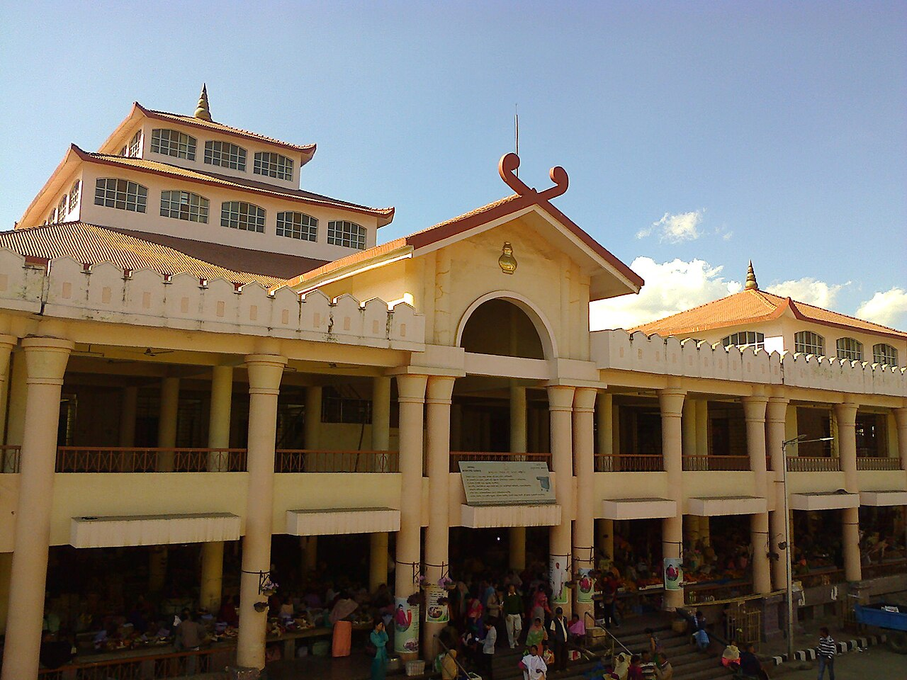




Problem Statement — Manipur's tourism is scattered
What a first-time visitor, a local host and the Tourism Department each run into today
Information is scattered
Planning is one-size-fits-all
Destinations, events, food, stays and transport sit on separate sites, pages and word of mouth.
Interests, budget and days differ, yet there is no way to get a costed, local plan in one place.
Ima Keithel · Photo: PP Yoonus, CC BY-SA 3.0
Language is a real barrier
Local hosts are invisible
The result: visitors crowd a few famous spots, local hosts miss out, and the Department decides without seeing what visitors actually do.
Meiteilon is barely served by mainstream translation apps, so visitors and hosts struggle to talk.
Homestays, guides and artisans have little digital presence and no simple way to take a booking.
Notes:
[0:20–0:55] A first-time visitor has no single place to discover, plan, book and get help. Planning is generic. Meiteilon is poorly served by translation apps. Homestays and guides are hard to find and harder to book. So visitors cluster in a few places and the Department cannot see the signals.

Slide 3




Proposed Solution — OneStop Manipur
One platform, four interfaces, one shared tourism knowledge layer
Explore Manipur
Tourism Partners
Create for Manipur
Decision Room
Tourists
Homestays · guides · operators · artisans
Local creators
Tourism Department
Plan in your own words, discover places, food and events, book local hosts, get help.
Get verified, report availability daily, accept bookings and enquiries.
Take up Department campaigns with AI briefs built on verified facts.
Live tourism pulse, issues, campaigns and an AI analyst that shows its evidence.
Shared layer: destinations · heritage facts · stays · guides · transport · dishes · events · bookings · feedback
The closed loop — the same record moves through every interface
Promote
Discover
Plan
Book & visit
Feedback
Learn
Improve
A tourist's check-in or feedback reaches the Department's dashboard in seconds — no export step in between.
Notes:
[0:55–1:35] OneStop Manipur is one platform with four doors: tourists, local partners, creators and the Department. They are not four apps with one logo — a destination, a booking or a feedback item is the same record everywhere, so a tourist's feedback shows up on the Department's dashboard seconds later.

Slide 4








Proposed Solution — every problem statement, in one platform
What is built and working in the live prototype today
PS 1 Smart Discovery
PS 2 AI Travel Planner
14 destinations, 28 experiences, events, food, stays and transport on maps with road routing
Describe your trip in words → 2–3 costed options with stays, car and driver, guides, within budget
PS 3 Multilingual Assistant
PS 5 Homestays & Local Stays
Talk: hold-to-speak Manipuri ⇄ English/Hindi interpreter, offline phrasebook and etiquette
Verified hosts at their own rates: request → host accepts → pay by UPI or card (Razorpay)
PS 6 Taste of Manipur
PS 7 Events & Festivals
12 traditional dishes with ingredients and stories, 4 food trails, and who serves them
Filterable calendar of 15 events, registration and ticketing with live capacity
PS 8 One-Stop Guide
Everywhere
All of the above + heritage, shopping & crafts, emergency help, QR check-in, feedback, payments
Desktop web, phone app at /m and an Android APK — on one server and one dataset
Notes:
[1:35–2:15] Here is how it maps to the statements. Discovery and maps. An AI planner that returns costed options using real local partners. A Manipuri interpreter. Bookable homestays with UPI payment. Taste of Manipur with dishes and food trails. An events calendar with ticketing. And the one-stop layer: heritage, shopping, emergency help and feedback. All on web, phone and Android.

Slide 5
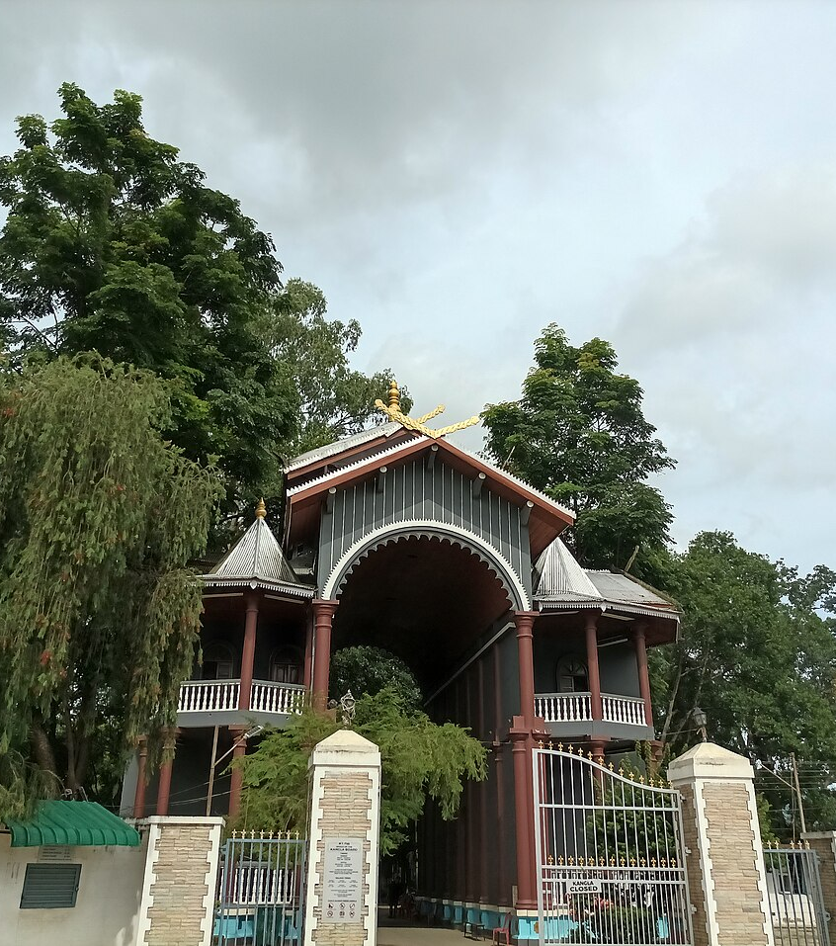




Proposed Solution — what makes it original
Not another directory or chatbot itinerary: a trustworthy tourism layer for Manipur
A closed loop, not a brochure
Promotion, planning, bookings and feedback share one record, so every visit teaches the next decision.
Every number shows its source
Seven provenance labels (official, partner, observed, estimated…) are enforced in code on every figure.
AI that cannot invent facts
Figures are computed first; the AI only writes the words. A rewrite that adds a number is thrown away.
Local money stays local
Plans are built from verified Manipur hosts at their own rates. Online finds are labelled, never priced.
Built for Meiteilon
The interpreter refuses rather than guesses. Unchecked phrases wait for a Manipuri speaker.
Kangla · Photo: Haoreima, CC BY-SA 4.0
Notes:
[2:15–2:55] Three things make this different. First, a closed loop. Second, trust: every figure carries its source, and the AI is never allowed to produce a number — we compute it, the AI only explains it. Third, it is local: plans use verified Manipur hosts at their own prices, and the interpreter is built for Meiteilon and refuses rather than guesses.

Slide 6
Technology & Technical Approach
Appropriate and effective use of technology
Experience
Desktop web · Phone app (/m) · Android APK (Capacitor) · QR check-in
360+
automated tests
Application
Next.js 16 + React 19 + TypeScript · server actions · role-based access checked on the server
33
Intelligence
Deterministic analytics compute every figure → AI (Gemini / Claude / OpenAI) writes the narrative → figure check
routes across 4 interfaces
7,376
Data
MySQL via Prisma · Zod-validated tourism dataset · 7 provenance categories · Postgres-ready
seeded tourism records, 16 districts
0
Services
MapLibre maps + OSRM road routing · Razorpay UPI/cards · speech: ASR → translate → TTS · web grounding
API keys needed to run the demo offline
Hosted on Vercel (Mumbai region). Keys stay on the server — never in the browser or the APK.
Notes:
[2:55–3:45] The stack is Next.js and TypeScript on MySQL, with a phone app and an Android build on the same server. The important design choice is in the intelligence layer: deterministic analytics compute every figure, and the language model — Gemini, Claude or OpenAI — only writes the explanation. If it slips in a number that isn't in the evidence, we discard it. MapLibre with road routing for maps, Razorpay for UPI, and a speech pipeline for the interpreter. Over 360 automated tests, and the whole demo runs offline.

Slide 7


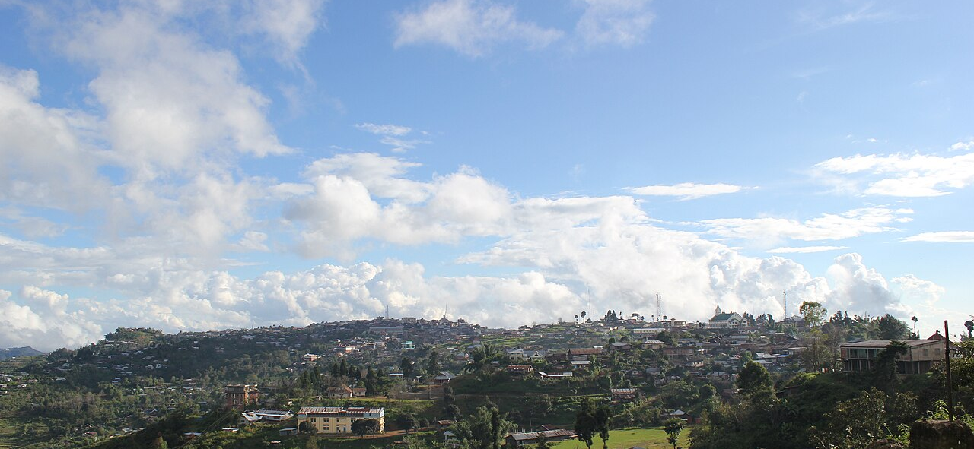
Impact on Tourism
Better visitor experience, wider destination promotion, and income that reaches local hands
Tourists
Local hosts & artisans
Creators
Tourism Department
A personal, costed trip from one conversation
Book local stays, events and guides in one place
Emergency help and a Manipuri interpreter in the pocket
Direct bookings and UPI payments, no middlemen
A verified badge and a shareable page with QR
Dishes, crafts and homestays get discovered
Paid Department campaigns
AI briefs grounded in verified facts
Credit tied to real visits, not just views
Live pulse from check-ins, bookings, feedback
Spot issues and crowding early
Promote quieter districts with evidence
Destination promotion beyond the usual circuit
The Department can see which places are crowded and which are ready, then steer campaigns and plans toward places like Ukhrul, Shirui and Andro — spreading visitors and income across Manipur's 16 districts. In a pilot we would measure local-host bookings, check-ins outside the top destinations, and feedback resolved.
Ukhrul · Photo: Ac apam, CC BY-SA 3.0
Notes:
[3:45–4:35] Impact. Tourists get a personal, bookable trip with help and language support built in. Local homestays, guides and artisans get direct bookings and payment. Creators get paid campaigns grounded in verified facts. And the Department gets a live picture that lets it promote quieter destinations like Ukhrul and Shirui with evidence — spreading visitors and income across the state.

Slide 8
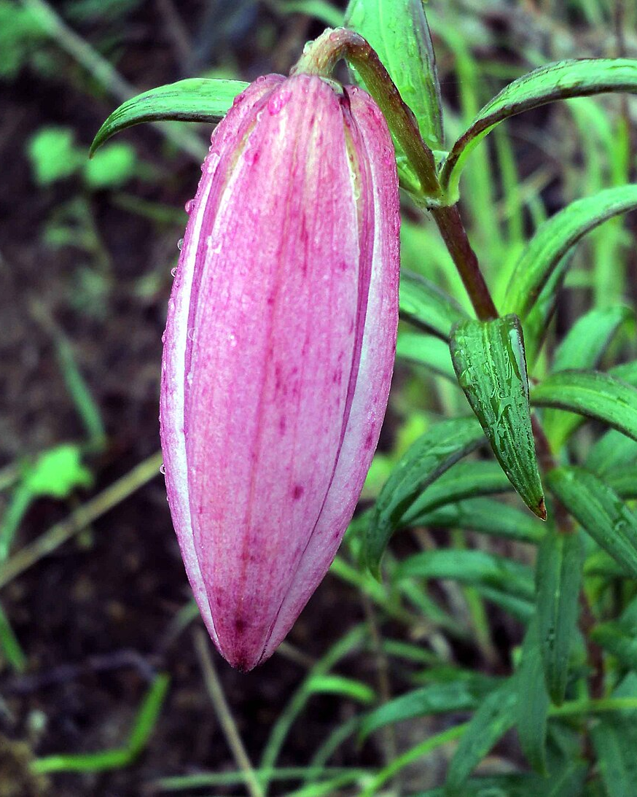


Ready to pilot
Live today — and a clear path to production
LIVE NOW
Web: onestop-manipur.vercel.app
Phone app at /m and an Android APK
Full demo in 5 minutes, runs offline
NEXT 90 DAYS
Connect Meiteilon speech models, checked by native speakers
Onboard homestays and guides in two pilot districts
Connect official Department statistics; offline mode for low network
OneStop Manipur — one stop for everyone in Manipur's tourism.
Shirui · Photo: Mashangva, CC BY-SA 4.0
Notes:
[4:35–5:00] It is live now on web, phone and Android. In the next 90 days we would connect the Meiteilon speech models with native speakers checking them, onboard hosts in two pilot districts, and connect official Department data. OneStop Manipur — one stop for everyone in Manipur's tourism. Thank you.

