Slide 1
Skill Issue
Decomposing Procedural Knowledge Injection for LLM-Agent Network Forensics
Yaakulya Sabbani
ORCID 0009-0001-3689-3109

Slide 2
Agent Skills now specialize LLM agents, yet no study tests whether they make a packet-forensics agent competent, or which part does the work
Skills package procedural knowledge (workflow, tool recipes, output contracts) injected into a generalist model at inference time.
Cross-domain evaluation reports cybersecurity as the largest-gain domain, but treats the skill as one atomic block.
Open question 1: does a skill make a tshark-driving agent a competent analyst, measured against vetted ground truth?
Open question 2: which component of a skill produces any gain?
SkillsBench 2026; Anthropic Agent Skills; agentskills.io

Slide 3
We hold the model and toolbox fixed and vary only the injected skill across six arms, isolating each component by ablation
Arm | Injected skill | Components
A | none (vanilla) | baseline
B | community Wireshark skill | external
C | custom IOC-forensics skill | workflow + recipes + schema
D1 | C minus workflow | recipes + schema
D2 | C minus recipes | workflow + schema
D3 | C minus schema | workflow + recipes
Same neutral task: investigate the evidence, write an incident report.
Ablations remove one marked section verbatim, so each differs from C by one component only.
Runtime: Claude Code CLI, read-only tools, web and file-transfer denied.
Metrics: IOC recall, victim-ID accuracy, family attribution, hallucination, tool calls, cost

Slide 4
Validating every indicator against packets exposed wrong C2 IPs in three of nine published answer keys
9 real malware-infection captures (RAT, stealer, loader families) with official analyst writeups.
We transcribed each writeup to a typed IOC set, then checked every indicator with tshark.
3 of 9 answer keys printed a C2 IP absent from every packet (e.g. STRRAT key says 141.98.10.69; port-12132 traffic goes to 141.98.10.79).
Corrected against primary evidence. Forensic ground truth must be validated, not trusted.
Malware-Traffic-Analysis.net; validation via tshark 4.6

Slide 5
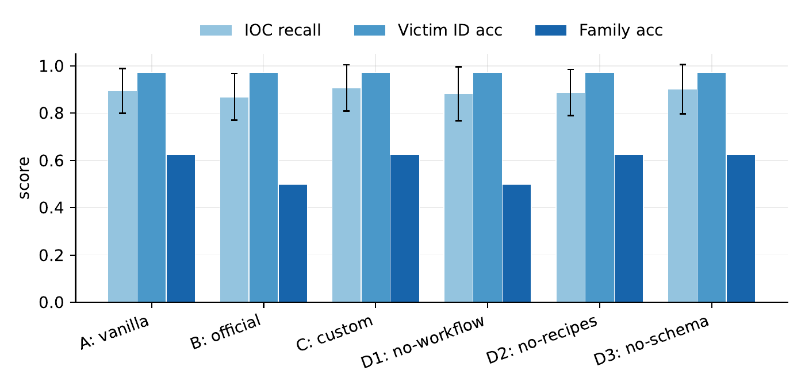
A capable base model already identifies the victim host in 97 percent of cases, so skills barely move accuracy
Victim-ID accuracy is identical (0.97) across all six arms.
IOC recall spans a narrow 0.87 to 0.91.
A skill does not turn a capable model into an analyst; it already is one for routine work.
So we look past recall: efficiency, faithfulness, and where the components matter.
Mean across 9 cases, up to 3 reps each (111 valid runs)

Slide 6
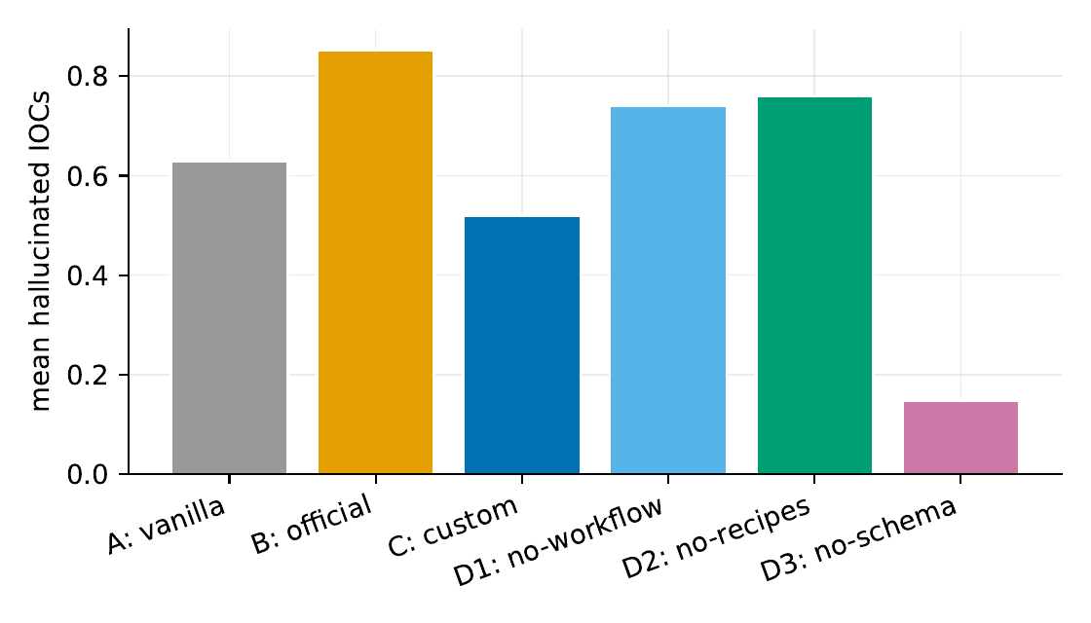
A generic community skill is net-negative: it has the worst attribution and the most fabricated indicators
Official skill (B): highest hallucination (0.85 fabricated IOCs per case).
Also the worst family attribution (0.50 vs 0.625).
No recall benefit over the untreated baseline.
Injecting off-the-shelf procedural knowledge is not free.
Hallucination = IOC-shaped tokens asserted but absent from the capture

Slide 7
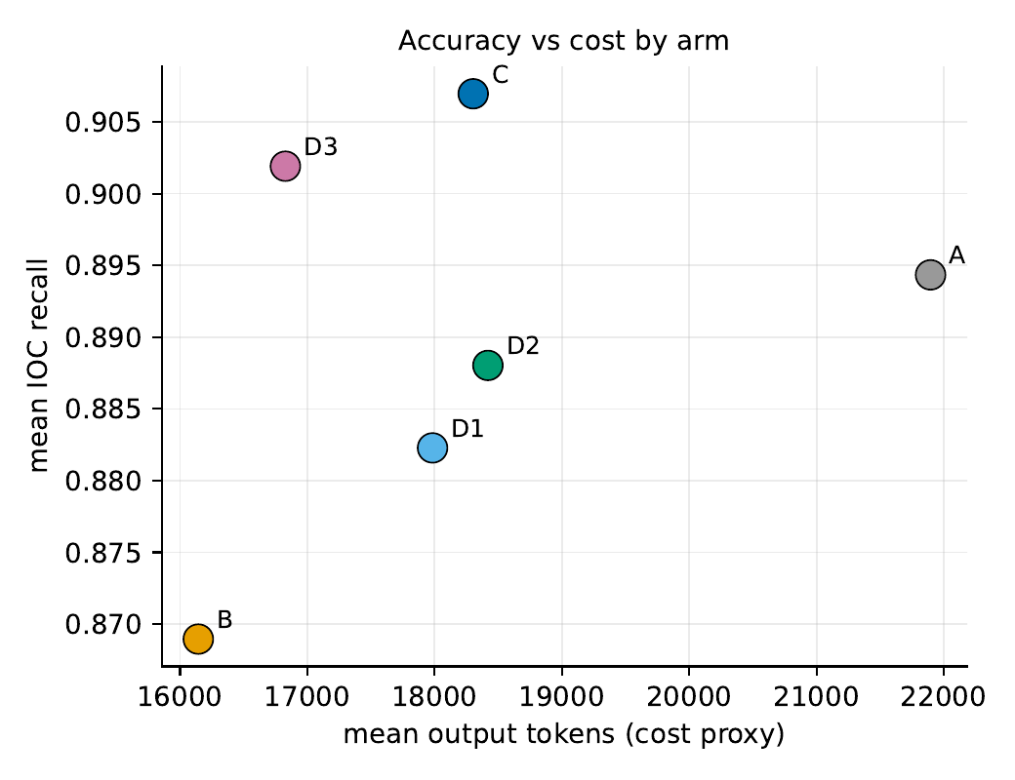
A purpose-built skill buys efficiency and safety, not accuracy: equal recall with 37 percent fewer tshark commands
Custom skill (C): best recall (0.907) at the lowest command count.
37% fewer tshark commands than vanilla (10.7 vs 17.0).
Lower hallucination than both vanilla and the generic skill.
The win is a leaner, more faithful investigation, not a higher ceiling.
Each point is one arm's mean over 9 cases

Slide 8
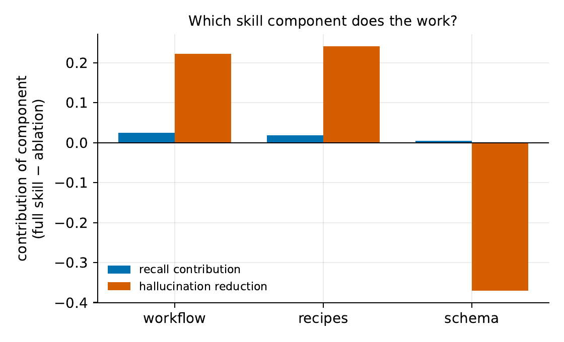
Ablation shows the workflow and recipes carry the benefit, while the output schema is the largest driver of fabrication
Removing workflow (D1): recall and attribution drop to the generic-skill level.
Removing recipes (D2): lowest recall, higher hallucination.
Removing schema (D3): recall unchanged, hallucination falls to 0.15 (best in study).
The rigid IOC template appears to induce fabrication: named slots invite filling.
Contribution = full skill (C) minus the ablation that removes each component

Slide 9
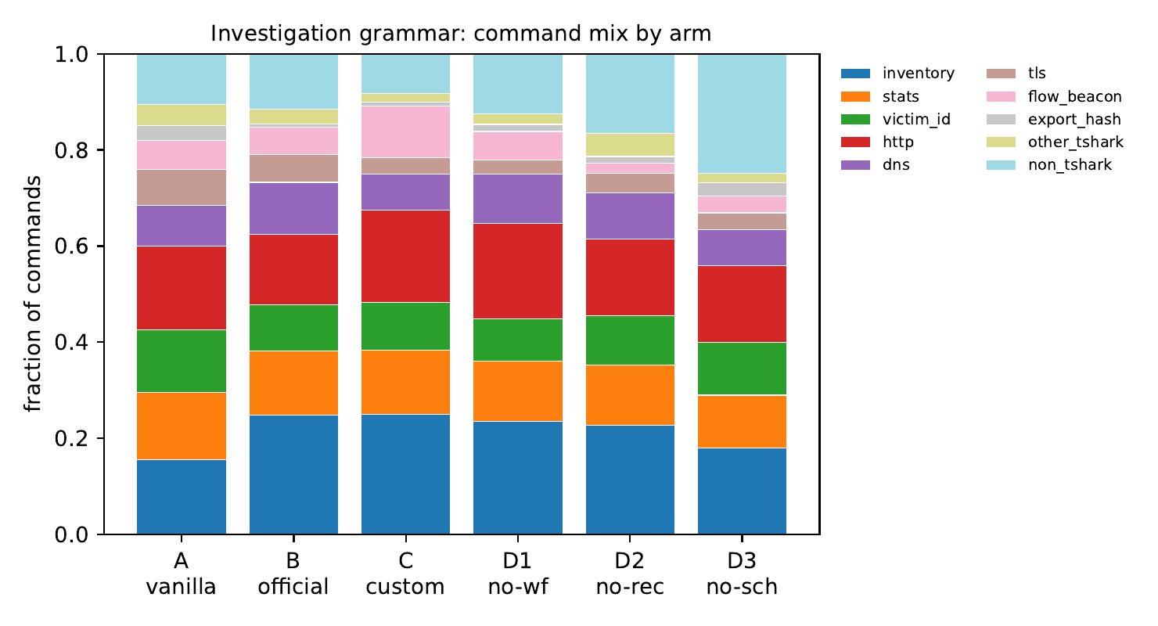
The investigation grammar shows the custom skill runs a leaner, more targeted inquiry
The mix of command categories each arm issues, normalized.
The custom skill concentrates on victim-ID and statistics passes.
It issues fewer commands overall while covering the same evidence.
After a fix, all arms inventory the directory and read available IDS alerts.
Commands classified from full agent trajectories

Slide 10
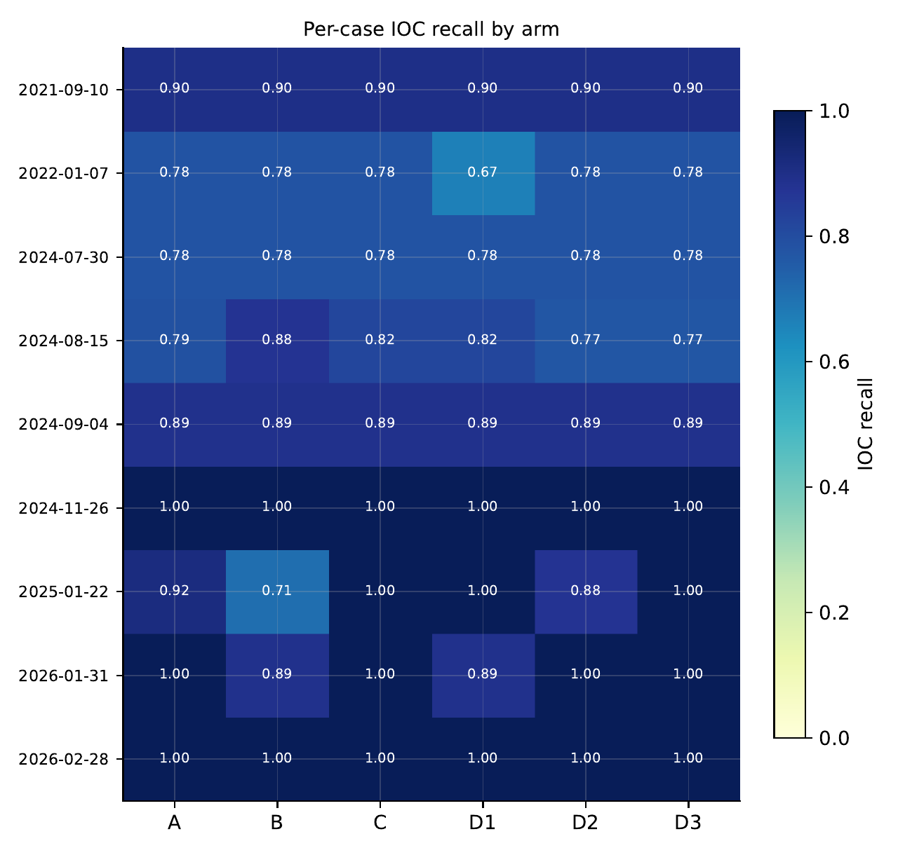
Family attribution is the hard ceiling: no arm exceeds six of nine, bounded by alert-free behavioral cases
Per-case IOC recall by arm; most cases sit near the ceiling.
Where Suricata alerts are present, all arms read them and attribute correctly.
Where alerts are absent, no skill closes the attribution gap.
This bounds the promise of packet-only agentic attribution.
Rows are cases; columns are arms

Slide 11
Skill authors should invest in workflow and recipes, prefer evidence-gated output, and widen the evidence an agent considers
On a strong base model, a skill is an efficiency and safety tool, not a capability unlock.
Prefer evidence-gated output (emit an indicator only with a citation) over fixed templates that pressure the model to fabricate.
Design skills that widen, not narrow, the evidence considered; a narrow skill can suppress useful exploration (the skill-issue effect).
We release the harness, the evidence-validated dataset, and all skill variants.
Effects are modest vs case variance (n=9); the schema effect on hallucination is the most robust

Slide 12
References
[1] CyberSleuth: Autonomous Blue-Team LLM Agent for Web Attack Forensics. arXiv:2508.20643.[2] Holmes: Evidence-Grounded LLM Agent for Auditable DDoS Investigation. arXiv:2601.14601.[3] Before You Hand Over the Wheel: Evaluating LLMs for Security Incident Analysis. arXiv:2603.06422.[4] SkillsBench: Benchmarking How Well Agent Skills Work Across Diverse Tasks. arXiv:2602.12670.[5] Malware-Traffic-Analysis.net, B. Duncan. Traffic analysis exercises.[6] Wireshark and tshark, Wireshark Foundation, v4.6.

