Slide 1
Committee Meeting
October 31, 2017

Slide 2
How do oysters respond to ocean acidification?
Notes:
Using C. gigas as a model organism to understand responses to ocean acidification and ocean warming.

Slide 3
Proposed Chapters
How do location-specific environmental conditions in Puget Sound (pH, temperature, dissolved oxygen) affect Pacific oyster physiology?
How does ocean acidification affect reproductive development and larval performance?
Pacific oysters
Eastern oysters
Notes:
Chapters in progress

Slide 4
How do location-specific environmental conditions in Puget Sound affect Pacific oyster physiology?
Notes:
Proteomics experiment. Puget Sound is changing, but it’s not changing uniformly. We can use mass spectrometry to undesrtand how environmental variabilty affects physiological response of Pacific oyters. Understanding how local environmental variables affect C. gigas is crucial for both conservation and aquaculture in the face of climate change. Because protein expression is sensitive to environmental conditions, target proteins can be used as biomarkers to monitor water quality in Puget Sound. This proteomic resource can also be used to assess if conditions at growout locations are optimal.

Slide 5
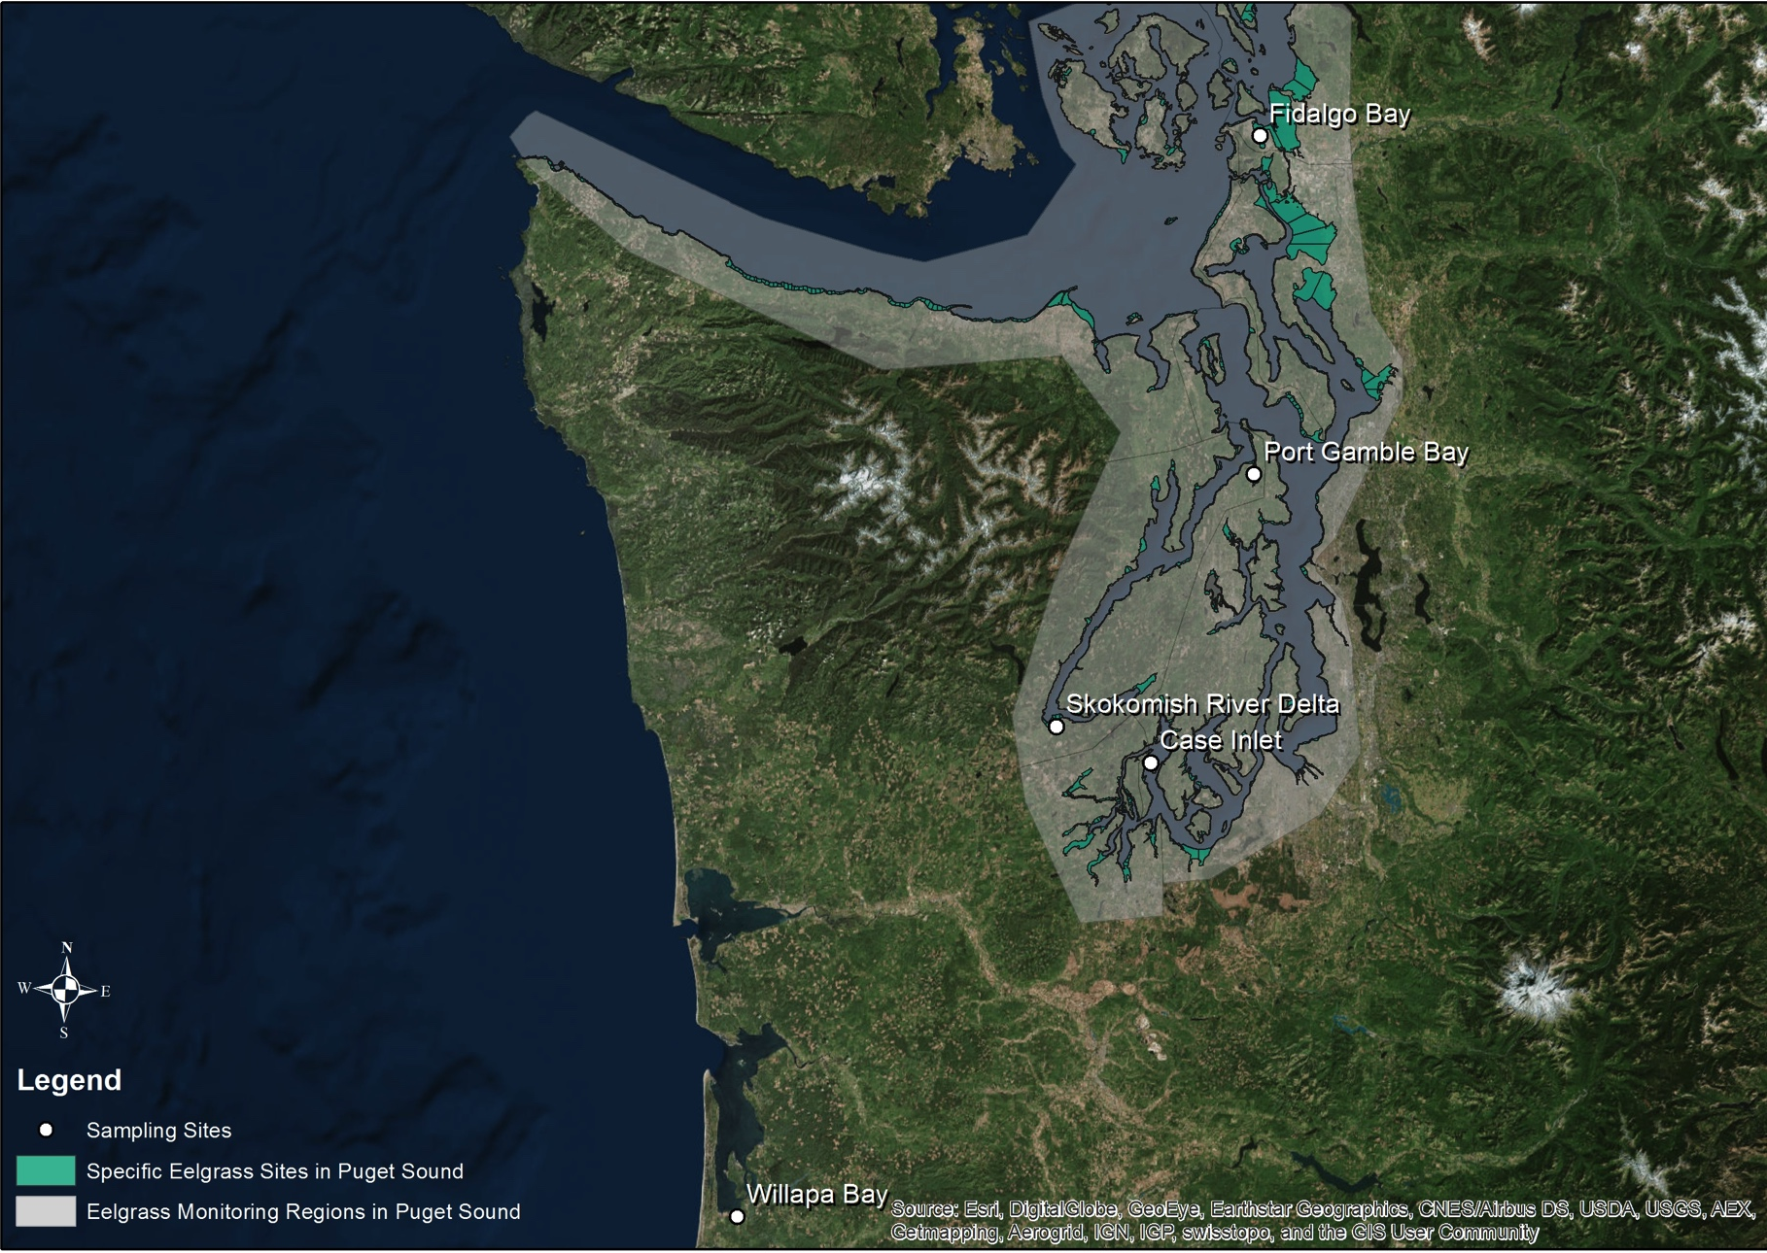
Exploring Proteomic Variation in Pacific oysters
Hypothesis: Local environmental variability will drive differential physiological responses
150 sibling oysters outplanted June 2016
5 locations and 2 different habitats
Continuous environmental monitoring (pH, DO, temperature)
Collected ctenidia tissue samples after one month of exposure

Slide 6
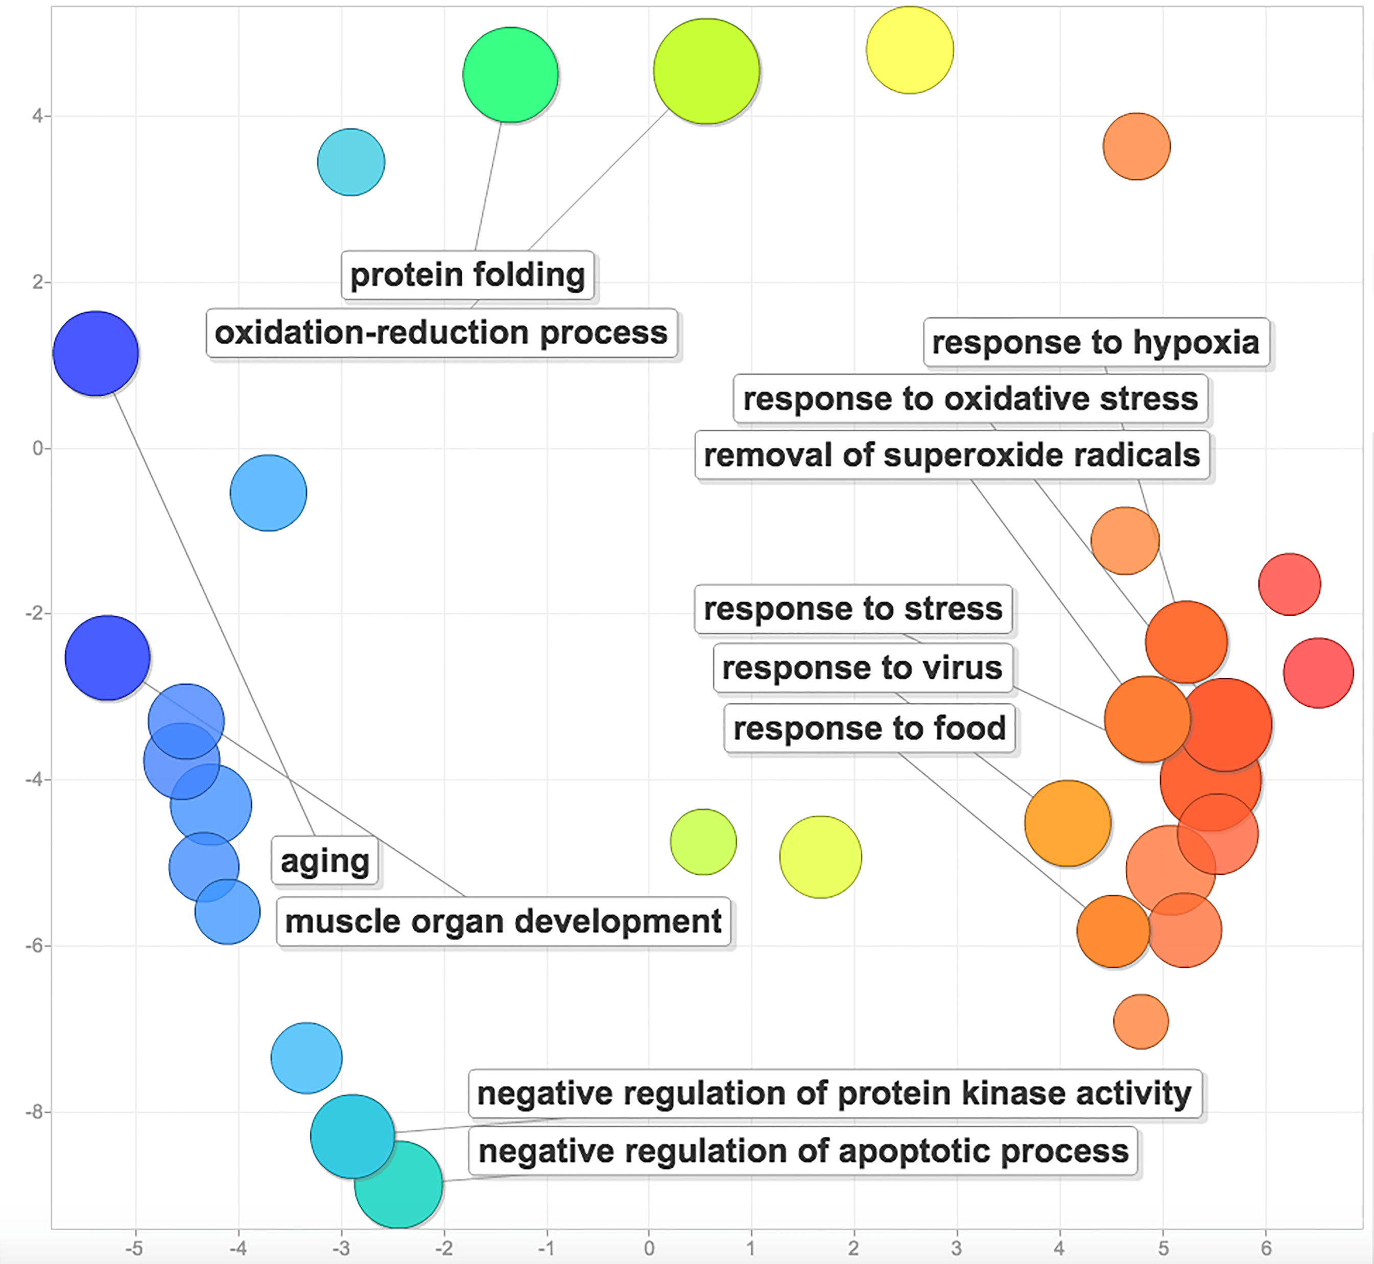
Exploring Proteomic Variation in Pacific oysters
Figure 1. Environmental response protein functions overrepresented in shotgun proteomics results.
Shotgun proteomics: What proteins are there?
10 ctenidia samples, 1 from each location and habitat type
9,047 proteins identified
273 related to environmental response

Slide 7
Exploring Proteomic Variation in Pacific oysters
Table 1. Protein functions used in targeted assay.
Function | Number of Proteins
Oxidative stress | 4
Heat shock | 1
Acid-base balance | 1
Drug resistance | 1
Fatty acid metabolism | 1
Carbohydrate metabolism | 2
Cell growth and maintenance | 5
Total | 15
Targeted proteomics: What environmental response are we interested in?
15 protein targets identified from shotgun data
50 ctenidia samples, 5 for each site and habitat type

Slide 8
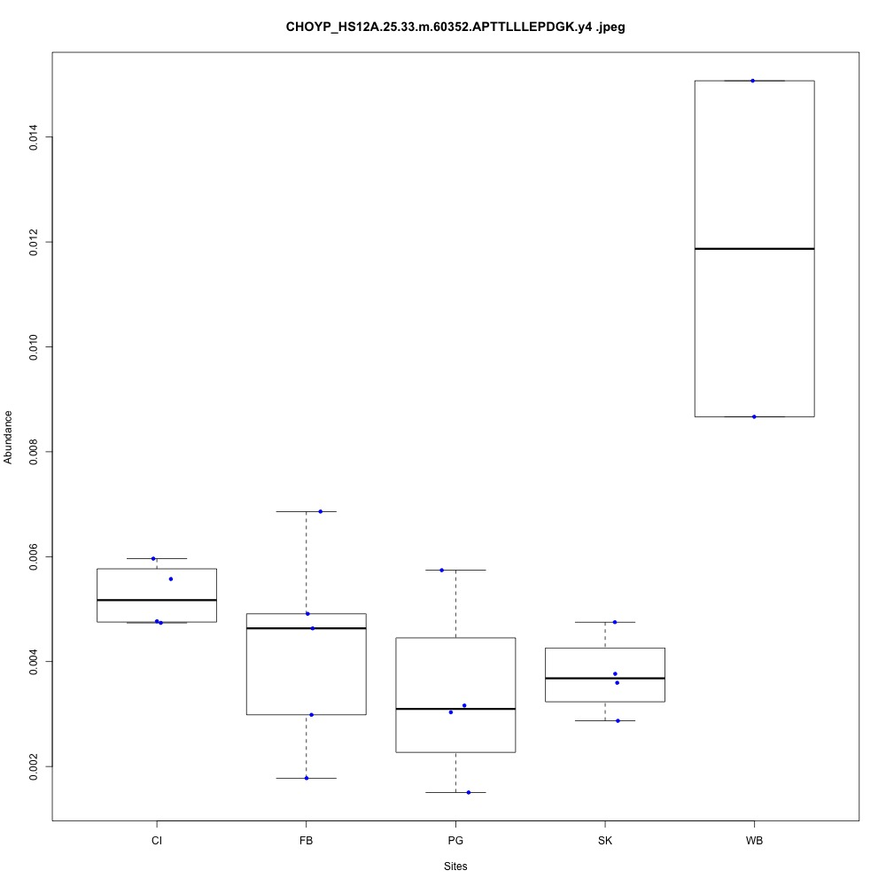
Exploring Proteomic Variation in Pacific oysters
Figure 2. Heat shock protein expression at different sites.
Targeted proteomics: What environmental response are we interested in?
15 protein targets identified from shotgun data
50 ctenidia samples, 5 for each site and habitat type
18ºC
15ºC
16ºC
15ºC
15ºC

Slide 9
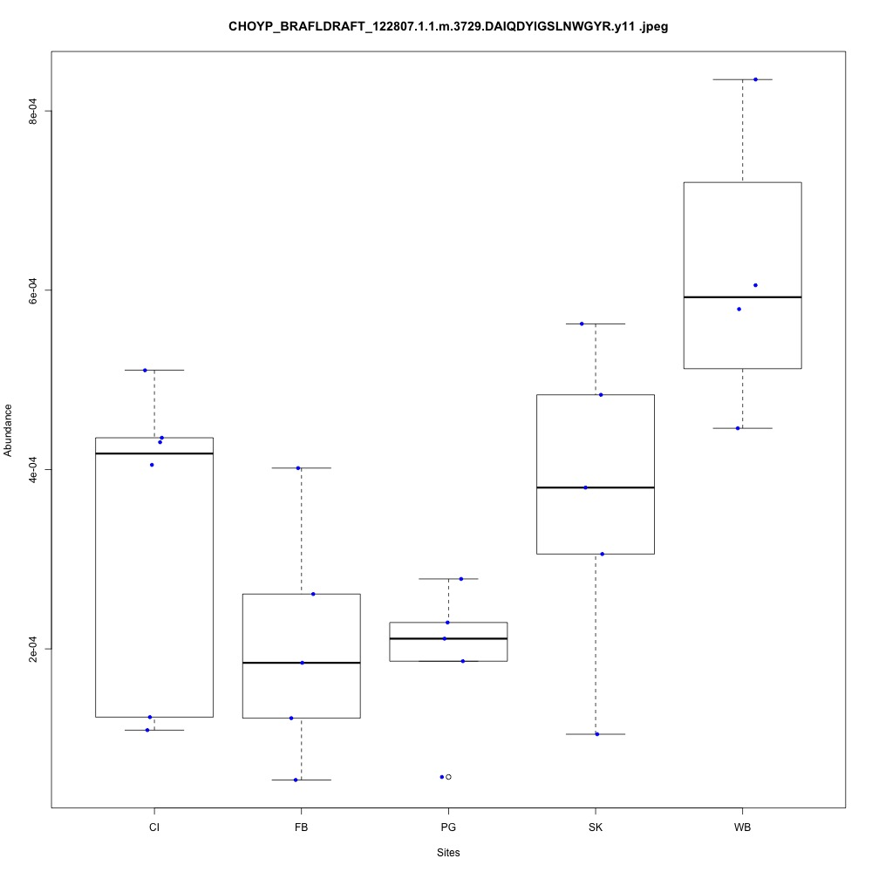
Exploring Proteomic Variation in Pacific oysters
Figure 3. Thioredoxin reductase expression at different sites.
10.3
9.6
Targeted proteomics: What environmental response are we interested in?
15 protein targets identified from shotgun data
50 ctenidia samples, 5 for each site and habitat type
14.6
9.6
12.5

Slide 10
Exploring Proteomic Variation in Pacific oysters: Next Steps
Understand how site, habitat, and local environmental variables drive protein expression
Enhance reproducibility of analysis pipeline
Expected manuscript completion: December 2017

Slide 11
How does ocean acidification affect reproductive development and larval performance?
Notes:
Epigenetics is the next frontier for understanding how environmental variability affects an organism’s physiological response and ability to acclimate to future ocean conditions. The epigenome consists of all gene expression modifications that do not arise from changes in the DNA sequence itself.^{1,2} The most-studied epigenetic mechanism in marine organisms is the methylation of cytosine bases.³ Environmental response genes that are less methylated are prone to more spurious transcription and alternative splicing patterns, thereby increasing phenotypic plasticity.^{4,5} Genomic regulation by DNA methylation therefore is crucial for adaptation and acclimation, especially if methylomes are inherited by subsequent generations. My research will be the first to test epigenetic inheritance in C. gigas as a response to climate change stressors. By evaluating how DNA methylation affects fitness in adult C. gigas and their offspring, I will elucidate how marine invertebrates respond to climate variation at an organismal and population level.

Slide 12
Pacific oysters and Ocean Acidification: Adults
Hypothesis: Environmental conditions will result in a change in methylation that corresponds with regulation in environmental response genes
How does low pH affect tissue methylation in adults?
150 sibling oysters exposed to either ambient or low pH conditions for 7 weeks
Randomly sampled 20 oysters before and after pH exposure
Measured and weighed oysters
Collected ctenidia, mantle, adductor tissues, gonad for histology
Sampled water and counted mortality twice weekly
20 oysters sampled
150 sibling oysters
7 week exposure: February 4, 2017 to April 8, 2017
10 oysters sampled
Ambient pH
Low
pH
10 oysters sampled
Notes:
Changes in methylation will produce different gene isoforms that increase fitness in the face of environmental stressors. I do not predict any significant interaction between pH and temperature on methylation patterns.

Slide 13
Pacific oysters and Ocean Acidification: Reproduction
Hypothesis: Low pH conditions will negatively affect gonad maturation, egg production, and larval output. The heat shock will not affect egg production and larval output.
How does parental stress affect reproduction?
20 “extra” sibling oysters
Heat shock: 1 hour, 40ºC
Return to ambient conditions
13o sibling oysters
Remaining oysters conditioned 2 months after end of exposure
Stripped spawned to create three female egg pools
Crossed individual males with egg pools
Calculated hatch rate after 24 hours of fertilization
Strip spawning and fertilization: July 30, 2017
Low pH
Ambient
Heat Shock
Sperm
1
2
3
4
5
6
1
2
3
4
5
6
1
2
Eggs
Pool (n=24 )
Pool (n=29)
Pool (n=6)
A x L
n=12
L x L
n=12
L x A
n=12
A x L
n=12
A x A
n=12
L x A
n=12
HS x HS
n=4
Individual males were crossed with females, and each cross had a replicate.
Notes:
Responding to an environmental stressor diverts energy away from reproduction

Slide 14
Pacific oysters and Ocean Acidification: Larval Mortality
Hypothesis: Environmentally-induced methylation patterns inherited by offspring will affect larval mortality
How does parental exposure affect larval fitness?
L x L
n=5
L x A
n=12
A x L
n=12
A x A
n=5
HS x HS
n=4
Larvae counted and sampled every other day
Did not grow after first week
Sampled 10,000 larvae per cross August 15, 2017
Remaining larvae collected and experiment terminated August 17, 2017
Individual crosses were pooled and redistributed in equal numbers. Any larvae that was not redistributed was kept and frozen.
Larval growth: August 1, 2017 to August 17, 2017
Larvae did not grow after August 3, 2017. Populations started crashing.
10,000 larvae per population were sampled on August 15, 2017
Experiment terminated: August 17, 2017
All remaining larvae were kept and frozen.
Notes:
Methylomes inherited from parents that experienced low pH will increase larval growth and decrease mortality in experimental conditions.

Slide 15
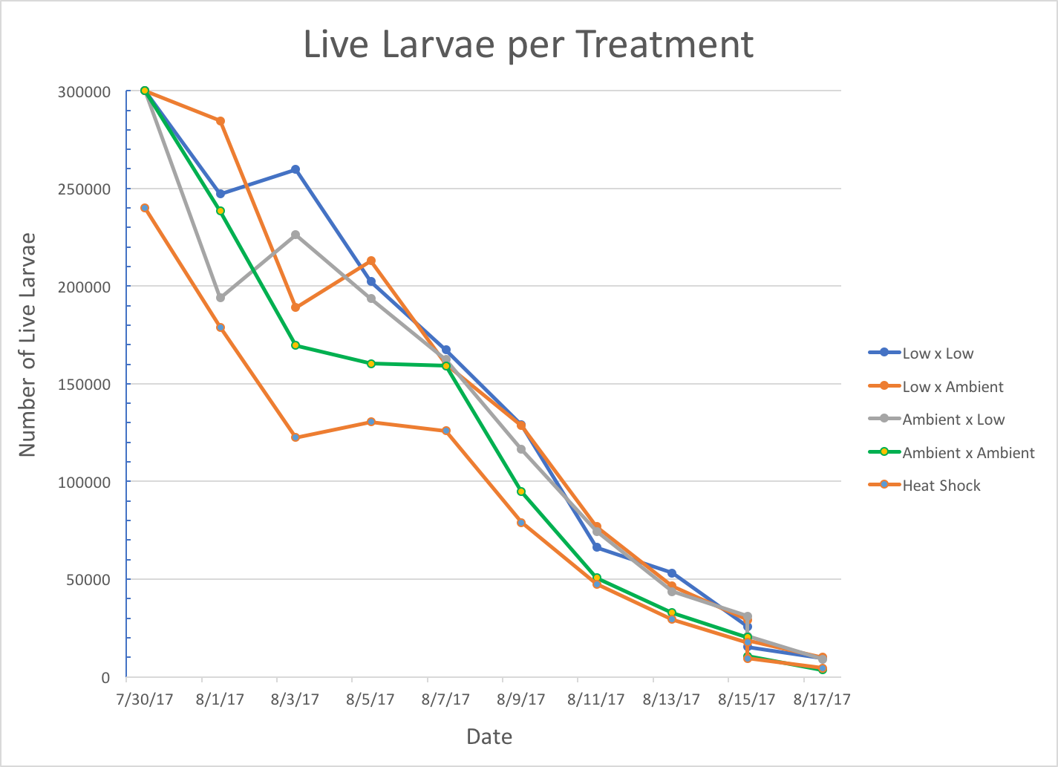
Manchester Experiment: Larval Mortality
Genomic sample dates circled in blue
Potentially differing mortality rates based on parental exposure?
Notes:
QUANTIFY WHAT DATA I HAVE
Methylomes inherited from parents that experienced low pH will increase larval growth and decrease mortality in experimental conditions.

Slide 16
Pacific oysters and Ocean Acidification: Next Steps
Adults
Identify gene methylation sites in ctenidia, mantle, and gonad tissues
Process water chemistry samples
Reproduction
Examine adult gonad histology slides to characterize maturation before and after pH exposure
Larval mortality
Analyze significance of mortality data
Identify gene methylation in larval samples and compare to adults
Expected manuscript completion: March 2018
Research, paper, and conference presentation funded by Hall Conservation Genetics Research Award

Slide 17
Eastern oysters and Ocean Acidification
Hypothesis: Environmental conditions will result in a change in methylation that corresponds with regulation in environmental response genes
Oysters exposed to either control or high pCO₂ conditions for four weeks
Will examine methylation in post-exposure gonad samples
Preliminary information for Spring 2018 larval experiment
Can compare Eastern oyster gonad tissue methylation to Pacific oyster gonads
12 oysters
4 week exposure at 15ºC: Summer 2016
Control
pCO₂
(400)
High
pCO₂ (2800)
5 oysters sampled
6 oysters sampled

Slide 18
Eastern oysters and Ocean Acidification: Next Steps
Eastern oysters
Identify gene methylation gonad tissue
Understand how different pCO₂ levels drive differential methylation patterns
Eastern and Pacific oysters
Compare methylation sites between species
Expected manuscript completion: Autumn 2018

Slide 19
Plan of Study
Required SAFS Classes
Statistical Inference (Winter 2017)
Current Topics
Seminar in Quantitative Science (Autumn 2016)
Bevan Series (Winter 2017)
Proposal Writing (Winter 2017)
Hot Topics (Autumn 2016)
Additional Requirements
Bioinformatics (Fall 2016 and Fall 2017)
R Programming (Fall 2016)
Regression Analysis (Spring 2017)
Integrative Environmental Physiology (Spring 2017)
Multivariate Statistics (Fall 2018)
Notes:
Taken a lot of seminar classes. Any other suggestions on ways to fill in my knowledge gaps?

Slide 20
Proposed Timeline
Item | Autumn 2016 | Winter 2017 | Spring 2017 | Summer 2017 | Fall 2017 | Winter 2018 | Spring 2018 | Summer 2018
Proteomics | Shotgun analysis |  | Targeted analysis, complete manuscript |  |  | Publish manuscript
Pacific oyster |  | Adult experiment |  | Reproduction and Larvae | Analyze data and write manuscript |  | Publish manuscript
Eastern oyster |  |  |  |  |  |  | Start processing samples
Presentations | GSS | NSA |  |  | PCSGA, GSS, WSN | NSA
Committee |  |  |  | Formed Committee | Committee Meeting | Proposal for Bypass | Committee Meeting to Bypass
Funding | SAFS Fellowship (4 quarters used, 4 remaining) |  |  |  | SeaGrant, applied for NSF GRFP | Bevan Series TA | Shellfish Biology TA/ SeaGrant/ SAFS Fellowship | SeaGrant/ SAFS Fellowship
Notes:
Plan to bypass Spring 2018.
After Winter quarter: have 4 more quarters SAFS fellowship, can also be paid off of Virginica grant

