Slide 1
I use “-omics” tools to answer relevant ecological questions.
Notes:
Use oysters as a model organism to study interactions between an organism and their changing environments.

Slide 2
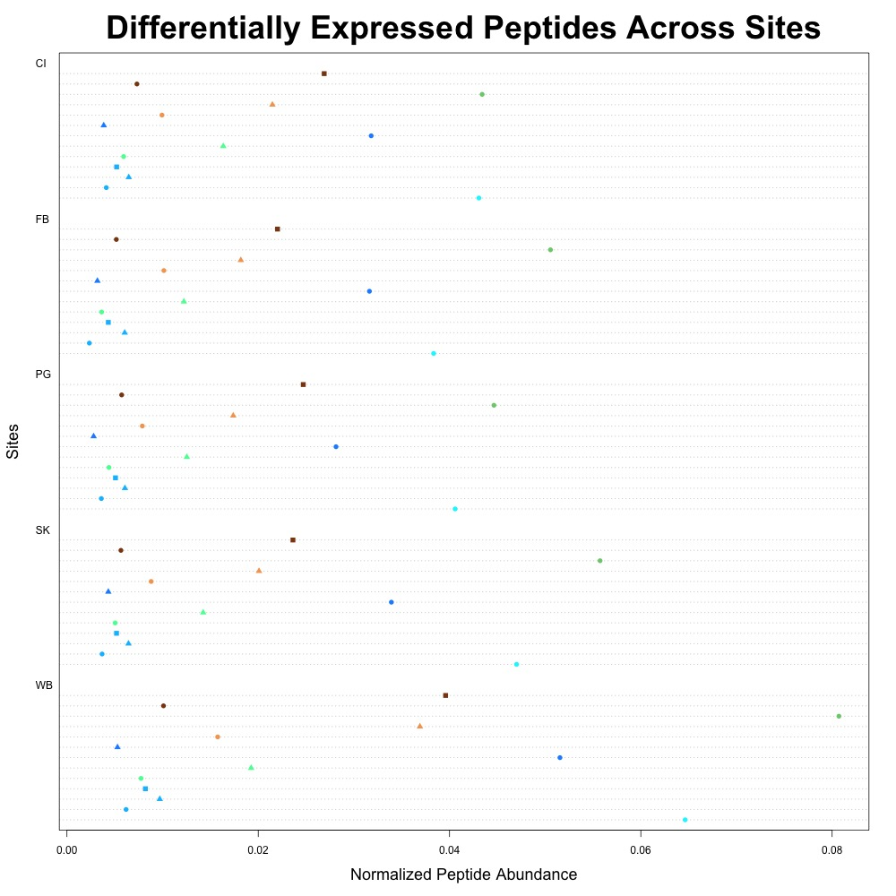
Environment → Pacific oyster physiology
Outplanted 150 sibling Pacific oysters at 5 locations
Local environmental variability will drive differential physiological responses
Differences in protein expression between Willapa Bay and Puget Sound
Implications for aquaculture, future research
Notes:
This finding alone generates a suite of new hypotheses for lab and field experiments comparing the effect regional conditions on physiological responses of marine invertebrates. Currently, there are several isolated studies examining oyster growth and performance in both of these regions. At the time of publication, this study is one of the first to link regional environmental conditions to physiological responses. Information from additional ouptlant seasons (July 2016-August 2016 and June 2017-July 2017) could elucidate if short-term and long-term temporal variation would drive different physiological responses. Understanding the difference between these two estuaries is important for the persistence of natural reefs and oyster aquaculture in the face of climate change.

Slide 3
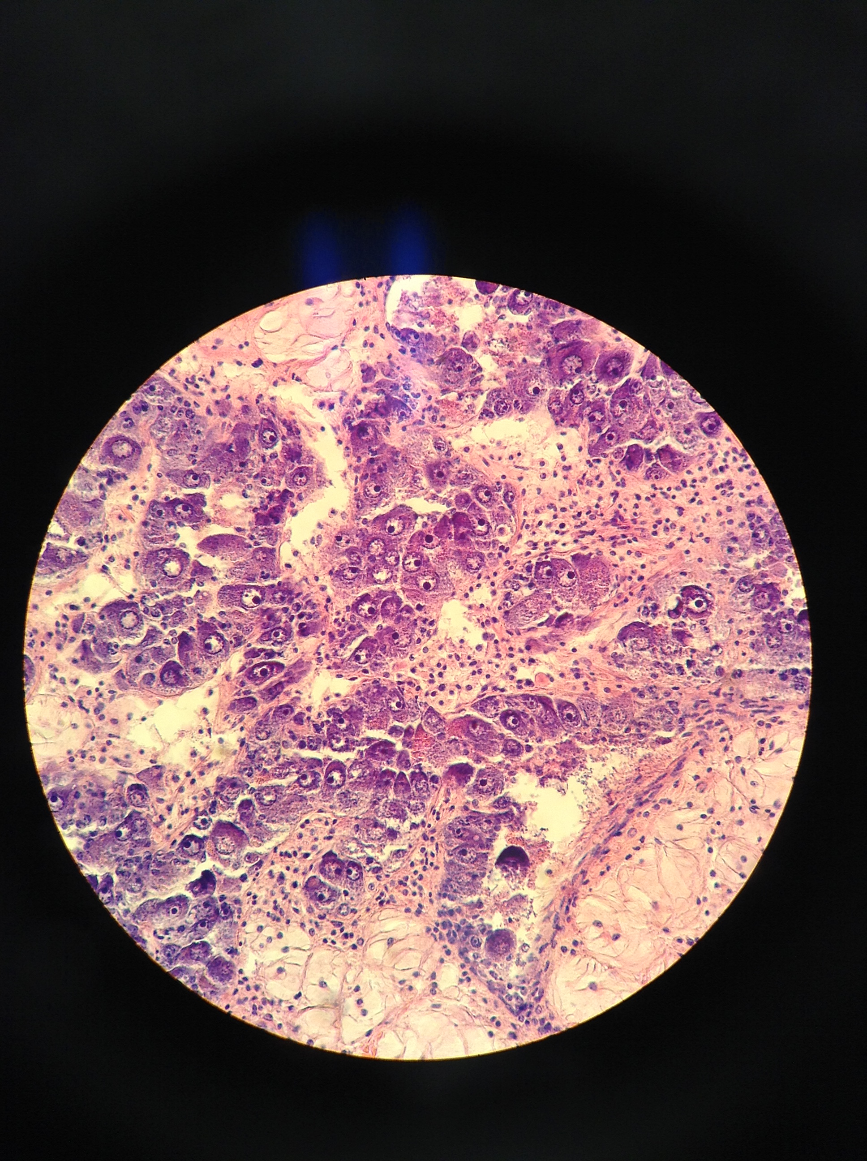
Ocean acidification → Oyster reproduction
Exposed adult Pacific oysters to low or ambient pH conditions for 7 weeks
Examined gonad maturation, eggs produced, and hatch rates
Female exposure to low pH lead to lower larval hatch rate
Similar work in Eastern oysters
Notes:
Species persistence in changing conditions
Eastern oysters: gonad methylation → how does evolution occur?

