Slide 1
Boolean Expressions, Universal Gates and Truth-Tables

Slide 2

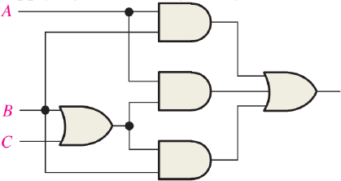
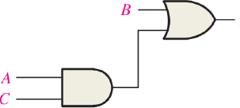
A large Boolean Logic Expression can often be simplified to a simpler and shorter Boolean Logic Expression. This is done by applying the laws and rules of Boolean Algebra.
Using Boolean algebra techniques, simplify this expression:
𝐀𝐁 + 𝐀 𝐁 + 𝐂 + 𝐁 𝐁 + 𝐂
This can be simplified to:
𝐁 + 𝐀𝐂

Slide 3



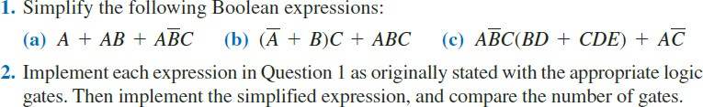
***Applying rules of Boolean algebra and
DeMorgan’s Theorem show that
i) MN+𝐌𝐎 + 𝐌𝐍^{ഥ}𝐎 𝐌𝐍 + 𝐎 = 𝟏
ii) 𝐀^{ഥ}𝐁𝐂^{ത} + 𝐀^{ഥ}𝐁𝐂 + 𝐀𝐁𝐂^{ത} + 𝐀𝐁𝐂 = 𝐁

Slide 4
Universal Gates
Although we can implement any circuit with AND/OR/NOT, we can also implement any circuit with only NAND or NOR gates.
We might want to do this because of technology considerations, that is, these gates might be cheaper to implement in silicon or they might be the only type of gates we have available.
Since we can always use only NAND or NOR gates, these gates are sometimes called universal gates.
The “trick” (if you want to call it that) is to see that we can implement the three basic gates (AND, OR, NOT) in terms of NAND or NOR gates.

Slide 5



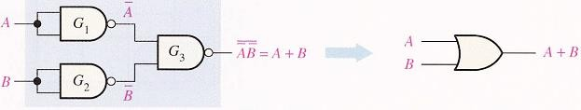
Universal Property of NAND and NOR gate
The NAND gate as a Universal logic gate:
1) One NAND gate used as an inverter (NOT gate):
2) Two NAND gates used as an AND gate
) Three NAND gates used as an OR gate

Slide 6

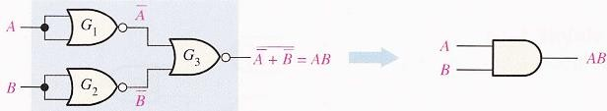
The NOR gate as a Universal logic gate:
1) One NOR gate used as an inverter (NOT gate):
2) Two NOR gates used as an OR gate:
3) Three NOR gates used as an AND gate:

Slide 7
Steps for Construction of Logic circuits Using Universal Gates
First construct the logic expression using basic gates ( AND/OR/NOT),
Replace each basic gate with its equivalent universal gate implementation,
Cancel two consecutive NOT gates (according to Boolean algebra),
Redraw the final circuit.

Slide 8
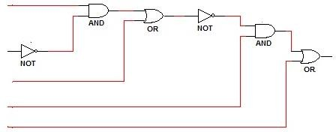
Example: Implement the following expression with (a) NAND gates ONLY, (b) NOR gates ONLY. Y=(AB’+C)’D+E Solution: Implementation using NAND gates ONLY: i) Implementation with Basic gates:

Slide 9
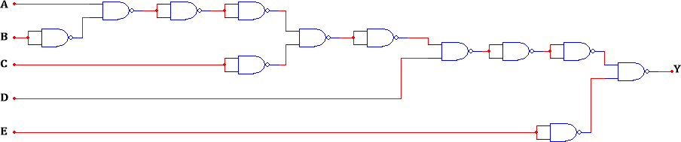
(ii) Replace each basic gate with its equivalent NAND gate implementation from Table 1.
(iii) Cancel two consecutive NOT equivalent gates (according to Boolean algebra).

Slide 10
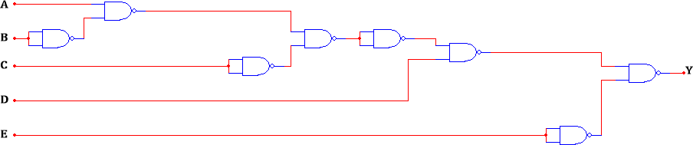
(iv)Redraw the final circuit
Implementation using NOR gates ONLY:
Implementation with Basic gates:

Slide 11
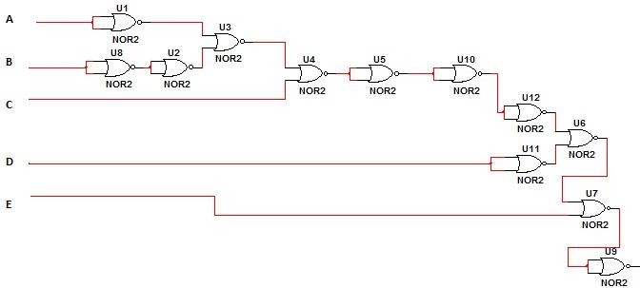
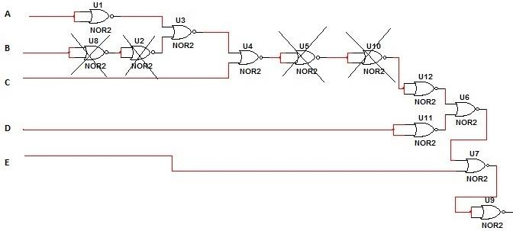
(ii) Replace each basic gate with its equivalent NOR gate implementation from Table 1.
(iii) Cancel two consecutive NOT equivalent gates (according to Boolean algebra).

Slide 12
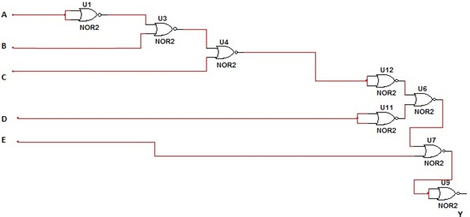
(iv)Redraw the final circuit.

Slide 13

Sum of Products: A Product is defined as a term consisting of products of the literals. When two or more products are summed in a Boolean expression, it is called the Sum- of-Products (SOP).
𝐀 + 𝐀^{ഥ}𝐁 + 𝐁𝐂
Standard SOP: It is an expression where all the variables are present in each product terms. Each of the products are called min terms (𝐦_{𝐢}) .
𝐀𝐁𝐂 + 𝐀𝐁𝐂 + 𝐀𝐁𝐂
Product of Sum: A Sum is defined as a term consisting of sum of the literals. When two or more sum terms are multiplied in a Boolean Expression, it is called the Product-of- Sum (POS).
(𝐁 + 𝐂)(𝐀 + 𝐁)
Standard POS: It is an expression where all the variables are present in each sum terms.
Each sum terms are called max terms (𝐌_{𝐢}).
(𝐀 + 𝐁 + 𝐂)(𝐀 + 𝐁 + 𝐂)

Slide 14
Minterms and Maxterms
° Each variable in a Boolean expression is a literal
° Boolean variables can appear in normal (x) or complement form (x’)
° Each AND combination of terms is a minterm
° Each OR combination of terms is a maxterm
For example: Minterms
For example: Maxterms
x y z
0 0 0
0 0 1
…
1 0 0
…
1 1 1
Minterm
x y z Maxterm
0 0 0 x+y+z M₀
x’y’z’ m₀
x’y’z m₁
0 … | 0 | 1 | x+y+z’ | M₁
1 … | 0 | 0 | x’+y+z | M₄
1 | 1 | 1 | x’+y’+z’ | M₇
xy’z’ m₄
xyz m₇

Slide 15

Conversion of SOP to Standard SOP
Step1: Multiply each of the non-standard terms with a term made up of the sum of the
missing variable and its complement. This do not change the function as we are just
multiplying by 1.
Step2: Repeat step 1 until all the non-standard terms become standard terms.
Conversion of POS to Standard POS
Step1: Add to each non-standard product terms a term made up of the product of the missing variable and its complement. This does not change the expression as we are just adding a 0.
Step2: Apply rule 12: 𝐀 + 𝐁𝐂 = (𝐀 + 𝐁)(𝐀 + 𝐂)
Step3: Repeat step 1 until all the sum terms contain all the variable in the domain.

Slide 17

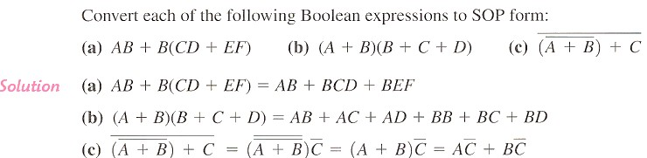
The sum-of-product (SOP) form
When two or more product terms are summed by Boolean addition. the resulting
expression is a sum-of-products (SOP). Some examples are
Conversion of a General Expression to SOP Form

Slide 18

The product of sum (POS) form
When two or more sum terms are multiplied, the resulting expression is a product-of-sums (POS). Some examples are

Slide 19

The Standard SOP Form

Slide 20


The Standard POS Form
: Add
to each nonstandard term.

Slide 21
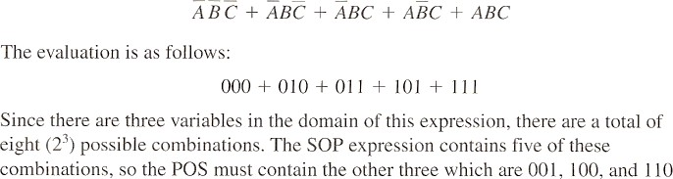

Converting Standard SOP to Standard POS

Slide 22
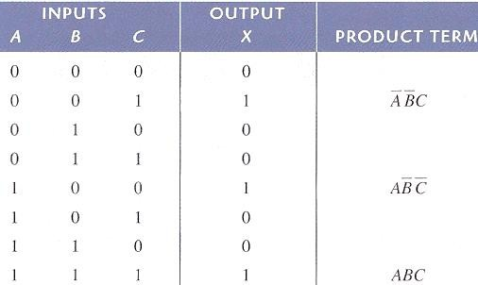
BOOLEAN EXPRESSIONS AND TRUTH TABLES
All standard Boolean expressions can be easily converted into truth table format using binary values for each term in the expression. The truth table is a common way of presenting, in a concise format, the logical operation of a circuit. Also. standard SOP or POS expressions can be determined from a truth table. You will find truth tables in data sheets and other literature related to the operation of digital circuits.
Converting SOP Expressions to Truth Table Format

Slide 23
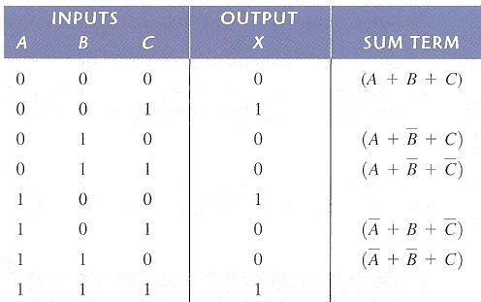
Converting POS Expressions to Truth Table Format

Slide 24
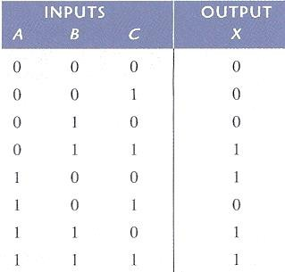
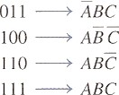
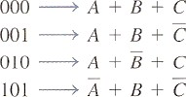

24

Slide 25
Textbooks:

 [1] Thomas L. Floyd, “Digital Fundamentals” 11th
edition, Prentice Hall.
 [2] M. Morris Mano, “Digital Logic & Computer Design” Prentice Hall.

