Slide 1
Karnaugh Map

Slide 2



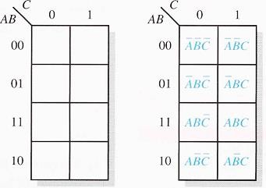
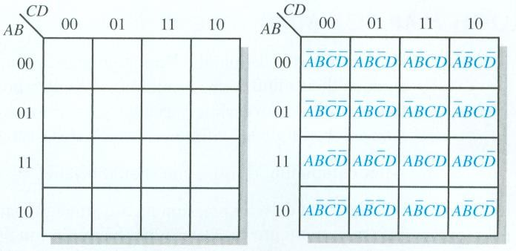
The Karnaugh Map
A Karnaugh map provides a systematic method for simplifying Boolean expressions and, if properly used, will produce the simplest SOP or POS expression possible, known as the minimum expression. As you have seen, the effectiveness of algebraic simplification depends on your familiarity with all the laws, rules, and theorems of Boolean algebra and on your ability to apply them. The Karnaugh map, on the other hand, provides a "cookbook" method for simplification.
A Kamaugh map is similar to a truth table
25

Slide 3

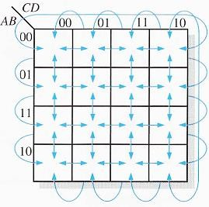
Cell Adjacency
Cells that differ by only one
variable are adjacent.
26

Slide 4
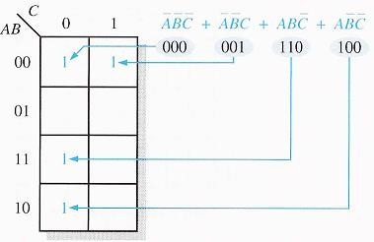
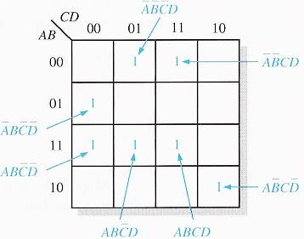
KARNAUGH MAP SOP MINIMIZATION
Mapping a Standard SOP Expression
27

Slide 5
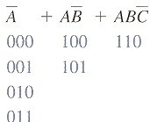
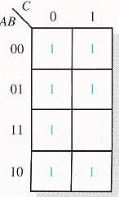
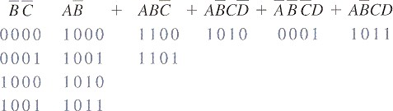
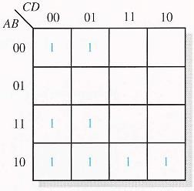
Mapping a Nonstandard SOP Expression
A Boolean expression must first be in standard form before you use a Karnaugh map.
28

Slide 6
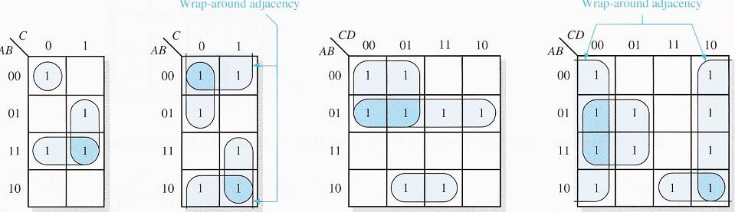
Karnaugh Map Simplification of SOP Expressions
a minimum SOP expression is obtained by grouping the 1s
Grouping the 1s: You can group 1s on the Karnaugh map according to the following rules by enclosing those adjacent cells containing Is. The goal is to maximize the size of the groups and to minimize the number of groups.
A group must contain either 1, 2, 4, 8, or 16 cells, which are all powers of two. In
the case of a 3-variable map, 2 3 = 8 cells is the maximum group.
Each cell in a group must be adjacent to one or more cells in that same group. but all cells in the group do not have to be adjacent to each other.
Always include the largest possible number of I s in a group in accordance with rule
1.
Each 1 on the map must be included in at least one group. The Is already in a group can be included in another group as long as the overlapping groups include
Non-common 1s.

Slide 7
Determining the Minimum SOP Expression from the Map: When all the Is representing the standard product terms in an expression are properly mapped and grouped, the process of determining the resulting minimum SOP expression begins. The following rules are applied to find the minimum product terms and the minimum SOP expression:
Group the cells that have 1 s. Each group of cells containing I s creates one product term composed of all variables that occur in only one form (either un-complemented or complemented) within the group. Variables that occur both un-complemented and complemented within the group are eliminated. These are called contradictory variables.
Determine the minimum product term for each group.
For a 3-variable map:
A 1-ceIl group yields a 3-variable product term
A 2-cell group yields a 2-variable product term
A 4-cell group yields a I-variable term
An 8-cell group yields a value of I for the expression
For a 4-variable map:
A 1-cell group yields a 4-variable product term
A 2-cell group yields a 3-variable product term
A 4-cell group yields a 2-variable product term
An 8-cell group yields a I-variable term
A 16-cell group yields a value of I for the expression
When all the minimum product terms are derived from the Karnaugh map, they are summed to form the minimum SOP expression.

Slide 8
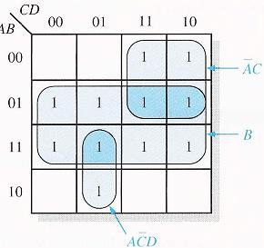

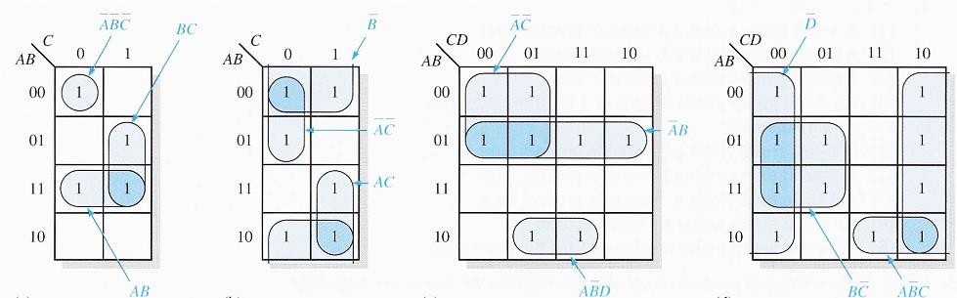

Slide 9

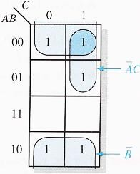

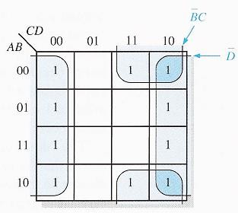
32

Slide 10
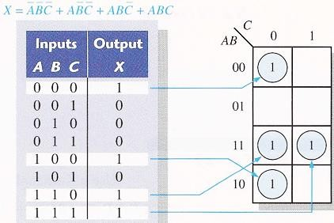
Mapping Directly from a Truth Table

Slide 11
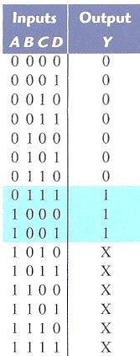
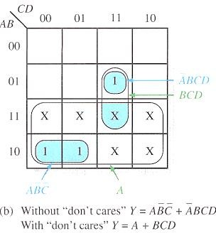
"Don't Care" Conditions
Sometimes a situation arises in which some input variable combinations are not allowed. For example, in BCD code there are six invalid combinations: 1010, 1011, 1100, 1101, 1110, and 1111. Since these un-allowed states will never occur in an application involving the BCD code, they can be treated as "don't care" terms with respect to their effect on the output. That is, for these "don't care" terms either a 1 or a 0 may be assigned to the output: it really does not matter since they will never occur.
The "don't care" terms can be used to advantage on the Karnaugh map. Figure below shows that for each "don't care" term, an X is placed in the cell. When grouping the 1s, the Xs can be treated as 1s to make a larger grouping or as 0s if they cannot be used to advantage. The larger a group, the simpler the resulting term will be.

Slide 12
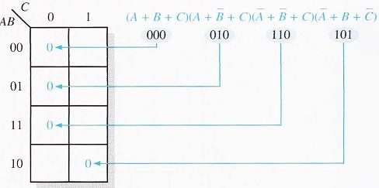
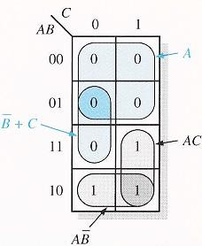



35

Slide 13
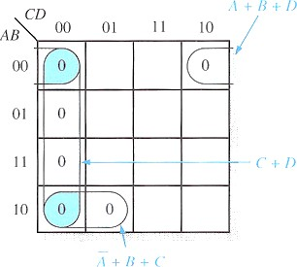

Slide 14
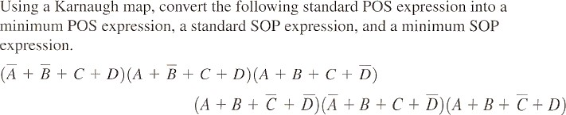
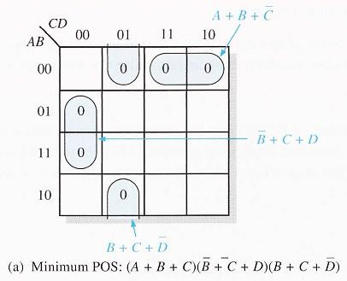

Slide 15
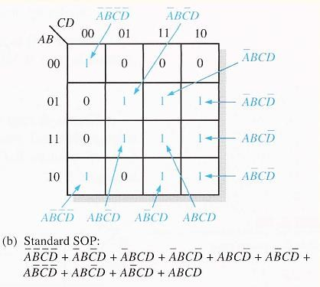
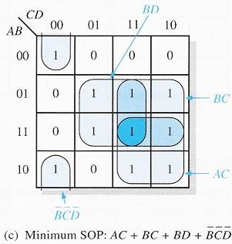
Determine the simplifies POS for the following expression
F(A,B,C,D)= _{ᵋ}(308,1,3,5)

Slide 16
Textbooks:

 [1] Thomas L. Floyd, “Digital Fundamentals” 11th
edition, Prentice Hall.
 [2] M. Morris Mano, “Digital Logic & Computer Design” Prentice Hall.

