Slide 1
Digital System Design
Topics to be covered
Adders (Half, Full, Parallel Adders)
Subtractor (Half and Full)
N-bit Comparator
Encoder, Decoder and Priority Encoder
Multiplexer and DeMultiplexer

Slide 2
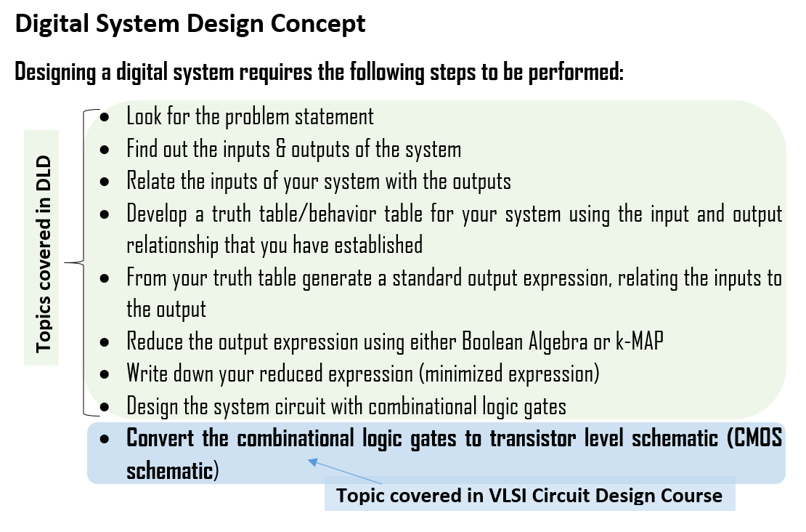

Slide 3

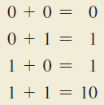

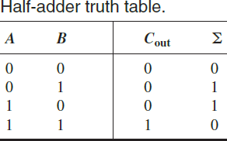
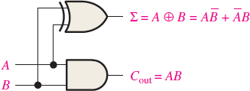

Basic Rules for Binary Addition

Slide 4
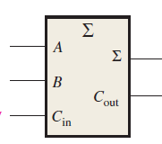
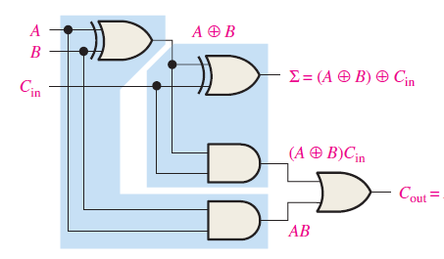

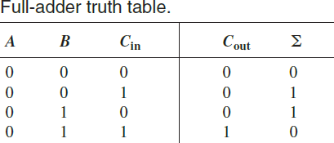



Slide 5

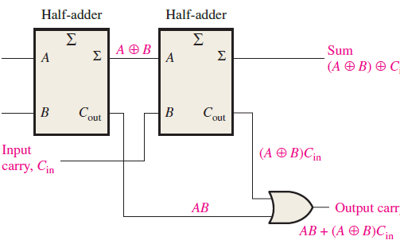



Slide 6
