Slide 1

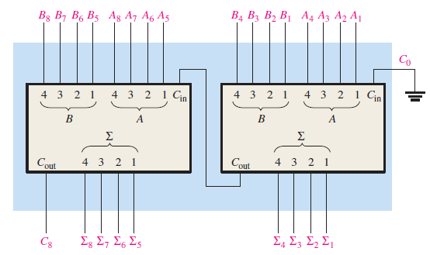




Slide 2
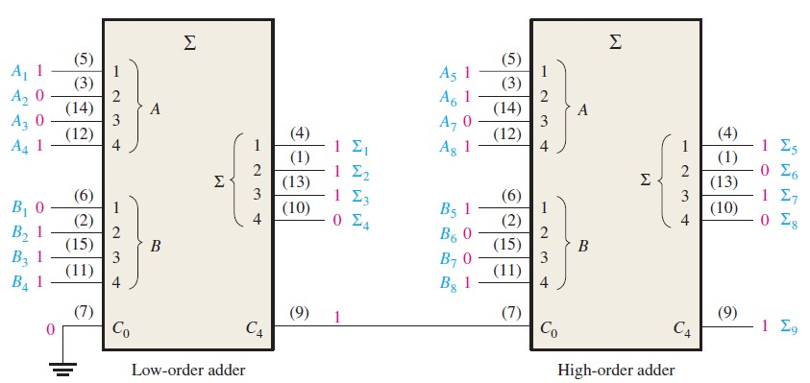




10111001
+10011110

Slide 3

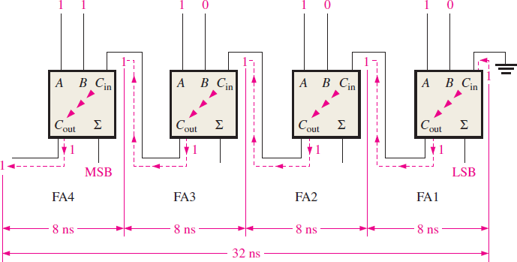
A ripple carry adder is one in which the carry output of each full-adder is connected to the carry input of the next higher order stage. The sum and output carry of any stage cannot be produced until the carry input occurs. Thus causing a delay in the overall addition process.

