Slide 1
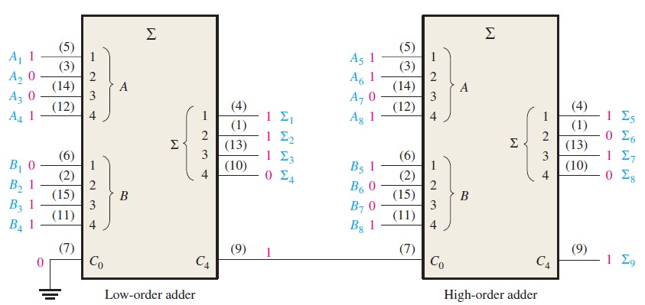




10111001
+10011110

Slide 2

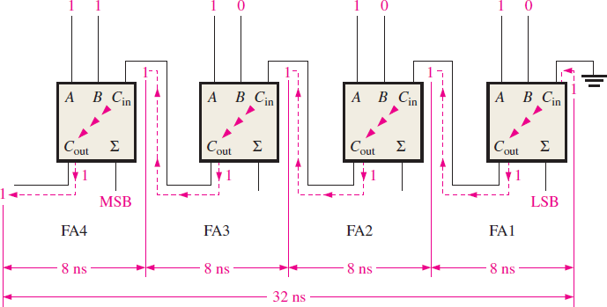
A ripple carry adder is one in which the carry output of each full-adder is connected to the carry input of the next higher order stage. The sum and output carry of any stage cannot be produced until the carry input occurs. Thus causing a delay in the overall addition process.

Slide 3

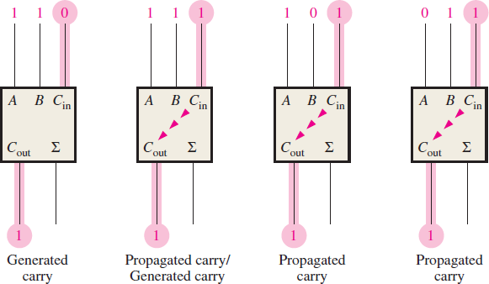

A look ahead carry adder can overcome the delay of a ripple adder. It generates a carry either by carry generation or by carry propagation.
From the conditions of carry, we can see carry is generated when both inputs are 1.
𝐂_{𝐠} = 𝐀𝐁
And carry propagates when either of the inputs or both the inputs are 1.
𝐂_{𝐩} = 𝐀 + 𝐁
^{𝐂}𝐨𝐮𝐭 ^{= 𝐂}𝐠 ^{+ 𝐂}𝐩^{𝐂}𝐢𝐧

Slide 4

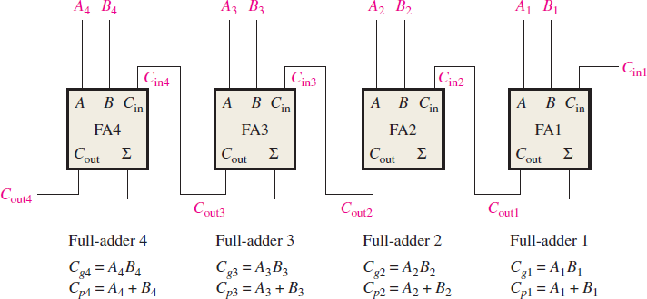

The carry output is dependent on the generated carry, propagation carry and carry input(C_{IN}). The carry generation and carry propagation for each stage are immediately available as soon as the inputs are available.

