Slide 1
The Digital Comparator
Another common and very useful combinational logic circuit is that of the Digital Comparator circuit. Digital or Binary Comparators are made up from standard AND, NOR and NOT gates that compare the digital signals present at their input terminals and produce an output depending upon the condition of those inputs.
For example, along with being able to add and subtract binary numbers we need to be able to compare them and determine whether the value of input A is greater than, smaller than or equal to the value at input B etc. The digital comparator accomplishes this using several logic gates that operate on the principles of Boolean Algebra. There are two main types of Digital Comparator available and these are.
Identity Comparator – an Identity Comparator is a digital comparator that has only one output terminal for when A = B either “HIGH” A = B = 1 or “LOW” A = B = 0
Magnitude Comparator – a Magnitude Comparator is a type of digital comparator that has three output terminals, one each for equality, A = B greater than, A > B and less than A < B
The purpose of a Digital Comparator is to compare a set of variables or unknown numbers, for example A (A1, A2, A3, …. An, etc) against that of a constant or unknown value such as B (B1, B2, B3, …. Bn, etc) and produce an output condition or flag depending upon the result of the comparison. For example, a magnitude comparator of two 1-bits, (A and B) inputs would produce the following three output conditions when compared to each other.
Which means: A is greater than B, A is equal to B, and A is less than B

Slide 2
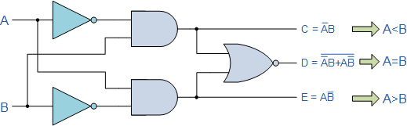
1-bit Digital Magnitude Comparator: Truth Table:
Logic Diagram:
Inputs |  | Outputs
B | A | A > B | A = B | A < B
0 | 0 | 0 | 1 | 0
0 | 1 | 1 | 0 | 0
1 | 0 | 0 | 0 | 1
1 | 1 | 0 | 1 | 0
Logic Expression:
X0 = A0B0+A0’B0’
(A=B)=X0, (A<B)= A0’B0 , (A>B)= A0B0’

Slide 3
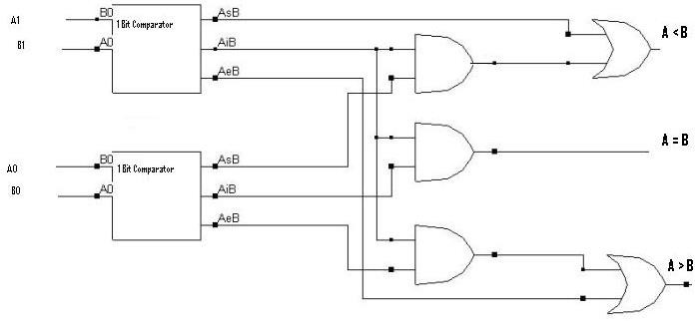
2-bit Digital Magnitude Comparator:
Logic Expression: Xn= AnBn+An’Bn’ (A=B)= X1X0
(A<B)= A1’B1+X1A0’B0 (A>B)= A1B1’+X1A0B0’
Block Diagram:
Figure 2: 2 Bit Comparator

Slide 4
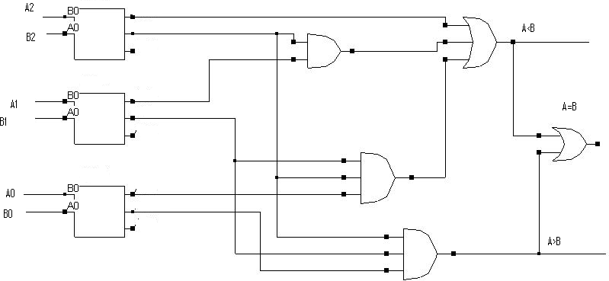
3-bit Digital Magnitude Comparator:
Logic Expression:
Xn= AnBn+An’Bn’ (A=B)=X2X1X0
(A<B)=A2’B2+X2A1’B1+X2X1A0’B0 (A>B)=A2B2’+X2A1B1’+X2X1A0B0’
Block Diagram:

Slide 5
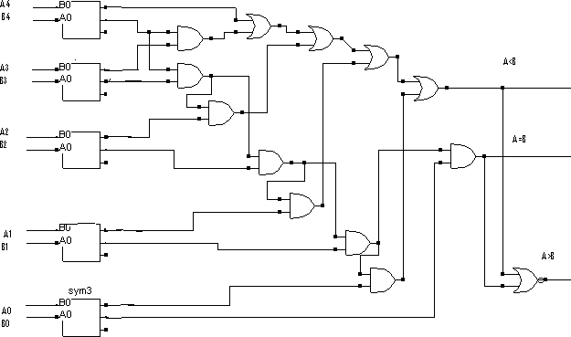
5-bit Digital Magnitude Comparator:
Logic Expression:
Xn= AnBn+An’Bn’ (A=B)=X4X3X2X1 X0
(A<B)=A4’B4+X4A3’B3+X4X3A2’B2+X4X3X2A1’B1+X4X3X2X1A0’B0 (A>B)=A4B4’+X4A3B3’+X4X3A2B2’+X4X3X2A1B1’+X4X3X2X1A0B0’

Slide 6
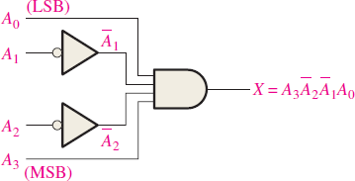
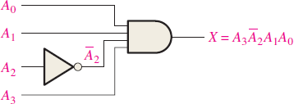
DECODERS:
A decoder is a digital circuit that detects the presence of a specified combination of bits on its inputs and indicates the presence of that code by a specified output level. In general form, a decoder has n-input lines to handle n-bits and 𝟐^{𝐧} outputs to indicate 𝟐^{𝐧} combinations.
Determine the logic required to decode the binary number 1001 by producing a HIGH level on the output.
Determine the logic required to decode the binary
number 1101 and produce an active-LOW output.
Determine the logic required to decode the binary number 1011 by producing a HIGH level on the output.
Determine the logic required to decode the binary number 1110 and produce an active-LOW output.

Slide 7
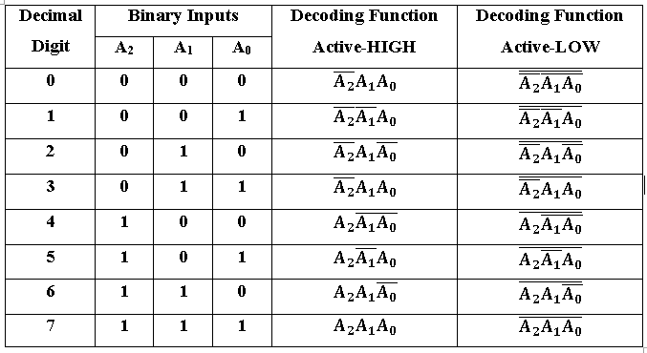
3-Line to 8-Line Decoding Function for Active-HIGH and Active-LOW

Slide 8
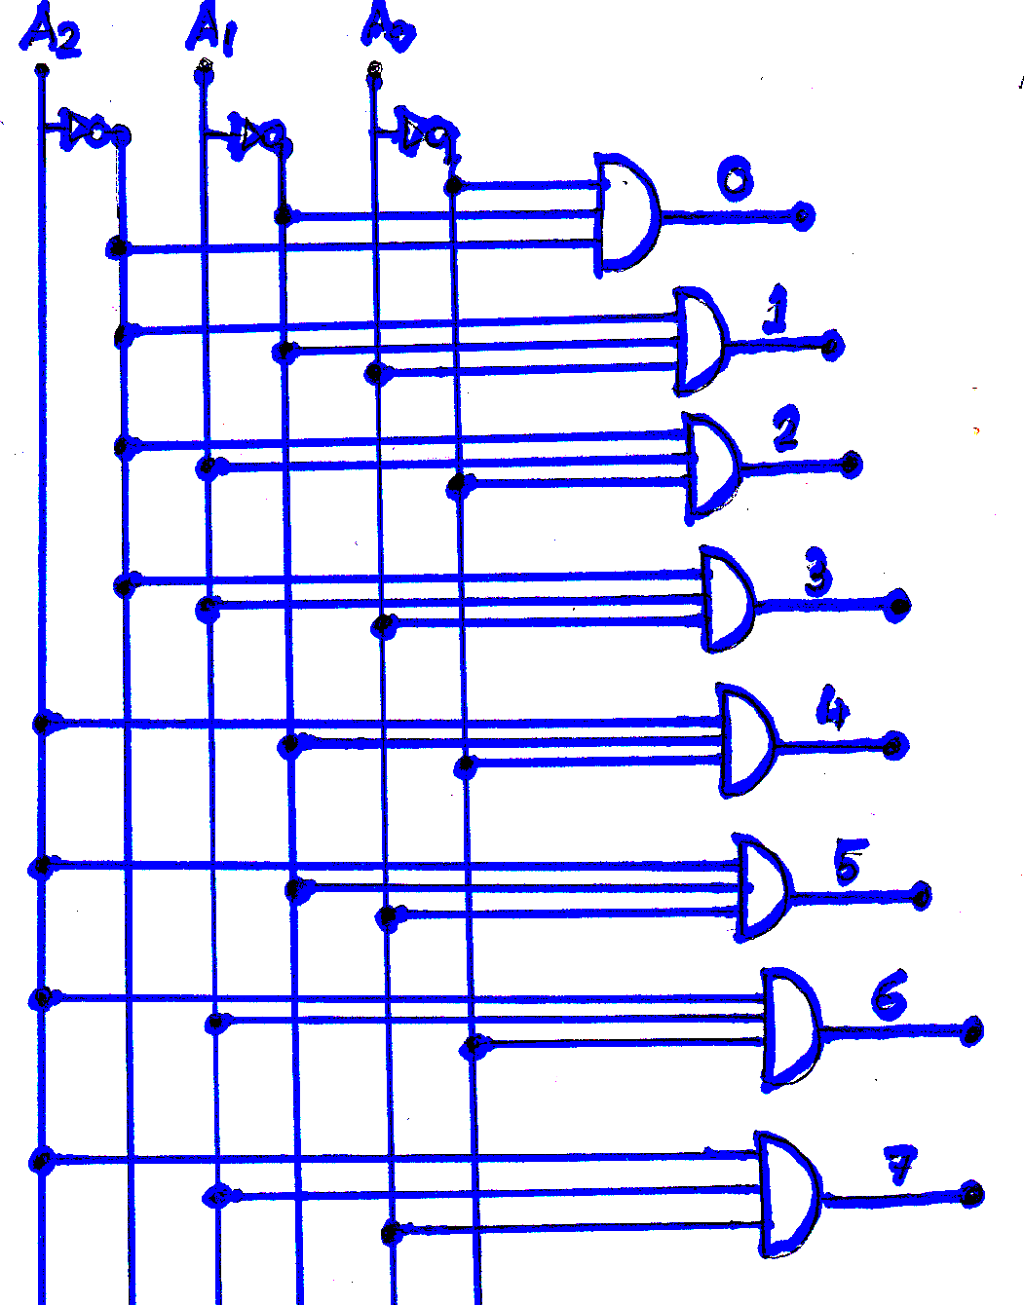
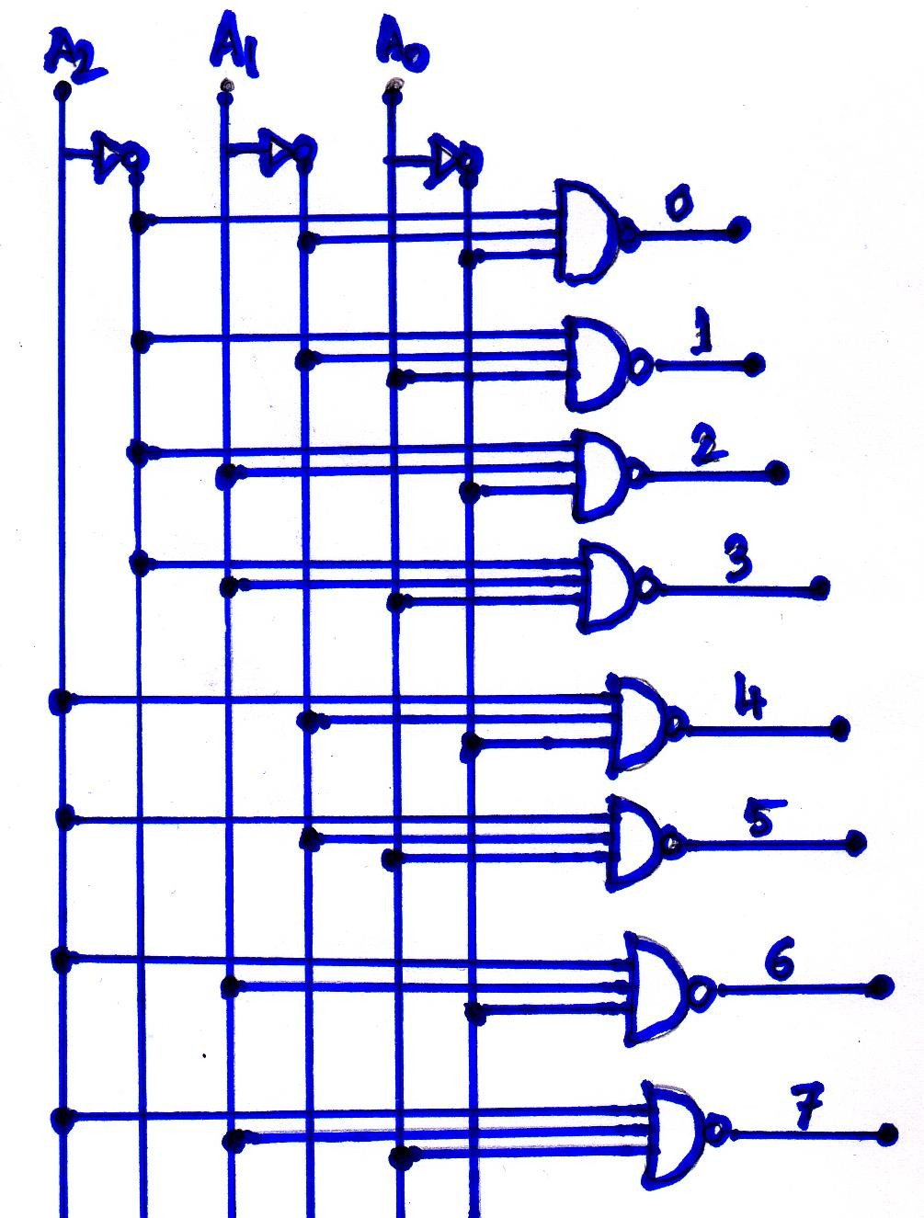
Active-HIGH output
Active-LOW output

Slide 9
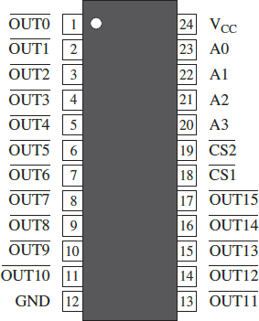
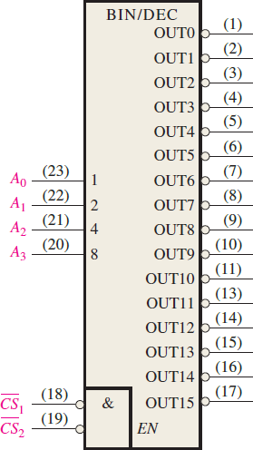
74HC154 Pin Diagram
7CHC154 Logic Symbol

Slide 10
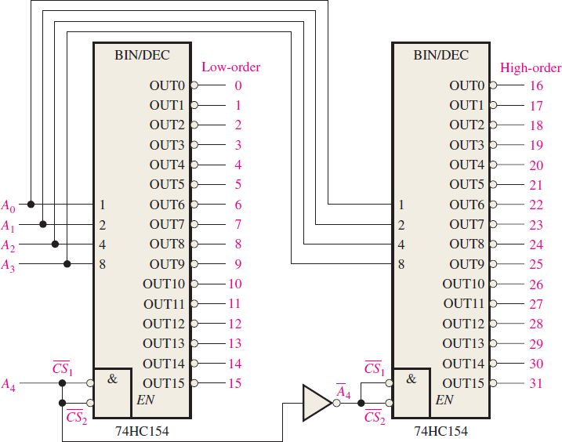
Design a 5- bit Decoder using 74HC154.
Solution:
Since the 74HC154 can handle only 4- bits, two decoders must be used to form a 5-bit expansion. The fifth bit, 𝐀_{𝟒}, is
connected to the chip select inputs, 𝐂𝐒_{𝟏} and 𝐂𝐒_{𝟐} , of one decoder, and 𝐀_{𝟒} , is connected to the chip select inputs of the other decoder. When the decimal number is 15 or less, 𝐀_{𝟒} = 𝟎, the lower order decoder is enabled, and the high- order decoder is disabled. When the decimal number is greater than 15,
𝐀_{𝟒} = 𝟏 and 𝐀_{𝟒} =0, the higher order is enabled, and the lower order decoder is disabled.

Slide 11
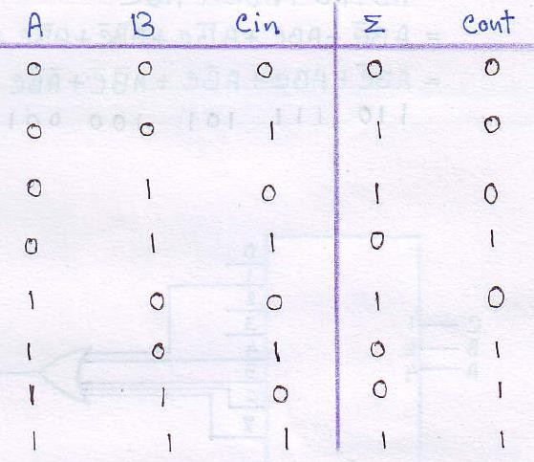
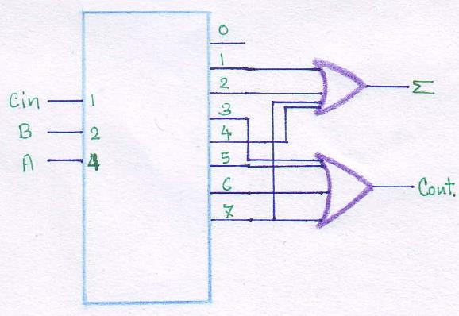
Implement a Full-Adder using 3-bit decoder.
Full-Adder Logical Circuit
with Decoder
Full-Adder Truth Table

Slide 12
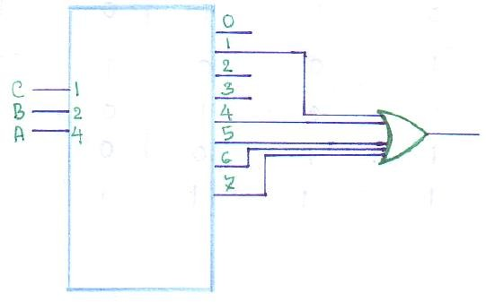
Implement the following function a 3-bit Decoder and necessary gates.
𝐅 = 𝐀 + 𝐁 𝐂
Implement the following function a 4-bit Decoder and necessary gates.
𝐅 = 𝐀𝐃 + 𝐁 𝐂
𝐅 = 𝐀 + 𝐁 𝐂
∴ 𝐅 = 𝐀𝐁𝐂 + 𝐀𝐁𝐂 + 𝐀𝐁 𝐂 + 𝐀𝐁 𝐂 + 𝐀 𝐁 𝐂
Implement the following function a 3-bit Decoder and necessary gates.
𝐅 = 𝐁 + 𝐀 𝐂
Implement the following function a
3-bit Decoder and necessary gates.
𝐅 = 𝐀 + 𝐂 𝐁
Implement a BCD to 7-segment display decoder/driver.

Slide 13
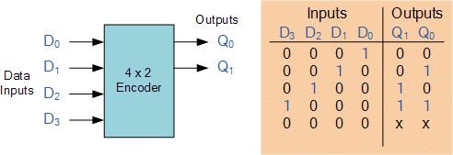
ENCODERS:
An encoder is a combinational circuit that detects the presence of an active level in its input and converts it to a coded output. E.g. Decimal to Binary encoders, Decimal to BCD encoders, Octal to Binary encoders, Priority Encoders, Irregular Sequence Encoder etc.
4X2 Decimal to Binary Encoder

Slide 14
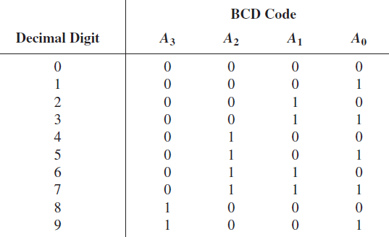
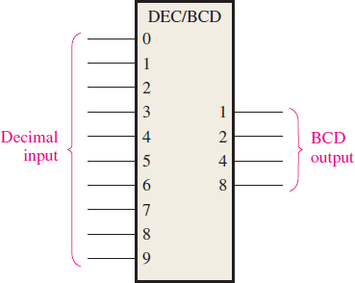
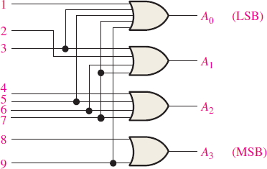
Decimal to BCD Encoder: A decimal to BCD encoder encodes the decimal numbers to its equivalent BCD codes.
Functions for the output pins:
𝐀_{𝟑} = 𝟖 + 𝟗
𝐀_{𝟐} = 𝟒 + 𝟓 + 𝟔 + 𝟕
𝐀_{𝟏} = 𝟐 +3+ 𝟔 + 𝟕
𝐀_{𝟎} = 𝟏 + 𝟑 + 𝟓 + 𝟕 + 𝟗

Slide 15
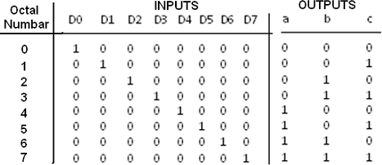
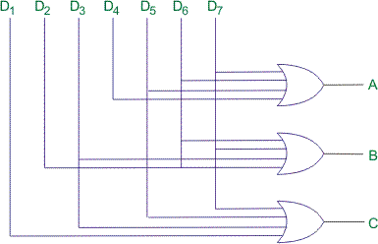
Octal to Binary Encoder: An Octal to Binary encoder encodes an octal number to its equivalent binary code.
Functions for the output pins:
𝐀_{𝟑} = 𝟒 + 𝟓 + 𝟔 + 𝟕
𝐀_{𝟏} = 𝟐 + 𝟑 + 𝟔 + 𝟕
𝐀_{𝟎} = 𝟏 + 𝟑 + 𝟓 + 𝟕

Slide 16
Priority Encoder: A priority encoder also encodes a given input however, the flexibility of a priority encoder is that, we can assign the priority of inputs. E.g Highest Priority Encoder, Lowest Priority Encoders, Irregular Sequence Encoders.
Design a 4X2 Highest Priority Encoder.
Design a 4X2 Lowest Priority Encoder.
Design a Decimal to BCD Highest Priority Encoder.
Design a Decimal to BCD Lowest Priority Encoder.
Design a Decimal to BCD Irregular Sequence Encoder with priority sequence of 1,5,6,7,0,4,3,2,8,9.
Follow Class Lecture

Slide 17
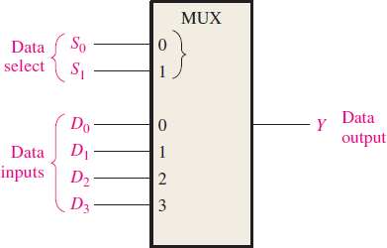
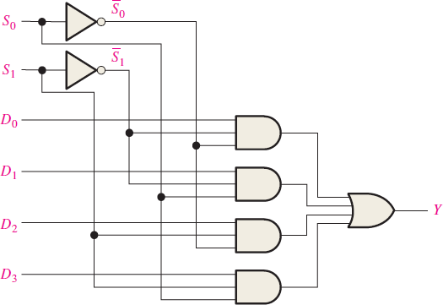
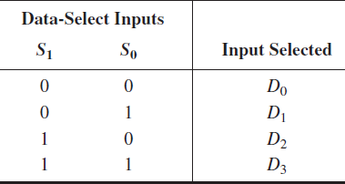
Multiplexer: A multiplexer is a combinational circuit which selects binary information from one of many input lines and directs it to a single output line.

Slide 18
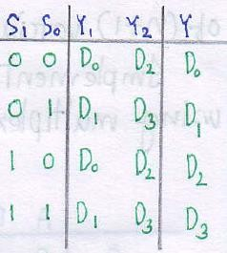
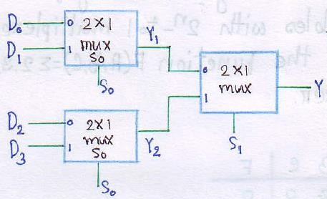
Cascading Lower Input MUX to Design Higher Input MUX
4X1 MUX with two 2X1 MUX

Slide 19
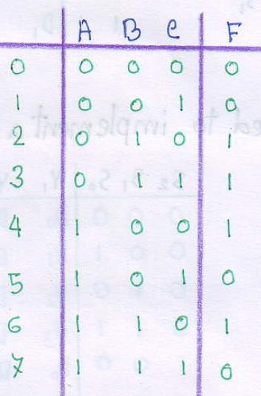
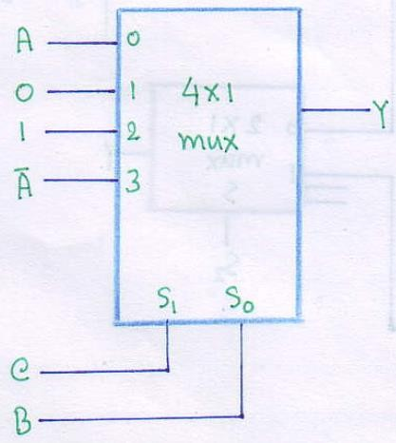
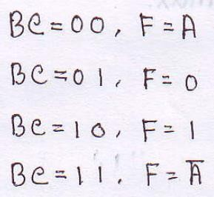
Boolean Function Implementation with MUX
It is possible to design a n+1 variable Function with 2^{N}X1 MUX.
Implement the function 𝐅 = (𝟐, 𝟑, 𝟒, 𝟔) using a MUX.

Slide 20
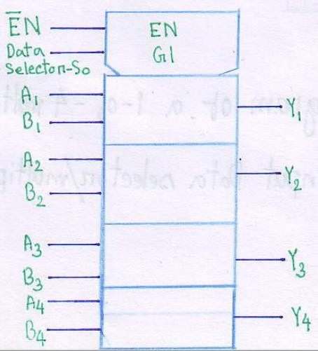
Quadruple 2-Input Data Selector Design
A MUX can also be considered as a data selector. A simple 2X1 MUX can be used to select between two 1-bit data. But what if, we have a 2-bit data or a 4-bit data. So we can integrate several 2X1 MUX and design multiple-bit data selectors. The figure shows the logical symbol of a 4-bit 2-input data selector with an Active-Low enable input.
Design the logical circuit for a 4-bit 2-input data selector.
Logic Symbol of a Quadruple 2-input Data Selector

Slide 21
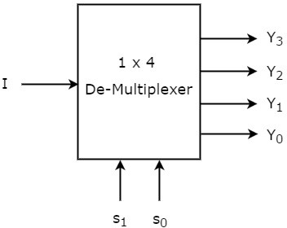
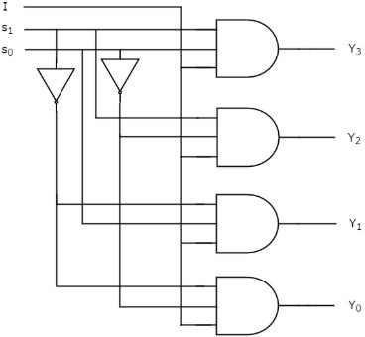
Demultiplexer (DEMUX): A demultiplexer reverses the multiplexing function. It basically takes input from a single line and distribute the incoming data to its respective data line.
Design a 3X8 Decoder Using 1X8 DEMUX.

Slide 22
Textbooks:

 [1] Thomas L. Floyd, “Digital Fundamentals” 11th
edition, Prentice Hall.
 [2] M. Morris Mano, “Digital Logic & Computer Design” Prentice Hall.

