Slide 1
Integrated Circuit Technologies

Slide 2
Introduction
When working with
an IC or Integrated Circuit as an
engineer we should be aware of the following factors:
The integration level
The logic family or technology
The logic level parameters
The performance parameters

Slide 3
Integration Level
The integration level of an IC or a semiconductor chip gives us an idea about the number of gates that are present in the chip.
Integration Level for Integrated Circuits.
Small Scale Integration (SSI) (<12 gates/chip).
Medium Scale Integration (MSI) (<100 gates/chip).
Large Scale Integration (LSI) (…1K gates/chip).
Very Large Scale Integration (VLSI) (…10K gates/chip).
Ultra Large Scale Integration (ULSI) (…100K gates/chip).
Giga Scale Integration (GSI) (…1M gates/chip).
Examples:
Pentium III Coppermine( 32-bit, large cache): 21,000,000 gates
Pentium 4 Willamette (32-bit, large cache): 42,000,000 gates
Core 2 Duo Conroe (dual-core 64-bit, large caches): 291,000,000 gates
ARM Cortex-A9 (32-bit, (optional) SIMD, caches):26,000,000 gates
Atom (32-bit, large cache): 47,000,000

Slide 4
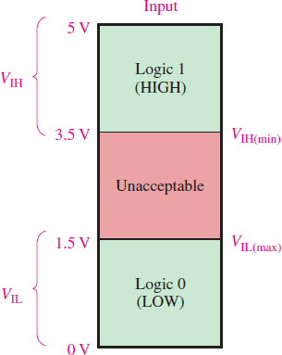
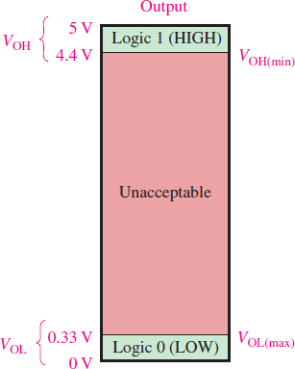
Definition of Logic Level Parameters
Different Logic Families usually operate at different voltage and current levels. Before knowing the particular levels for different families one should first be acquainted with the logic level parameters and their definitions.
Voltage Parameters
High-Level Output Voltage, V_{OH} (MIN): This is the minimum output voltage available
at the output under stated loaded condition which corresponds to logic ‘1’.
Low-Level Output Voltage, V_{OL} (MAX): This is the maximum output voltage available at the output under stated loaded condition which corresponds to logic ‘0’
High-Level Input Voltage, V_{IH} (MIN): This is the minimum voltage required at an input to be recognized as a logic ‘1’.
Low-Level Input Voltage, V_{IL} (MAX): This is the maximum voltage at an input which
will be recognized as a logic ‘0’.
Current Parameters
High-Level Output Current, I_{OH} : This is the maximum current at the output under
specified loaded condition that a gate can sink at logic level ‘1’.
Low-Level Output Current, I_{OL}: This is the maximum current a gate can sink at specified load at logic ‘0’,
High-Level Input Current, I_{IH}: This is the minimum current a supply must provide in order to maintain the logic ‘1’.
Low-Level Input Current, I_{IL}: This is the minimum current that must be provided in
order maintain a logic ‘0’.

Slide 5
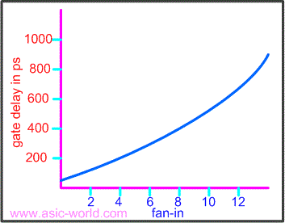
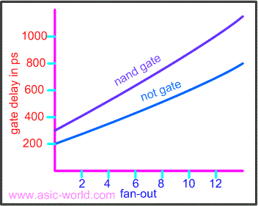
Performance Parameters of Logic Families
Fan-In: It is the number of input that can be connected to a particular gate. As more inputs are connected the delay in the input side increases. Delay approximately has a quadratic relationship with Fan-in.
Fan-Out: The maximum number of logic input that the output of a gate can drive reliably without any unacceptable voltage degradation is called Fan-out. As in the case of Fan-in, delay increases with Fan-out as well.
^{𝐈}𝐎𝐇 , ^{𝐈}𝐎𝐋
𝐃𝐂 𝐅𝐚𝐧𝐨𝐮𝐭 = 𝐦𝐢𝐧
^{𝐈}𝐈𝐇 ^{𝐈}𝐈𝐋

Slide 6
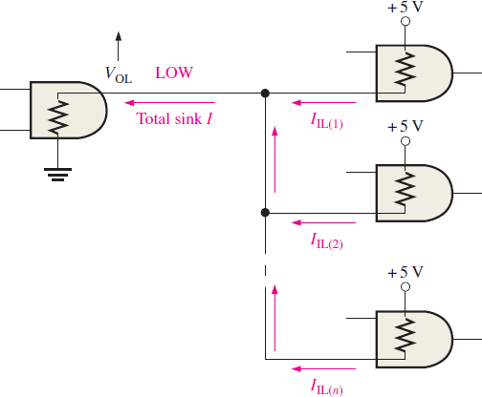
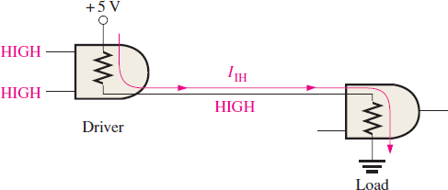
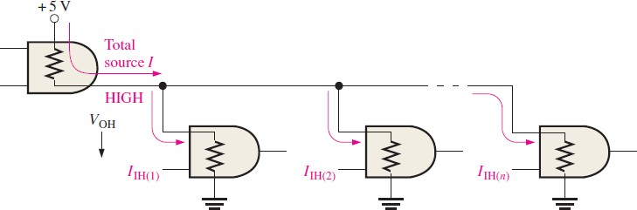
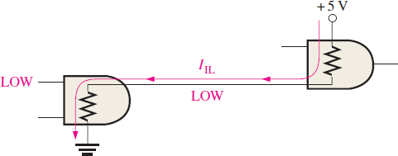
Performance Parameters of Logic Families
Loading and Fan Out: When the output of a gate is connected to the input of one or more gates, a load is created on the driver gate. There is a limit to the number of input that the output a gate can drive. This is determined by the fan-out.
TTL loading in LOW state
TTL loading in HIGH and LOW state
TTL loading in HIGH state

Slide 7
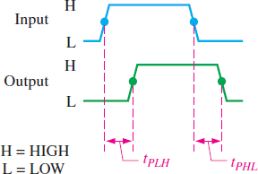
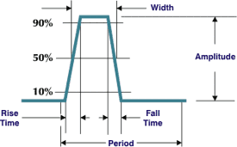
Performance Parameters of Logic Families
Propagation Delay: The time elapsed between 50% change in input wave-form to the 50% change in output wave-form.
T_{pHL}: Propagation delay for High to Low.
T_{pLH}: Propagation delay for Low to High.
𝟏
^{𝐭}𝐏𝐃 ⁼ _{𝟐} ^{(𝐭}𝐏𝐇𝐋 ^{+ 𝐭}𝐏𝐋𝐇⁾
Time Rise, t_{r}: The time required for a logic to rise from 10% of its value to 90% of the value.
Time Fall, t_{f}: The time required for the logic to fall from 90% of its value to 10% of its value.

Slide 8
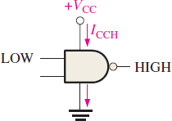
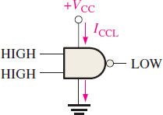
Performance Parameters of Logic Families
Power Dissipation: A gate draws in current both in HIGH and LOW states. Therefore, in both states a gate dissipates power. The current associated with HIGH state is named I_{CCH} and the current associated with LOW state is named I_{CCL}. Therefore,
Power Dissipation in HIGH state, P_{DH} = V_{CC}I_{CCH}
Power Dissipation in LOW state, P_{DL} = V_{CC}I_{CCL}
So the average power dissipated in a cycle with duty cycle of X%is,
𝐗 × 𝐏_{𝐃𝐇} + 𝟏𝟎𝟎 − 𝐗 𝐏_{𝐃𝐋}
𝐏𝐃 =
𝟏𝟎𝟎
Find the average power dissipated for a NAND gate with V_{CC} = 5V,
I_{CCH} = 4mA and I_{CCL} = 2mA when the duty cycle is:
a) 40%
b) 75%
c) 100%
d) 0%
e) 25%

Slide 9
Performance Parameters of Logic Families
Speed Power Product: It is a very important parameter of comparison for logic circuit where both power dissipation and propagation delay are together needed to be considered. The speed power product and its significance can be understood from the following equation:
𝐂𝐕_{𝐂𝐂}𝐕_{𝐋}
𝐏 =
𝐃
𝐓_{𝐃}
where C is the capacitance, V_{CC} is the common collector voltage, V_{L} is the logic swing of voltage and T_{D} is the propagation delay. We can rewrite this equation as,
𝐏_{𝐃}𝐓_{𝐃} = 𝐂𝐕_{𝐂𝐂}𝐕_{𝐋}
For a logic family, V_{CC}, C and V_{L} are all constant. Therefore, if we decrease power dissipation then propagation delay will increase and if we decrease propagation delay power dissipation will increase. Therefore, there will always be a trade-off between the two parameters. However, to decrease both we will need to change construction parameter.

Slide 10
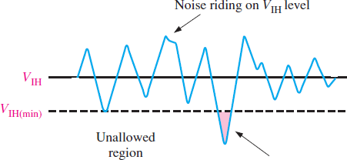
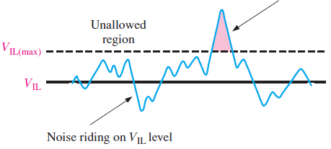
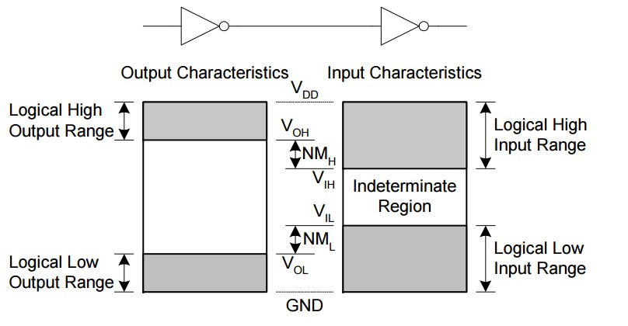
Performance Parameters of Logic Families
Noise Immunity: All electrical circuits are susceptible to noise. Noise is the presence of unwanted induced voltage in the electrical circuit. This unwanted induced voltage can disrupt the operation of a digital circuit. In order to not get adversely affected by noise the circuit should have some amount of noise immunity. Noise Immunity is the ability to tolerate unwanted voltage fluctuation.
Noise Margin: The amount of unwanted voltage a circuit can tolerate is measured by the noise margin. There are two noise margins: High Level Noise Margin and Low Level Noise Margin.
𝐍𝐌_{𝐋} = 𝐕_{𝐈𝐋} − 𝐕_{𝐎𝐋}
𝐍𝐌_{𝐇} = 𝐕_{𝐎𝐇} − 𝐕_{𝐈𝐇}

Slide 11
Digital Logic Families
Digital integrated circuits are classified not only by their complexity or logical operation, but also by the specific circuit technology to which they belong. The circuit technology is referred to as a digital logic family.
The basic circuit in each technology is a NAND, NOR, or an inverter gate.
The Logic Families are :
RTL → Resistor-Transistor Logic
DTL → Diode Transistor Logic
I²L → Integrated Injection Logic
ECL → Emitter Collector Logic
TTL → Transistor Transistor Logic
MOS→ Metal Oxide Semiconductor
CMOS → Complementary MOS

Slide 12

Special Characteristics
The characteristics of IC digital logic families are usually compared by analyzing the circuit of the basic gate in each family.
The most important parameters that are evaluated and compared are
Fan-Out
Fan-In
Power Dissipation
Propagation Delay
Speed-Power Product
Noise Margin

Slide 13
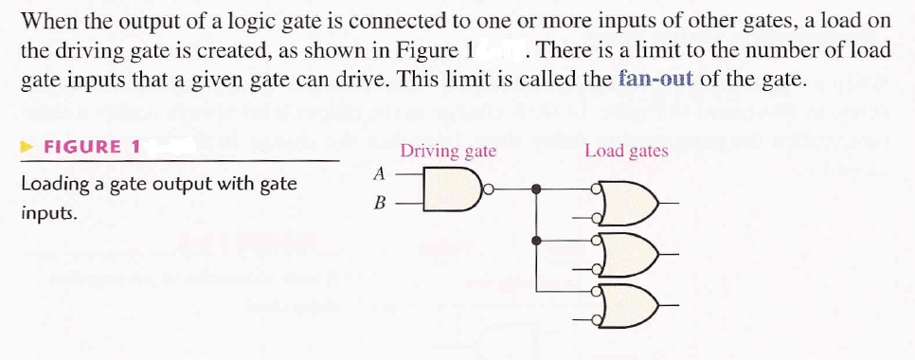
Fan-Out

Slide 14
Fan-Out
The fan-out of a gate specifies the number of standard loads that can be connected to the output of the gate without degrading its normal operation.
A standard load is usually defined as the amount of current needed by an input of another gate in the same logic family. Sometimes the term loading is used instead of fan-out.
This term is derived because the output of a gate can supply a limited amount of current, above which it ceases to operate properly and is said to be overloaded.
Each input consumes a certain amount of current from the gate output, so that each additional connection adds to the load of the gate.
Exceeding the specified maximum load may cause a malfunction because the circuit cannot supply the power demanded from it.
The fan-out is the maximum number of inputs that can be connected to the output of a gate, and is expressed by a number.

Slide 15
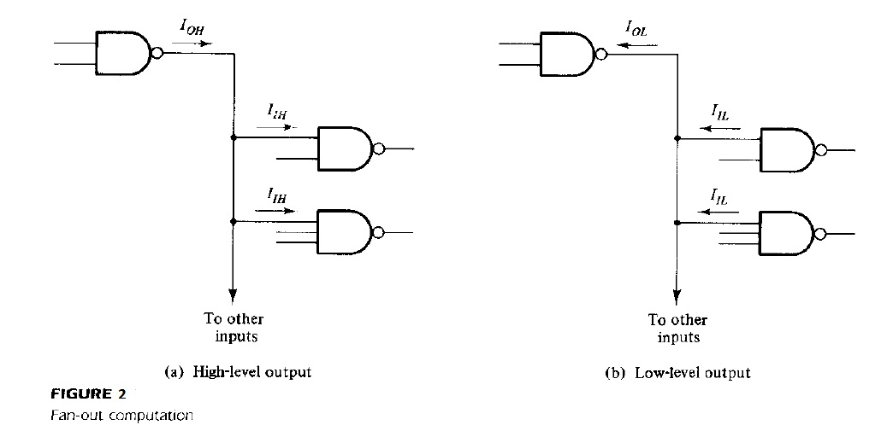
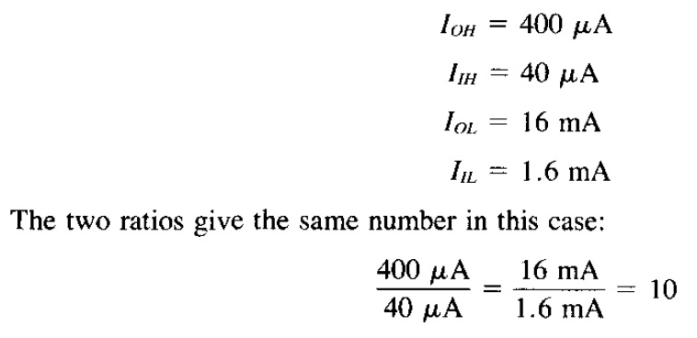
Fan-Out
The fan-out of the gate is calculated from the ratio I_{OH}/l_{IH} or l_{OL} I I_{IL}
For example, the standard TTL gates have the following values for the currents:

Slide 16
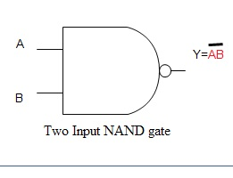
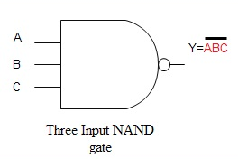
Fan-In
The fan in defined as the maximum number of inputs that a logic gate can accept.
If number of input exceeds, the output will be undefined or incorrect.
It is specified by manufacturer and is provided in the data sheet.
Fan In = 2
Fan In = 3

Slide 17
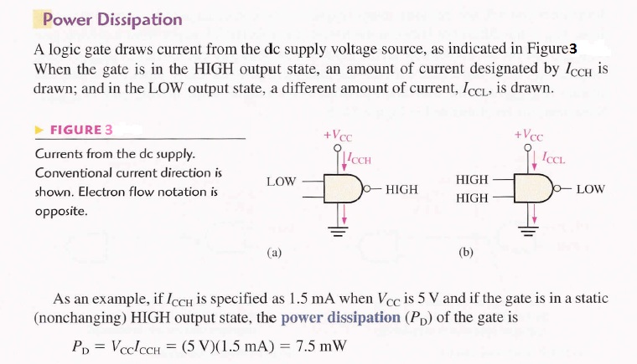
Power Dissipation

Slide 18
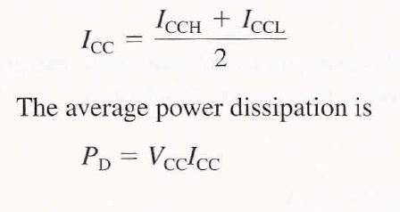
Power Dissipation
The power dissipation is a parameter expressed in milliwatts (mW) and represents the amount of power needed by the gate.
The number that represents this parameter does not include the power delivered from another gate; rather, it represents the power delivered to the gate from the power supply.
An IC with four gates will require, from its power supply, four times the power dissipated in each gate.
When gate is pulsed, its output switches back and forth between HIGH and Low, and the amount of supply current varies between I_{CCH} and I_{CCL.} The average power dissipation depends on the duty cycle is 50%, the output is HIGH half the time and LOW the other half. The average Supply Current is Therefore:

Slide 19
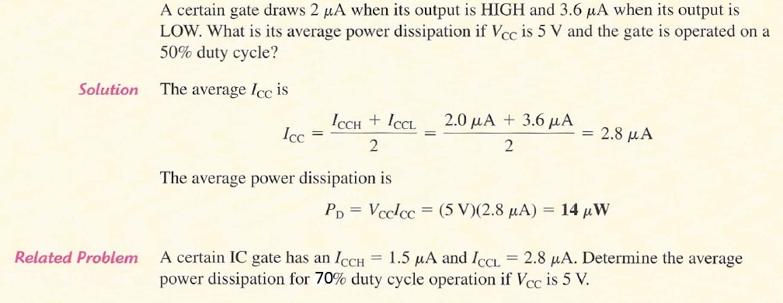




Power Dissipation

Slide 20
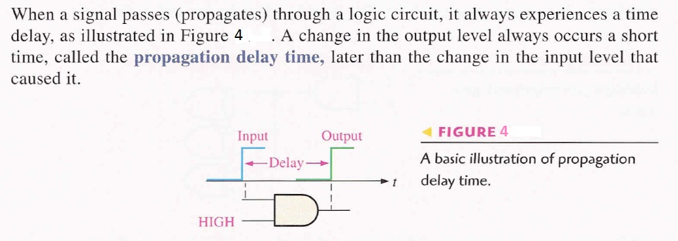
Propagation Delay

Slide 21
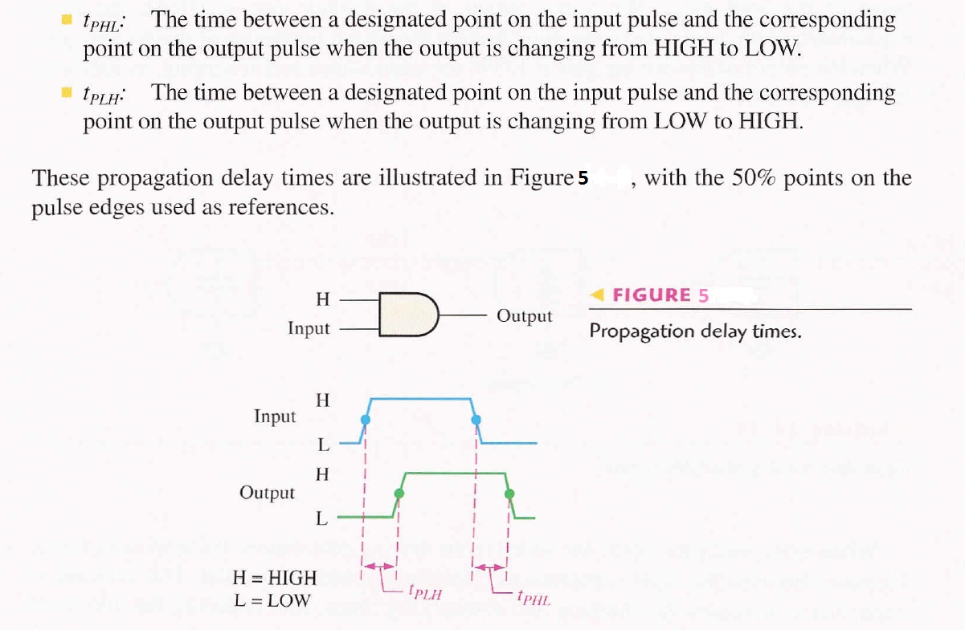
Propagation Delay

Slide 22
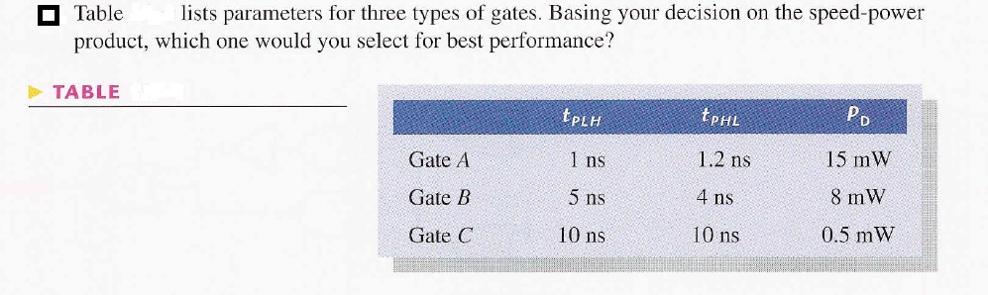
Speed Power Product
The speed power product provides the basis for the comparison of logic circuits when both propagation delay time and power dissipation are important considerations in the selection of the type of logic to be used in a certain application.
The lower the speed-power the better.
The unit of speed-power product is Pico joule(pJ).
Speed-Power Product = Propagation Delay × Power Dissipation

Slide 23
Noise Margin
Unwanted signals are referred to as noise.
There are two types of noise to be considered :
DC noise is caused by a drift in the voltage levels of a signal.
AC noise is a random pulse that may be created by other switching signals.
Noise margin is the maximum noise voltage added to an input signal of a digital circuit that does not cause an undesirable change in the circuit output.
Noise margin is expressed in volts and represents the maximum noise signal that can be tolerated by the gate.

Slide 24
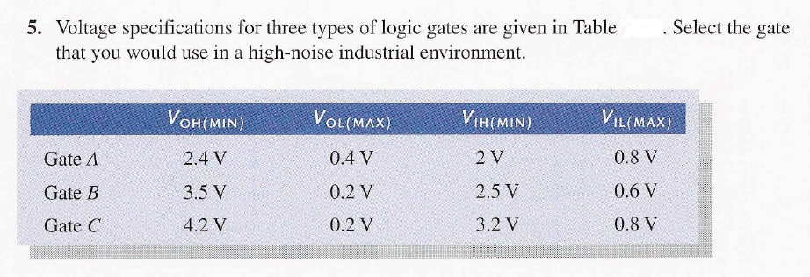
Noise Margin

Slide 25
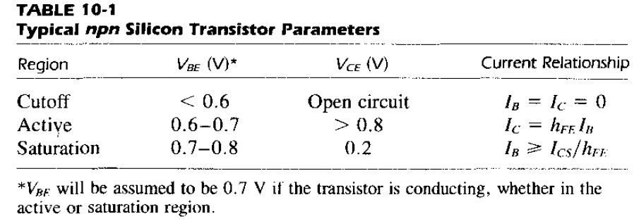
Bipolar-transistor Characteristics

Slide 26
References
Thomas L. Floyd, “Digital Fundamentals” 8th edition, Prentice Hall – Pearson Education.
M. Morris Mano, “Digital Logic & Computer Design” Prentice Hall

