Slide 1


Lewis-Gateway Project 1
Quality Engineering Test Strategy, Audit Findings & Recommendations
Muhammad Uzair Salaam | Mogamat Yaaseen Karriem
redAcademy Quality Engineering • Cohort 2027A
18 September 2026
Wordmark shown is a placeholder — replace with official Lewis Group Limited artwork before final submission.

Slide 2
AGENDA
What We'll Cover
1
Project Scope & Objectives
2
Testing Methodology
3
API Layer — Coverage & Findings
4
Database Layer — Audit & Findings
5
Defect Log — Severity & Business Risk
6
Recorded Demo
7
Recommendations
LEWIS-GATEWAY PROJECT 1
2

Slide 3
INTRODUCTION
Project Scope
Lewis-Gateway — e-commerce platform backed by a SQL Server database (LewisStoresDb). Our brief was to independently verify the platform is trustworthy at two levels: that the API behaves correctly, and that the data underneath it actually supports what the API reports.
1
Layer 1 — API
Functional & negative testing of stock and pricing endpoints, driven through Postman.
Objective
2
Layer 2 — Database
Confirm that what the API promises is actually backed by the data underneath it — and surface any gap between the two as a reportable defect.
+-100
A systems-of-record integrity audit run directly against LewisStoresDb via T-SQL.
total validation checks executed across both layers (+-50 API +- 50 database)
LEWIS-GATEWAY PROJECT 1
3

Slide 4
Testing Methods
HOW WE WORKED
1
Discovery-First
2
API Testing
Confirmed the real Swagger contract and live database schema before writing a single test — no test was built on a guessed table or column name.
Postman collections with JavaScript test scripts, validating status codes, the ProblemDetails error shape, and response payloads.
3
Database Auditing
4
Traceability
T-SQL scripts run in VSCode directly against LewisStoresDb — cross-table reconciliation and schema-level constraint checks.
Every check logged in a structured test case log: Test ID, Description, Expected Result, Actual Result, Pass/Fail.
LEWIS-GATEWAY PROJECT 1
4

Slide 5
LAYER 1
15
20
15
API Layer — Test Coverage
Stock Adjustments
VAT & Pricing validation cases
Credit & Debt Governance
API-STK-001 to 015
API-PRC-001 to 020
API-CRD-001 to 015
Endpoints under test
PATCH /api/Products/{id}/stock • POST /api/Pricing/validate - POST /api/Credit - POST /api/Orders
Full request bodies and JavaScript assertions were delivered as an importable Postman collection alongside this report.
LEWIS-GATEWAY PROJECT 1
5

Slide 6
LAYER 1
API Layer — Key Finding
Currency values are returned unrounded — beyond 2 decimal places
HIGH
Observed response — POST /api/Pricing/validate
Business impact
{
"subtotal": 99.99,
"vatRate": 0.15,
"vatAmount": 14.9985,
"total": 114.9885,
"currency": "ZAR"
}
A real invoice cannot display “R114.9885” — this is not a valid currency amount. Left uncorrected, this risks incorrect invoice totals, rounding mismatches against accounting reconciliation, and inconsistent display across the storefront, cart, and checkout.
Recommendation: round Subtotal, VatAmount, and Total to 2 decimal places before the API response is serialized.
LEWIS-GATEWAY PROJECT 1
6

Slide 7
LAYER 2
Database Layer — Audit Approach
15
15
10
10
Stock Reconciliation
Pricing Audit
Data Hygiene & Constraints
Business Intelligence Reports
API vs. underlying table counts
Multi-table joins vs. billing rules
Duplicate SKUs, negative costs
Top sellers, dead stock
P0
P0
P1
P2
50
T-SQL scripts total, run against LewisStoresDb (SQL Server)
Discovery-driven: we confirmed the real Orders.Status values, the AuditLogs event-type convention, and the actual format of Orders.Items via live queries before finalizing the audit scripts — several assumptions from Swagger alone turned out to be wrong.
LEWIS-GATEWAY PROJECT 1
7

Slide 8
FINDINGS
Defect Log — Critical & High Severity
ID | Layer | Finding | Severity | Business Risk
DB-01 | Database | No stock/inventory audit trail exists in AuditLogs | CRITICAL | Cannot trace who changed stock, when, or why. No accountability for shrinkage, fraud, or error investigation — a foundational control gap.
DB-02 | Database | No CHECK constraints on StockQuantity, Price, or Rating | HIGH | A bug or direct database write can silently corrupt stock or pricing data — nothing at the database layer prevents negative or invalid values.
DB-03 | Database | VAT is never persisted anywhere in the schema | HIGH | Historical orders cannot be audited for correct tax treatment — a compliance risk for tax/SARS reporting and financial reconciliation.
LEWIS-GATEWAY PROJECT 1
8

Slide 9
FINDINGS
Defect Log — Medium & Low Severity
ID | Layer | Finding | Severity | Business Risk
API-01 | API | VAT and total amounts returned unrounded (4 decimal places) | MEDIUM | Risk of incorrect invoice display and mismatches during accounting reconciliation.
DB-04 | Database | Orders.Items free text duplicates the OrderItems table | MEDIUM | Two representations of the same order can silently drift apart over time, with no way to detect it.
DB-05 | Database | CartItems table has no UserId column | MEDIUM | Carts cannot be attributed to a specific customer at the database level, complicating recovery and analytics.
DB-06 | Database | Orders.Date stored as free text, not a real date type | LOW | Unreliable date-based reporting; malformed date values can enter the system undetected.
LEWIS-GATEWAY PROJECT 1
9

Slide 10
BUSINESS RISK
Business Risk — By Category
ID | Category | Risk | Severity | Why It Matters to Lewis Group
RISK-01 | Fraud & Loss Prevention | No traceable record of stock changes | CRITICAL | Stock can be silently manipulated with no way to detect, attribute, or prove it — undermining internal fraud and shrinkage investigations.
RISK-02 | Tax & Regulatory Compliance | VAT and order dates not reliably auditable | HIGH | Historical VAT treatment can't be reconstructed and unreliable date data threatens revenue-period reporting — direct exposure in a SARS audit.
RISK-03 | Financial Reporting Accuracy | Unrounded totals & duplicate order-item records | HIGH | Charged and recorded amounts can silently diverge at scale, and two conflicting order records complicate dispute and chargeback resolution.
RISK-04 | Data Integrity & Customer Trust | No DB-level constraints; carts not user-scoped | MEDIUM | Invalid stock or pricing values can enter undetected, and cart data cannot be reliably attributed to a customer, undermining BI and recovery.
LEWIS-GATEWAY PROJECT 1
10

Slide 11
BUSINESS RISK
Business Risk — Bottom Line
Not isolated bugs — they sit beneath Lewis Group’s core numbers
CRITICAL
Risk categories at a glance
The bottom line
CRITICAL Fraud & Loss Prevention
HIGH Tax & Regulatory Compliance
HIGH Financial Reporting Accuracy
MEDIUM Data Integrity & Customer Trust
These findings are not isolated technical defects. Together, they sit directly under Lewis Group’s ability to trust its own financial numbers, defend a tax audit, and detect internal fraud.
Priority: fix the audit-trail (DB-01) and VAT-persistence (DB-03) gaps first — they carry both compliance and fraud-detection exposure.
LEWIS-GATEWAY PROJECT 1
11

Slide 12
LIVE WALKTHROUGH
Recorded Demo
1
Cypress UI Automated Walkthrough
2
Postman Verification Test
Confirm the live end to end Happy Path.
Execute a test against the order created on the UI, and check if it reflects on the API side.
3
VSCode Database Query
Execute a query against the order created on the UI and check if the database reflects the changes.
LEWIS-GATEWAY PROJECT 1
12

Slide 13
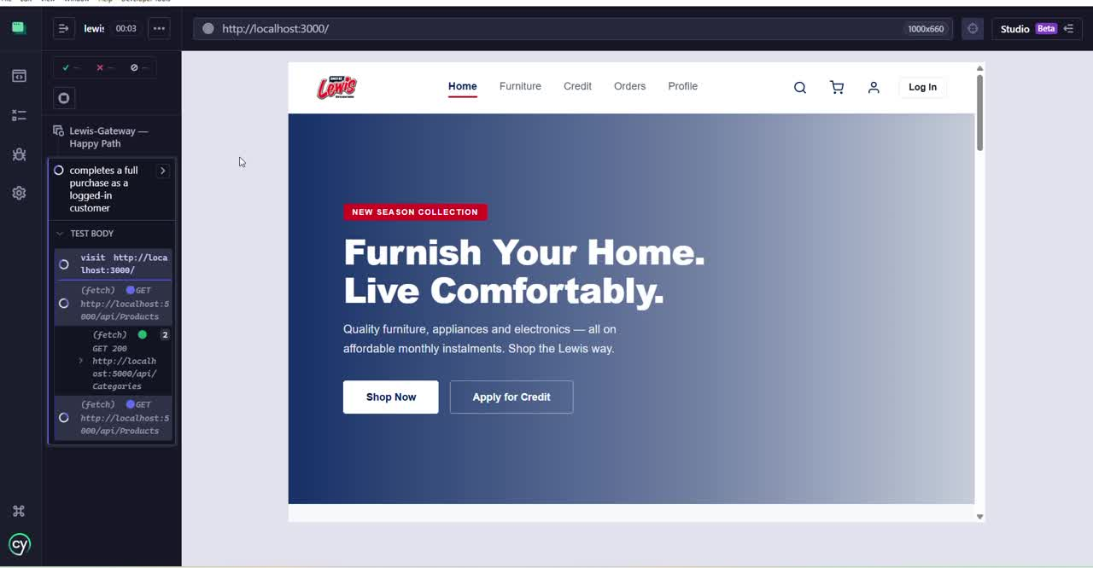
End-To-End Happy Path Demo

Slide 14
NEXT STEPS
Recommendations
✓
Add a product.stock.updated audit event, matching the existing auth.* / order.* naming convention.
✓
Add CHECK constraints for StockQuantity ≥ 0, Price ≥ 0, and Rating between 0 and 5.
✓
Persist a VAT breakdown (Subtotal, VatRate, VatAmount) on OrderItems for compliance auditing.
✓
Round all currency values to 2 decimal places before returning them from the Pricing API.
✓
Resolve the Orders.Items / OrderItems duplication — treat OrderItems as the single source of truth.
LEWIS-GATEWAY PROJECT 1
13

Slide 15
Thank You
Questions?
Muhammad Uzair Salaam | Mogamat Yaaseen Karriem
redAcademy Quality Engineering • Cohort 2027A

